Slide 1
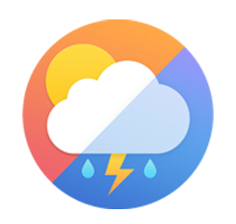
AI/ML Project-1
Weather App
Submitted By :
Kanchan Yadav(2210990471)
Submitted To :
Mr. Tushar

Slide 2
Table of content
Introduction
Problem Statement
Technical Details
Key Features
Project Highlights

Slide 3
Introduction
Welcome to my Weather App presentation! In today's digital age, access to real-time weather information is more important than ever. Whether planning daily activities, traveling to new destinations, or simply staying informed about weather conditions, having reliable and up-to-date weather data at our fingertips is invaluable.
My Weather App aims to address this need by providing users with an intuitive and user-friendly platform to access accurate weather forecasts effortlessly. Developed using Python and leveraging various libraries and APIs, our app offers a seamless experience for users to stay informed about current weather conditions, no matter where they are.
Join us as we take you through the journey of our Weather App, exploring its key features, technical details, and the problem it aims to solve. From its inception to its implementation, discover how our app transforms the way users interact with weather data, making it easier and more convenient than ever before.
Let's dive in and explore the world of weather forecasting with our innovative Weather App!

Slide 4
Problem Statement
In today's fast-paced world, staying updated with accurate weather forecasts is crucial for making informed decisions in various aspects of life, such as planning outdoor activities, commuting, and agricultural practices.
However, accessing reliable weather information can be challenging, especially when dealing with diverse geographical locations and time zones.
Traditional weather forecasting methods may not always provide real-time updates or cater to individual preferences and needs, leading to inconvenience and potential disruptions.

Slide 5
Solution Statement
My Weather App aims to address these challenges by offering a user-friendly platform that provides real-time weather updates tailored to the user's location and preferences.
By leveraging advanced technologies such as geocoding and timezone detection, our app ensures accurate and timely weather forecasts for users worldwide.
Through an intuitive interface and seamless integration with various APIs, users can easily access essential weather information, including temperature, humidity, wind speed, and more.
With my app, users can make informed decisions and plan their activities with confidence, regardless of their location or time zone.

Slide 6
Technical Details
Python used for Weather App.
tkinter for Graphical Interface.
Geocoding locates user's location.
Timezone detection manages time zones.
OpenWeatherMap API fetches weather data.
Data displayed using tkinter labels.
Error handling ensures app reliability.
App deployable on multiple platforms.

Slide 7
Real-time Weather Updates: Get instant access to up-to-date weather information.
Location-based Forecasting: Receive weather forecasts tailored to your current location.
User-friendly Interface: Intuitive design for effortless navigation and use.
Comprehensive Weather Data: View detailed information including temperature, humidity, wind speed, and more.
Search Functionality: Easily search for weather forecasts in any location worldwide.
Timezone Detection: Automatically adjusts forecasts based on your local timezone.
Error Handling: Robust error handling ensures smooth operation and reliability.
Cross-platform Compatibility: Works seamlessly on various operating systems, including Windows, macOS, and Linux.
Customization Options: Personalize settings to suit individual preferences and needs.
Offline Access: Access recent weather data even without an internet connection.
Key Features

Slide 8

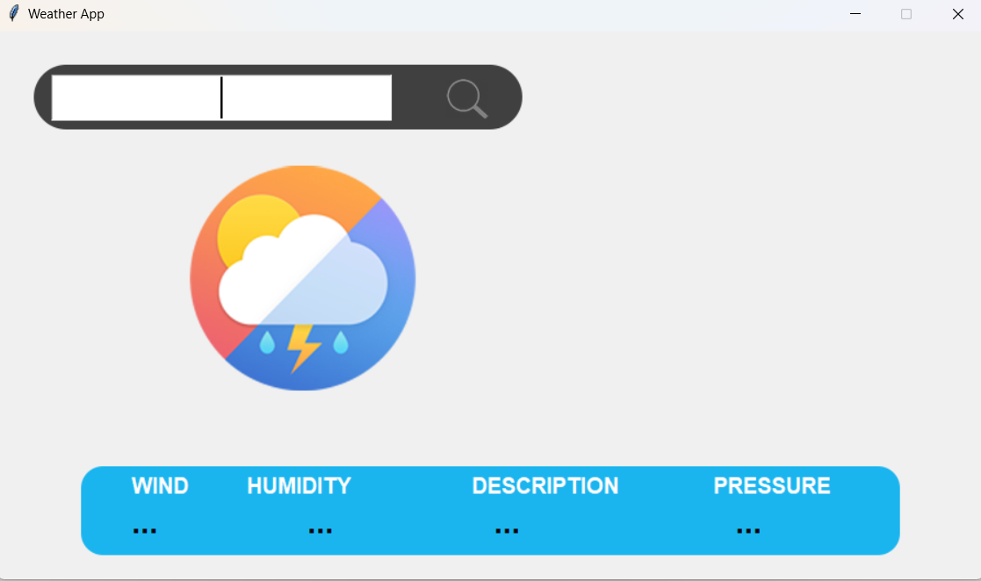
Here are few Project snapshots for preview:
Main Window:

Slide 9

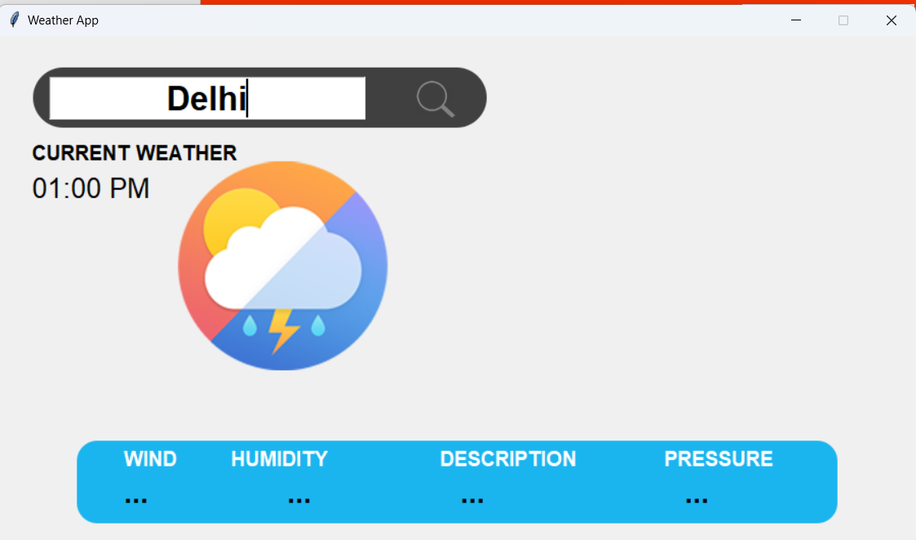
After filling data:

Slide 10
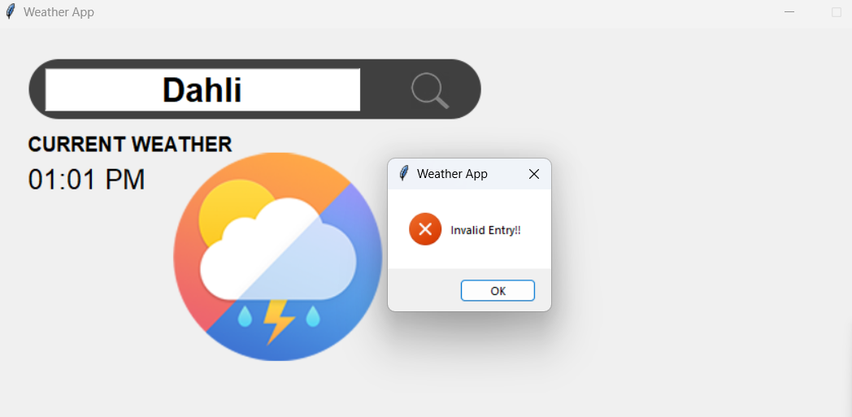
Project Highlights
If you fill wrong data:

Slide 11
Repository & Netlify link
Repository link:
https://github.com/ydv-kanchan/Weather_App

Slide 12


