Slide 1
Voice Driven Quote Assistant
Shri Prakash Yadav
Matricola:D03000084
NLP Final Project

Slide 2
Problem Statement & Objective
People often recall only fragments of famous quotes just a few words or phrases without remembering the full wording, the source, or the author. While generative AI can fill in these gaps, it frequently hallucinates or misattributes quotes.
This project aims to build a voice driven assistant that listens to speech, identifies quote fragments or user intent, and retrieves the exact quote along with metadata from a graph database.
“Selfishness is not living as one wishes to live, it is asking others to live as one wishes to live”
“I resolved from the beginning of my quest that I would not be misled by sentiment and desire into beliefs for which there was no good evidence.”
Mistral 7B

Slide 3
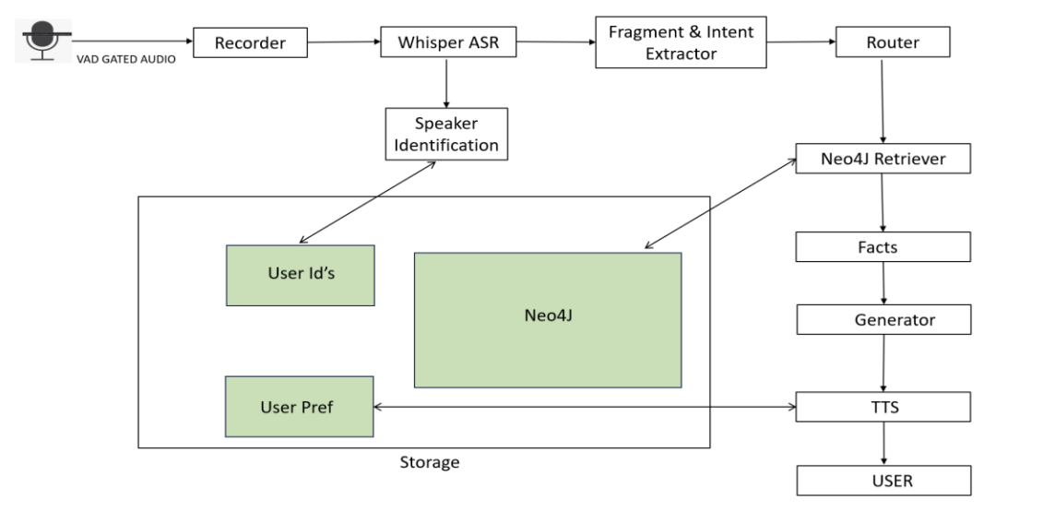
System Architecture
Input Layer: Mic + VAD -> Whisper ASR for transcription.
Speaker Identification & Registration: Parallelly, voice encoding for speaker identification or registration.
Understanding Layer: Extracts quote fragments, user intents, metadata queries, or control commands.
Router: Handles control intents directly and deterministically, queries go to Neo4j Retriever.
Retrieval Layer: Full-text search + relationships (SAID_BY, ABOUT, DISPUTED, MISATTRIBUTED).
Answer Layer: Deterministic responses grounded in DB facts / LLM response( more generalized and robust but slow).
Personalization & Output: User ID + User Prefs -> TTS with user’s voice settings.

Slide 4
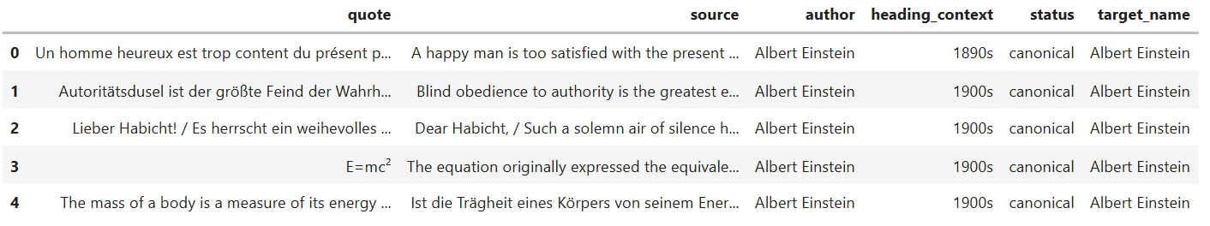
Quote Data Extraction & Preprocessing
Extracted ~30k quotes and metadata from Wikiquote dump using pattern rules (* = quote, ** = source, sub_headings = context).
Author attribution (canonical / misattributed / disputed / about).
EDA revealed issues: missing/NaN quotes, fragmented authors, trivial/short sources, duplicates.
Preprocessing fixes:
  Recovered template pages, empty quotes etc.
  Removed invalid rows, duplicates, meaningless sources.
  Dropped very long quotes more than 1000 chars, sources were trimmed to 1000 chars.
Final dataset: 27,799 clean, high-quality records ready for Neo4j.

Slide 5
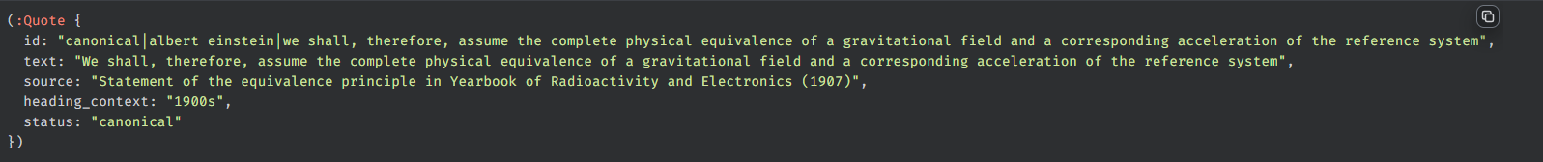

Graph Database
Database: Neo4j used to store and query quotes and metadata.
Nodes:
  Quote nodes: Text, Source, heading_context, status (canonical / about / misattributed / disputed).
  Person nodes: Stores authors or entity linked to quote.
Relationships:
  The Quote and Person nodes are connected with semantic relationships.
  SAID_BY, ABOUT, MISATTRIBUTED_TO, DISPUTED_WITH.
Full-Text Index:
  Created Lucene based full-text index quoteTextFT for fast search.
Retrieval:
  The retrieval framework combines full-text index with graph traversal.

Slide 6
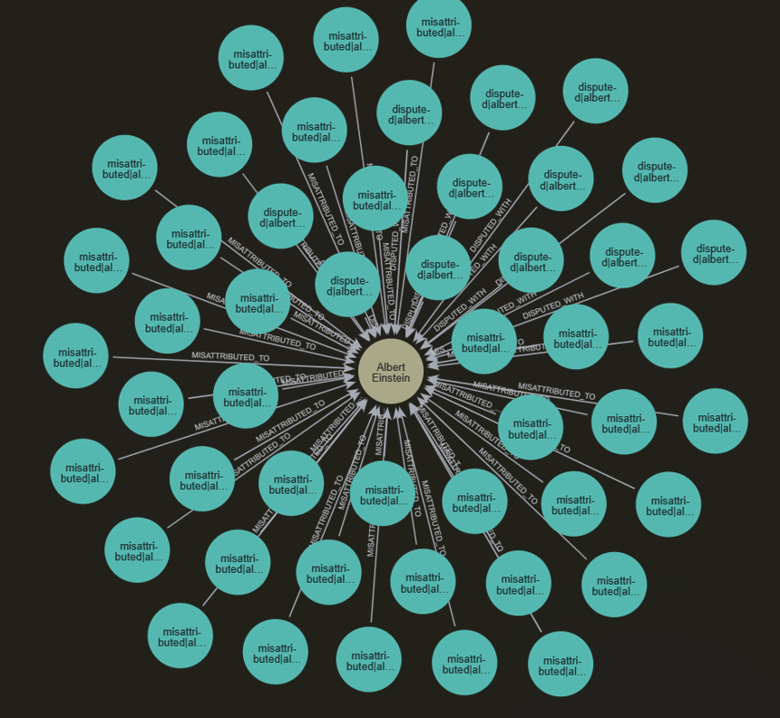
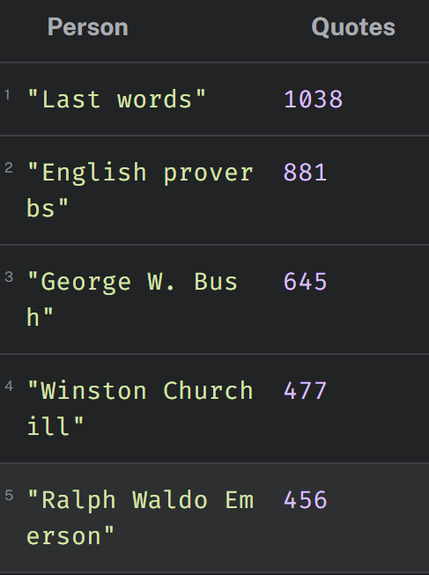
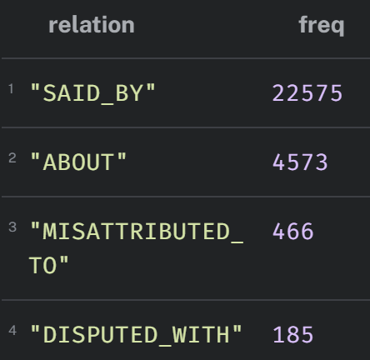
Graph Database

Slide 7
Voice Interface
Audio Capture:
  Implemented WebRTC VAD gate on the mic stream.
  Recording stops after 500 ms of silence.
  Max recording length is 25s.
ASR:
  The captured audio is transcribed with Whisper AI model.
Speaker Registration & Identification:
  If the speaker utters “register” command, then the enrollment procedure is initiated.
  Speaker enrolls with 5 short text readings.
  Recordings are encoded with SpeechBrain model(192 -D) and centroid embedding is saved.
  Speaker Identification by cosine similarity on stored centroids.
  When a user is recognized, the system automatically switches to that user’s session & preferences.
  Accept if similarity score ≥ 0.65 and duration ≥ 0.8 s.
  Otherwise, keep current session active or default setting.
User Prompts & Controls Commands:
  “register”, “who said…”, “finish the quote…” etc.
  Controls commands: “set my voice to Zira/David”, “set my rate to slow/medium/fast”, “make it louder/quieter”, etc.
TTS & Personalization:
  Loading more robust personalized TTS models caused system crash.
  Used simpler personalization approach, pyttsx3 with voices David/Zira.
  Per-user preferences (voice, rate, volume) are saved in a JSON files.
  On successful identification these preferences are used to generate response.

Slide 8
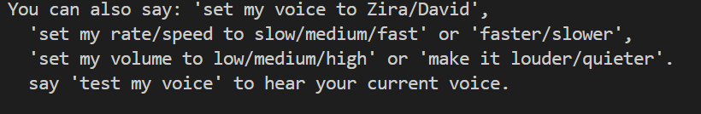
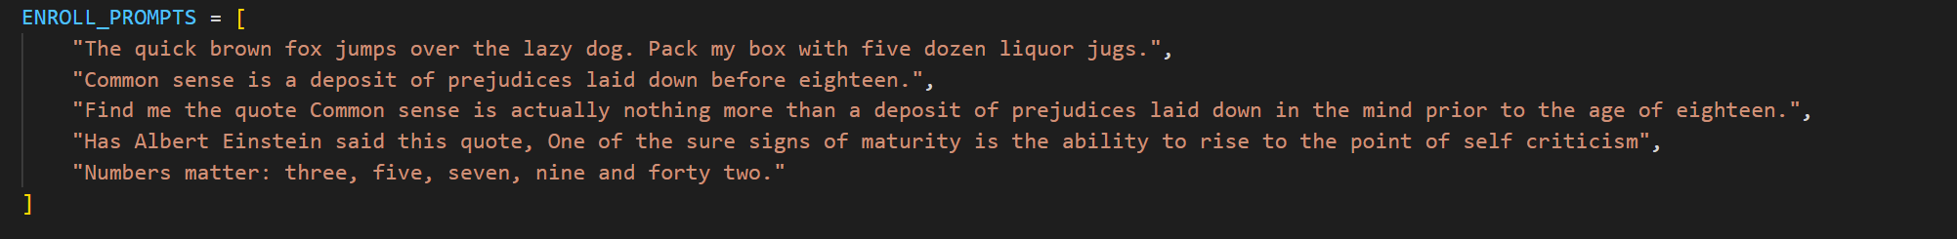
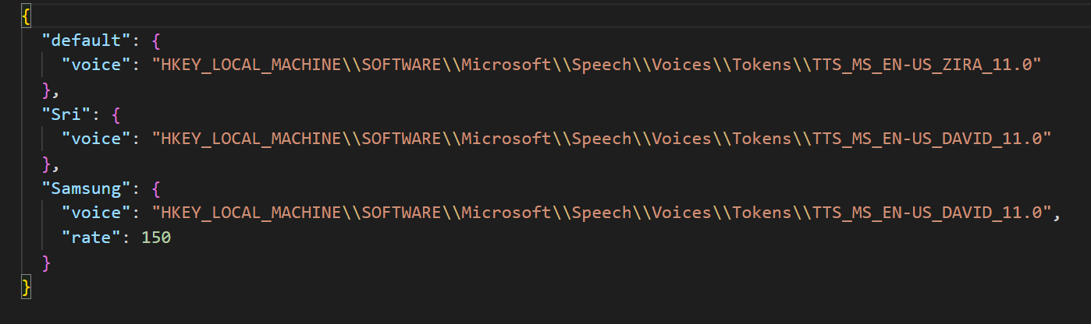
Voice Interface
Control Commands Ex:
Speaker Enrollment:
User Preferences:

Slide 9
Language Understanding & Answering
Fragment Extraction:
  LLM span extractor(Mistral 7B) pulls only the quote fragment from the user’s sentence.
  Removes commands/author names, and only accepts fragments with at least 3 meaningful quote words.
Intent Mapping (Regex):
  Detects user intent without needing an LLM.
  Maps natural language phrases into clear internal intents.
  Fast and deterministic, ideal for structured quote queries.
  “who said” / “who wrote” maps to said_by.
  “finish it” / “complete” maps to finish_quote.
  “where from/source” maps to source.
  “About whom” maps to about.
  Overall: fragment decides search, intent decides action.”
Intent Router:
  If a quote fragment exists, then perform DB search.
  If no fragment is found but the user session has context, then it is treated as follow-up question (“ who wrote?”).
  If no fragment and no context, then ask the user for more words (“Give a few words”).
Session & Speaker Stickiness:
  Each speaker has their own quote context.
  Follow-ups stick to the same user’s last quote.

Slide 10
Language Understanding & Answering
Answer generation – Two Paths:
  Deterministic:-
  Uses a rule-based template that reads only the fields stored in the database results.
  Behavior:
    “Who said it?” -> returns the exact name from the SAID_BY field.
    “What’s the source?” -> returns the source field only.
    “Finish the quote…..” -> returns the exact quote text.
    Find the quote… -> full quote + author + source.
  Very fast, reliable and zero hallucination because it uses only graph facts.
  LLM (flag USE_LLM_ANSWERS =1):-
  Reranked DB_RESULTS passed to LLM(Mistral 7B).
  Strict System Prompt: Must use only DB results, no external knowledge.
  Used to answer in natural sentences while keeping all facts from the graph.
  Examples:
    Turns "Albert Einstein. Unknown source." into “It was said by Albert Einstein.”
    Turns the raw quote + author into “Here’s the full quote by Einstein, from <source>.”

Slide 11
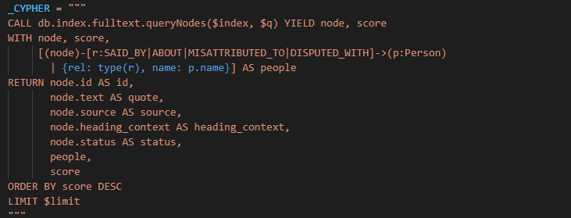
Retrieval Module
Quote Search: Uses Lucene index (quoteTextFT) with multiple quote fragment styles (exact, token, and fuzzy matching).
Candidate Enrichment: Pulls Quotes text, metadata, and linked people along with relations (who said it, about, misattributed, disputed).
Reranking: Scores candidates by token coverage, Lucene score, and phrase bonus, best match is selected.
  final_score = 0.55*(token_coverage) + 0.35*(norm_ft_score) + 0.10*(phrase_bonus)
  Lucene score alone is not reliable for short fragments.
Output:
  Returns a single best candidate with max final_score.
Advantage: Robust to ASR noise and little phrase variations.

Slide 12
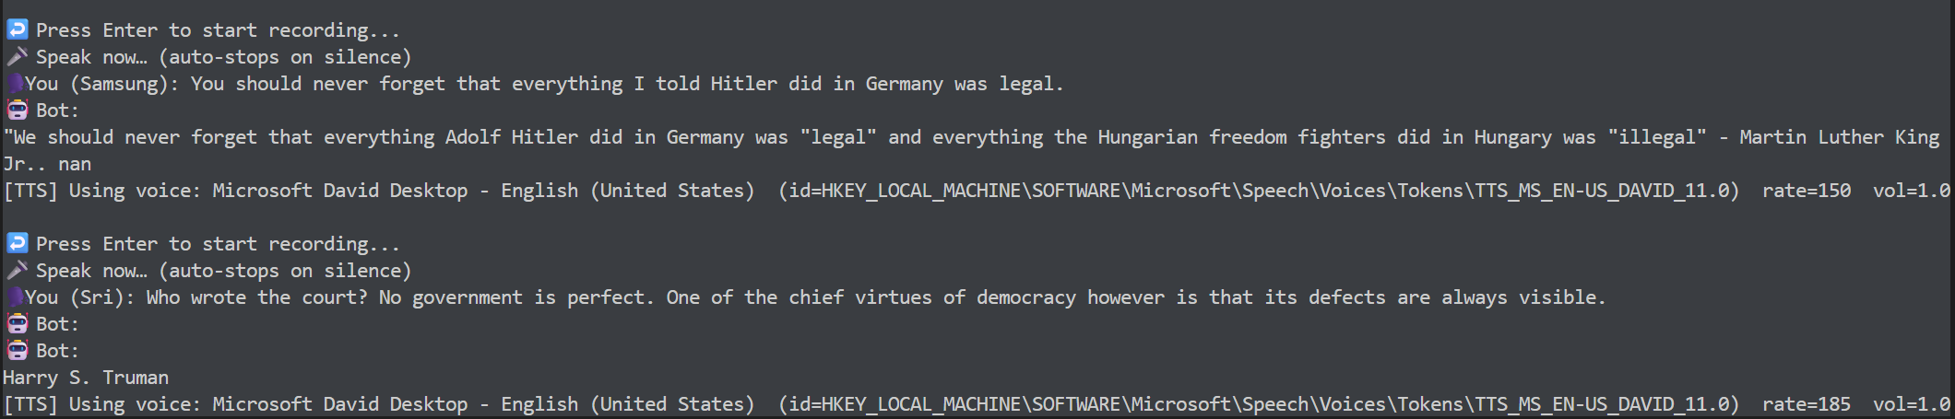
Evaluation & Results
Focused only on Retrieval & Answering, since Whisper, SpeechBrain, and pyttsx3 are pre-build libraries.
Retrieval Performance:
  Top-1 accuracy: 93.7%
  Top-5 recall: 96.8%
  MRR@5: 0.95
  Median latency: 22 ms.
Speaker Recognition:
  Tested with 5 different speakers.
  Accurate when speech is long & environment consistent
  Minor errors if speech is short or recorded in different environments
Human Interaction Results:
  Successfully, completes quotes and answers metadata questions.
  Correctly answered follow-ups from context (“who said this?”)
  Repeated quotes reliably, showing session stickiness
Limitations
  Short queries often fail because they lack enough signal for retrieval.
  Some sources are noisy or missing (NaN values) due to Wikiquote inconsistencies.

Slide 13
Conclusion & Future Work
Built a voice driven assistant that combines a knowledge graph, retrieval, and a dialogue logic.
Regex-based decision rules kept the system fast and responsive on modest hardware while, LLM based answering sounds more natural and humanlike.
LLM used only for fragment extraction and natural answer phrasing, experiments with full LLM-driven routing were too slow locally.
Strengths: Accurate retrieval, fact-grounded answers, multi-turn interaction, personalized voice settings.
Trade-offs: Regex rules are brittle and must be handcrafted, system sometimes misses fuzzier phrasing.
Future direction:
  Shift toward a fully LLM-driven router as compute improves.
  Enable more natural, flexible conversation handling and better generalization.
  Ex:- “Tell me a quote about Einstein”.

