Slide 1
Capstone Project - 3
Airline Passenger Referral Prediction By- Shri Prakash Yadav

Slide 2
Points of Discussion
Problem Statement
Data Summary
Bivariate Analysis
Univariate Analysis
Covariance
Model Creation
Feature Importance
Conclusion
Challenges

Slide 3
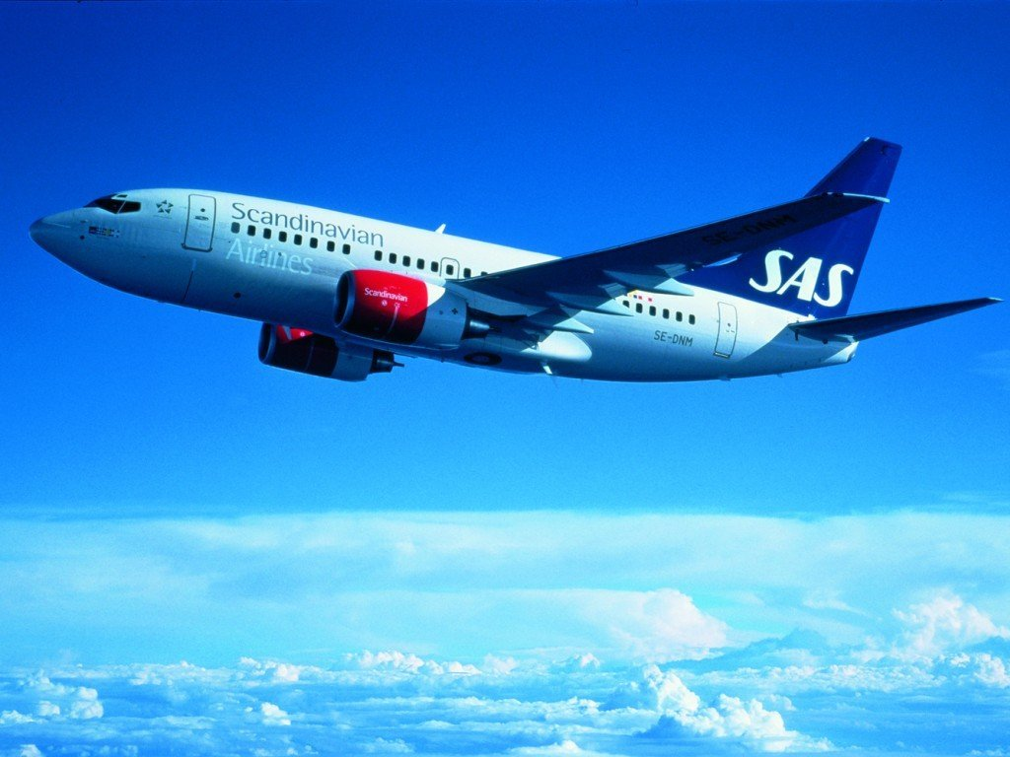
Problem Statement
Airline is a fast and premium mode of travel.
For a decent portion of population nowadays
airways is the first choice. For airline giants it is
important to know whether a passenger likes
their services or not. It would be very
informative for them if they can analyse and
predict whether any passenger is going to
recommend their flight or not. Analysing
reviews can also help them with the services
or features that passenger likes the most.

Slide 4
Data Summary
The dataset airline review consists of 65947 rows and 17 columns which are listed below:
seat_comfort : seat comfort rating (0-5)
cabin_service : cabin service rating (0-5)
entertainment : entertainment rating (0-5)
ground_service : cabin service rating (0-5)
value_for_money : value for money rating (0-5)
overall : overall rating given by reviewer (0-10)
food_bev : rating given to food and beverage (0-5)

Slide 5
Date Summary
Dates
review_date : date on which review was given
flown _date : date of flight
Others
airline : name of the airline
aircraft : name of the aircraft
author : name of the author who has given the review
routs : route of flight
review : review given by author
recommended : whether a traveller going to recommend the flight or not

Slide 6
Data Summary
cabin_type : type of cabin
traveller_type : type of traveller

Slide 7
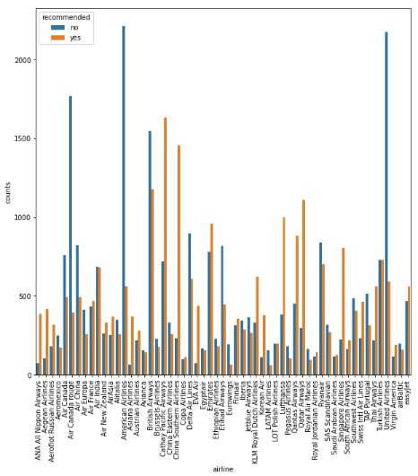
Bivariate Analysis
American airlines and United
airlines have highest number of
no recommendations.
Cathay Pacific and China
Southern airlines have highest
number of yes recommendations.

Slide 8
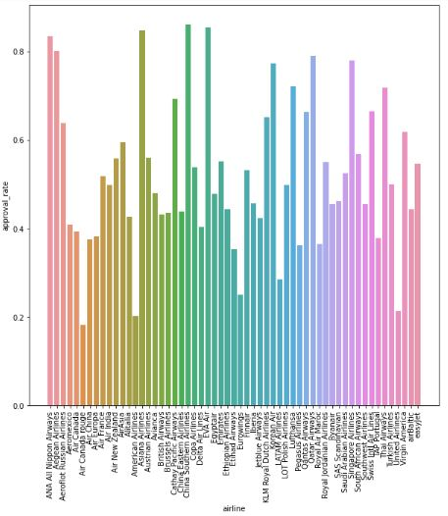
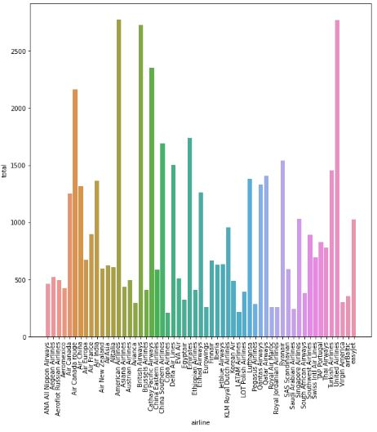
Bivariate Analysis
China Southern, Asiana and Eva
Air airlines have highest yes
recommendation rate.
Air Canada rouge and American
airlines have the lowest yes
recommendation rate.
American airlines have received
highest number of reviews.
Copa airlines have received
minimum number of reviews.

Slide 9
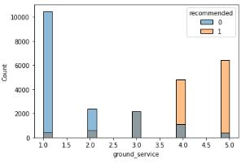
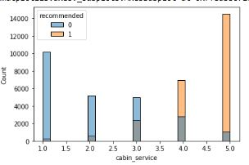
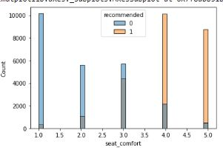
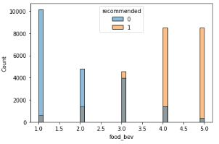
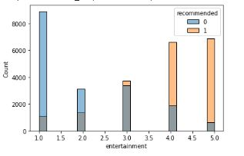
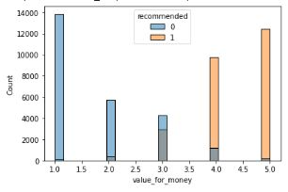
Bivariate Analysis
For ground_service, cabin_
service, seat_comfort, food_
bev, entertainment, value_for_
money if rating is less than or
equal to 2 the recommendation
is mostly no and for rating
values greater than or equal to
4 the recommendation is
mostly yes.
For rating equal to 2 the
recommendation could be both
yes or no.

Slide 10
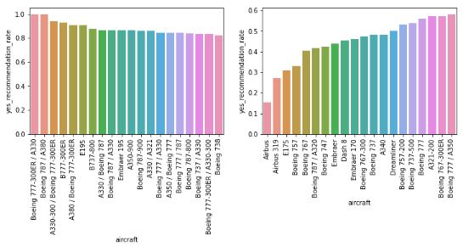
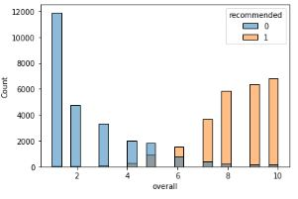
Bivariate Analysis
Boeing 777-300ER/A330
and Boeing 787/A380 has
the highest yes
recommendation rate.
Airbus has the lowest yes
recommendation rate.
For overall values greater
than 6 recommendation is
mostly yes.
For overall values less than
6 the recommendation is
mostly no.

Slide 11
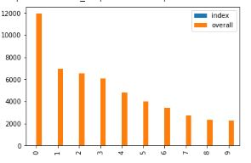
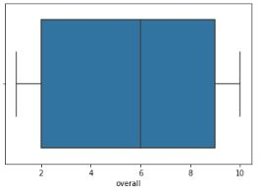
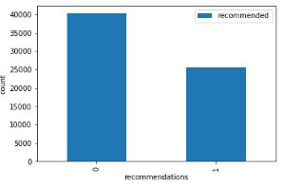
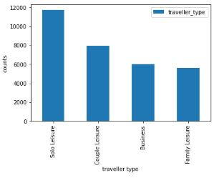
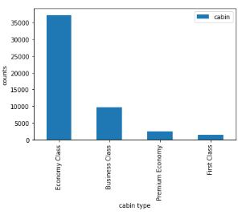
Univariate Analysis
The mean of overall is 6.
For most of the reviews
overall recommendation is
below 6.
Solo leisure type of
travellers are highest.
Travellers mostly uses
economy class.
The dataset is
imbalanced.

Slide 12
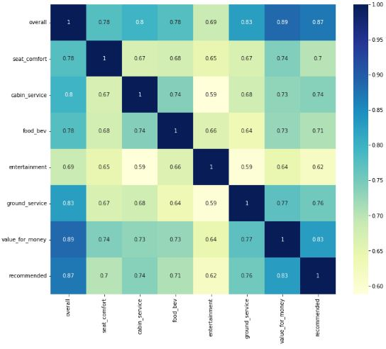
Covariance
All the numerical features are
strongly correlated with
target variable.
Recommended highest
correlated with value_for_
money and overall.

Slide 13
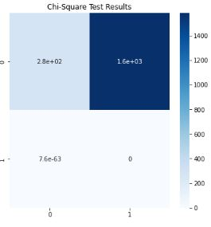
Covariance
For both cabin_type and traveller type
p_value is less than 0.05 means both are
correlated with our target variable.

Slide 14
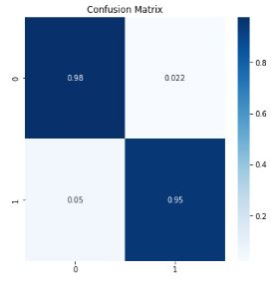
KNN Classifier
For a distance base model KNN was performing
very good.
The best n_neighbors calculated using gridsearch
cv was 85.
Accuracy score for KNN was 0.96.
F1 score for KNN was 0.95.

Slide 15
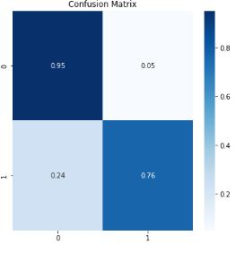
Naive Bayes
Naive bayes was not a good choice as the
dimension of dataset was high.
The accuracy score for NB was 0.86.
F1 score for NB was 0.83.

Slide 16
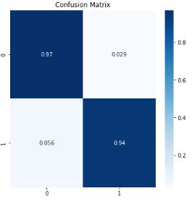
Logistic Regression
Logistic Regression model was working like KNN
model.
Accuracy score for LR was 0.96.
F1 score for LR model was 0.94.

Slide 17
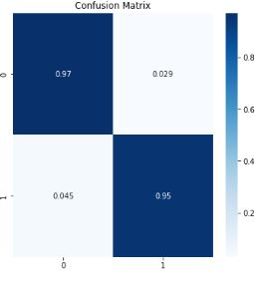
Support Vector Machine Classifier
Support Vector Machine was working better than
KNN and LR model.
Accuracy score for SVM model was 0.96.
F1 score for SVM was 0.95.

Slide 18
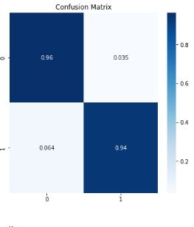
Decision Tree
As the dataset was high dimensional still
Decision Tree was performing good.
Accuracy score for DT was 0.95.
F1 score for DT was 0.94.

Slide 19
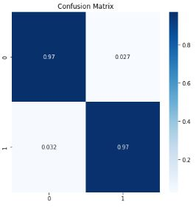
Random Forest
The best model than I could train was Random
Forest.
Accuracy score for RF model was 0.968.
F1 score for RF was 0.96.

Slide 20
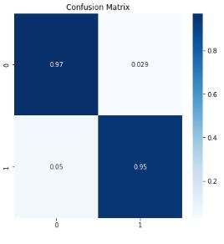
Gradient Boosting Classifier
Gradient Boosting was also performing very
good on our dataset.
Accuracy score for GB classifier was 0.96.
F1 score for GB classifier was 0.95.

Slide 21
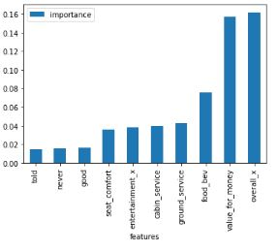
Feature Importance
The most important features which
determines the recommendations are
Overall, value_for_money, food_bev,
ground_service, cabin_service,
entertainment, seat_comfort, good, never
and told.
Good, never and told features come from
bag of word vectorization of reviews.

Slide 22
Conclusion
That’s it! I performed EDA and modelling on airline review dataset. I was able to find various trend and dependencies from dataset. The best model that I could train was Random Forest whose accuracy score was 0.97 and F1 score was 0.96. The most important pre existing features were overall, value_for_money and food_bev rating.

Slide 23
Challenges
The dataset had reviews as one of its features. Converting this textual feature to numerical feature was one of the challenges. The other challenge that I faced in this project was that the dataset had a lot of null values. Handling the null values was another challenge.

Slide 24
THANK YOU

