Slide 1
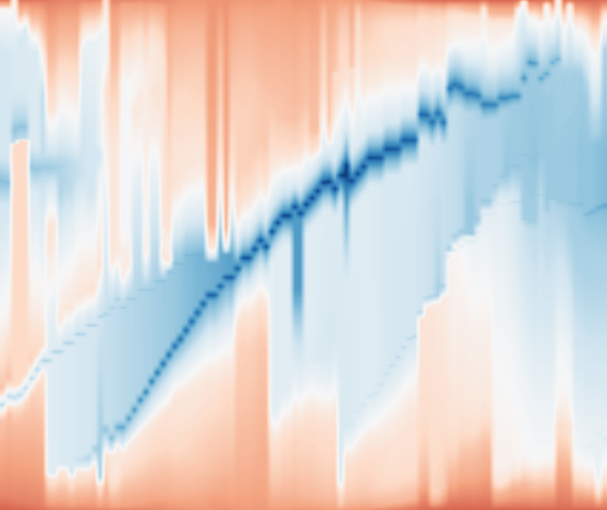
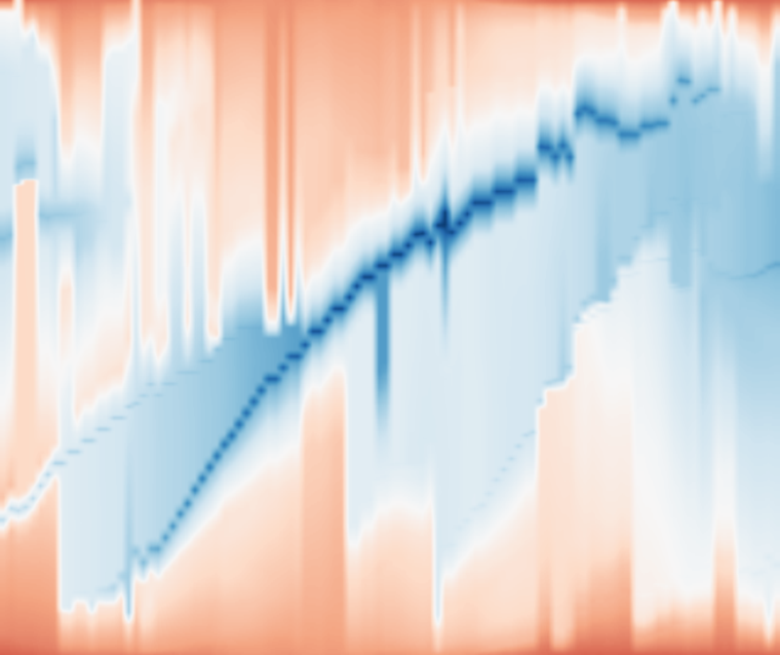
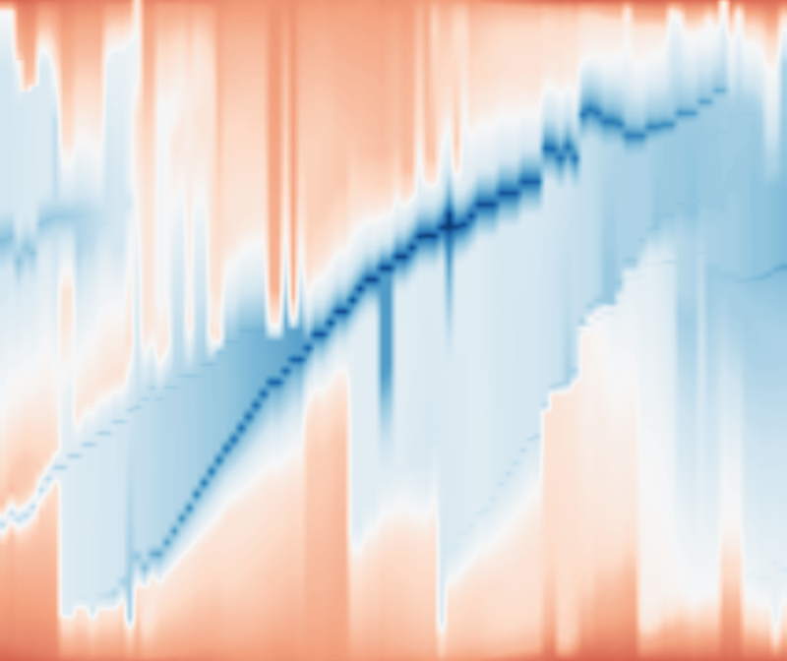

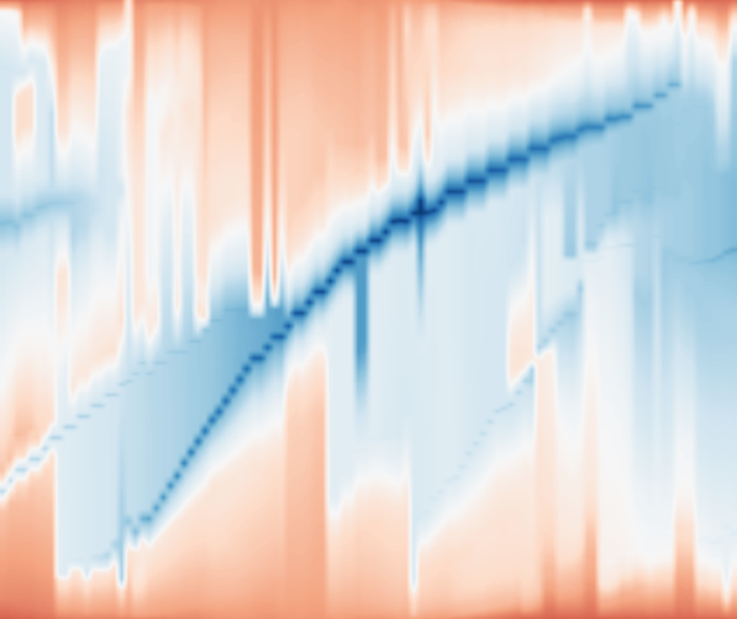





AnchorMTM
Exact Topology (ε = 0%)
Bounded Topology (ε > 0%)
ε = 0%
ε = 2%
ε = 5%
ε = 10%
ε = 20%
Improvement 2
Improvement 1
+ Topology Budget
+ Spatial Awareness
→
→
ST-MTM
TMTM
Notes:
Top row preserves the approved original lower event-map row exactly: titles, scalar backgrounds, editable trajectories, ROI rectangles, crop backgrounds, markers, dashed references and connectors. Baselines use the same 744 fields and augmented trees; actual baseline rasters are separate scalar image layers. Module captions and arrows are native editable objects. Source configuration and adapters: baseline_protocol.json. No complete figure is flattened into an image.

