Slide 1
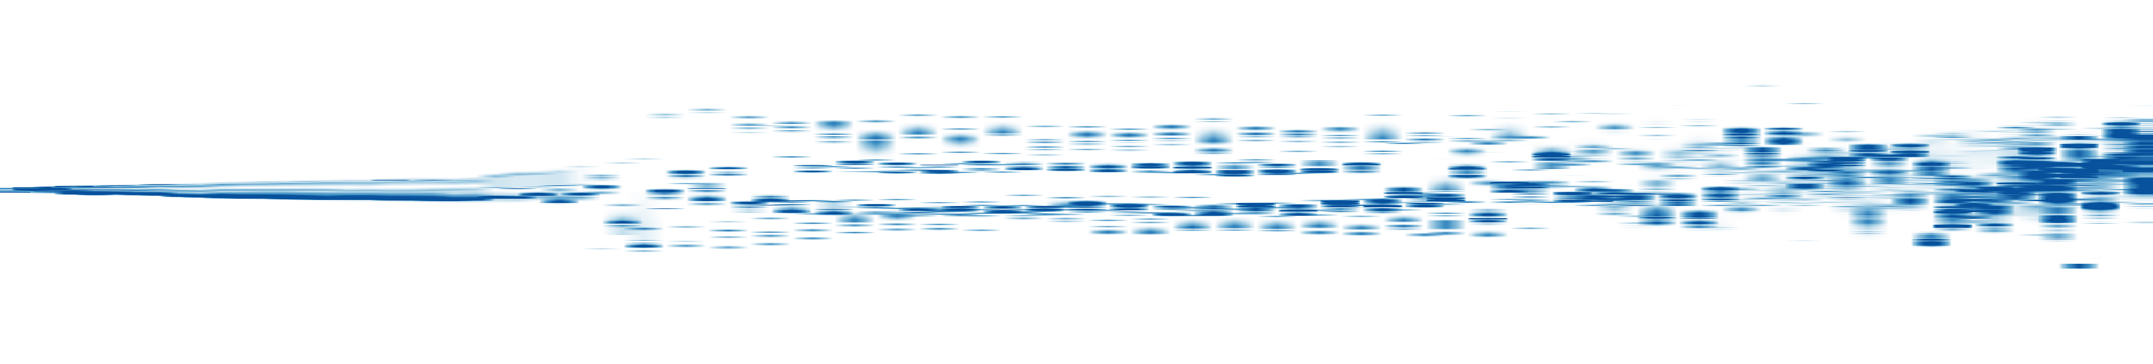

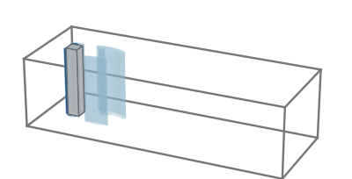
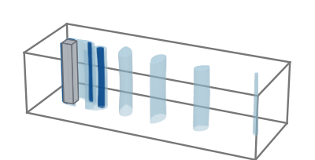
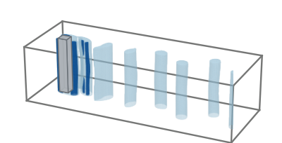
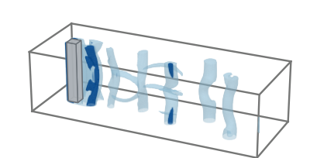
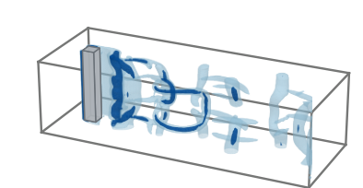
Q
1.0
I: Early
II: Transition
III: Shedding
IV: Transition
V: Late
linearized space
0.5
0.0
0
0
40
40
80
80
120
120
160
160
t = 32.1
t = 56.1
t = 80.2
t = 120.3
t = 162.0

