Slide 1

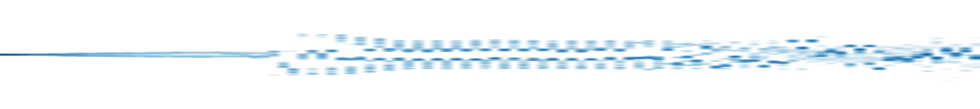

1
AnchorMTM, central-tree variant (guidance weight 16)
0.5
0
1D layout position
1
TMTM
0.5
0
1
ST-MTM
0.5
0
0.0
32.1
56.1
80.2
120.3
162.0
simulation time t

