Slide 1




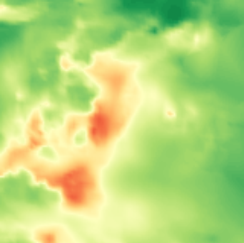
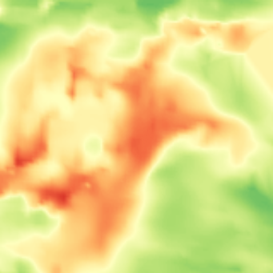
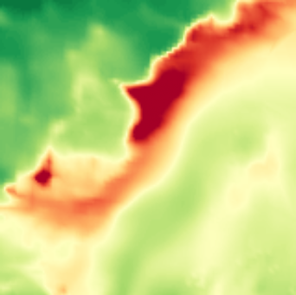

TMTM
ST-MTM
AnchorMTM, ε = 5%
axis: tree order
axis: relative distance
axis: spatial position
a
b
c
d
e
a
b
c
d
e
a
b
c
d
e
1.0
400
Mapped position
350
0.5
300
250
PM2.5 (μg m−3)
200
0.0
Jan 22
Jan 25
Jan 27 12h
Jan 22
Jan 25
Jan 27 12h
Jan 22
Jan 25
Jan 27 12h
150
(a) 01-22 00:00
(b) 01-23 12:00
(c) 01-25 00:00
(d) 01-26 12:00
(e) 01-27 12:00
100
50
0

