Slide 1
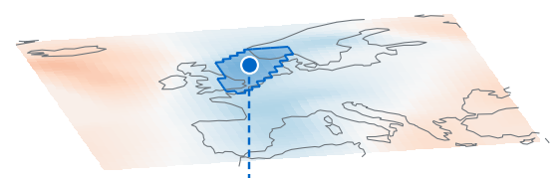
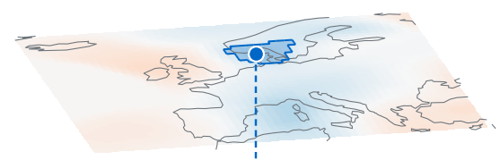
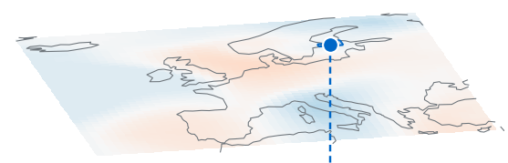


Input
(1) Extract & reference
(2) Topology-budgeted
layout
(3) Topology-to-1D mapping
Output
F(x, t)
(a) Spatial projection
d
Exact
η = 0
A
B
C
D
x
Iᵋ(t, u) = ψₜᵋ(u)
t
A
B
C
D
q
A
C
B
D
Temporal profiles ψₜ
A
C
B
D
t
(b) Merge tree Tₜ
t + 1
t + 1
Budgeted
η > 0
t + 2
A
C
B
D
x
A
C
B
D
t + 2
q
A
C
B
D
Notes:
User-requested scientific workflow restyling of the existing five-column flowchart. Input grids and the first spatial-projection diagram are explanatory schematics following the supplied visual references. The three times use different feature locations and grid color assignments. The diagonal reference uses orthogonal projections of four feature extrema. Three temporal rows use editable circle/diamond node sequences and segmented scalar-color strips, following the supplied reference. Grid diagrams are not measured Storms fields. The output is schematic and assembled directly from the same eight temporal strip arrays shown in stage3: each row is rotated90 degrees counterclockwise, so its left-to-right order becomes bottom-to-top, and times are concatenated left-to-right. All output cells are native editable rectangles. Display/reference order comparisons show strict ABCD against reference ACBD, and budgeted ACBD against the same reference. The first spatial grid swaps the orange and green extrema consistently so its projected reference order is ACBD. No actual Storms output is represented in this revision. Small explanatory prose removed. Each section has a uniform black frame. All grids, nodes, strips, labels, trees and section frames are native editable PowerPoint objects; the output scalar map is raster.

