Slide 1



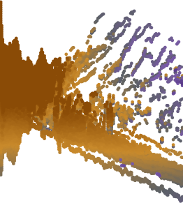
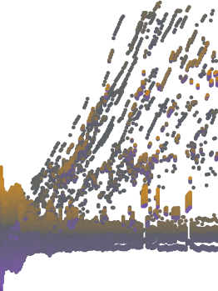
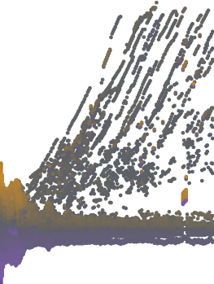
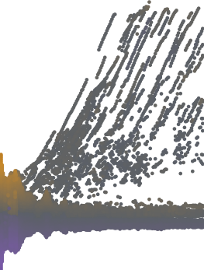




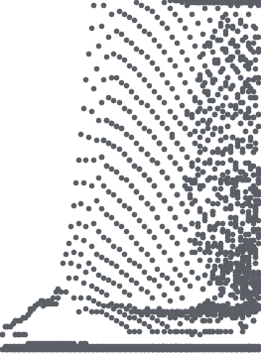



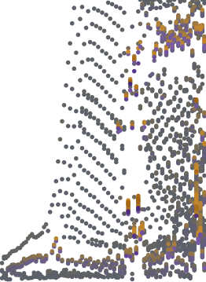

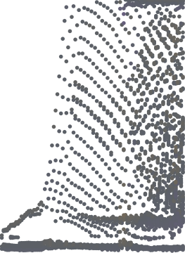

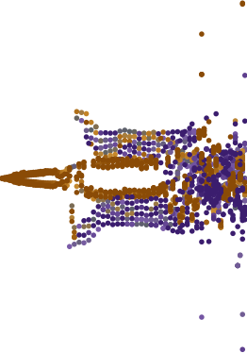
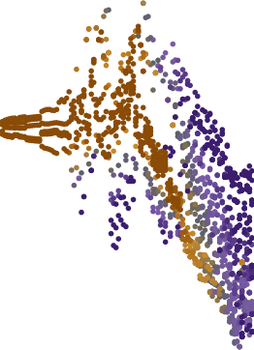
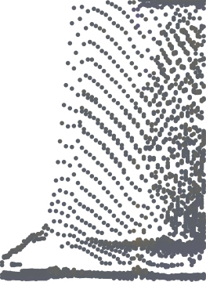
AnchorMTM
Reference q
(target)
TMTM
ST-MTM
ε=0
ε=5%
ε=20%
NPE (% of axis)
1
0.3
TMTM
38.7
axis position
Tangaroa
ST-MTM
32.9
0.5
signed displacement (x−q)/L
ε=0
8.6
0.15
ε=5%
5.4 (merge 5.0)
ε=20%
3.7 (merge 19.7)
0
0
200
0
200
0
200
0
200
0
200
0
200
0
30
60
0
1
TMTM
47.7
axis position
Cylinder
-0.15
ST-MTM
51.6
0.5
ε=0
9.2
ε=5%
1.2 (merge 4.8)
-0.3
ε=20%
1.2 (merge 14.3)
0
0
101
0
101
0
101
0
101
0
101
0
101
0
30
60
Time (frame)

