Slide 1
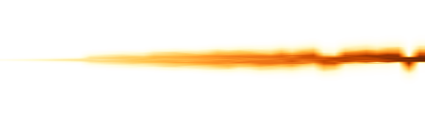

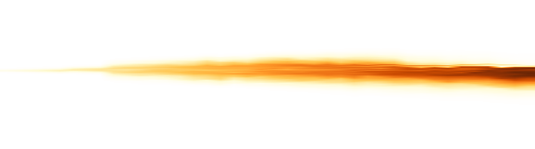

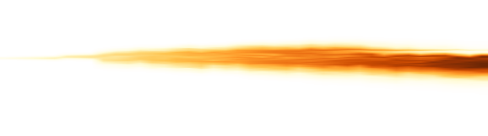
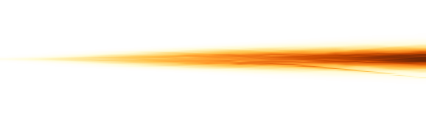



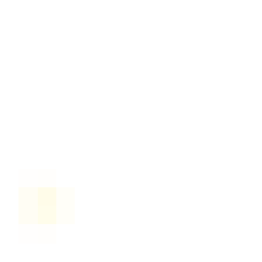




AnchorMTM
0
6
12
ε = 0%, α = 0
Hilbert
1
0
ε = 2%, α = 0.1
1
Morton
0
ε = 5%, α = 0.25
1
Normalized position
TMTM
0
ε = 10%, α = 0.5
1
0
ε = 20%, α = 1
ST-MTM
1
0
0
39
0
39
t
t = 0
t = 10
t = 20
t = 30
t = 39

