Slide 1


with game
< Neuro Evolution of Augmenting Topologies >
Generic
Algorithm
Dae Young. Yang

Slide 2

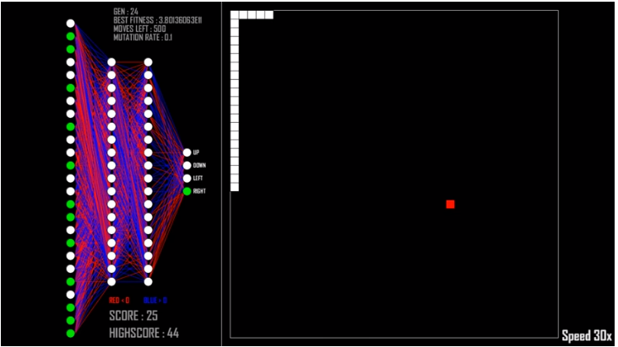
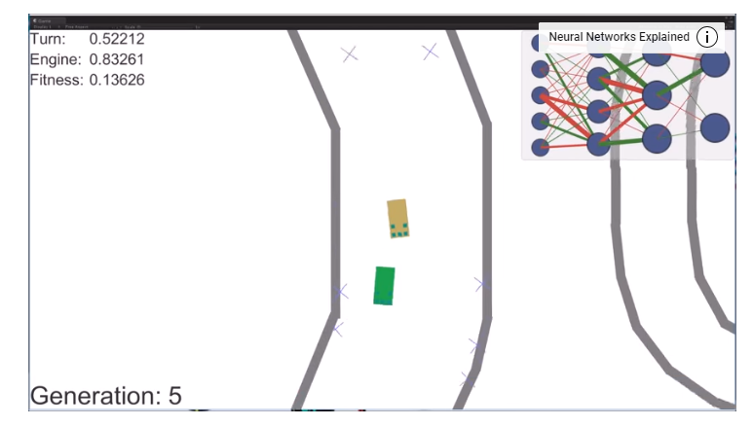

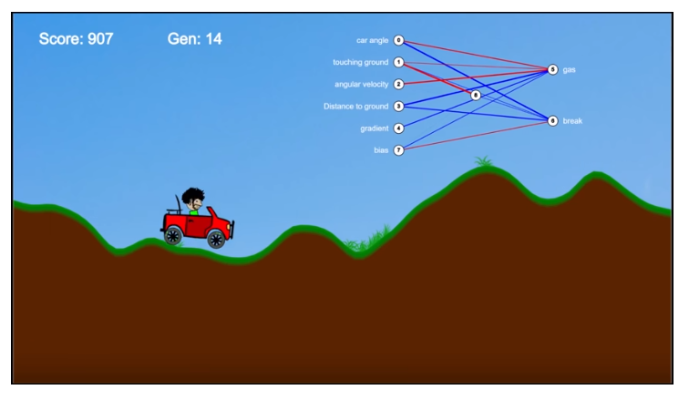
Neat projects

Slide 3
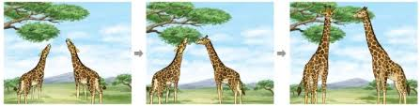


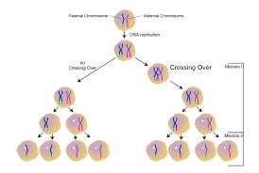
NEAT?
1. Elite Selection
2. Cross over
3. Mutation

Slide 4
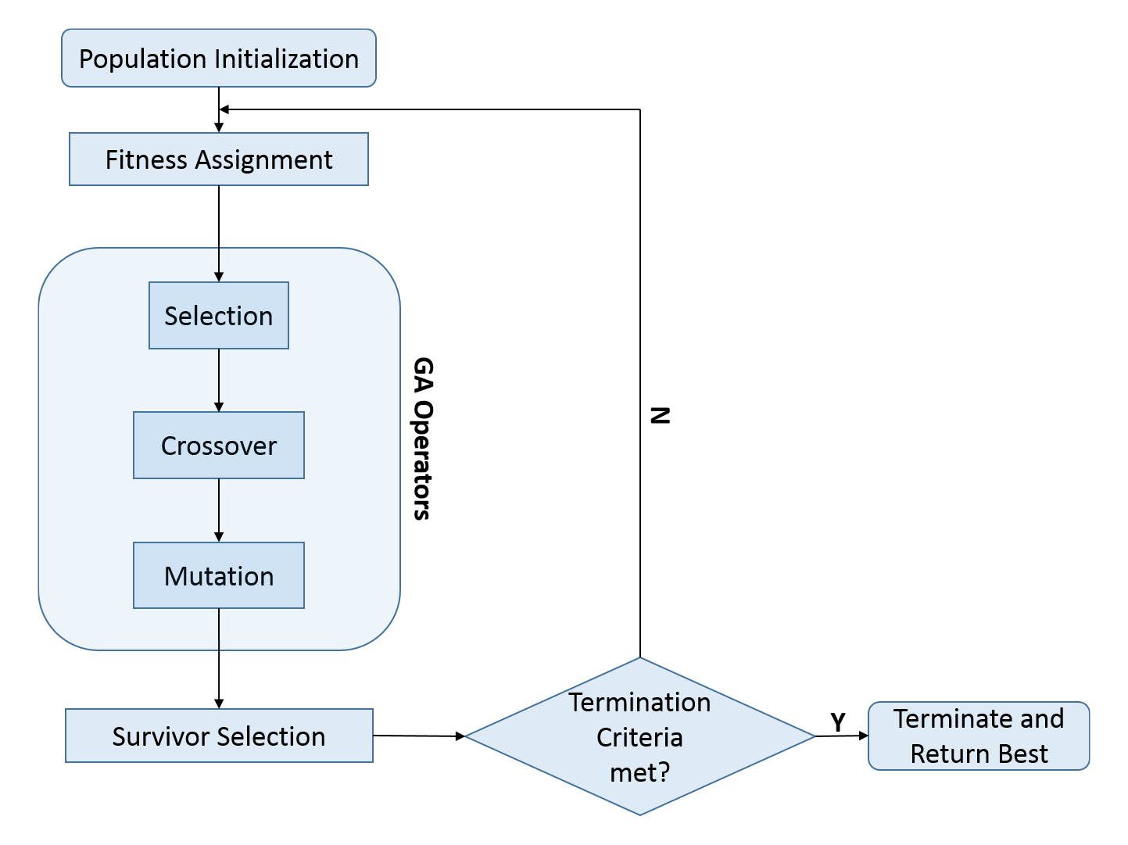
Generic Algorithm

Slide 5

Population Initialization
genome 1
genome 2
NEAT
genome N

Slide 6
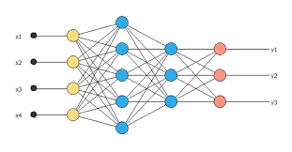
Genome
genome 1

Slide 7
Genome
genome 1
genome 2
genome 2

Slide 8
Population Initialization
Simulating
Elite

Slide 9

This is Sparta

Slide 10

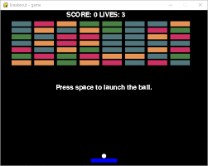
Elite ?
How can we define the elite?

Slide 11

Fitness value
How about this?
Good!
+ Fitness value
Genome 1
Fitness_value = 0
Fitness_value = 0.5

Slide 12

Fitness value
How about this?
Nope!
- Fitness value
Genome 1
Fitness_value = 0.5
Fitness_value = 0

Slide 13
Elite Selection
Fitness value
100
Fitness value
40
Fitness value
10
Fitness value
90
Fitness value
80
Fitness value
100
Fitness value
90

Slide 14
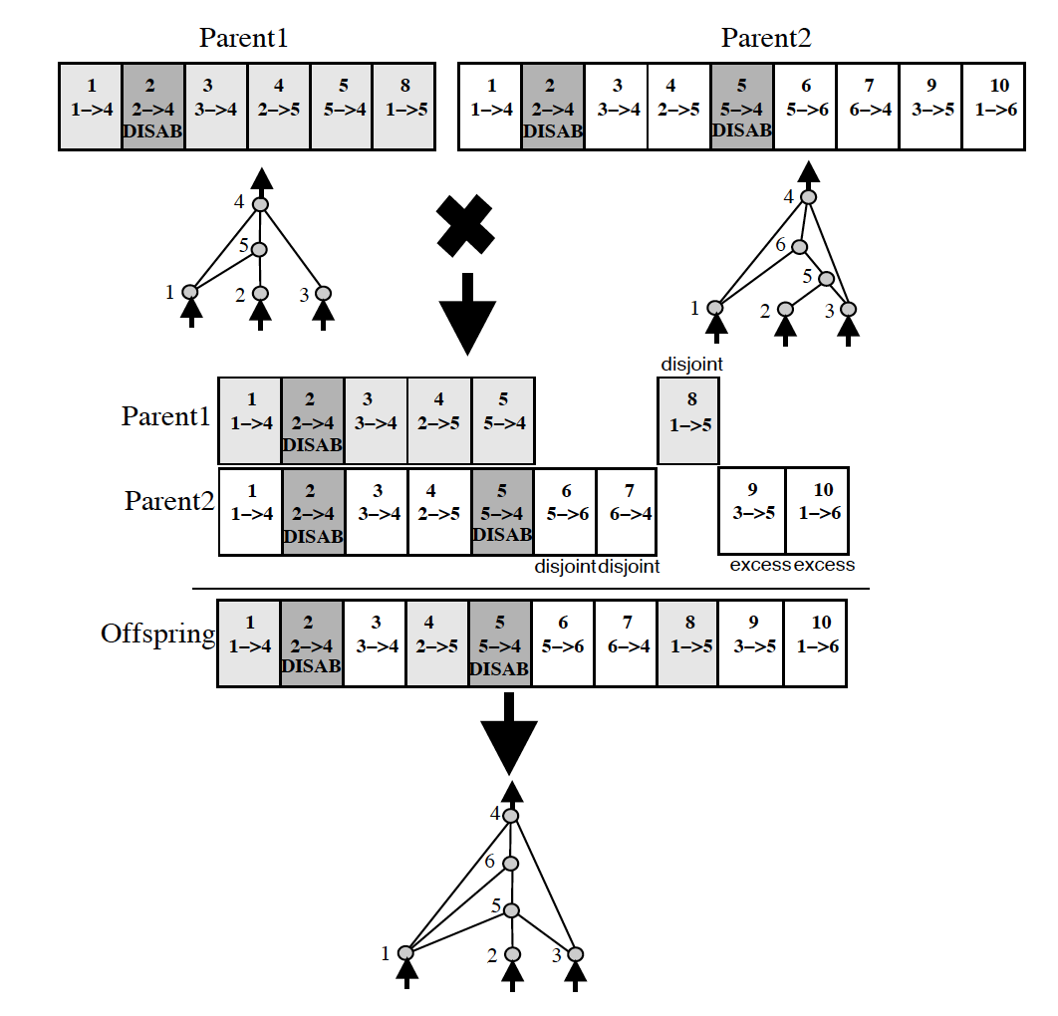
Cross over + mutation
Cross over
Cross over
Fitness value
100
Cross over
Cross over
Fitness value
90
Mutation

Slide 15

Find Best model
Simulating
Elite

Slide 16
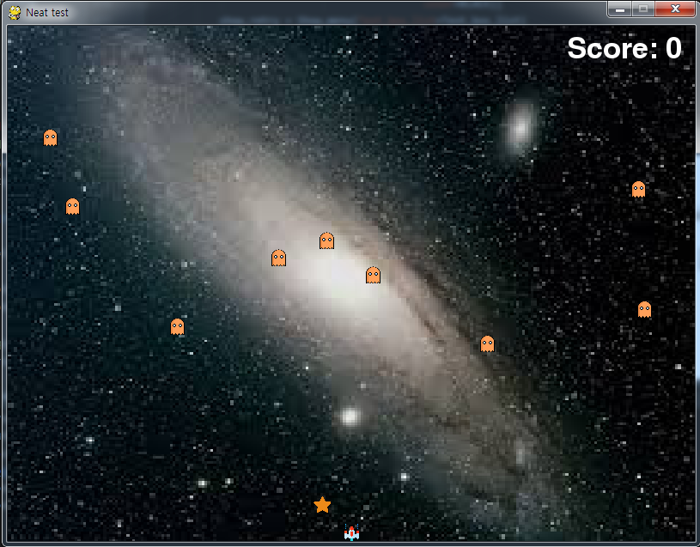
Environment

Slide 17
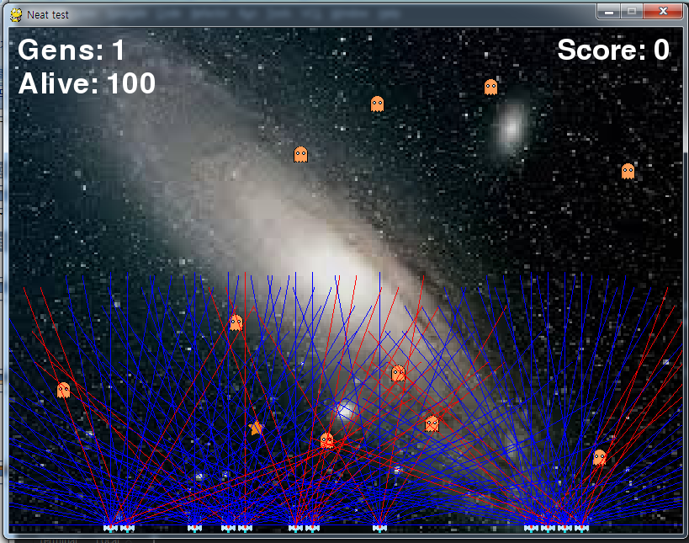
Train model
1. Each Genome has a razer sensor.
2. Whenever razer is blocked by meteor, pilot calculates the distance from meteor.
3. Min-Max scaling is adapted.

Slide 18
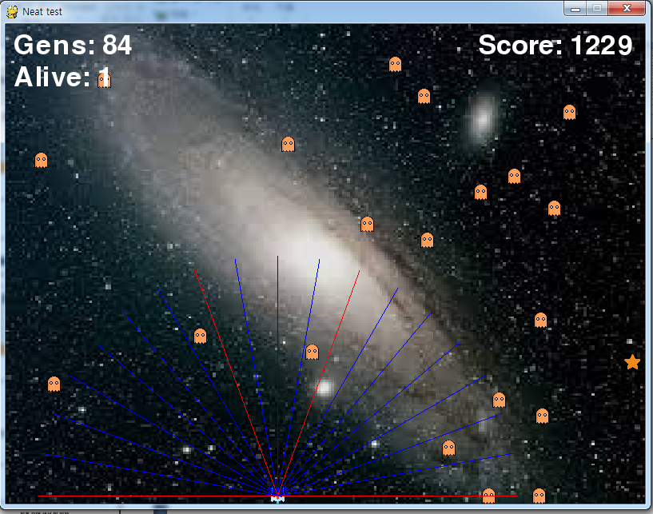
After generations……

Slide 19
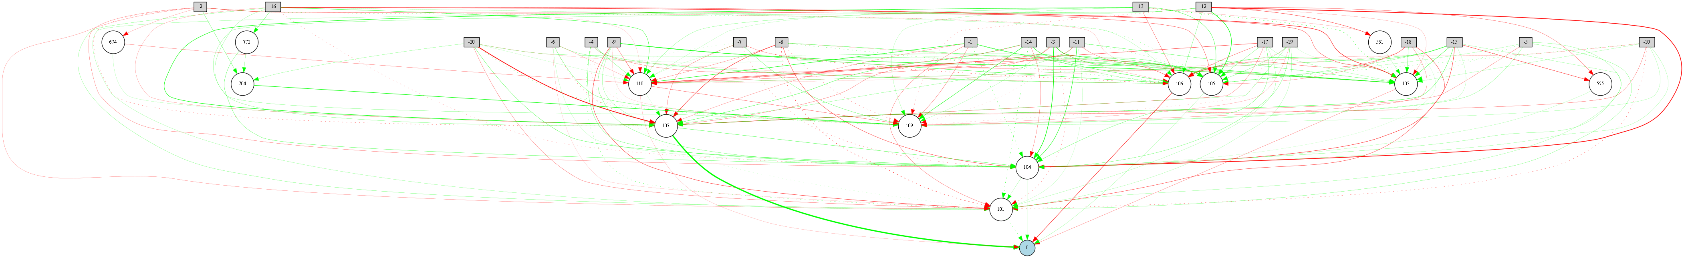

Slide 20
Classical NN modeling
Train model by feeding data.
Predefine hyper parameters
(hidden layers, hidden nodes, drop out)…
Examine performance and determine whether use it or not.

Slide 21
[NEAT]
fitness_criterion = max
fitness_threshold = 20000
pop_size = 50
reset_on_extinction = False
[DefaultGenome]
# node activation options
activation_default = tanh
activation_mutate_rate = 0.0
activation_options = tanh
# node aggregation options
aggregation_default = sum
aggregation_mutate_rate = 0.0
aggregation_options = sum
# node bias options
bias_init_mean = 0.0
bias_init_stdev = 1.0
bias_max_value = 30.0
bias_min_value = -30.0
bias_mutate_power = 0.5
bias_mutate_rate = 0.7
bias_replace_rate = 0.1
# genome compatibility options
compatibility_disjoint_coefficient = 1.0
compatibility_weight_coefficient = 0.5
# connection add/remove rates
conn_add_prob = 0.5
conn_delete_prob = 0.5
# connection enable options
enabled_default = True
enabled_mutate_rate = 0.01
feed_forward = True
initial_connection = full
# node add/remove rates
node_add_prob = 0.2
node_delete_prob = 0.2
# network parameters
num_hidden = 10
num_inputs = 20
num_outputs = 1
# node response options
response_init_mean = 1.0
response_init_stdev = 0.0
response_max_value = 30.0
response_min_value = -30.0
response_mutate_power = 0.0
response_mutate_rate = 0.0
response_replace_rate = 0.0
# connection weight options
weight_init_mean = 0.0
weight_init_stdev = 1.0
weight_max_value = 30
weight_min_value = -30
weight_mutate_power = 0.5
weight_mutate_rate = 0.8
weight_replace_rate = 0.1
[DefaultSpeciesSet]
compatibility_threshold = 3.0
[DefaultStagnation]
species_fitness_func = max
max_stagnation = 30
species_elitism = 2
[DefaultReproduction]
elitism = 2
survival_threshold = 0.2
Neat modeling
[NEAT]
fitness_criterion = max
fitness_threshold = 20000
pop_size = 50
reset_on_extinction = False
[DefaultGenome]
# node activation options
activation_default = tanh
activation_mutate_rate = 0.0
activation_options = tanh
# node aggregation options
aggregation_default = sum
aggregation_mutate_rate = 0.0
aggregation_options = sum
# node bias options
bias_init_mean = 0.0
bias_init_stdev = 1.0
bias_max_value = 30.0
bias_min_value = -30.0
bias_mutate_power = 0.5
bias_mutate_rate = 0.7
bias_replace_rate = 0.1
# genome compatibility options
compatibility_disjoint_coefficient = 1.0
compatibility_weight_coefficient = 0.5
# connection add/remove rates
conn_add_prob = 0.5
conn_delete_prob = 0.5
# connection enable options
enabled_default = True
enabled_mutate_rate = 0.01
feed_forward = True
initial_connection = full
# node add/remove rates
node_add_prob = 0.2
node_delete_prob = 0.2
# network parameters
num_hidden = 10
num_inputs = 20
num_outputs = 1
# node response options
response_init_mean = 1.0
response_init_stdev = 0.0
response_max_value = 30.0
response_min_value = -30.0
response_mutate_power = 0.0
response_mutate_rate = 0.0
response_replace_rate = 0.0
# connection weight options
weight_init_mean = 0.0
weight_init_stdev = 1.0
weight_max_value = 30
weight_min_value = -30
weight_mutate_power = 0.5
weight_mutate_rate = 0.8
weight_replace_rate = 0.1
[DefaultSpeciesSet]
compatibility_threshold = 3.0
[DefaultStagnation]
species_fitness_func = max
max_stagnation = 30
species_elitism = 2
[DefaultReproduction]
elitism = 2
survival_threshold = 0.2
Set parameters for
Neat.
( Input shape, output shape, mutate rate....)
Simulating
Get best genomes

Slide 22

Thank you for watching me!!
https://github.com/ydy1412/pygame_with_ML.git

Slide 23
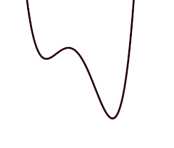
Classical ANNA modeling
Set hyper parameter
Gradient Descent

Slide 24
Neat
(selection + cross over)
Generate genomes
Selection
Cross over
Selection
Cross over

Slide 25
Neat
(selection + cross over)
Selection
Cross over
Selection
Cross over
Selection

Slide 26
Neat
(selection + cross over + _mutate)
Selection
Cross over + mutate
Selection
Cross over + mutate
Cross over + mutate

Slide 27
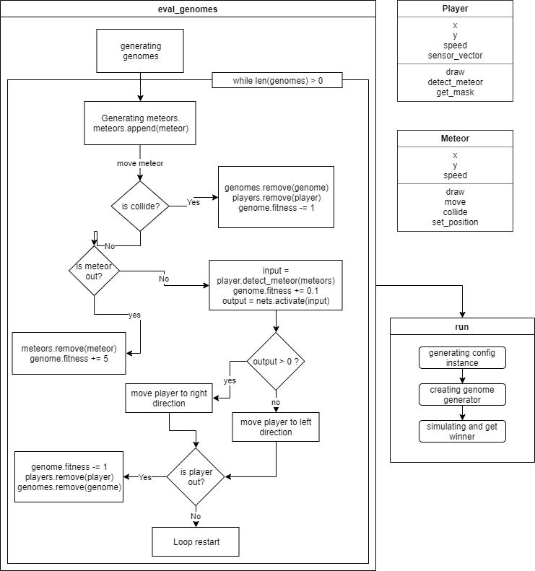
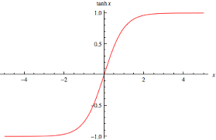
Flow chart

Slide 28
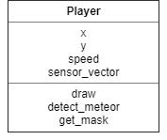
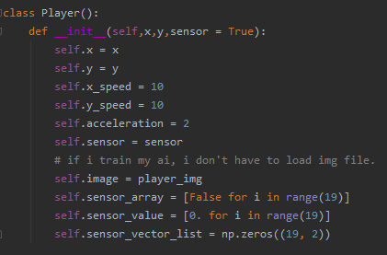
Code
Sensor on/off
button
Distance From
meteor
Sensor vector
array

Slide 29
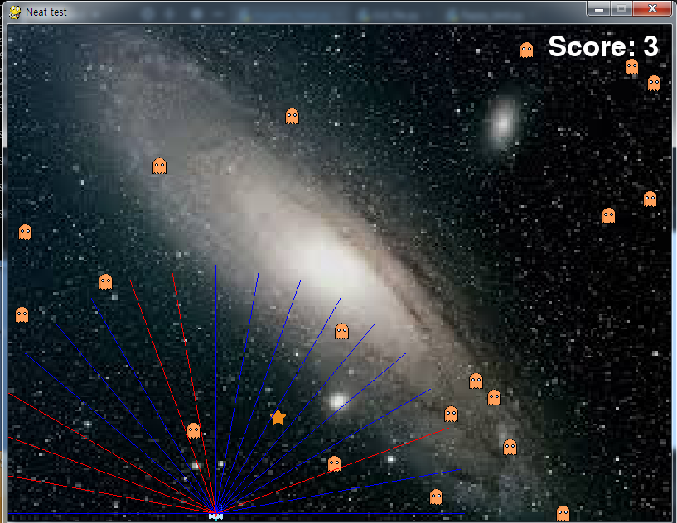
Code
self.sensor_array[2] == True
Self.sensor_value[2] == distance from meteor
Self.sensor_vector_list[2] = [a,b]

Slide 30
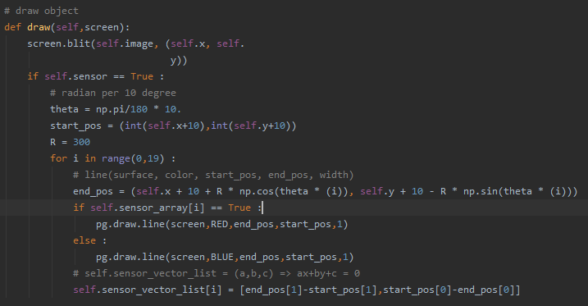
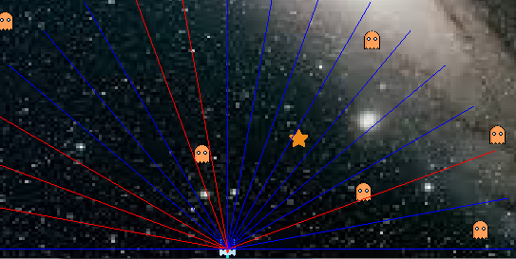
Code

Slide 31
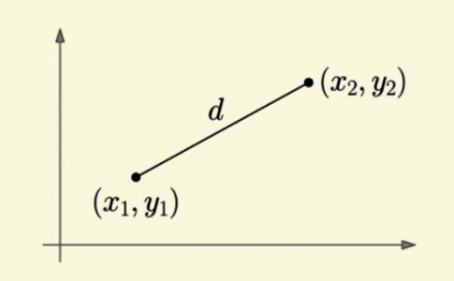
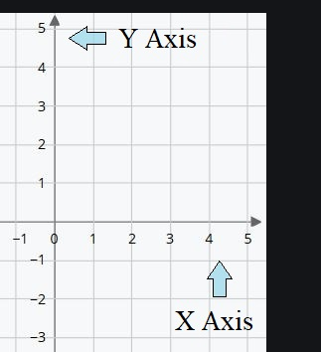
Code
x1, y1 : sensor’s start point
x2, y2 : sensor’s end point
Vector = (x2-x1, y2-y1)
But !!!!
<Original Cartesian>
<Pygame Cartesian>
Vector = (x2-x1, y1-y2)

Slide 32
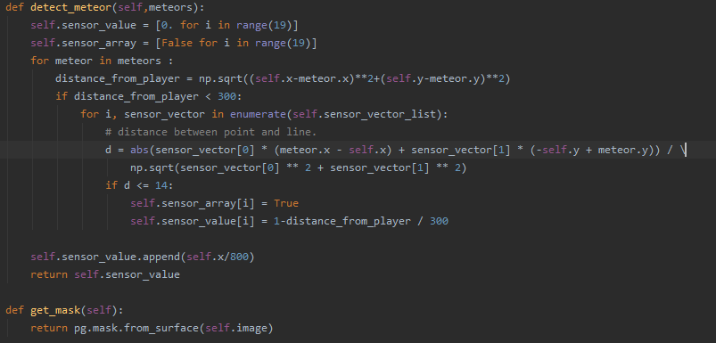
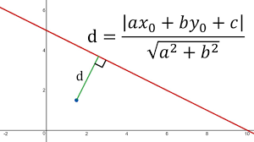
Code
Meteors list that has meteor objects.
Scaling

Slide 33
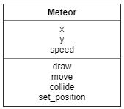
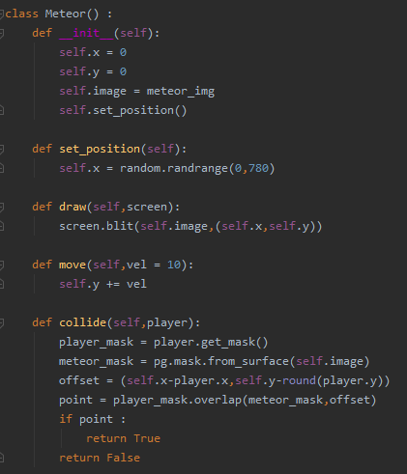
Code
Just for random position
Hitbox

Slide 34
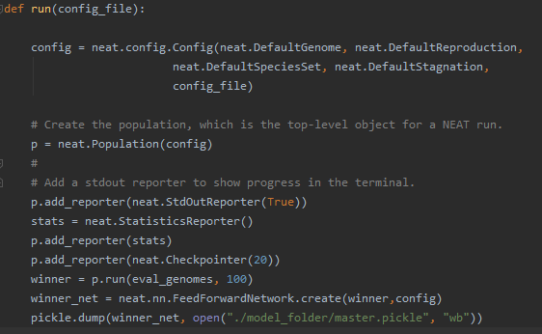
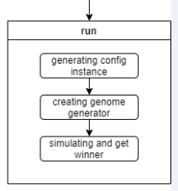
Code

Slide 35
Neat parameter Config file
[NEAT]
fitness_criterion = max
fitness_threshold = 20000
pop_size = 50
reset_on_extinction = False
[DefaultGenome]
# node activation options
activation_default = tanh
activation_mutate_rate = 0.0
activation_options = tanh
# node aggregation options
aggregation_default = sum
aggregation_mutate_rate = 0.0
aggregation_options = sum
# node bias options
bias_init_mean = 0.0
bias_init_stdev = 1.0
bias_max_value = 30.0
bias_min_value = -30.0
bias_mutate_power = 0.5
bias_mutate_rate = 0.7
bias_replace_rate = 0.1
# genome compatibility options
compatibility_disjoint_coefficient = 1.0
compatibility_weight_coefficient = 0.5
# connection add/remove rates
conn_add_prob = 0.5
conn_delete_prob = 0.5
# connection enable options
enabled_default = True
enabled_mutate_rate = 0.01
feed_forward = True
initial_connection = full
# node add/remove rates
node_add_prob = 0.2
node_delete_prob = 0.2
# network parameters
num_hidden = 10
num_inputs = 20
num_outputs = 1
# node response options
response_init_mean = 1.0
response_init_stdev = 0.0
response_max_value = 30.0
response_min_value = -30.0
response_mutate_power = 0.0
response_mutate_rate = 0.0
response_replace_rate = 0.0
# connection weight options
weight_init_mean = 0.0
weight_init_stdev = 1.0
weight_max_value = 30
weight_min_value = -30
weight_mutate_power = 0.5
weight_mutate_rate = 0.8
weight_replace_rate = 0.1
[DefaultSpeciesSet]
compatibility_threshold = 3.0
[DefaultStagnation]
species_fitness_func = max
max_stagnation = 30
species_elitism = 2
[DefaultReproduction]
elitism = 2
survival_threshold = 0.2

Slide 36
Code

Slide 37
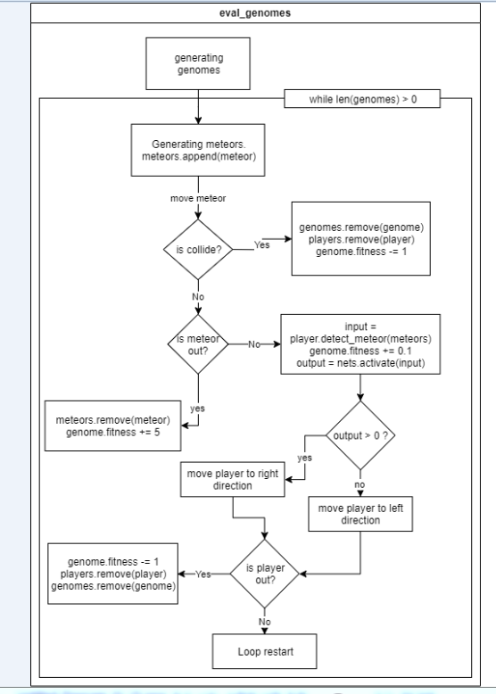
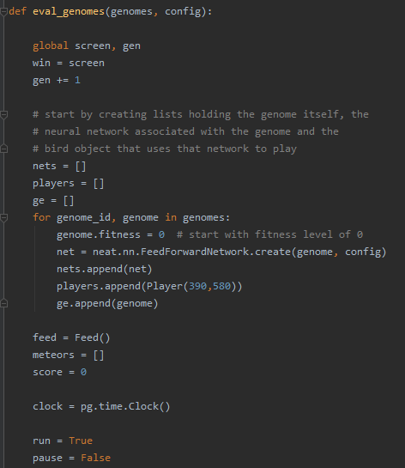
Code

Slide 38
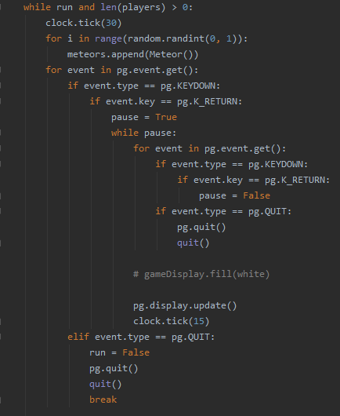
Code

Slide 39
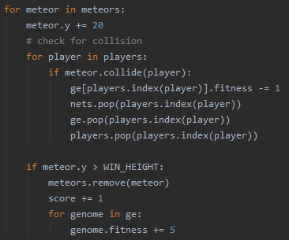
Code

Slide 40
Code

Slide 41
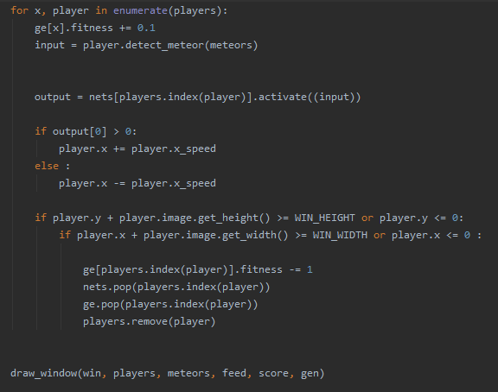
Code

Slide 42
Code

Slide 43
Code

Slide 44
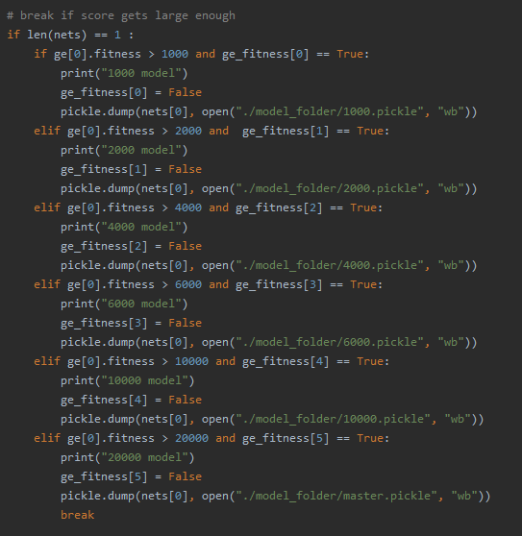
Save models using pickle

