Slide 1

RLTS4Myanmar
Real-Time Logistics Monitoring for Myanmar Trading
A rapid, AI-assisted prototype for cross-border cargo tracking under volatile connectivity
Group 3 Members :
Aint Kyi Phyu Sin
Su Yee Hlaing
Aung Ko Ko Oo
Phyo Myat Oo
Thein Kyaw Lwin
Htun Aung Kyaw
Pyae Phyo Paing
Aung Ko Ko Oo
Paing Phyo Oo
Aung Chan Nyein
B2 Assignment 5 · AI Engineering for Software Development · 20 September 2026

Slide 2





Agenda
01
Introduction
What RLTS-MM is, and what it had to do
02
Background Information
The problem, and the real systems we studied
03
Methodology & Technical Stack
Architecture, tools, and the offline-sync design
04
Results & Outputs
What actually runs, live, on real devices
05
Discussion, Conclusion & Future Work
What we'd tell a reviewer, honestly
RLTS-MM · B2 Assignment 5
2 / 15

Slide 3


01 · INTRODUCTION
What is RLTS-MM?
A working prototype that tracks cargo trucks moving along Myanmar's key cross-border trade corridors — built end-to-end using AI-assisted “vibe coding” rather than hand-written from scratch.
Objective
Scope
Four Roles
Architect the system, write effective prompts, and integrate AI-generated components into one working application.
Two real trade corridors: Yangon → Muse (China) and Yangon → Myawaddy (Thailand).
Admin, Data Entry Clerk, Trader, and Driver — each with its own RBAC-gated view.
RLTS-MM · B2 Assignment 5
3 / 15

Slide 4



01 · INTRODUCTION
Core Requirements
Role-Based Access Control
Tracking Dashboard
Admin, Trader, and Driver (plus Clerk) each see only what their role permits — enforced server-side, not just hidden in the UI.
A visual milestone timeline (Booked → Delivered) plus a simulated live GPS map of the truck.
Gate & Route Control
Offline Capability
Admin toggles Muse / Myawaddy / Chinshwehaw gate status; affected traders are alerted instantly.
Driver actions queue locally the instant they're made, and sync automatically once reconnected.
RLTS-MM · B2 Assignment 5
4 / 15

Slide 5



02 · BACKGROUND
The Problem: Volatility by Design
Cargo moving along Myanmar's Northern (China) and Eastern (Thailand) corridors faces operational hurdles that most commercial telematics platforms simply aren't built for.
Unpredictable Closures
Prolonged Inspections
Network Blackouts
Information Asymmetry
Border gates and mountain bypasses close abruptly — policy shifts, customs disputes, regional instability.
Military, customs, and regional checkpoints cause unannounced bottlenecks.
The Shan Hills and Dawna Range create extended zero-signal dead zones.
Traders lose all visibility the moment cargo leaves the depot.
RLTS-MM · B2 Assignment 5
5 / 15

Slide 6

02 · BACKGROUND
Real Systems, Not Just Prompts
The offline-first design borrows specific, cited patterns from field-proven eLMIS/SCM platforms — their actual sync code was read, not just their names.
Open mSupply
Logistimo
Append-only changelog, idempotent sync de-duplication, client-vs-server timestamp separation.
Structured-SMS fallback channel for extreme, total-blackout connectivity loss.
OpenLMIS
OpenIMIS (Flutter apps)
Design rule: never let server data silently overwrite a field operational log.
Connectivity-status stream pattern and a lightweight localization approach.
RLTS-MM · B2 Assignment 5
6 / 15

Slide 7






03 · METHODOLOGY
System Architecture
Admin
(Web)
Data Entry
Clerk (Web)
Trader
(Web)
Driver
(Web PWA)
Driver
(Native Android)
Shared Backend API + Server-Side Data Store
One real server every client polls & writes to — not a per-browser demo state
Google Cloud Compute Engine VM · pm2
RLTS-MM · B2 Assignment 5
7 / 15

Slide 8

03 · METHODOLOGY
Technology Stack
Web Frontend
Offline Queue (Web)
Native Driver App
Next.js 14, React, Tailwind CSS
Dexie.js over IndexedDB
Flutter + Dart — Android tested
Backend
Deployment
Route Geometry
Next.js API routes on Node, file-backed store
GCP Compute Engine (Ubuntu) + pm2
OSRM — queried once offline, baked in as static data
RLTS-MM · B2 Assignment 5
8 / 15

Slide 9


03 · METHODOLOGY
Offline-First Sync Design
The three principles borrowed directly from Open mSupply's changelog design:
1
2
3
Append-Only Event Log
Idempotent Apply via UUID
client_recorded_at ≠ server_synced_at
Checkpoint events are only ever inserted, never edited or overwritten — the server never silently rewrites a driver's field record.
Every event carries a client-generated UUID. A retried sync batch over unstable 2G can't create duplicate history.
A truck out of contact for hours still shows its checkpoints in the order they actually happened, not a burst at reconnection.
RLTS-MM · B2 Assignment 5
9 / 15

Slide 10
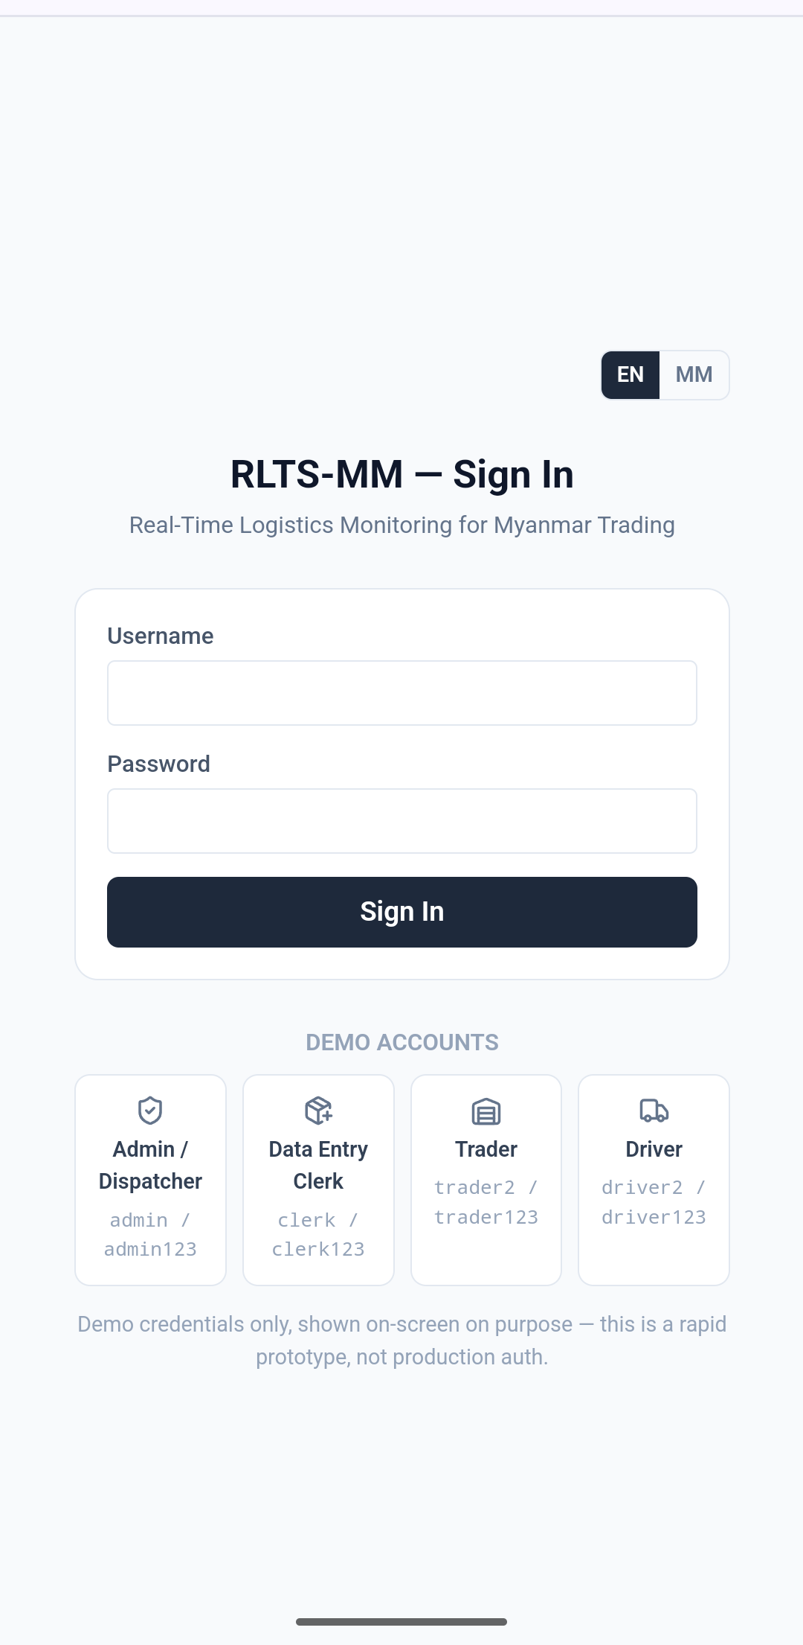
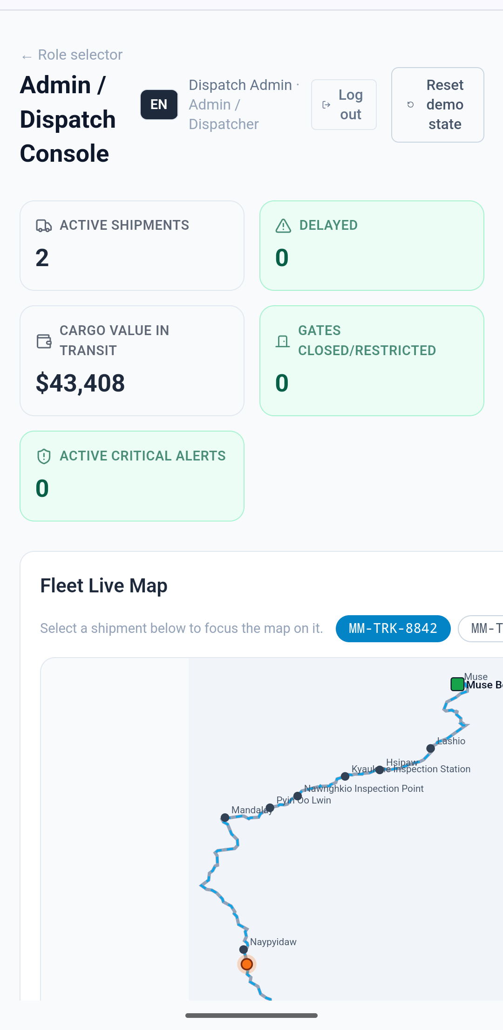
04 · RESULTS & OUTPUTS
Results: Web Portal
Role-based sign-in — 4 accounts, each redirected to its own page
Admin: live KPI cards + a road-following route map, selectable per shipment
RLTS-MM · B2 Assignment 5
10 / 15

Slide 11
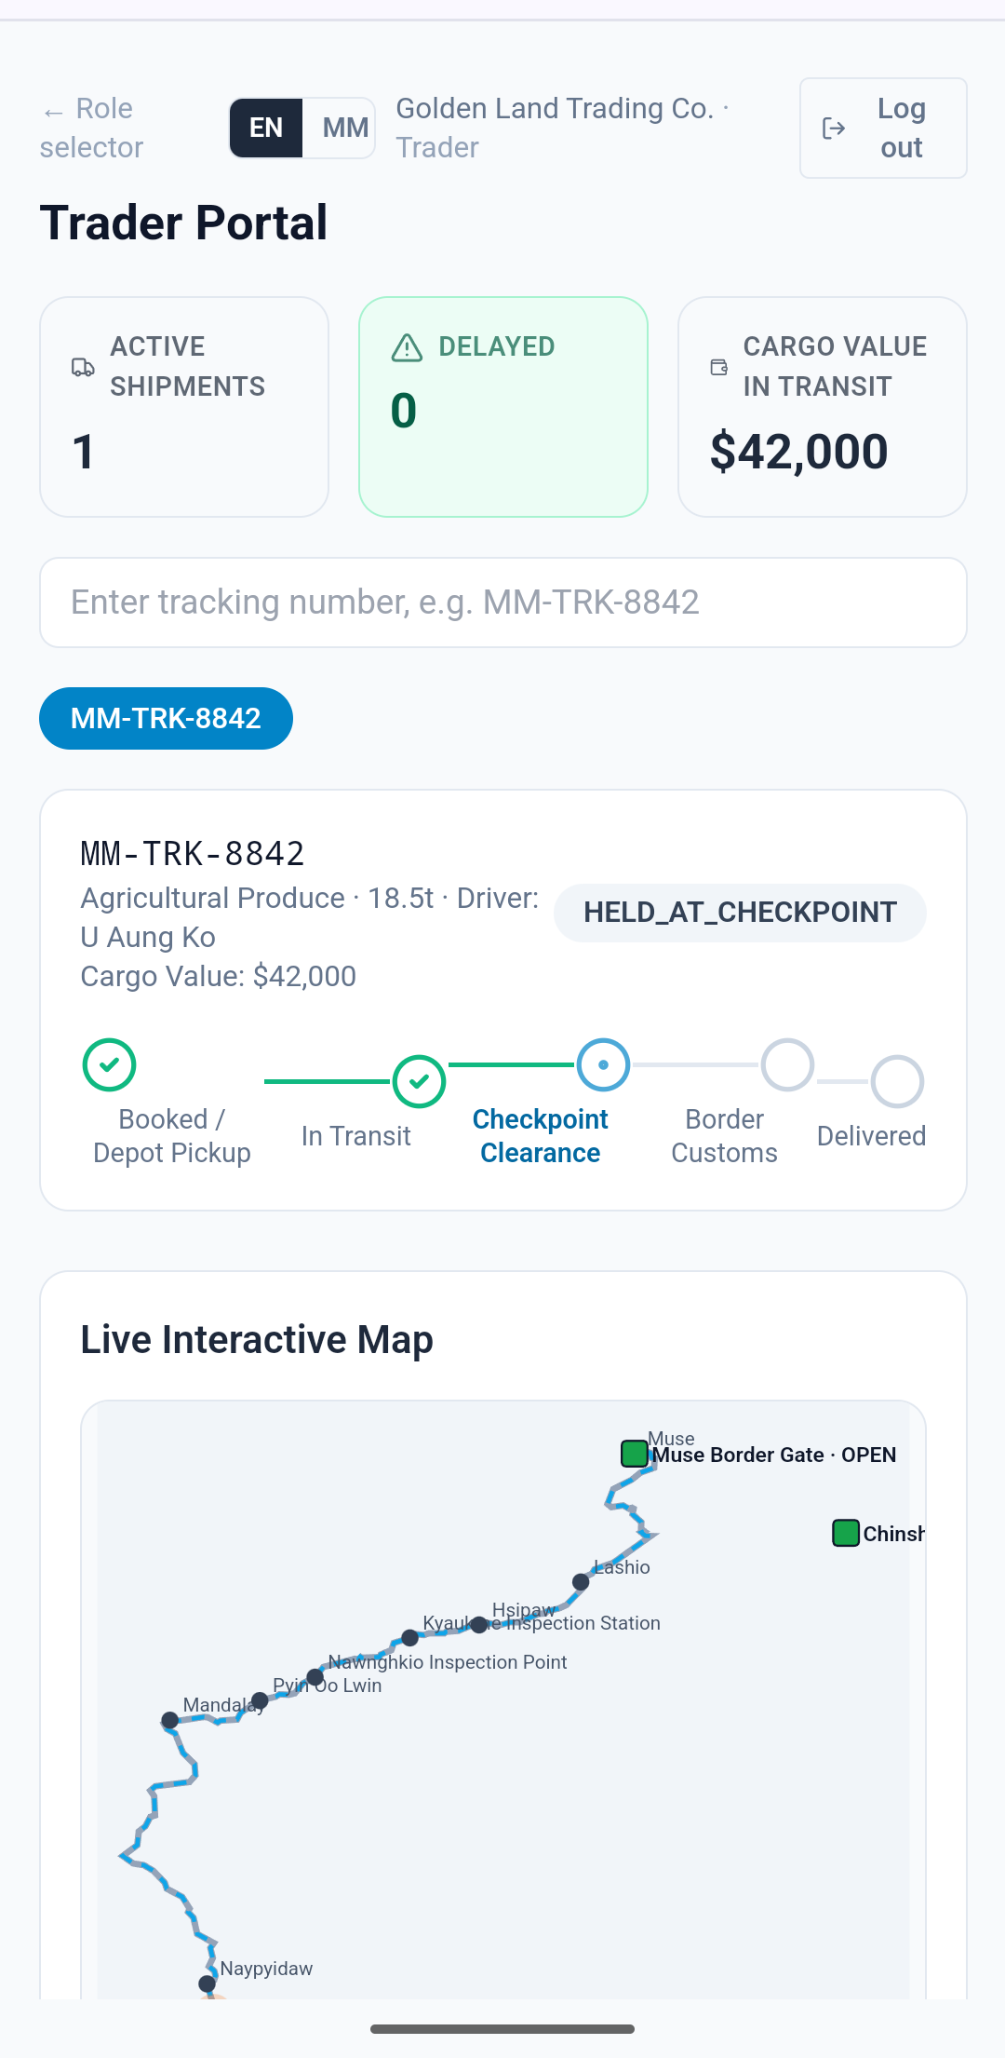

04 · RESULTS & OUTPUTS
Results: Trader Portal
Milestone Stepper
Booked → In Transit → Checkpoint → Customs → Delivered, live.
Multi-Currency Cargo Value
USD, CNY, or MMK entered at intake, formatted correctly on every screen.
Real-Time Critical Alerts
Gate closures reach the Trader independent of the driver's own connectivity.
Scoped, Not Fleet-Wide
Each trader account only ever sees its own shipments and cargo value.
RLTS-MM · B2 Assignment 5
11 / 15

Slide 12
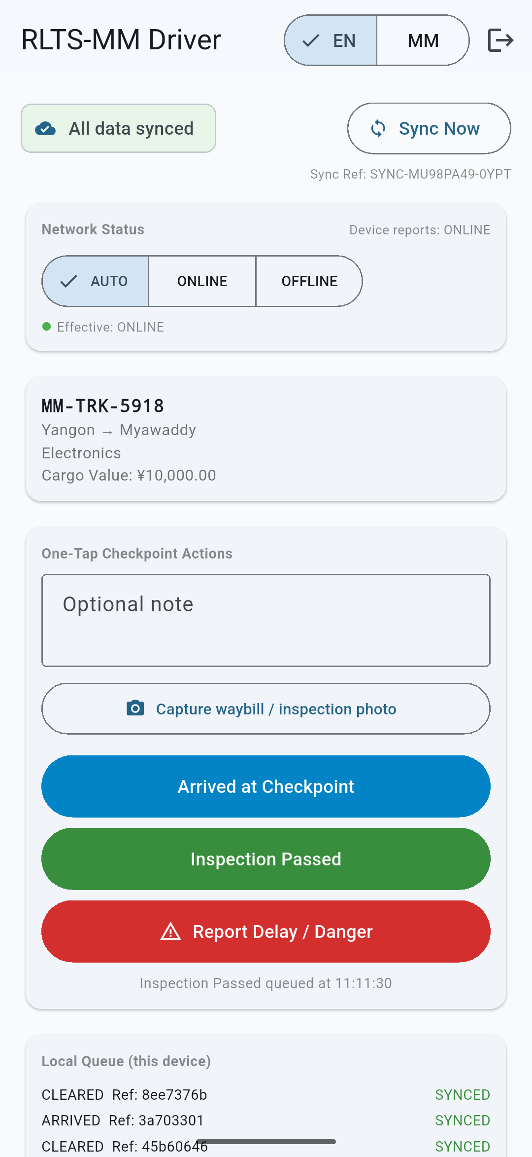
04 · RESULTS & OUTPUTS
Results: Native Driver App & Live Deployment
Android
NATIVE APP — TESTED ON EMULATOR
2 → 1
CLIENTS (NATIVE + WEB) → ONE SHARED BACKEND
✓
SYNC NOW / SYNC REF VERIFIED AGAINST LIVE SERVER
A checkpoint logged from this native app was confirmed, via a direct API check, to update the shipment status seen on the web Trader view — proving one real backend, not two separate demos.
Live: 136.85.81.202:3000
RLTS-MM · B2 Assignment 5
12 / 15

Slide 13


05 · DISCUSSION
AI Engineering Reflection
What Worked
Known Limitations
Vibe-coded iteratively with Claude across the full stack, not a single one-shot prompt
Real reference codebases (Open mSupply, OpenIMIS) were read and cited, not just named
End-to-end test scripts surfaced a real gap — a missing DELIVERED status transition — before it reached a live demo
Idempotent sync was verified directly: posting the same event twice only ever applies once
Demo-only authentication — plaintext credentials, no hashing, not production-grade
Backend is a file-backed store, not a real database — fine for a demo, not at scale
Currency conversion uses static, non-live exchange rates
Myanmar translations are AI-generated and not yet reviewed by a native speaker
RLTS-MM · B2 Assignment 5
13 / 15

Slide 14


05 · DISCUSSION
Conclusion & Future Work
A working, tested, multi-role, multi-platform logistics prototype — deployed live, not just designed on paper.
FUTURE WORK
Migrate to Supabase / Postgres for real persistence and Realtime push
Add dwell-time and average-transit-time KPIs once delivery timestamps exist
Complete the shipment lifecycle with a real DELIVERED transition
Build and test the native app on iOS, not just Android
Replace demo auth with real Supabase Auth against existing RBAC roles
Native-speaker review of all Myanmar-language UI strings
RLTS-MM · B2 Assignment 5
14 / 15

Slide 15

Thank You
Questions & Live Demo
RLTS-MM · 136.85.81.202:3000 · B2 Assignment 5

