Slide 1

University of Technology (Yatanarpon Cyber City)
Faculty of Information and Communication Technology
University Chatbot using Artificial Intelligence Markup Language
Date: 28.1.2021

Slide 2
Group Member
Ma Cho Zin Oo
Ma Cho Wah
Ma Hnin Ei Ei Cho
Ma Phyo Hay Mar Wai
Ma May Myat Myat Khine
Ma Hay Man Htun

Slide 3
Abstract
Chatbots are conversational systems that can do chat interactions with human automatically.
Most of the chatbots utilize the algorithms of artificial intelligence (AI) in order to get the required responses.
In this project, we developed the design of a University Chatbot about university information in Myanmar Language based on Artificial Intelligence Markup Language.

Slide 4
Introduction
Conversational agents become essential by interacting of machines with the desired users to provide natural language interfaces.
The role of chatbots in the information technology and communication is widely in used.
Many chatbots are created day by day through marketing, medical, education and banking.
In educational system, it is essential for teaching, learning and searching the desired information for a specific area.

Slide 5
Artificial Intelligence Markup Language
AIML is an XML based markup language for specifying chatbot content.
AIML consists of data objects called AIML objects, which are made up of units called topics and categories.
Categories are the basic units of knowledge in AIML.
One category is a rule for matching an input and converting to an output, and consists of a pattern, which represents the user input, and a template, which responses the answer.
The AIML pattern is simple and consists of words, spaces, and the wildcard symbols _ and *.

Slide 6
AIML Categories
There are three AIML types:
  atomic categories,
  default categories, and
  recursive categories

Slide 7
Atomic Category
Atomic categories are those with patterns that do not have wildcard symbols, _ and *.
<category> <pattern> မင်္ဂလာပါ </pattern> <template> ဟုတ်ကဲ့ မင်္ဂလာပါရှင့် </template> </category>

Slide 8
Default Category
Default categories include wildcard symbols * or _.
<category> <pattern> _ အဆောင်ပေး * </pattern> <template> ဟုတ်ကဲ့ အဆောင်ပေးပါတယ်။ </template> </category>

Slide 9
Recursive Category
Recursive categories are the categories with templates <srai> and <sr> tags, which represent recursive artificial intelligence and symbolic reduction.
Recursive categories involve many applications:
  (i) symbolic reduction
(ii) divide and conquer
    (iii)synonyms resolution

Slide 10
Symbolic Reduction
<category>
<pattern> တီ ချယ် နှင်း အေး သန့် ကို သိ လား </pattern>
<template> သိပါတယ်။ ICT ဌာန ရဲ့ ဌာနမှူး ဖြစ်ပါတယ်။ </template>
</category>
<category>
<pattern> တီချယ်အေးဝေဉီးကိုသိလား </pattern>
<template> သိပါတယ်။ CE ဌာန ရဲ့ ဌာနမှူးဖြစ် ပါတယ်။ </template>
</category>
<category>
<pattern> * ကို သိ လား </pattern>
<template> <srai><star/> ကို သိ လား </srai> </template>
</category>

Slide 11
Divide and Conquer
<category>
<pattern> ကျေးဇူးပါရှင့် </pattern>
<template> ဟုတ်ကဲ့ ပြန်လည်တွေ့ဆုံဖို့မျှော်လင့်ပါတယ်။ </template>
</category>
<pattern> ကျေးဇူးပါ * </pattern>
<template><srai> ကျေးဇူးပါရှင့် </srai></template>
</category>

Slide 12
Synonym Resolution
<category>
<pattern> ကျောင်းလိပ်စာ သိချင်လို့ပါ </pattern>
<template>
ပြင်ဉီးလွင် မန္တလေးလမ်းမကြီး၊ မိုင်တိုင် ၂၈၊ ရတနာပုံမြို့သစ် အနီး၊ ပြင်ဉီးလွင်ခရိုင်၊ မန္တလေးတိုင်းဒေသကြီး ဖြစ်ပါတယ်။
</template>
</category>
<category>
<pattern> ကျောင်းကဘယ်မှာရှိတာလဲ။</pattern>
<template><srai> ကျောင်းလိပ်စာ သိချင်လို့ပါ </srai></template>
</category>

Slide 13
Flowchart of the System
Start
Accept User Query
Word Segmentation
Pattern
Matching
Knowledge Base
Response the query
End

Slide 14
Implementing the System
We have implemented a Myanmar interactive chatbot for university frequently asked questions.
According to the Artificial Intelligence Markup Language, we have used different AIML tags to get the user required information from the bot.
Word Segmentation :
Pattern Matching : use Python File by calling AIML interpreter
Evaluation : manual
https://github.com/stevenay/myan-word-breaker/find/master

Slide 15
AIML Tags Used In The System
No | Tags Used for AIML Categories
1 | <category> </category>
2 | <pattern> </pattern>
3 | <template> </template>
4 | <srai> </srai>
5 | <random> </random> with <li> </li>
6 | <set> </set>
7 | <get> </get>

Slide 16
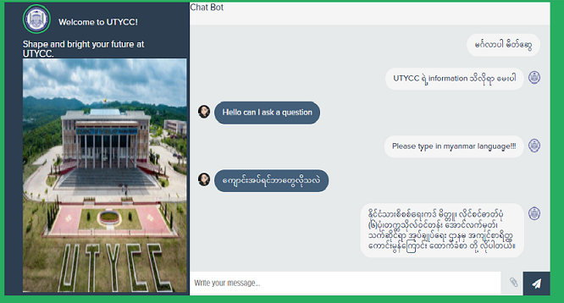
Sample output of the System

Slide 17
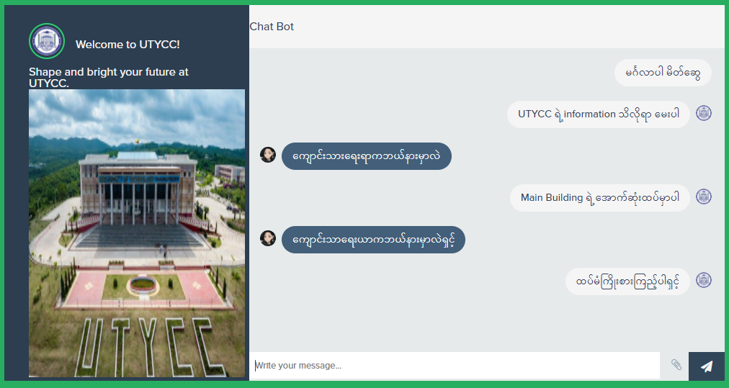
Mismatch Question Example

Slide 18
Testing and Evaluation
Rule-based chatbot contains a faster time-to- relevance,delivering a faster impact on user interaction.
This chatbot is one of rule-based chatbot and developed on AIML language for the UTYCC, PyinOoLwin.
The data include the university related questions and information that the students, teachers and parents frequently asked.
The number of question-answer pairs in the system that are utilized for different topics and type of categories are about 350.

Slide 19
Result
Topics | Number of Questions | Matched Answer | No Matched Answer | No Answer
Location and Address | 5 | 3 | 0 | 2
Academic | 10 | 7 | 2 | 1
Brief History | 7 | 4 | 2 | 1
Faculty and Staff | 5 | 3 | 1 | 1
Library | 5 | 2 | 3 | 0
Total | 32 | 19 | 8 | 5

Slide 20
Workload
Cho Zin Oo | Building Database, UI, Implementation, Testing
Cho Wah | Preparing data for Faculty & staff and Academic, Report, Testing
Hnin Ei Ei Cho | Building Database, Power Point, Implementation, Testing
Phyo Haymar Wai | Building Database, UI, Implementation, Testing
May Myat Myat Khine | Preparing data for Brief History and General, Evaluation, Testing
Hay Man Htun | Preparing data for Conference and Library, Report, Testing

Slide 21


