Slide 1


NLP Project Presentation
Group Members
Badounmar Ph.D(IT)-18 Nan Yu Hlaing Ph.D(IT)-16
Hnin Yu Hlaing Ph.D(IT)-10 Thida San Ph.D(IT)-12
Hlaing May Tin Ph.D(IT)-6 Zun Hlaing Moe Ph.D(IT)-17

Slide 2
Outline
Motivation
Introduction
Tacotron2
Dataset Preparation
Experiment
Implementation
Demonstration
Conclusion

Slide 3
Motivation
Myanmar TTS has been developed by statistical parametric speech synthesis method: HMM, DNN.
We focus Deep learning based end to end speech synthesis(Tactron2) with small corpus in our project.
To investigate end-to-end generated text-to-speech (TTS) model with syllable and word-level.
1
2
3

Slide 4
Introduction
1
The modern TTS trend is more complex.
End-to-End speech synthesis is a new research direction in the deep learning area in recent years.
In this project, we experimented TTS by Tacotron2 which is to synthesize speech directly from the characters.
2
3

Slide 5
Tacotron2
Text input
Linear-scale spectrogram
Tacotron: End-to-end Speech Synthesis
Pre-processing
Encoder
Decoder
Post-processing
Speech
Fig1: Block Diagram of Tacotron2

Slide 6
Data set preparation
1
Collected data from Grade 2 Myanmar textbook.
Prepared Myanmar sentences and audio files.
Applied input text as syllable and word-level.
Used a regular expression perl script developed by Saya Ye Kyaw Thu for the syllable segmentation.
Utilized speech data that has been recorded for Myanmar Braille TTS.
2
3
4
5

Slide 7
Implementation
We used Tensorflow framework to implement tacotron.
Other requirements: numpy, scikit-learn, librosa, falcon, tqdm, matplotlib.
Training time is a week for ten sentences.
The maximum input text length is 117.
1
2
3
4

Slide 8
Experiment
1
Syllable level
Word level
2

Slide 9
Syllable Level
Input text sentence
ဒုတိယတန်း မြန်မာ ဖတ်စာ ။
ဒု တိ ယ တန်း မြန် မာ ဖတ် စာ ။
Segmented sentence
Text and audio pair for Training
ဒု တိ ယ တန်း မြန် မာ ဖတ် စာ ။,g2_0001.wav,
အ ခန်း ၁ ။ ,g2_0002.wav,
Train data with tacotron2 model.
Linear spectrogram , Mel spectrogram and alignment of encoder and decoder

Slide 10
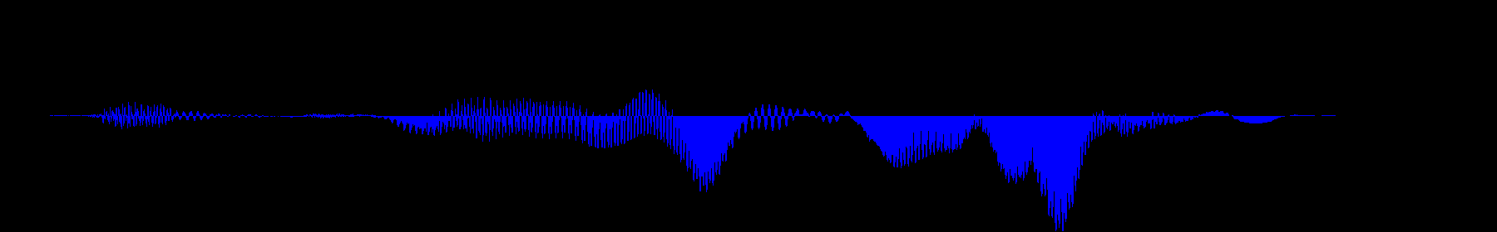
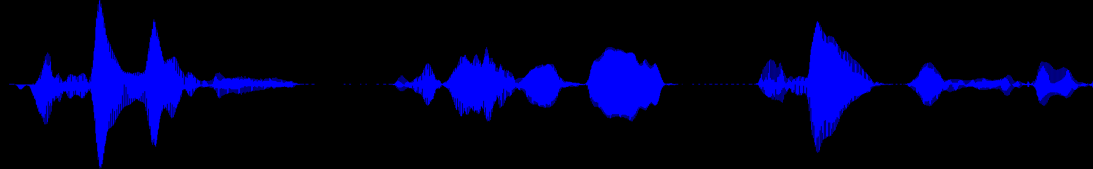
Syllable Level Test Output
Test sentence
အ ခန်း တစ် ။
Fig2: Test output Wave form
Test sentence
ဘယ် ကို သွား ခဲ့ သ လဲ ။
Fig3: Test output Wave form

Slide 11
Experiment
1
Syllable level
Word level
2

Slide 12
Word Level Test Output
Test sentence
အ ခန်း တစ် ။
Fig4: Test output Wave form
Test sentence
ဘယ် ကို သွား ခဲ့ သ လဲ ။
Fig5: Test output Wave form

Slide 13
Evaluation
Fig6: MOS results for test sentences

Slide 14
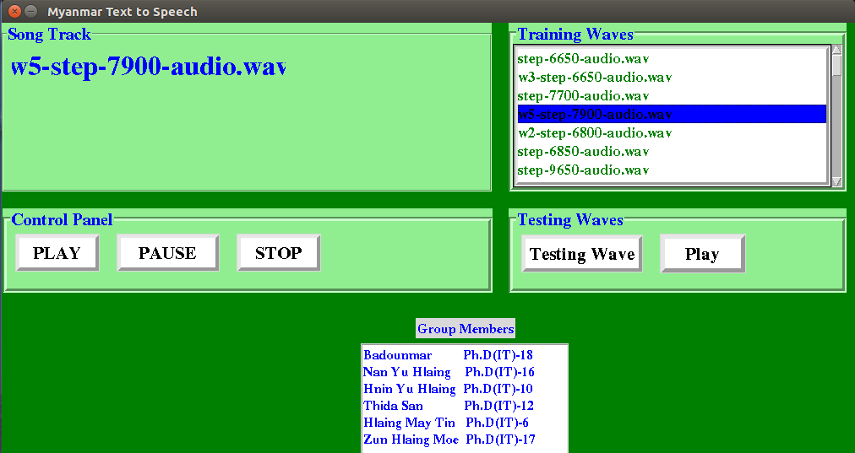
Demonstration
We created Myanmar Text to Speech User Interface for this project.
LET’S GO UI
Fig7: User Interface of this project

Slide 15
Conclusion
1
This mini project was contributed the evaluation of the end-to-end speech synthesis with tacorton model.
We evaluated end-to-end TTS with the small corpus by using ten sentences from Grade 2 Myanmar Basic Education Textbook.
Although the syllable-level achieved 3.8 MOS score, the word-level achieved 3.4 on closed tests with listeners.
syllable-level also obtained more clearance result than word-level.
Good speech output depends not only on recording condition but also on tone signature.
2
3
4
5

Slide 16


