Slide 1




myNER: Contextualized Burmese Named Entity Recognition with Bidirectional LSTM and fastText Embeddings via Joint Training with POS Tagging
Kaung Lwin Thant, Kwankamol Nongpong, Ye Kyaw Thu
Thura Aung, Khaing Hsu Wai, Thazin Myint Oo

Slide 2
Outline of Presentation
Introduction
Corpus Development
Methodology Overview
Experiment Setting
Results
Limitations
Future Works

Slide 3
Introduction
What is NER?
Identifies names, dates, orgs, locations
Extracts structure from unstructured text
Key NLP task for information extraction
Supports MT, QA, search, chatbots
Requires accurate, context-aware tagging
Modeled as token-level classification
Needs annotated corpora for training
Challenges in Burmese NER
Burmese is low-resource and underrepresented
Public annotated corpora are very limited
Complex script and rich morphology
No word boundaries (no whitespace)
Non-Latin script complicates preprocessing
Domain shifts affect entity tag consistency
Manual annotation is labor-intensive

Slide 4
Our Contributions
Word-level NER corpus named myNER_7tags
BIOES scheme + 7 NER tag categories
POS tags added for richer syntax signals
Corpus has 16,605 manually tagged sentences
Traditional CRF and NN-based BiLSTM-CRF models evaluated
Achieved up to 98% overall accuracy, SOTA results

Slide 5
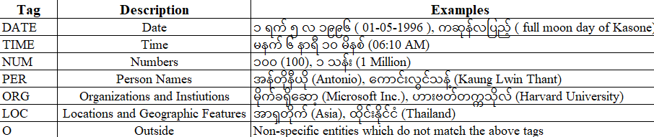
Corpus Development
Table 1: Tag Names, Description, and Examples of myNER Corpus
Built mostly upon the myPOS Corpus (version 3):Linguistically diverse and representative Burmese text.
Contains 16,605 manually annotated sentences, suitable for academic NLP experiments.

Slide 6
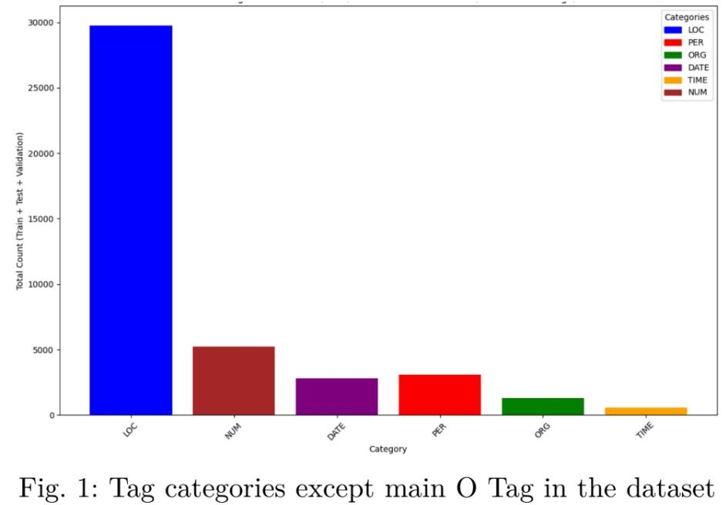
Corpus Development (Cont'd)
Token distribution shown in Fig. 1
13,000+ location names
5,000+ numbers (NUM)
3,000+ personal names (PER)
600+ organizations (ORG)
Tag imbalances are still challenging factor

Slide 7
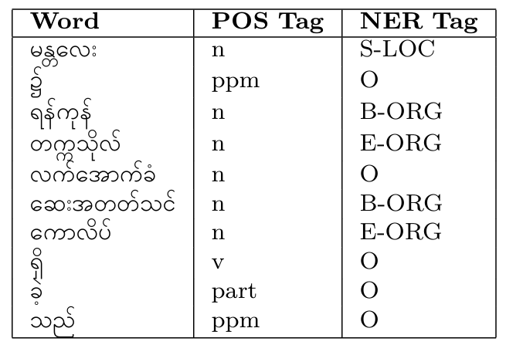
Corpus Development (Cont'd)
BIOES scheme marks entity boundaries
S-LOC = Single-token location
B-ORG/E-ORG = Multi-token organization
POS tags provide syntactic context
O = Non-entity tokens
TABLE 2: myNER sample data with CoNLL format

Slide 8
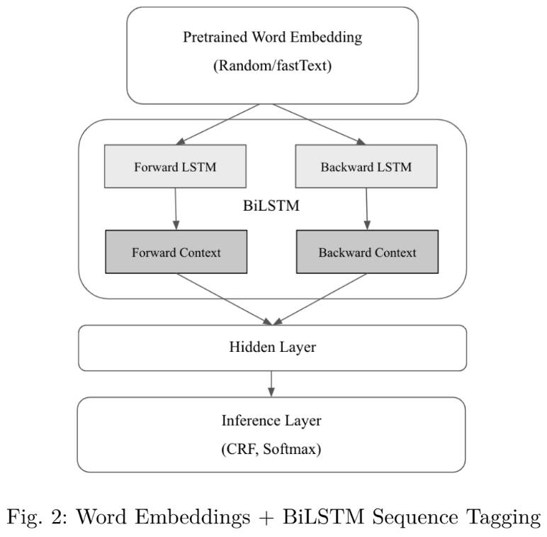
Methodology Overview
Input: Pretrained fastText embeddings
Context: BiLSTM (forward + backward)
Output: CRF/Softmax inference
Key: Joint POS+NER training

Slide 9
Joint Modeling for POS and NER Approach
Embedding Layer: fastText word vectors/random embedding
BiLSTM Layer captures sentence context
Shared Layer: used by both POS and NER
Trained together with shared BiLSTM encoder
Output Layer: two CRFs (one per task)
POS predicts grammar tags (noun, verb, etc.)
NER predicts entity types (PER, LOC, ORG)

Slide 10
fastText Embeddings
Subword-aware (handles OOV/rare words)
Morphology semantics in one model
300-dim vectors (Burmese Wikipedia)
Works in fixed or fine-tuned mode
Fine-tuning boosts task accuracy
Good fit for Burmese morphology

Slide 11
Traditional CRF Model with Feature Engineering
CRFs are probabilistic models used for structured prediction, well-suited for sequence labeling tasks like POS and NER.
Feature Engineering
Lexical Features:
Current, previous, and next words
First/last word indicators
Morphological Features:
Prefixes & suffixes (1–3 chars)
Hyphenation, numeric detection (supports DATE/NUM recognition)
fastText-enhanced:
Embedding vector average included as a dense feature
Adds semantic generalization to statistical structure

Slide 12
BiLSTM + CRF Architecture
BiLSTM-CRF architecture integrates contextual encoding with structured output prediction.
BiLSTM Encoder: Encodes contextual representations for each token.
CRF Layer: Models label transitions to ensure coherent tag sequences (avoids invalid transitions like I-LOC following B-PER).
Combines deep contextual understanding (BiLSTM) with global sequence optimization (CRF).
Significantly improves accuracy in tasks where label dependencies matter.

Slide 13
Experiment Setting
Training Environment
Platform: Kaggle
GPU: NVIDIA Tesla P100 (16 GB
Task Configurations
Single-task (NER)
Joint-task (NER + POS tagging)
Dataset Split
Split: 80% Train – 10% Validation – 10% Test

Slide 14
Experiment setting(Hyperparameters)
CRF (Traditional ML)
Library: CRFsuite
Embedding: Pretrained fastText (300-dim)
Feature set:
Prefixes/Suffixes (1–3 chars)
Word shape, numeric/hyphen flags
Position in sentence (first/last)
Context window (previous & next word)

Slide 15
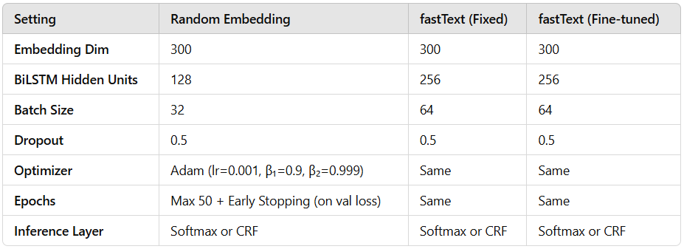
BiLSTM-Based Model Hyperparameters
Table 3: Hyperparameters of best-performing BiLSTM-based models
All models were implemented using the PyTorch deep learning framework.
Tuned hyperparameters for best model performance
Tested multiple embedding, hidden, batch, dropout configs

Slide 16
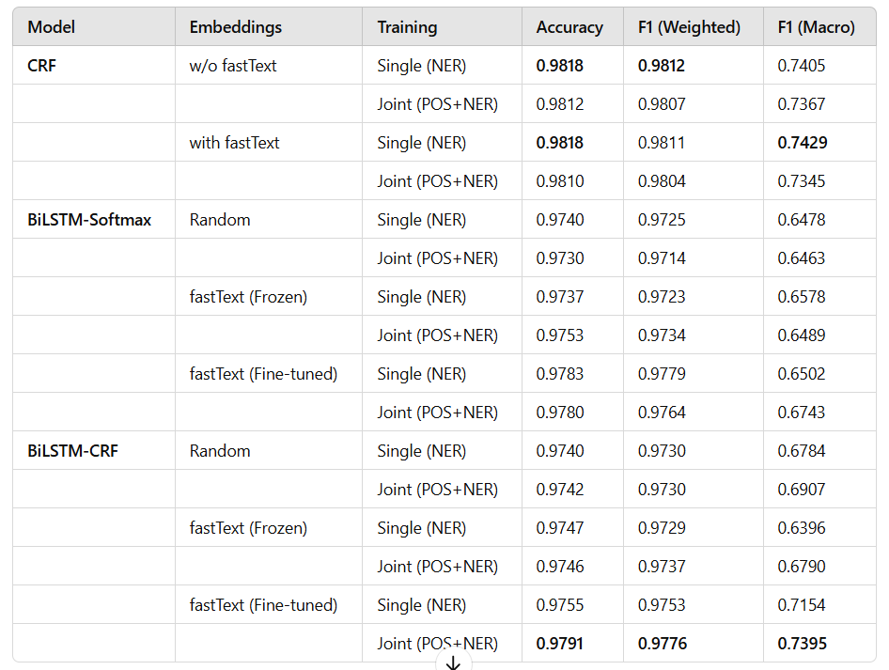
Results
The table compares NER performance across models using different training strategies, embeddings, and inference layers.
Three metrics were used: Accuracy, Weighted F1, and Macro F1
Table 4: Performance Comparison of Single NER
and Joint POS+NER Models

Slide 17
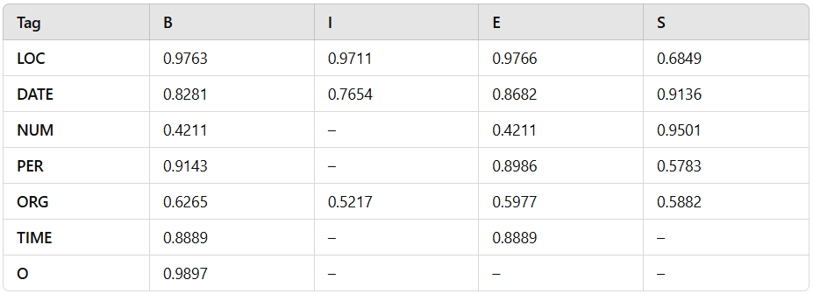
Tag-wise Evaluation Results
Table 5:Tag-wise F1-Scores for Joint BiLSTM-CRF Model with Fine-Tuned fastText Embeddings
Model captures LOC and DATE well with high F1.
Still promising performance on sparse tags like NUM and ORG despite imbalance.

Slide 18
Result Discussion
Best Macro F1: 0.7429 (CRF + fastText, single-task)
Best Weighted F1: 0.9811 — state-of-the-art result
Best Joint Model: BiLSTM-CRF + fine-tuned fastText
Macro F1 (joint model): 0.7395 — class-balanced performance
High-performing tags: LOC, DATE — due to higher frequency
Moderately performing tags: ORG, NUM — impacted by data sparsity
Joint training improves generalization with POS sharing

Slide 19
Limitations
Dataset Size: The dataset used was relatively limited in scale, which may restrict generalization across diverse linguistic patterns in Burmese.
Class Imbalance: A high dominance of the "O" tag and sparse samples for entities like TIME, ORG, and NUM affected macro-level performance.
Low-Frequency Tags: Tags with fewer training examples, such as NUM and TIME, led to noticeably lower macro F1 scores due to insufficient learning.
Handling OOV & Domain-Specific Terms: Despite fastText’s subword capability, the models still struggle with rare or domain-specific out-of-vocabulary words.
Training Efficiency of CRF: CRF-based models, though more accurate, require significantly higher training time (e.g., 257s vs. 34s for Softmax in joint setting), which limits scalability.

Slide 20
Future Works
Enhance Dataset Quality & Balance: Expand the corpus with more annotated data across diverse domains and apply class balancing techniques to improve performance on low-frequency tags (e.g., NUM, TIME, ORG).
Leverage Pretrained Language Models: Fine-tune large multilingual or Burmese-specific LLMs (e.g., mBERT, XLM-R) and explore transformer-based architectures for richer contextual understanding.
Integrate Linguistic Knowledge: Incorporate additional linguistic features such as syntactic dependencies, morphological patterns, or chunking to support learning.
Improve Model Efficiency: Explore lighter or quantized models for faster inference and real-world deployment in low-resource environments.

Slide 21
Thank You & Questions
I deeply appreciate your time and attention.
Contact Info:
Name: Kaung Lwin Thant (Matt)
Personal Email: kaunglwinthant@gmail.com

Slide 22
Reference
Hsu Myat Mo and Khin Mar Soe, "Named Entity Recognition for Myanmar Language," in Proceedings of the 2022 International Conference on Communication and Computer Research (ICCR 2022), Sookmyung Women's University, Seoul, Korea, 2022.
Rrubaa Panchendrarajan and Aravindh Amaresan, "Bidirectional LSTM-CRF for Named Entity Recognition," in Proceedings of the 32nd Pacific Asia Conference on Language, Information and Computation, Hong Kong, Dec. 2018. Available online
Zar Zar Hlaing, Ye Kyaw Thu, Thepchai Supnithi, and Ponrudee Netisopakul, "Improving neural machine translation with POS-tag features for low-resource language pairs," Heliyon, vol. 8, no. 8, p. e10375, 2022. DOI
Ye Kyaw Thu, Thura Aung, Thepchai Supnithi, "Neural Sequence Labeling Based Sentence Segmentation for Myanmar Language," in The 12th Conference on Information Technology and Its Applications (CITA 2023), Lecture Notes in Networks and Systems, vol. 734, Springer. DOIP.
Bojanowski, E. Grave, A. Joulin, and T. Mikolov, "Enriching word vectors with subword information," arXiv preprint arXiv:1607.04606, 2016. arXiv link
Hsu Myat Mo, Khin Thandar Nwet, and Khin Mar Soe, "CRF-Based Named Entity Recognition for Myanmar Language," in Genetic and Evolutionary Computing (ICGEC 2016), Advances in Intelligent Systems and Computing, vol. 536, Springer, 2017.
J. Lafferty, A. McCallum, and F. Pereira, "Conditional random fields: Probabilistic models for segmenting and labeling sequence data," in Proceedings of the 18th International Conference on Machine Learning, 2001.
J. Yang, S. Liang, and Y. Zhang, "Design challenges and misconceptions in neural sequence labeling," 2018.

