Slide 1

oppaWord: DAG-BiMM-LM based Myanmar Word Segmenter
(8th Seminar for Intern-3)
Ye Kyaw Thu Lab Leader, LU Lab., Myanmar
27 July 2025 (SUN)

Slide 2
Contents
Myanmar Word Segmentation
Core Algorithms
Overview of oppWord
Smart Space Remover
Syllable Breaking
DAG Construction
Bi-MM
N-gram LM
Viterbi Algorithm

Slide 3
Myanmar Word Segmentation
Challenge: No explicit word boundaries in Myanmar script (e.g., "ကျောင်းသား" = "ကျောင်း" + "သား").
Agglutinative morphology: Words formed by combining syllables.
Applications: NLP tasks like machine translation (MT), search engines, text-to-speech (TTS), automatic speech recognition (ASR), and Summarization.

Slide 4
Core Algorithms
Hybrid Approach
DAG Construction: Represent all possible segmentations.
Bi-MM Fallback: Bidirectional Maximum Matching for robustness.
N-gramLanguage Model
Syllable-level processing.
Multi-feature scoring (dictionary, frequency, LM).

Slide 5
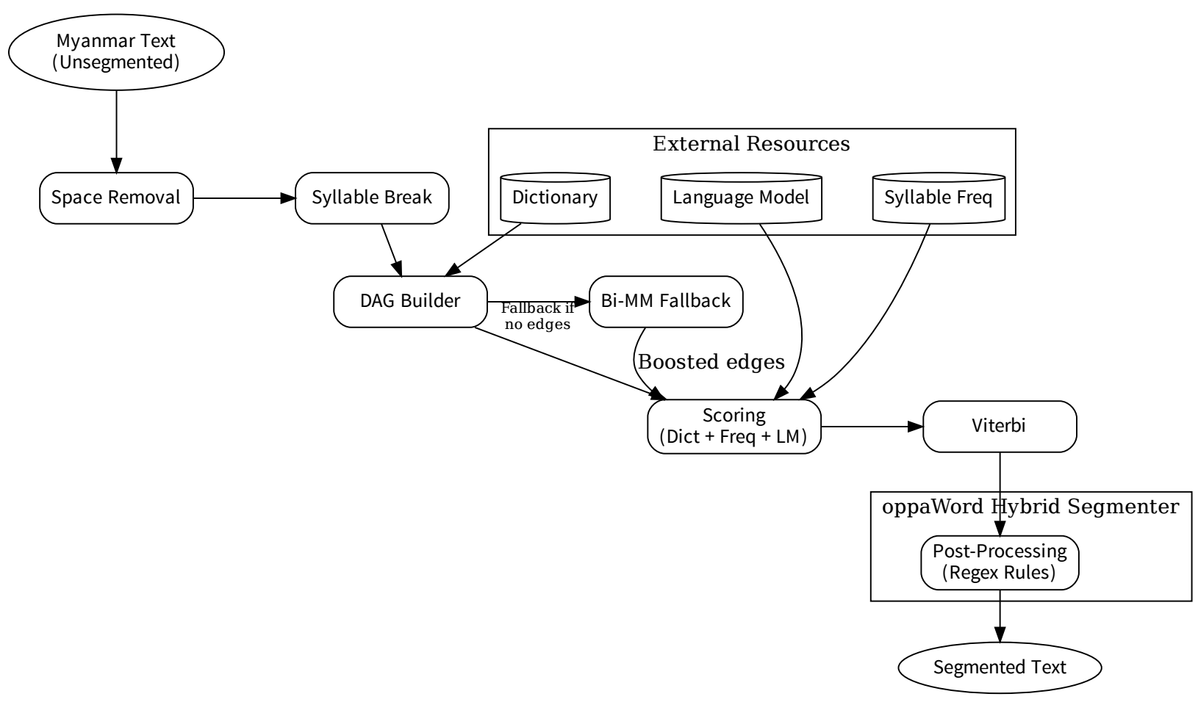
Overview of oppaWord

Slide 6
Smart Space Remover
Word Segmenter တွေကို input လုပ်တဲ့အခါမှာ space ဖြုတ်ပေးကြရတယ်
သို့သော် လက်တွေ့မှာ space အကုန်ဖြုတ်လိုက်ရင် နံပါတ် ကိစ္စတွေ၊ မြန်မာစာနဲ့အတူ ရောပါနေတဲ့ အင်္ဂလိပ်စာလုံးတွေ၊ တရုတ်စာလုံးတွေ၊ ဂျပန်စာလုံးတွေ၊ ထိုင်းစာလုံးတွေ ကိုရော ဘယ်လို လုပ်ကြမလဲ။
မော်ဒ်တွေထဲကို input လုပ်ရတဲ့အခါမှာ preprocessing တွေ လုပ်ပေးကြရတယ်
အဲဒီ ကိစ္စကို ဒီတခါမှာတော့ smart_space_remover.py နဲ့ ရှင်းခဲ့တယ်

Slide 7
Smart Space Remover
Chonburi ကိုသွားမယ့်နောက်လေယာဉ်မှာလက်မှတ်တစ်စောင်ပေးပါ
domain name တိုင်း Top level domain TLD name နဲ့အဆုံးသတ်ရပါတယ်
ဝမ် ၈၁၀၀ မှာမှတ်ပုံတင်ကြေးဝမ် ၈၀၀ ပေါင်းရင်စုစုပေါင်းဝမ် ၈၉၀၀ ကျပါတယ်
ဂျပန်တို့ကစင်္ကာပူကိုရှိုးနန်တိုး 昭南島 Shōnantō ဟုအမည်ပေးခဲ့ပြီး 昭和の時代に得た南の島 သို့ရှိုဝါခေတ်တွင်ရရှိခဲ့သောတောင်ဘက်ကျွန်းဟုအဓိပ္ပါယ်ရသည်
အမျိုးသားဦးရေ ၂၉ ဒသမ ၇၂ သန်းနှင့်အမျိုးသမီးဦးရေ ၃၀ ဒသမ ၀၆ သန်းရှိသည်
ဒီကြီးတဲ့ပစ္စည်းအတွက်ဆိုရင်တစ်နေ့ကို ၁.၅၀ ကျတယ်

Slide 8
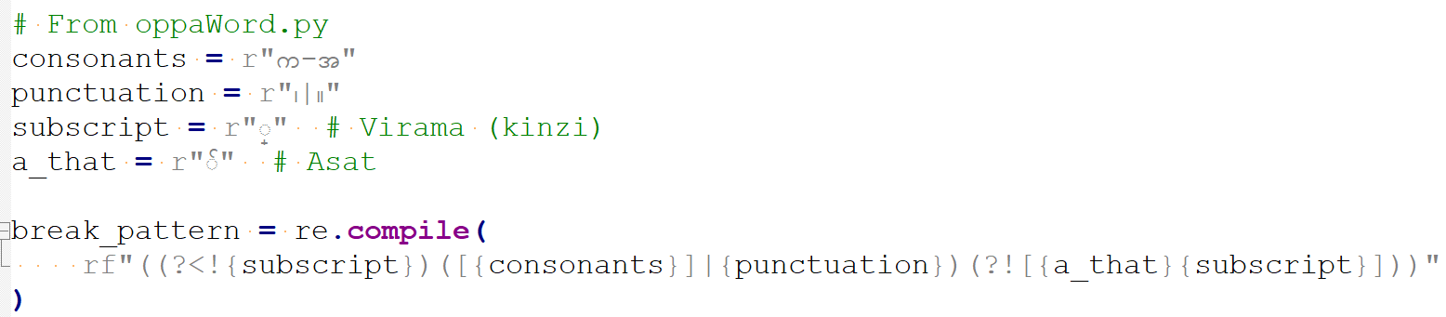
Syllable Breaking (edited-sylbreak)
Original sylbreak.py ရဲ့ Other words ဆိုတာကို ဖြုတ်လိုက်တယ်

Slide 9
DAG (Directed Acyclic Graph)
Definition:
A Directed Acyclic Graph (DAG) is a graph with directed edges and no cycles.
Nodes: Represent syllable positions in the input text.
Edges: Represent candidate words (valid dictionary entries or single syllables).
Key Property:
No cycles → Ensures linear progression from start to end of the sentence.

Slide 10
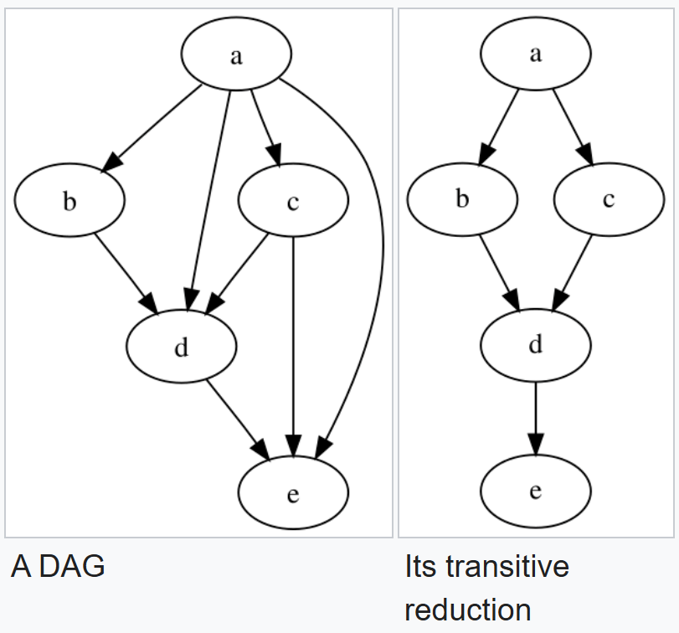
DAG Consturction
In mathematics, particularly graph theory, and computer science, a directed acyclic graph (DAG) is a directed graph with no directed cycles.
Fig. Transitive reduction (from wiki)

Slide 11
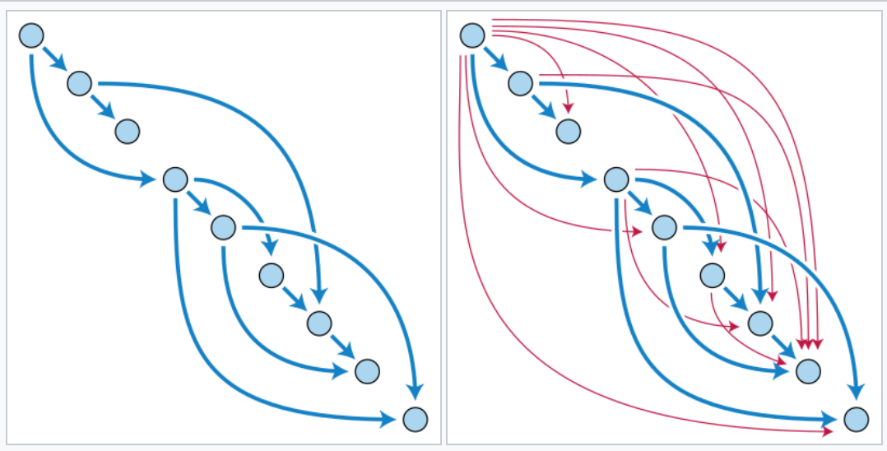
DAG Construction
Adding the red edges to the blue directed acyclic graph produces another DAG, the transitive closure of the blue graph. For each red or blue edge u → v, v is reachable from u: there exists a blue path starting at u and ending at v.
Fig. (from wiki)

Slide 12
DAG Construction (Why DAGs for Word Segmentation?)
Problem:
Myanmar text has no explicit word boundaries (e.g., "ကျေးဇူးပြု၍" → "ကျေးဇူး" + "ပြု" + "၍").
Exponentially many possible segmentations.
Solution:
DAG compactly encodes all valid segmentations in a single structure.
Enables efficient search for the best path (e.g., using Viterbi).

Slide 13
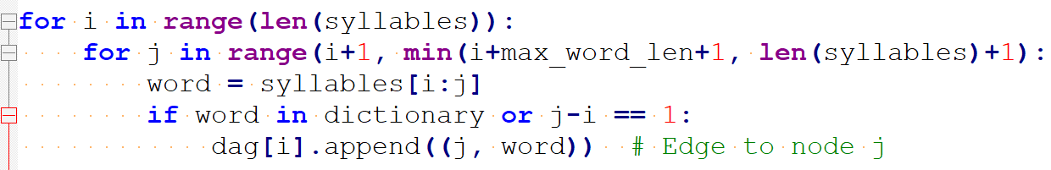
DAG Construction (Step by Step)
Input: Syllable list (e.g., ["ကျွန်တော်", "မ", "သိ", "ပါ"]).
Sliding Window: For each syllable position i, check substrings of length 1 to max_word_len (e.g., 6).
Validation: Keep substrings that exist in the dictionary or are single syllables.

Slide 14
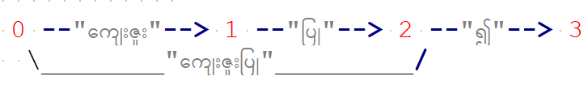
DAG Construction (Example)
Input Sentence: "ကျေးဇူးပြု၍" (syllables: ["ကျေးဇူး", "ပြု", "၍"]).
DAG Edges:
0 → 1: ကျေးဇူး
0 → 2: ကျေးဇူးပြု
1 → 2: ပြု
2 → 3: ၍

Slide 15
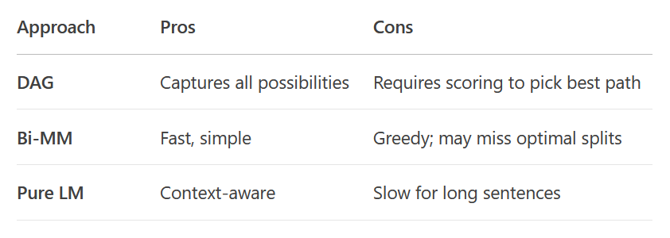
DAG Construction (vs Other Approaches)

Slide 16
DAG Construction (Scoring in oppaWord)
Edge Weights: Combine:
Dictionary membership (dict_weight).
Syllable frequency (log probability).
Language model score (n-gram probability).
Example:
Edge 0 → 1 ("ကျေးဇူး"):
score = 10.0 (dict) + -1.2 (freq) + -0.5 (LM) = 8.3

Slide 17
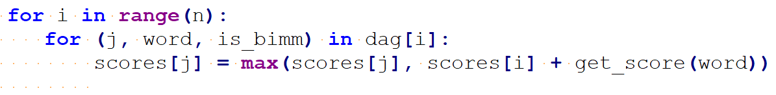
DAG Construction (Path Finding with Viterbi)
Input Sentence: Find the highest-scoring path from start (node 0) to end (node N).
Dynamic Programming:
scores[j] = max(scores[i] + edge_score) for all edges i → j.
Implementation:

Slide 18
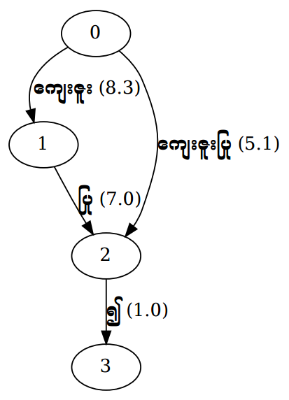
DAG Construction (Visualization)
Tool: Graphviz (dot).
Example:
digraph DAG {
0 -> 1 [label="ကျေးဇူး (8.3)"];
0 -> 2 [label="ကျေးဇူးပြု (5.1)"];
1 -> 2 [label="ပြု (7.0)"];
2 -> 3 [label="၍ (1.0)"];
}
Fig. Visualization
Notes:
Use Case: Debugging or teaching segmentation ambiguity.

Slide 19
DAG Construction (Limitation)
Memory: Can grow large for long sentences (O(N × max_word_len) edges).
Ambiguity: Multiple valid paths may exist
Mitigation:
Limit max_word_len (default: 6).
Fall back to Bi-MM for low-confidence paths.

Slide 20
Bi-MM (Bidirectional Maximum Matching)
MM Definition: A greedy algorithm that segments text by matching the longest possible word from a dictionary.
Directions:
Forward Maximum Matching (FMM): Left-to-right.
Backward Maximum Matching (BMM): Right-to-left.
Why Bidirectional?
Unidirectional MM can be direction-sensitive.
Example: "အပြင်သွား" → FMM: "အပြင်" + "သွား",
BMM: "အ" + "ပြင်" + "သွား".

Slide 21
Bi-MM (Bidirectional Maximum Matching)
Solution:
Run both FMM and BMM, then pick the better result (fewer segments or higher score).
Advantage:
More robust to dictionary gaps and ambiguities.

Slide 22
Bi-MM (Algorithm Steps)
Forward Pass (FMM):
Start at the first syllable.
Match longest valid word from the dictionary.
Move to the next unmatched syllable.
Backward Pass (BMM):
Start at the last syllable.
Match longest valid word backwards.
Conflict Resolution:
Choose the segmentation with fewer words (or apply scoring).

Slide 23
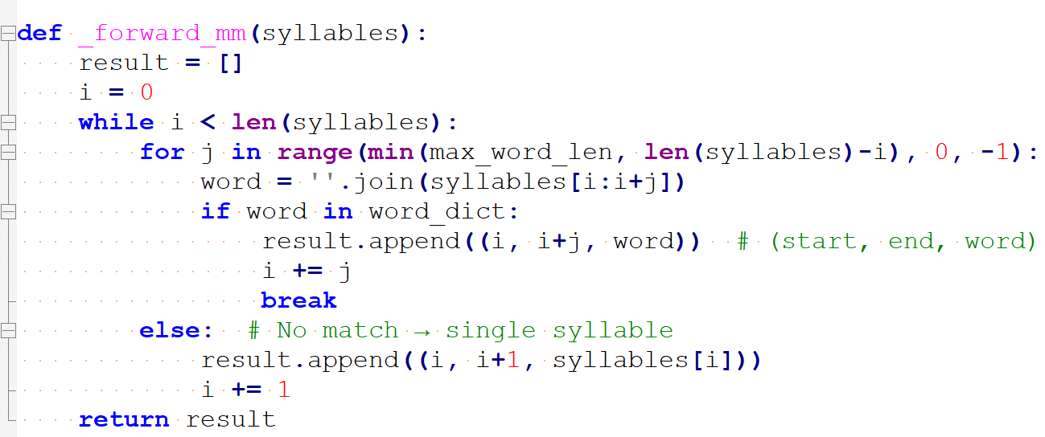
Bi-MM (Implementation)

Slide 24
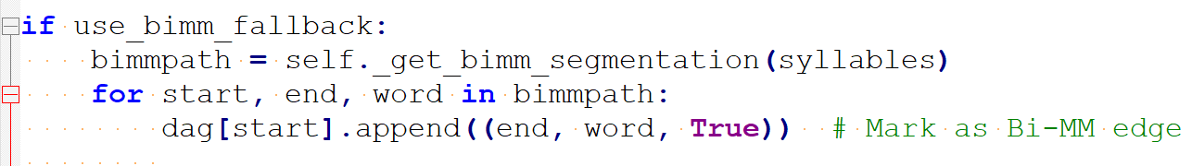
Bi-MM (Integration with DAG in oppaWord)
Role of Bi-MM:
Fallback Path: When DAG edges are missing (low-confidence/no dictionary match).
Score Boosting: Bi-MM paths get a bonus (bimm_boost parameter).

Slide 25
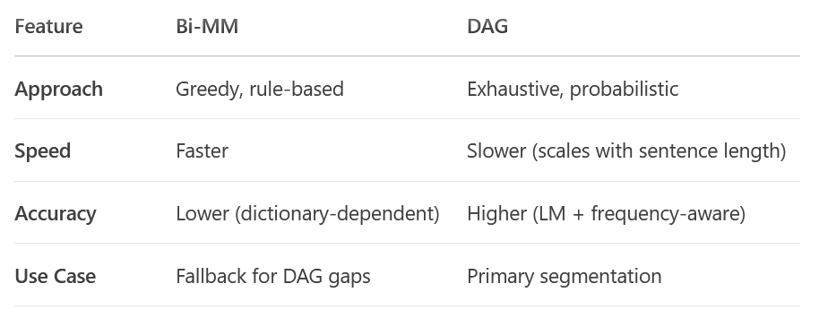
Bi-MM (vs. DAG Scoring)

Slide 26
Bi-MM (Configuration in oppaWord)
Parameters:
--use-bimm-fallback: Enable/disable Bi-MM.
--bimm-boost 0.5: Boost Bi-MM path scores (default: 0.0).
Trade-offs:
Higher boost → Prefer Bi-MM over DAG paths (useful for noisy text).

Slide 27
Bi-MM (Limitations)
Dictionary Bias:
Fails if dictionary is incomplete (e.g., missing compound words).
Directional Bias:
BMM and FMM may disagree (requires heuristic resolution).
No Context Awareness:
Ignores LM/frequency scores (fixed in DAG).

Slide 28
Bi-MM (Practical Tips)
Dictionary Quality:
Ensure coverage of common words and compounds.
Tuning bimm_boost:
Increase if DAG often produces unnatural splits.
Decrease to rely more on LM.
Visualization:
Use --visualize-dag to see Bi-MM fallback edges (marked with *).

Slide 29
N-gram LM
Definition:
Predicts the probability of a word given its preceding n-1 words.
Example (Trigram: n=3):
P("သွား" | "ကျောင်း" + "ကို") = probability of "သွား" after "ကျောင်းကို".
Types:
Unigram: Single word frequency (P("ကျေးဇူး")).
Bigram: Conditional probability (P("ပြု" | "ကျေးဇူး")).
Higher-order: Trigram, 4-gram, etc.

Slide 30
N-gram LM (for Segmentation?)
Problem:
Dictionary-based methods (e.g., Bi-MM) lack context awareness.
Example: "ဘုန်းကြီးကျောင်းသား" vs. "ဘုန်းကြီး" + "ကျောင်းသား"
LM picks the more probable sequence.
Solution:
LMs score candidate segmentations using real-world word co-occurrence statistics.

Slide 31
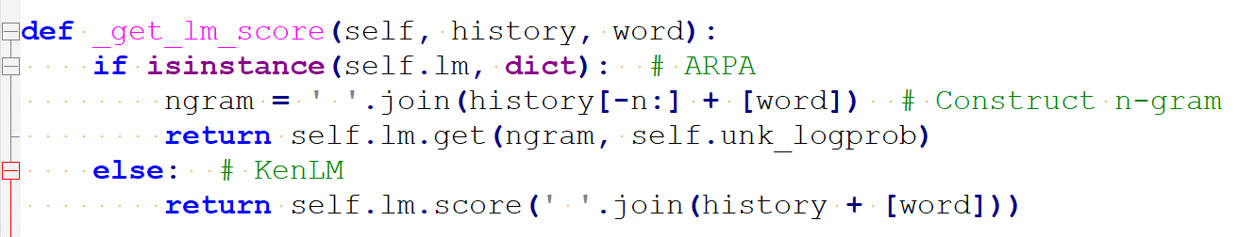
N-gram LM (Implementation in oppaWord)
Supported Formats:
ARPA: Human-readable n-gram counts and probabilities.
KenLM Binary: Efficient memory-mapped format.

Slide 32
N-gram LM (Scoring)
Input Syllables: ["နေ", "ကောင်း", "လား"]
Candidate Paths:
["နေ", "ကောင်း"] + ["လား"]
Bigram score: P("ကောင်း" | "နေ") + P("လား" | "ကောင်း")
["နေကောင်း"] + ["လား"]
Unigram score: P("နေကောင်း") + P("လား")
Result: Higher-probability path wins.

Slide 33
N-gram LM (Integration with DAG)
Step-by-Step:
DAG Construction: All possible segmentations (edges).
Viterbi Decoding: Scores paths using:
Visualization:
DAG edges show LM scores (e.g., "နေကောင်း (LM:-1.2)").

Slide 34
N-gram LM (Configuring LM in oppaWord)
Parameters:
Candidate Paths:
--arpa lm.arpa: Path to ARPA/KenLM file.
--max-order 5: Max n-gram order (default: 5).
Trade-offs: \
Higher max-order → More context but slower.

Slide 35
N-gram LM (Limitations & Mitigations)
Sparsity: Rare n-grams → fallback to lower-order models.
oppaWord's Solution: Uses unk_logprob for unknown words.
Memory:
Large LMs need KenLM binaries.
Summary:
n-gram LMs add context awareness to segmentation.
oppaWord Hybrid: Combines DAG, Bi-MM, and LM for optimal accuracy.

Slide 36
Viterbi Algorithm
Definition:
A dynamic programming algorithm to find the most likely sequence of states (here, word segments) in a probabilistic model (DAG + LM).
Key Properties:
Optimal: Guarantees the highest-scoring path.
Efficient: O(N×M) time (N = syllables, M = max word length).

Slide 37
Viterbi Algorithm (for Word Segmentation?!)
Challenge:
Exponentially many possible segmentations
Solution:
Viterbi efficiently explores all paths in the DAG using memoization.

Slide 38
Viterbi Algorithm (Core Component in oppaWord)
DAG Representation:
Nodes = syllable positions.
Edges = candidate words (e.g., 0 → 2: "ကျေးဇူး").
Scoring:
Each edge has a score:

Slide 39
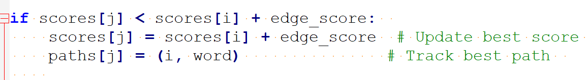
Viterbi Algorithm (Step by Step)
Initialization:
scores[0] = 0 (start node), others = -∞.
paths[j] stores the best path to node j.
Recursion:
For each node i, update all outgoing edges i → j:
Termination:
Backtrack from the end node (e.g., node N) using paths.

Slide 40
Viterbi Algorithm (Example Walkthrough)
Input Syllables: ["နေ", "ကောင်း", "လား"]
DAG Edges:
0 → 1: "နေ" (score=8), 0 → 2: "နေကောင်း" (score=12)
1 → 2: "ကောင်း" (score=7), 2 → 3: "လား" (score=5)
Viterbi Steps:
Scores: [0, 8, 12, -∞]
Update node 2: max(8+7=15, 12+5=17) → scores=[0,8,17]
Best path: 0 → 2 → 3 → "နေကောင်း လား"

Slide 41
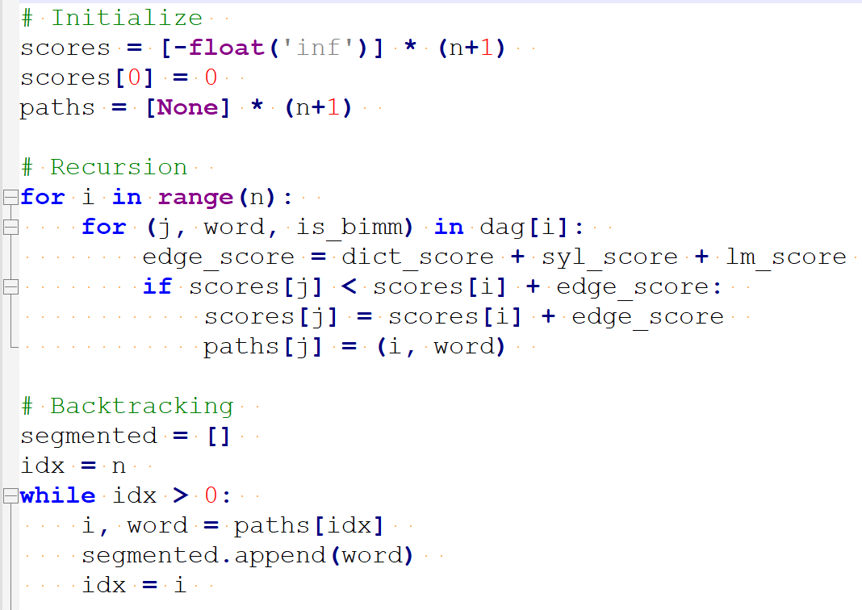
Viterbi Algorithm (Implementation)

Slide 42
Viterbi Algorithm (Summary)
Viterbi finds the globally optimal segmentation in O(N×M) time.
oppaWord Hybrid: Combines DAG, LM scores, and Viterbi for accuracy.

Slide 43
References
DAG: https://en.wikipedia.org/wiki/Directed_acyclic_graph
Viterbi Algorithm: https://en.wikipedia.org/wiki/Viterbi_algorithm
Viterbi AJ (April 1967). "Error bounds for convolutional codes and an asymptotically optimum decoding algorithm". IEEE Transactions on Information Theory. 13 (2): 260–269.
Gai, R. L., Gao, F., Duan, L. M., Sun, X. H., & Li, H. Z. (2014). Bidirectional Maximal Matching Word Segmentation Algorithm with Rules. Advanced Materials Research, 926–930, 3368–3372.
N-gram: https://en.wikipedia.org/wiki/N-gram
Word n-gram Language Model: https://en.wikipedia.org/wiki/Word_n-gram_language_model
KenLM: https://github.com/kpu/kenlm
KenLM website: https://kheafield.com/code/kenlm/

Slide 44
References
Sylbreak: https://github.com/ye-kyaw-thu/sylbreak
oppaWord: https://github.com/ye-kyaw-thu/oppaWord
Dynaic Programming: https://en.wikipedia.org/wiki/Dynamic_programming
myWord Segmentation Tool: https://github.com/ye-kyaw-thu/myWord
Ngram Format: http://www.speech.sri.com/projects/srilm/manpages/ngram-format.5.html
ARPA Language Models: https://cmusphinx.github.io/wiki/arpaformat/

