Slide 1


A Study on AI-Driven Question Generation Using ChatGPT for Python Programming Education
IINAE 2024: The 6th Workshop on Innovation Initiatives in NLP/AI/Education
Khaing Hsu Wai Ye Kyaw Thu, Thazin Myint Oo, Nobuo Funabiki, Lu Xiqin, Akihiro Yamamura
November 12, 2024

Slide 2
Agenda
Background and Contribution
ChatGPT-based Question Generation Program
Evaluations
Conclusion and Future Works
IINAE2024

Slide 3
Agenda
Background and Contribution
ChatGPT-based Question Generation Program
Evaluations
Conclusion and Future Works
IINAE2024

Slide 4
Python Programming Education
Programming strengthens critical thinking and problem-solving in the digital age.
Many universities include Python programming to build a strong foundational skill set.
Python is essential for fields like data science, machine learning, and AI.
Python education equips students for data-focused careers in a tech-driven world.

Slide 5
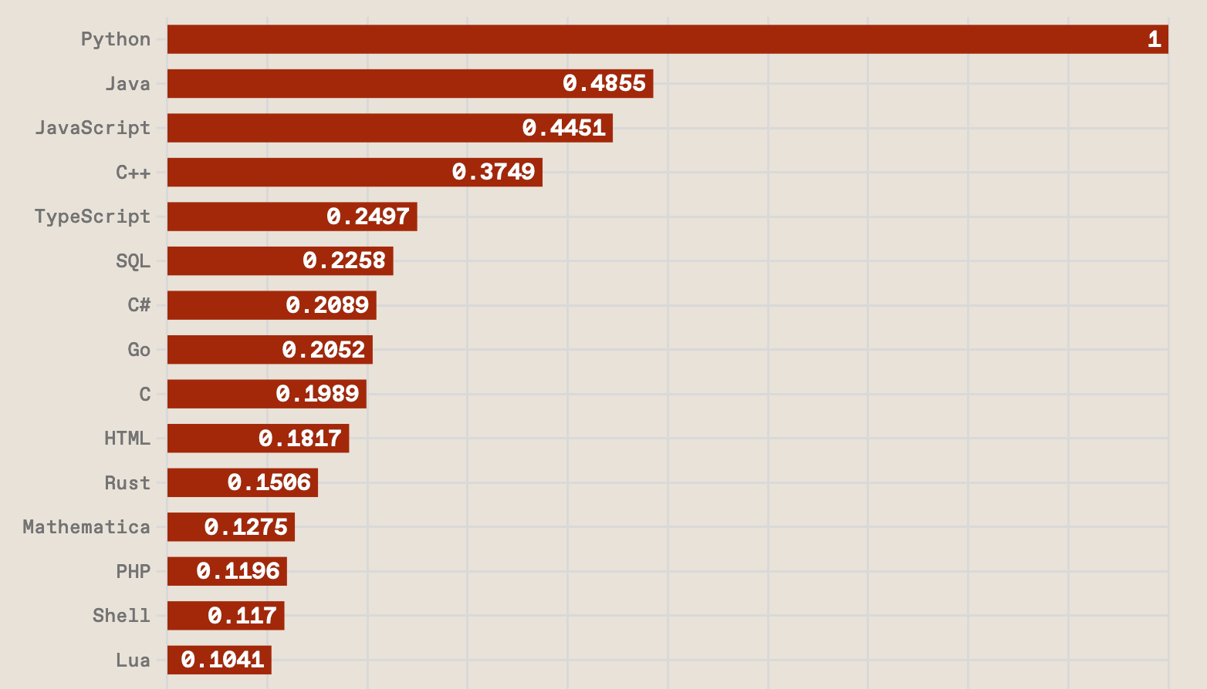
Python Programming Education
Python is ranked at the most popular programming language.
IEEE Spectrum, August 2024^{[1]}
[1] https://spectrum.ieee.org/top-programming-languages-2024

Slide 6
Importance of Practice for Learning
Quizzes and practice questions are crucial for mastering programming concepts.
Hands-on exercises help reinforce skills and understanding.
Teachers need to integrate quizzes and exercises effectively with the curriculum.

Slide 7
Motivation and Contribution
Making quizzes and practice questions for diverse programming topics can be time-consuming for the teachers.
propose
A ChatGPT-based question generation program that automatically creates Python programming questions, saving educators time and supporting effective learning.

Slide 8
Agenda
Background and Contribution
ChatGPT-based Question Generation Program
Evaluations
Conclusion and Future Works
IINAE2024

Slide 9
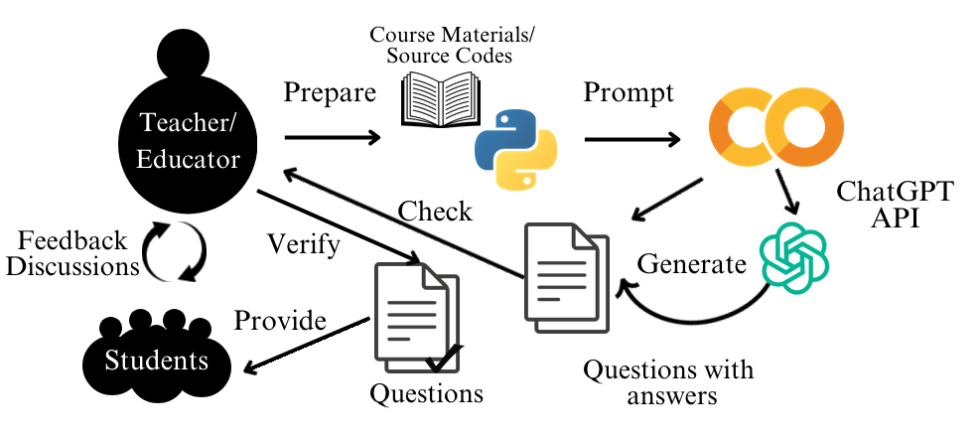
Conceptual Workflow of Question Generation
1
2
3
Figure: Overall Architecture of ChatGPT-based Question Generation Process

Slide 10
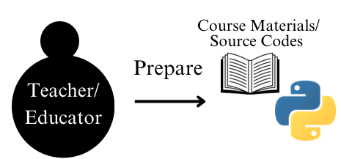
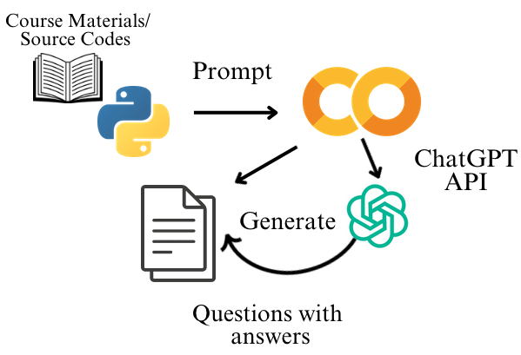
Source Code Analysis and Question Generation
Prepare Python source codes from textbooks, open-source repositories, and educational websites.
Source code is loaded into Google Colab, where each code snippet is analyzed.
The questions are generated using ChatGPT’s API based on the analyzed code.
Types of Questions:
Code Understanding
Output Prediction
Code Completion

Slide 11
Prompt Design and Question Formatting
The scenario is set to focus ChatGPT on educational goals.
Clear instructions are also important in generating specific question types.
Code Understanding and Output Prediction:
MCQ with 3 choices and the correct answer
True/False question and the correct answer
Code Completion:
Fill-in-the-blank by removing a key part of the code and the correct answer
I am a teacher and want to generate exactly one {question_type} question for my students based on the following Python code:
Figure: Prompt example for contextual introduction.

Slide 12
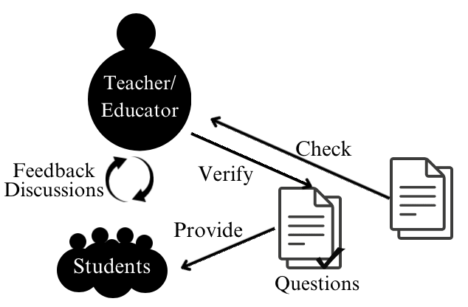
Output and Review
name = "Alice" # String data type
age = 25 # Integer data type
height = 5.6 # Float data type
is_student = True # Boolean data type
print("Hello , my name is", name)
print("I am", age , "years old.")
print("My height is", height , "feet.")
print("Am I a student ?", is_student )
Python source code for variables and data types
** Code understanding Questions :**
** Multiple Choice Question (MCQ):**
What data type is used to represent
whether someone is a student or not in the
code?
A) String
B) Integer
C) Boolean
** Correct Answer :** C) Boolean
** True/False Question :**
The variable ‘height’ represents the
height in meters .
** Correct Answer :** False
(It represents the height in feet.)
ready-to-use resource for student assessments
Generated questions with answers for code understanding.

Slide 13
Agenda
Background and Contribution
ChatGPT-based Question Generation Program
Evaluations
Conclusion and Future Works
IINAE2024

Slide 14
Evaluation Set Up
28 Python programming source codes were prepared to cover:
Introduction to Python (9 source codes),
Intermediate Python (10 source codes), and
Intermediate Python for Data Science (9 source codes)
The experiment was conducted online and link with 140 generated questions was shared with lab members via email.
Participants completed the questions independently, without supervision.

Slide 15
Performance Analysis of Question Generation Methods
Overview of prompting methods:
Zero-shot: No examples provided in the prompt.
One-shot: One example provided in the prompt.
Few-shot: Multiple examples provided in the prompt.
Prompt Method | Code Understanding |  | Output Prediction |  | Code Completion | Issues Observed
 | MCQ | T/F | MCQ | T/F | Fill-in-blank
Zero-shot | 96.3% | 21.1% | 96.3% | 17.8% | 53.7% | Low accuracy for T/F, moderate for Fill-in-Blank
One-shot | 100% | 100% | 100% | 100% | 100% | Duplicate questions, missing answers
Few-shot | 100% | 100% | 100% | 100% | 100% | relevant to use
Few-shot prompting was selected for its consistent accuracy and reliable output, ensuring high-quality questions for educational use.

Slide 16
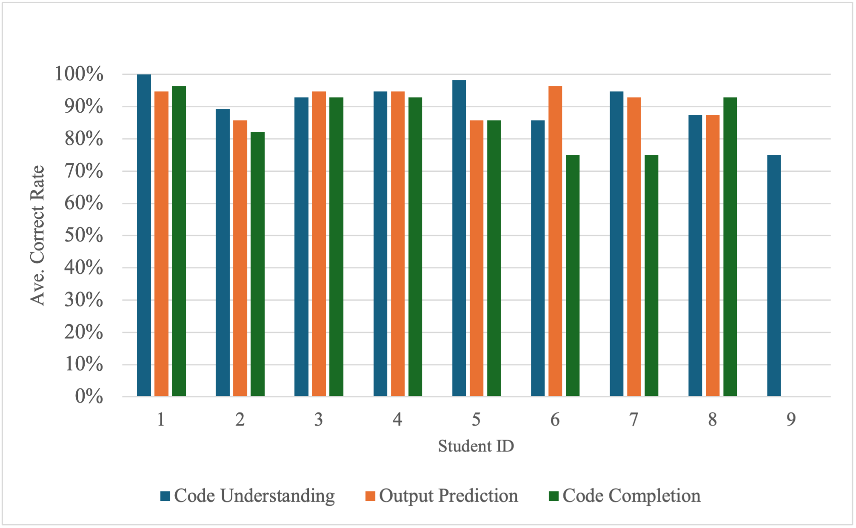
Student Solution Results
Educational Background of Participants
Bachelor, Master, and PhD students participated, providing a range of experience levels in programming
Most students scored above 80%, indicating strong comprehension of foundational programming concepts.
Code Completion task had a lower correct rate, showing students may need additional support in practical coding skills.

Slide 17
Agenda
Background and Contribution
ChatGPT-based Question Generation Program
Evaluations
Conclusion and Future Works
IINAE2024

Slide 18
Conclusion and Future Works
Conclusion:
Effective Question Generation
The proposed ChatGPT-based system effectively creates quality questions for Python education, with Few-shot prompting achieving the highest accuracy and reliability.
Student Performance Insights
High scores in Code Understanding and Output Prediction indicate strong foundational learning.
Lower scores in Code Completion highlight the need for more practical coding practice.
Educational Value
The system saves time for educators and provides targeted practice for students, enhancing the overall learning experience.

Slide 19
Conclusion and Future Works
Future Works:
Refined Prompt Design: Enhance prompts to create a wider variety of questions and adapt to different programming languages.
Broader Testing: Test with more participants and educational settings to validate effectiveness.
Adaptive Questioning: Develop a system to adjust question difficulty based on student progress.
LMS Integration: Integrate with learning platforms to provide seamless access for educators and students.

