Slide 1

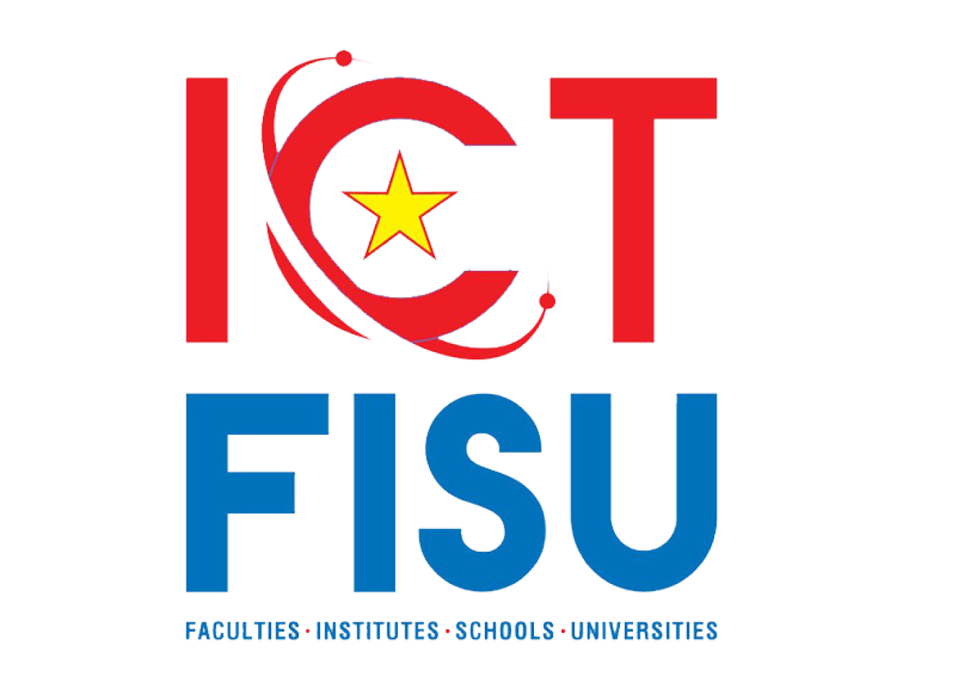


Statistical vs Neural Machine Translations for Khmer Braille​
The 1st ACIR⁺ WORKSHOP OF RESEARCH AND INNOVATION FOR STUDENTS (AWRIS 2024)
Theme: Towards innovative technology for paving the sustainable future in ASEAN
Authors:
Kimhuoy Yann, Ponleur Veng, Ye Kyaw Thu, Rottana Ly
Cambodia Academy of Digital Technology
July 20th, 2024

Slide 2
Table of contents
The 1st ACIR⁺ WORKSHOP OF RESEARCH AND INNOVATION FOR STUDENTS (AWRIS 2024)
Theme: Towards innovative technology for paving the sustainable future in ASEAN
01
02
03
04
Related Works
Khmer Braille
Corpus Development
Introduction
05
06
07
Experiment Setup
Discussion
Conclusions

Slide 3
01
Introduction
The 1st ACIR⁺ WORKSHOP OF RESEARCH AND INNOVATION FOR STUDENTS (AWRIS 2024)
Theme: Towards innovative technology for paving the sustainable future in ASEAN

Slide 4
Research Problem
The 1st ACIR⁺ WORKSHOP OF RESEARCH AND INNOVATION FOR STUDENTS (AWRIS 2024)
Theme: Towards innovative technology for paving the sustainable future in ASEAN
License Software Braille Translator
Education document needed to support blind people

Slide 5
Research Objective
The 1st ACIR⁺ WORKSHOP OF RESEARCH AND INNOVATION FOR STUDENTS (AWRIS 2024)
Theme: Towards innovative technology for paving the sustainable future in ASEAN
Research model that can translate from Khmer-to-Khmer Braille
Implement this model to Website and App application

Slide 6
02
Related Works
The 1st ACIR⁺ WORKSHOP OF RESEARCH AND INNOVATION FOR STUDENTS (AWRIS 2024)
Theme: Towards innovative technology for paving the sustainable future in ASEAN

Slide 7
The 1st ACIR⁺ WORKSHOP OF RESEARCH AND INNOVATION FOR STUDENTS (AWRIS 2024)
Theme: Towards innovative technology for paving the sustainable future in ASEAN
Ye Kyaw Thu et al Investigated SMT between Khmer and various languages using the Moses toolkit with different architectures (OSM, PBSMT, HPBSMT). https://aclanthology.org/Y15-1030
Zar Zar Hlaing et al Introduced Marian-NMT toolkit with different approach such as sequence-to-sequence (s2s) with both RNN-based. https://aclanthology.org/P18-4020
Zun Hlaing Moe et al Investigated statistical machine translation (SMT) between Myanmar text and Mu-Thit Braille, one of Myanmar’s two Braille systems, utilizing IBM Models 1 and 2. https://aclanthology.org/2021.wat-1.6
Yu et al Propose a novel pre-training approach for Chinese–Braille translation, addressing the challenge of limited parallel data https://doi.org/10.1016/j.displa.2023.102506

Slide 8
03
Khmer Braille
The 1st ACIR⁺ WORKSHOP OF RESEARCH AND INNOVATION FOR STUDENTS (AWRIS 2024)
Theme: Towards innovative technology for paving the sustainable future in ASEAN

Slide 9
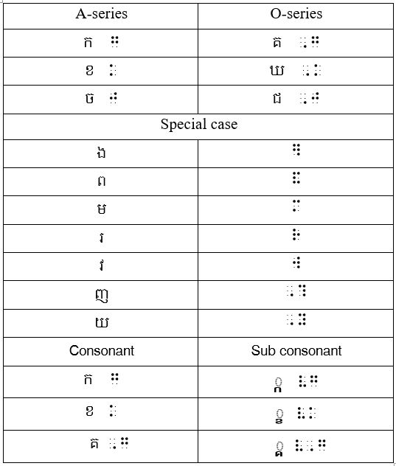
The 1st ACIR⁺ WORKSHOP OF RESEARCH AND INNOVATION FOR STUDENTS (AWRIS 2024)
Theme: Towards innovative technology for paving the sustainable future in ASEAN
Invented by Cambodians and Thais in 1988 in the Saitou camp, Cambodian and in 1994, the Krousar Thmey community, the Ministry of Education, Youth, and Sport of Cambodia (MoEYS)and the Maryknoll Lay Missioners community improved Cambodian Braille to follow the structure of written Khmer.
Use 6 dots per one cell system braille character.
Due to complexity of Khmer character, there are 144 character to represent, and 6 dots system limited to 63 characters to expend the number 18 dots, or 3 braille cell was introduced.
Position of Khmer braille really matter. Example:
ខ្មែរ​ = ខ​ + ្ម + ែ + រ
ខ្មែរ​ = ែ + ខ​ + ្ម + រ
Figure 1: Mappings for Khmer Braille consonants.

Slide 10
04
Khmer Braille Corpus Development
The 1st ACIR⁺ WORKSHOP OF RESEARCH AND INNOVATION FOR STUDENTS (AWRIS 2024)
Theme: Towards innovative technology for paving the sustainable future in ASEAN

Slide 11
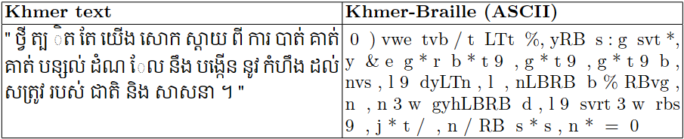
The 1st ACIR⁺ WORKSHOP OF RESEARCH AND INNOVATION FOR STUDENTS (AWRIS 2024)
Theme: Towards innovative technology for paving the sustainable future in ASEAN
20K Khmer-Braille parallel corpus was developed which Khmer text was sourced from the Asian Language Treebank (ALT)and Braille, we utilized the Duxbury Braille Translator software.
Word segmentation
Data Replacement
Manual Checking
01
02
03
04
05
Khmer-to-Braille Translation with Duxbury
Sub-word Segmentation with Byte Pair Encoding (BPE)
Figure 2: Parallel sentence segmented with BPE sub-words

Slide 12
05
Experiment Setup
The 1st ACIR⁺ WORKSHOP OF RESEARCH AND INNOVATION FOR STUDENTS (AWRIS 2024)
Theme: Towards innovative technology for paving the sustainable future in ASEAN

Slide 13
Statistical Machine Translation
The 1st ACIR⁺ WORKSHOP OF RESEARCH AND INNOVATION FOR STUDENTS (AWRIS 2024)
Theme: Towards innovative technology for paving the sustainable future in ASEAN
Phrase-Based Statistical Machine Translation (PBSMT)​
Operation Sequence Model (OSM)
Neural Machine Translatoin
Sequence-to-sequence (Seq2Seq)
Transformer

Slide 14
The 1st ACIR⁺ WORKSHOP OF RESEARCH AND INNOVATION FOR STUDENTS (AWRIS 2024)
Theme: Towards innovative technology for paving the sustainable future in ASEAN
Corpus Statistics and Training
Khmer-Braille corpus comprises a total of 20,106 parallel sentences and 715,013-word units.
we allocated 18,088 parallel sentences for training, 1,000 for development, and 1,018 for testing.
We train these SMT and NMT models using three AMD 3x RTX 3080ti 11GB GPUs, each paired with 64GB of RAM

Slide 15
06
Discussion
The 1st ACIR⁺ WORKSHOP OF RESEARCH AND INNOVATION FOR STUDENTS (AWRIS 2024)
Theme: Towards innovative technology for paving the sustainable future in ASEAN

Slide 16
The 1st ACIR⁺ WORKSHOP OF RESEARCH AND INNOVATION FOR STUDENTS (AWRIS 2024)
Theme: Towards innovative technology for paving the sustainable future in ASEAN
BiLingual Evaluation Understudy (BLEU Score)
Source-Target | Khmer-to-Braille | Braille-to-Khmer
PBSMT | 85.61 | 70.64
OSM | 85.65 | 70.63
Seq2Seq | 72.55 | 65.41
Transformer | 53.83 | 51.43
Table 1: BLEU Score result

Slide 17
The 1st ACIR⁺ WORKSHOP OF RESEARCH AND INNOVATION FOR STUDENTS (AWRIS 2024)
Theme: Towards innovative technology for paving the sustainable future in ASEAN
Word Error Rate (WER)
Source-Target | Khmer-to-Braille | Braille-to-Khmer
PBSMT | 13.30% | 22.10%
OSM | 13.20% | 22.40%
Seq2Seq | 25.60% | 49.20%
Transformer | 33.50% | 55.90%
Table 2: Word Error Rate (WER) result

Slide 18
07
Conclusion
The 1st ACIR⁺ WORKSHOP OF RESEARCH AND INNOVATION FOR STUDENTS (AWRIS 2024)
Theme: Towards innovative technology for paving the sustainable future in ASEAN

Slide 19
The 1st ACIR⁺ WORKSHOP OF RESEARCH AND INNOVATION FOR STUDENTS (AWRIS 2024)
Theme: Towards innovative technology for paving the sustainable future in ASEAN
First-time study results of SMT and NMT for Khmer text to Braille translation and vice versa
The development of a Khmer-Braille parallel corpus, which we plan to release publicly after further checking and data cleaning
The experimental results, in terms of BLEU and WER scores, show that SMT significantly achieved better translation performance than NMT
We plan to extend the Braille corpus to ASEAN languages.
Further study especially on NMT and current research trends of fine-tuning with large language model approaches

Slide 20
The 1st ACIR⁺ WORKSHOP OF RESEARCH AND INNOVATION FOR STUDENTS (AWRIS 2024)
Theme: Towards innovative technology for paving the sustainable future in ASEAN
Thank You
For
Your Listening

