Slide 1
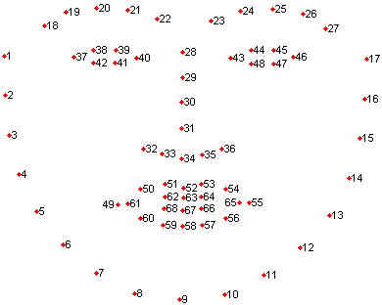
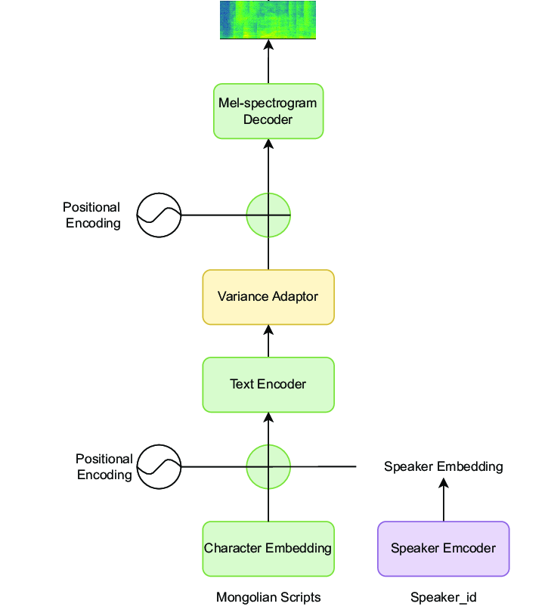
Face Landmark
Decoder

Slide 2


Decodec
Transformer-Based Neural Language Modeling
G2P Conversion
Encodec
Text

Slide 3
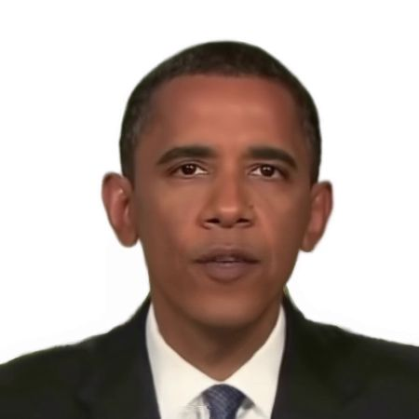
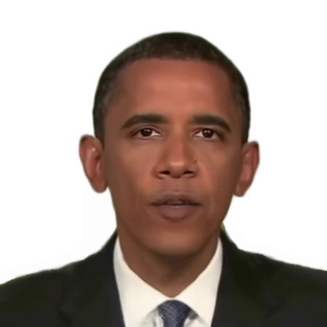


NeRF-Based Talking Head Modeling
Decodec
Transformer-Based Neural Language Modeling
G2P Conversion
Encodec
Text

