Slide 1
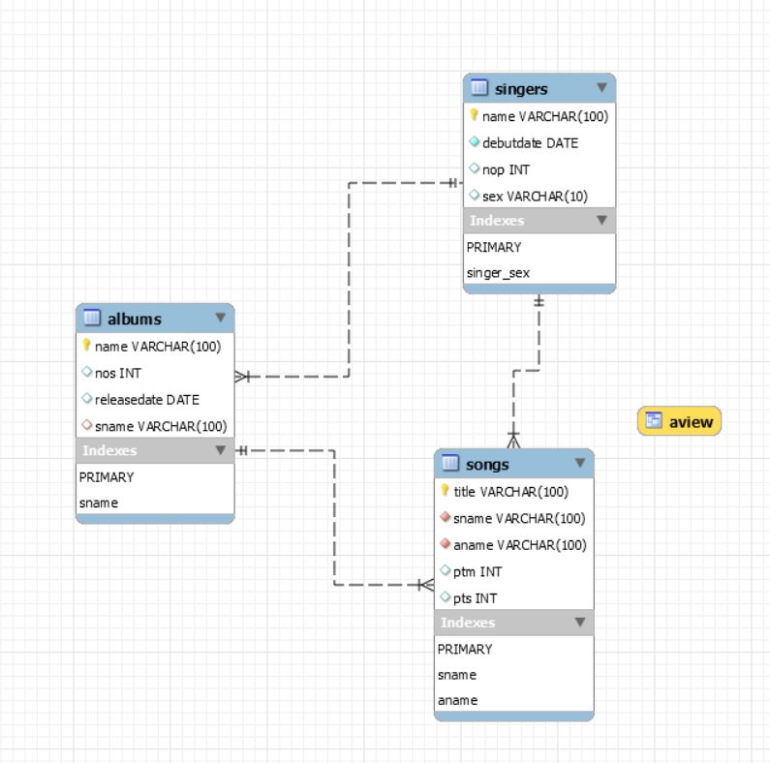
song
DATABASE project
presentation
1871009
Kim Ye-eun
create view aview as
select name, nos, title
from albums, songs
where albums.name=songs.aname;
sing
contain
singer
album
release

Slide 2
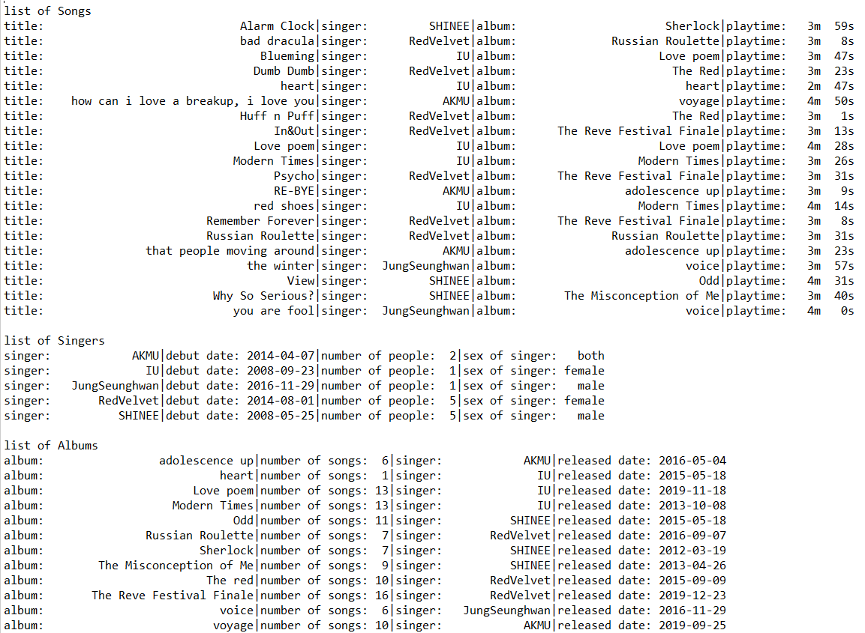
update songs set ptm=ptm+? where aname=?
update songs set pts=pts+? where aname=?
update albums set nos=? where name=?
update songs set ptm=ptm+? where aname=?
update songs set pts=pts+? where aname=?

Slide 3

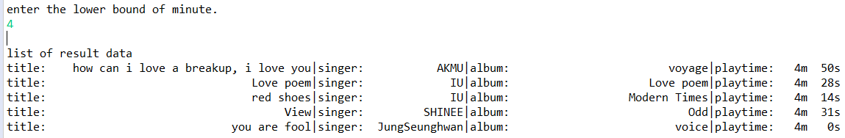
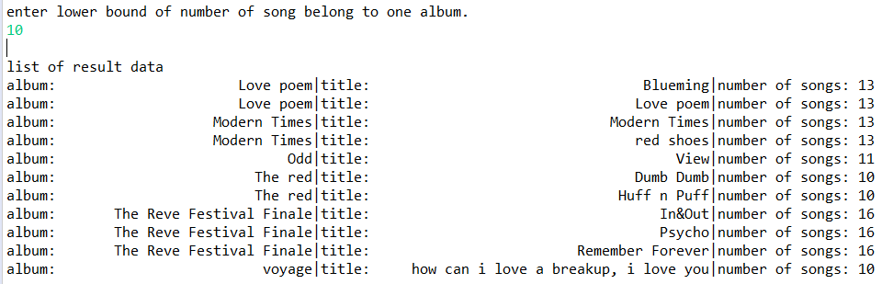
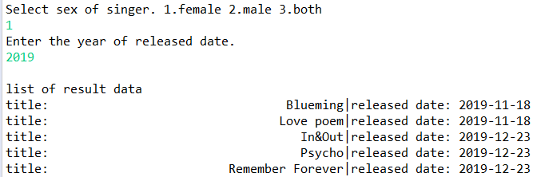
select * from songs where ptm>? or ptm=?
THANK YOU~
select * from aview where nos>? or nos=?
select title, releasedate
from songs inner join albums on songs.aname=albums.name
where (releasedate between ? and ?) and
(songs.sname=some(select name
from singers
where sex=?))

