Slide 1
SIC 2 Pass Assembler
資管三 110213076 鄭鈺曄

Slide 2
Table of contents
01
02
03
04
05
06
Pass 1
Pass 2
Basic Function
Successful Execution
Error Handling
Data Structure
Algorithm
Flowchart

Slide 3
01
Pass 1
Scan 原始檔並建立 symbol table
計算指令的 location
產出中間檔 (只要上述過程出現一次 error 則不會輸出中間檔)

Slide 4
02
Pass 2
確認 operand 是否存在於 symbol table
產生 object code (只要上述過程出現 error 就不會產生)
產出 object program 和 M record

Slide 5
03
Basic Function

Slide 6
A
Successful Execution
Terminal 用以輸出 error message，程式正確執行後 terminal 不會有任何輸出，直到按下鍵盤停止執行
產出中間檔、object program，額外輸出 symbol file 方便校對是否正確儲存

Slide 7
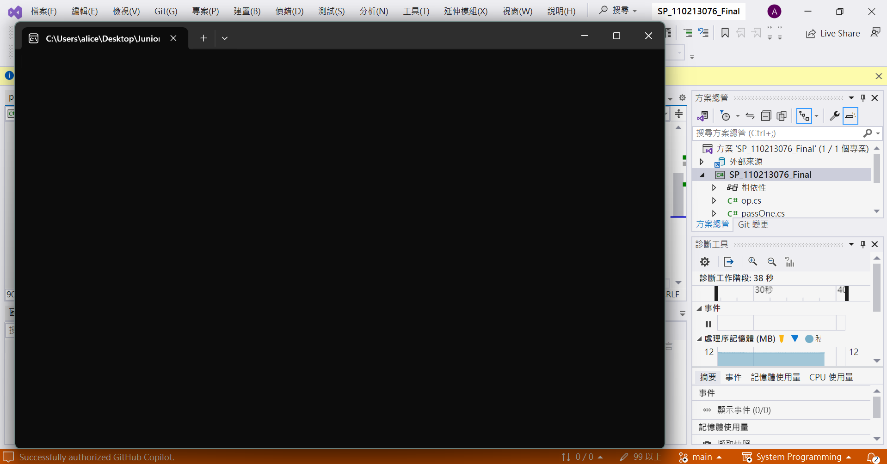

Slide 8
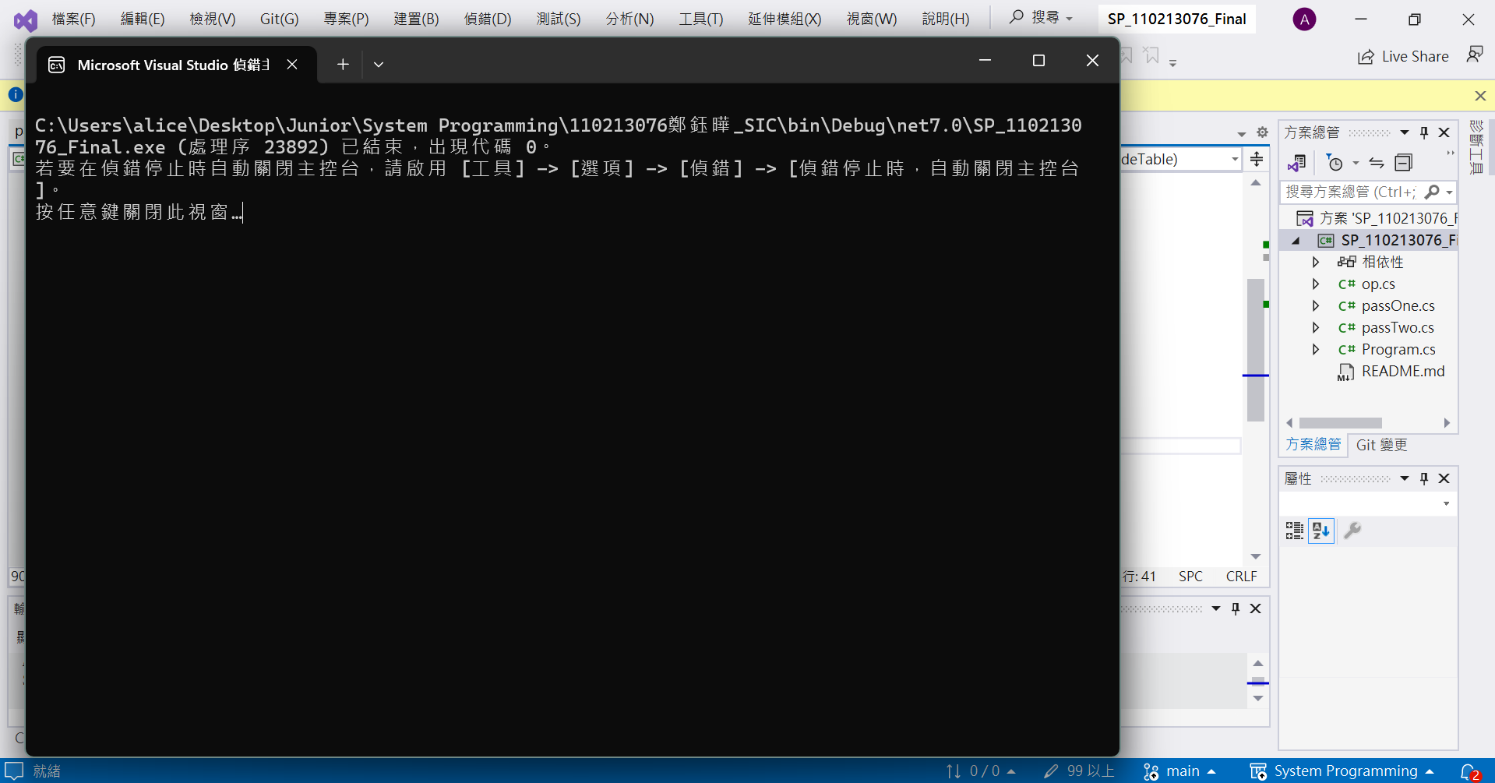

Slide 9
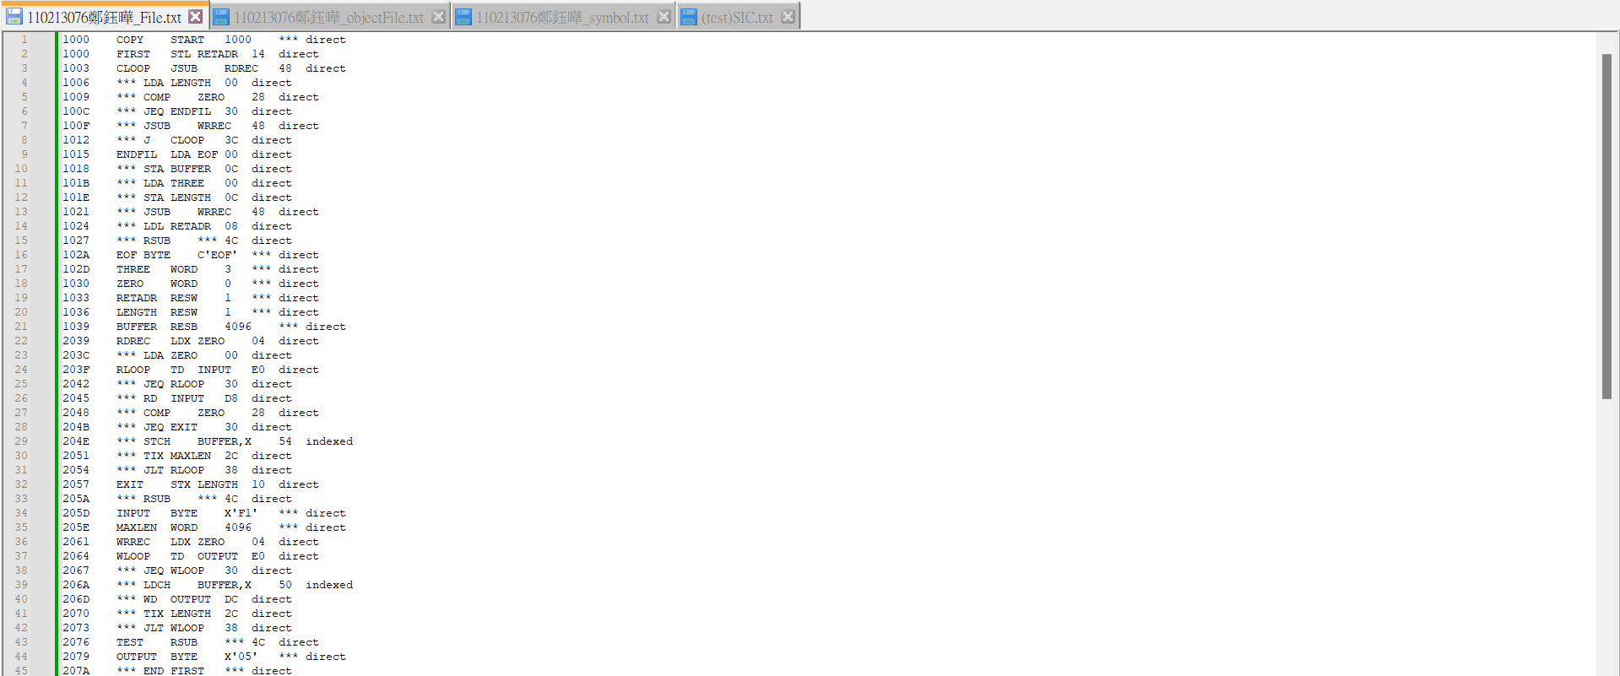

Slide 10
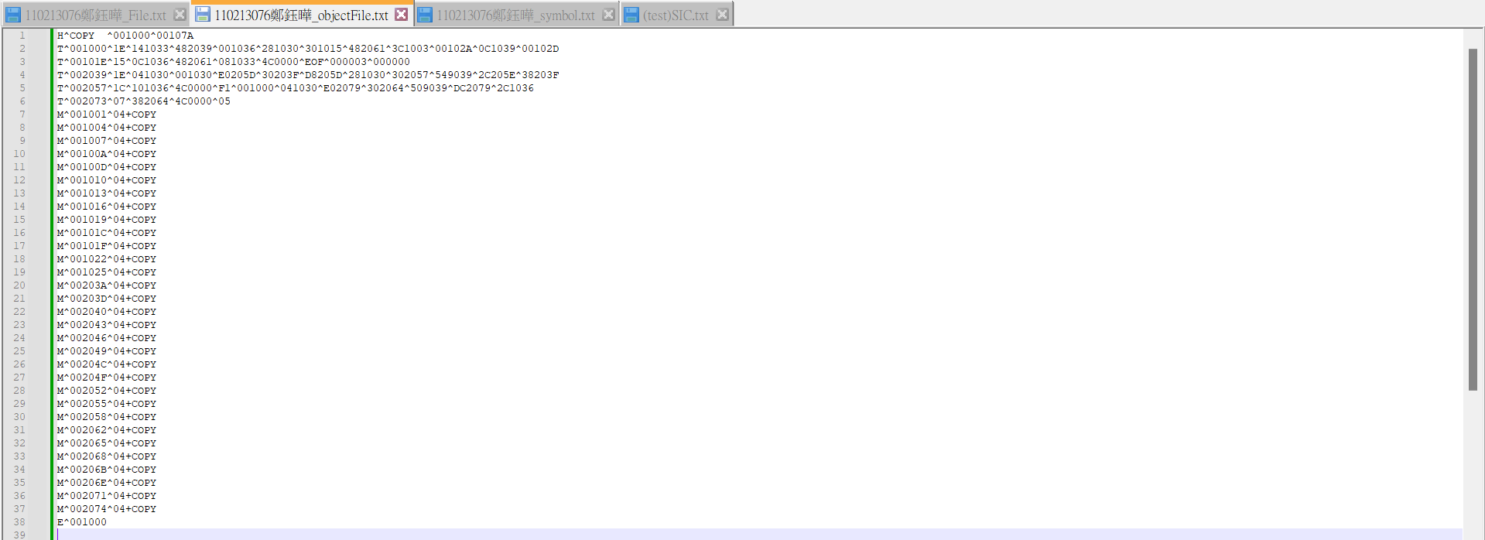

Slide 11
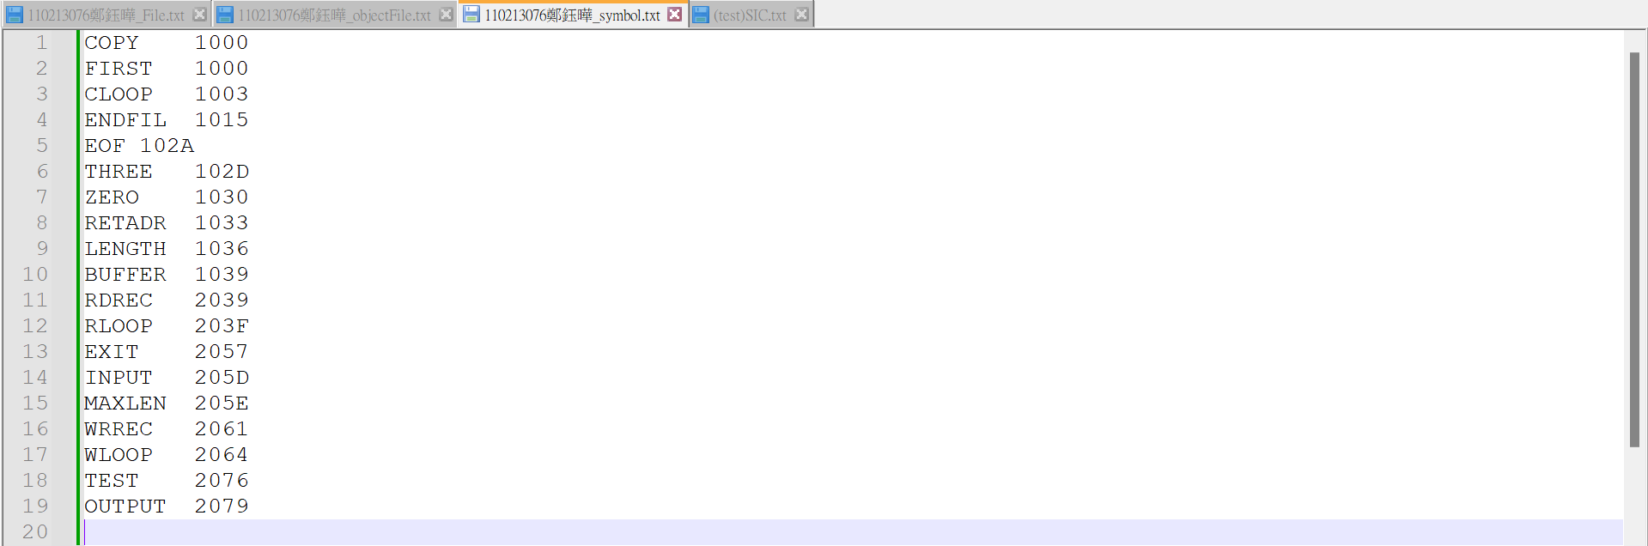

Slide 12
A
Successful Execution
Change in start location
e.g. COPY START 1000 → COPY START F

Slide 13
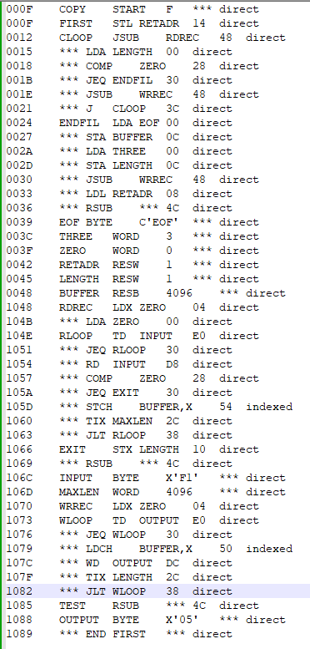
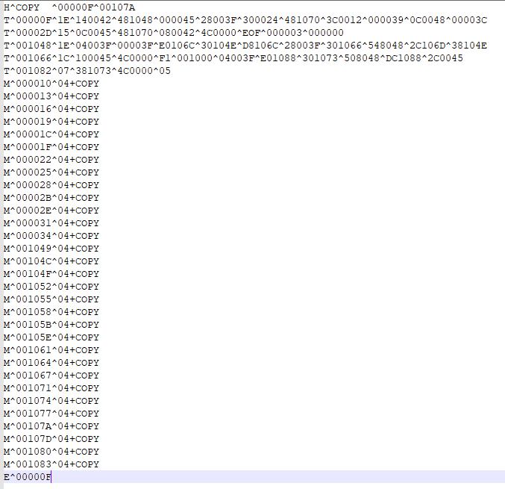
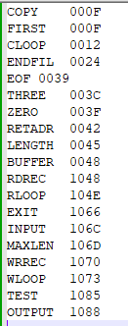

Slide 14
A
Successful Execution
Change in end label e.g. END FIRST → END EXIT

Slide 15
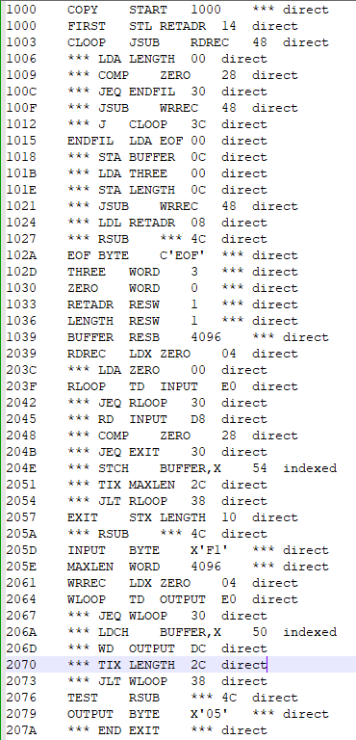
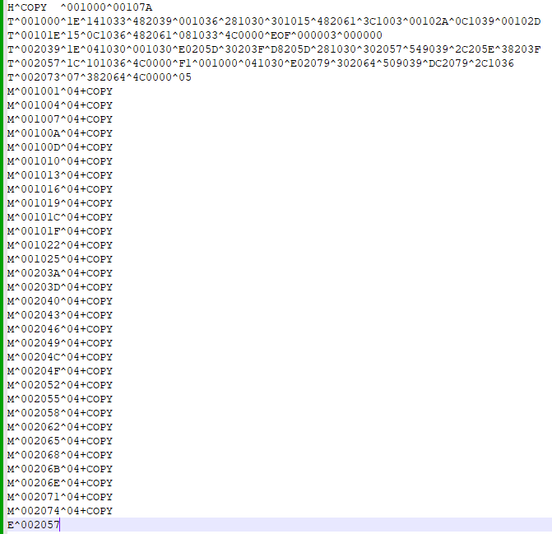
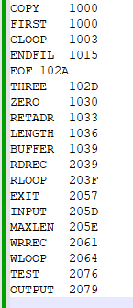

Slide 16
A
Successful Execution
RSUB can have a label e.g. RSUB → ABC RSUB

Slide 17
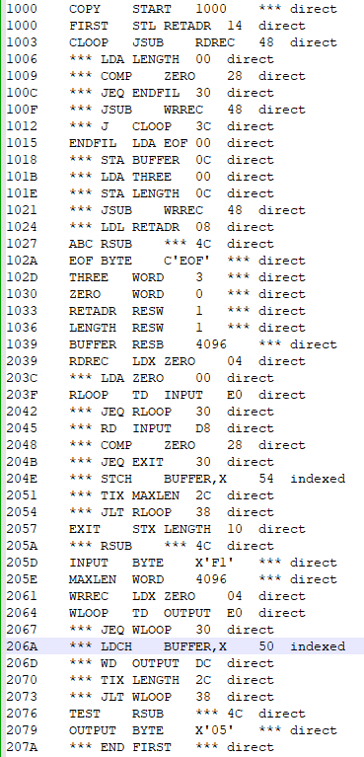
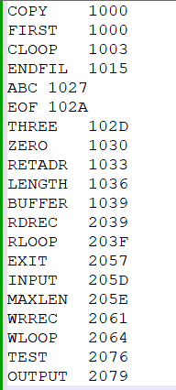

Slide 18
B
Error Handling
☑ Redefined and undefined symbol

Slide 19
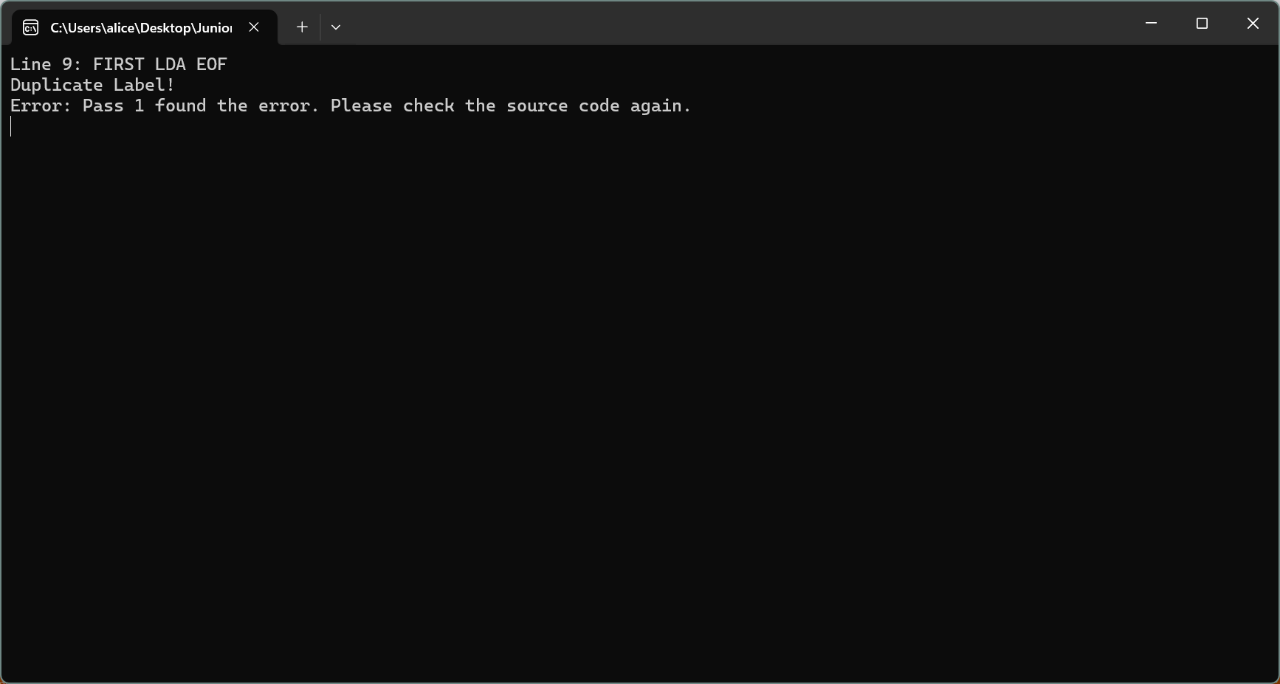
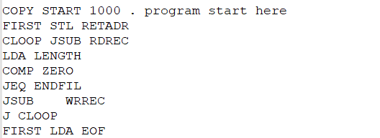

Slide 20
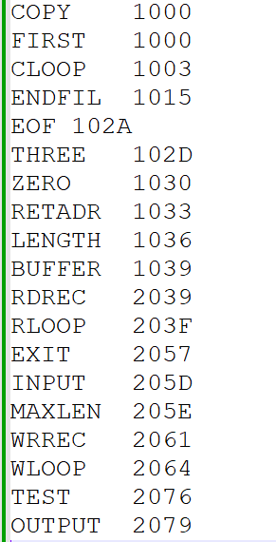
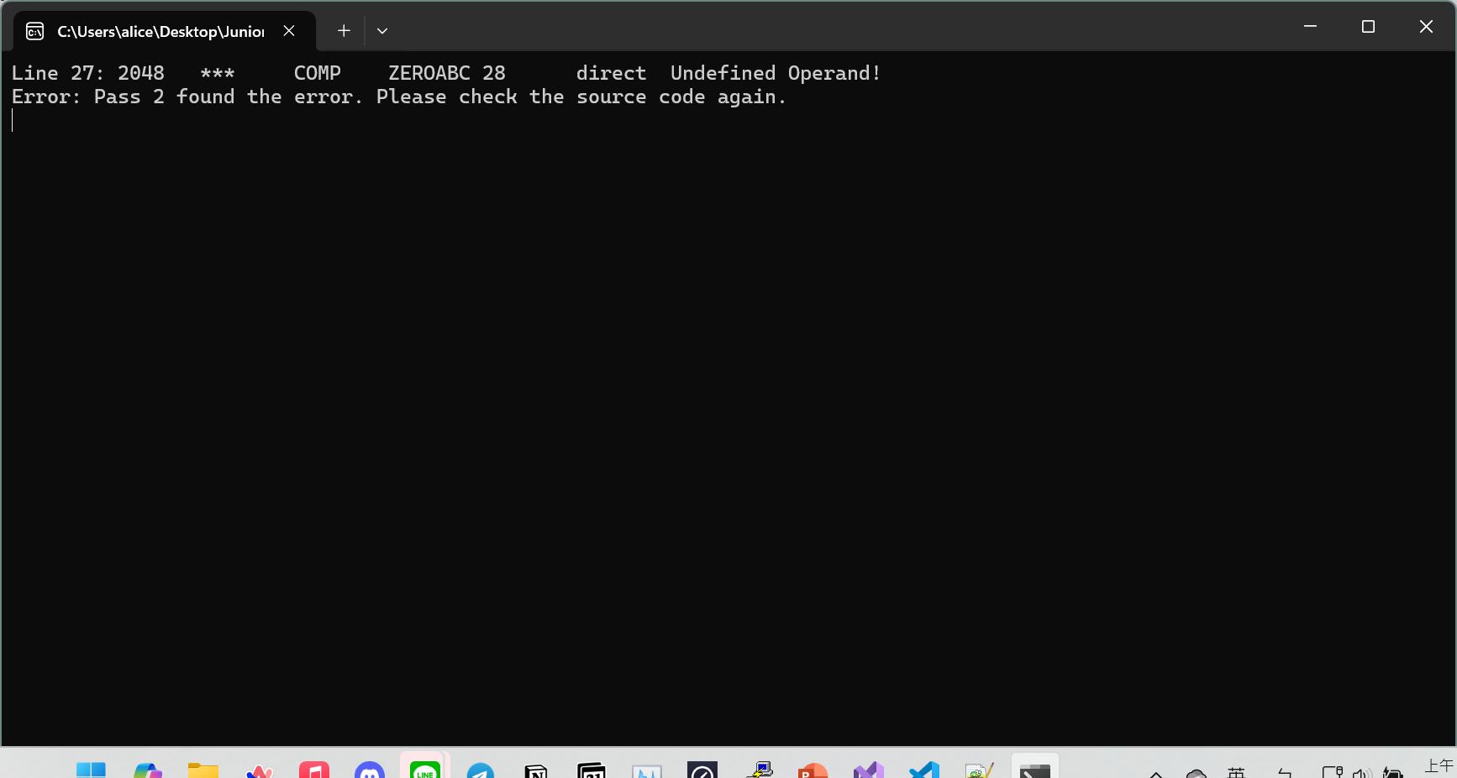

Slide 21
B
Error Handling
☑ The operand can’t be the same as the label on the same line

Slide 22
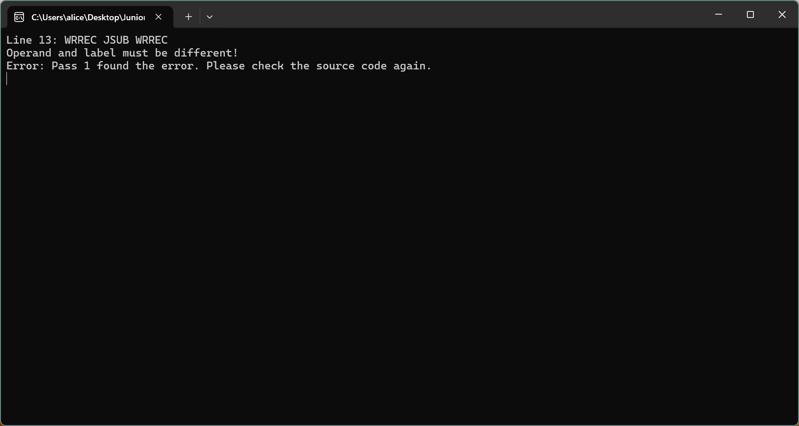

Slide 23
B
Error Handling
☑ Label must be different from mnemonic

Slide 24
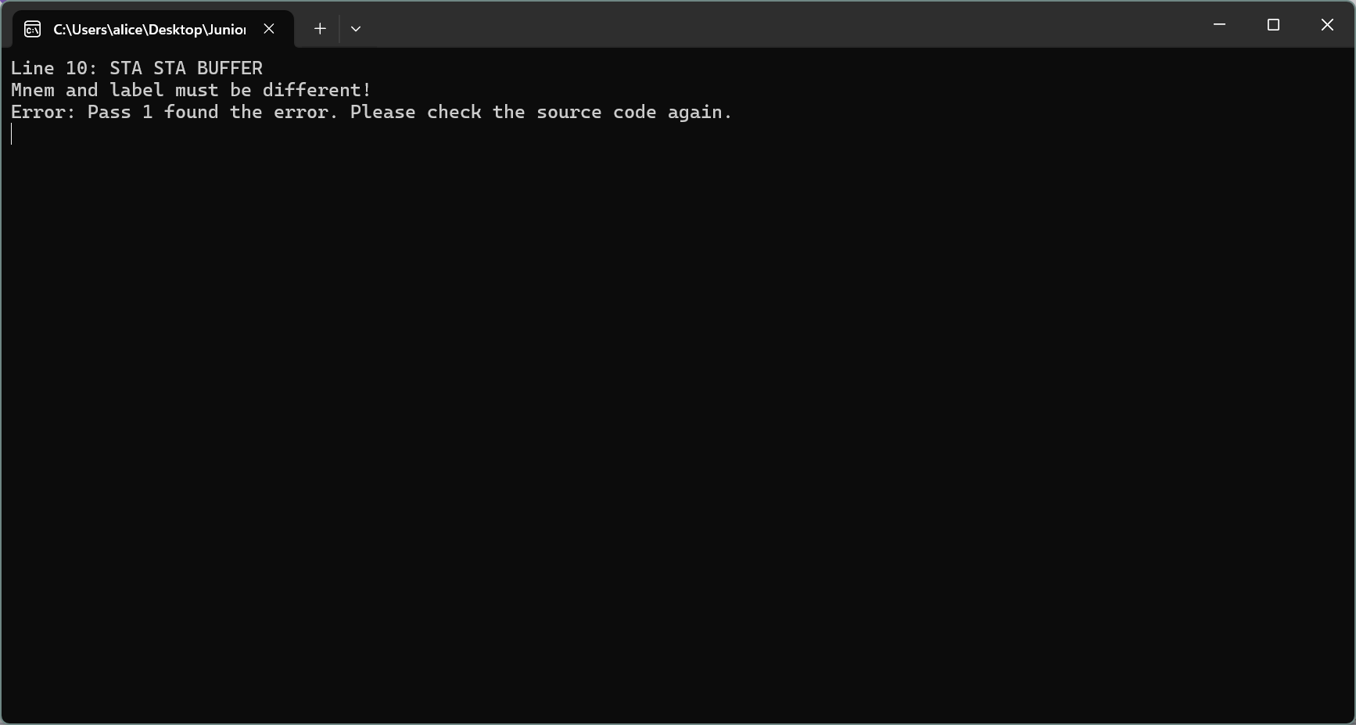

Slide 25
B
Error Handling
☑ Invalid mnemonic

Slide 26
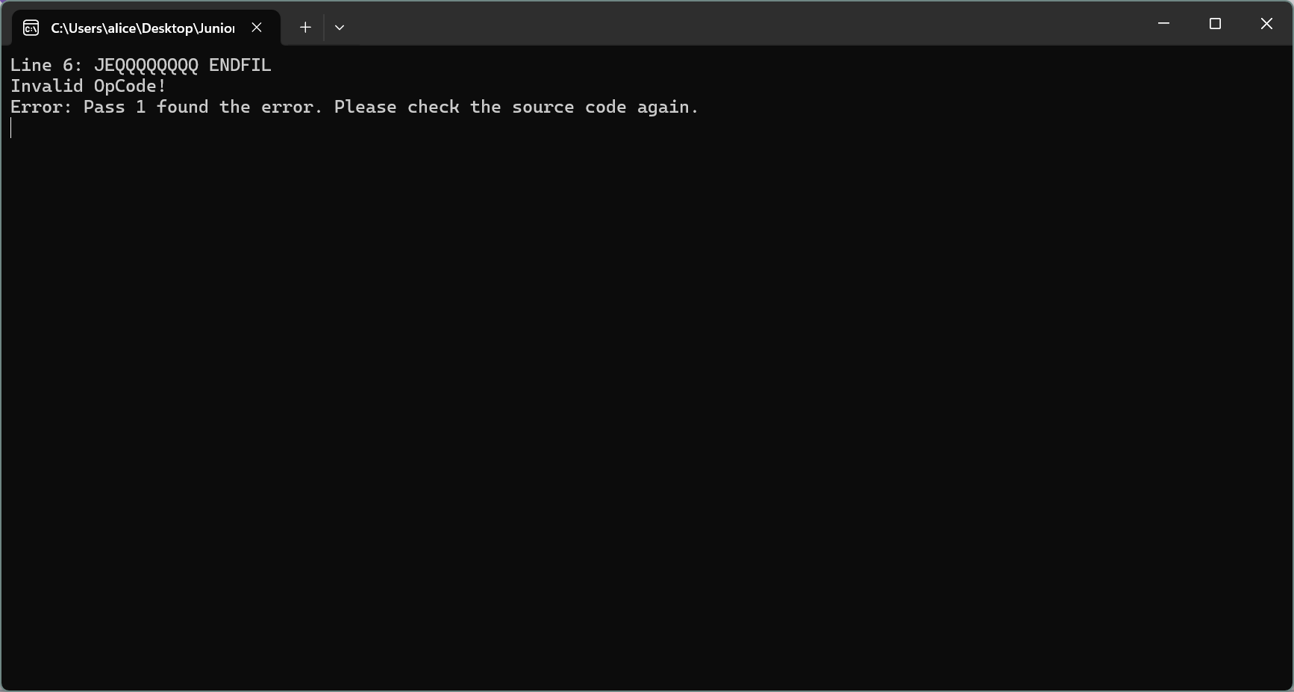

Slide 27
B
Error Handling
☑ RSUB cannot have operand

Slide 28
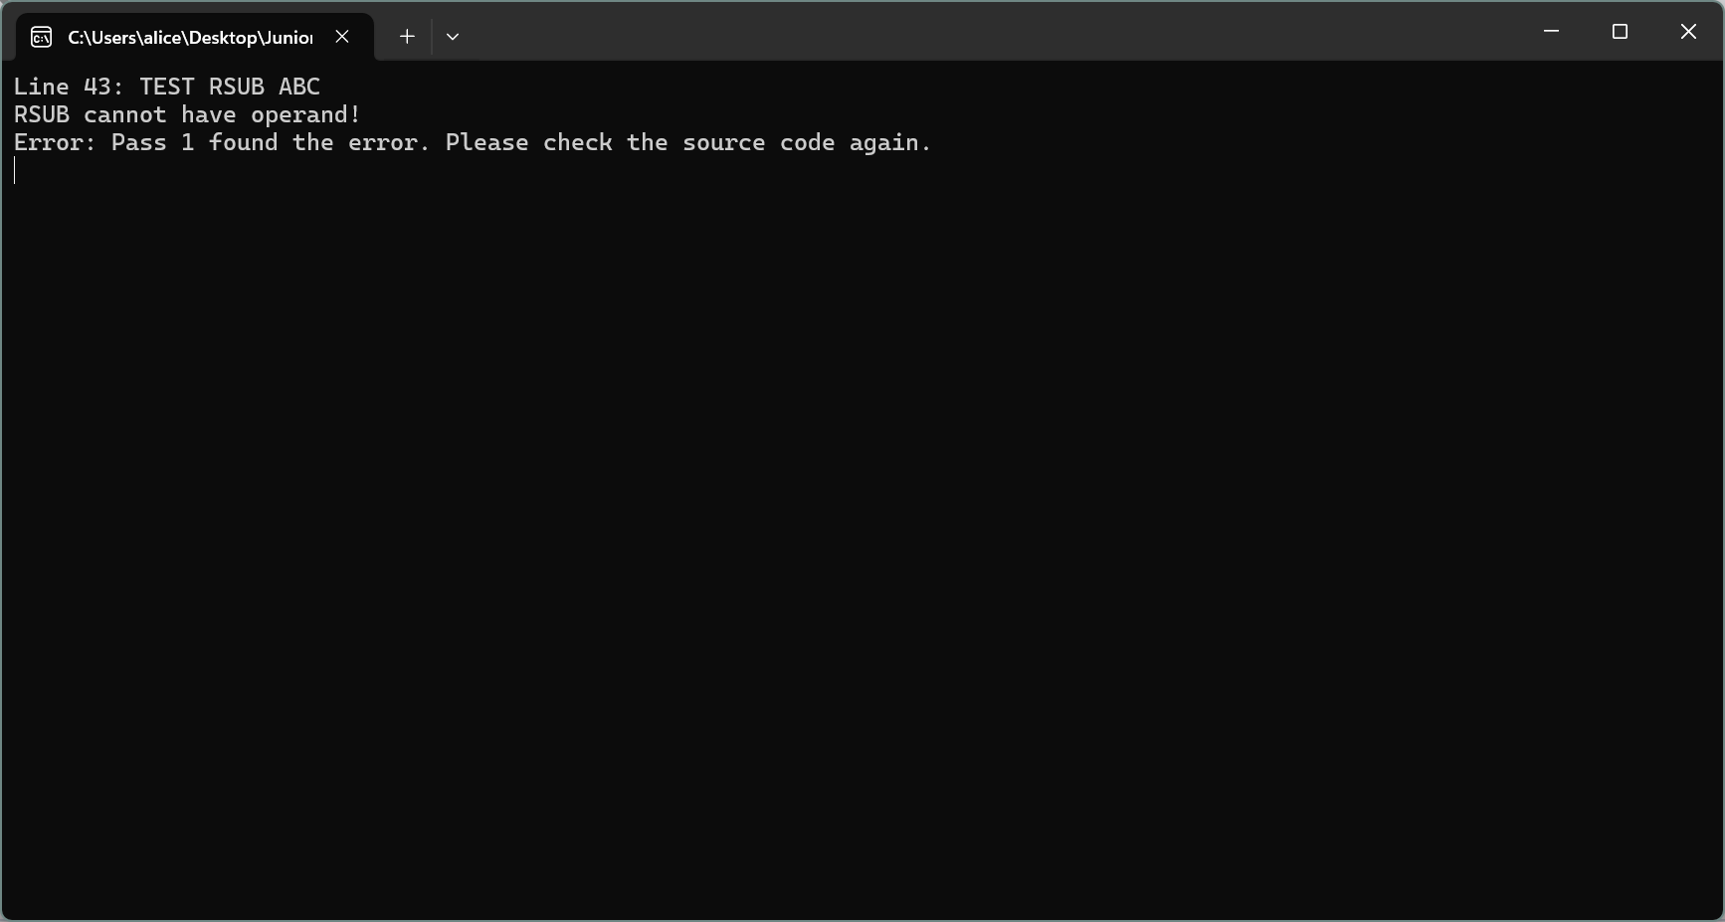

Slide 29
04
Data Structure
Array → char → delim → 儲存分割符號
string → LMO, sep → 切檔後儲存用 → pseudo → 儲存 pseudo code
Bool → isError → 作為 flag
Dictionary → opcode table, symbol table

Slide 30
04
Integer → lineCount → 紀錄行數 loc → 記錄 location
opeRES → 紀錄 pseudo code operand 相關
Prog_Length → object program 紀錄單行長度
String → addr → 紀錄定址方式 line → 讀 source code 用
startAddress, startLabel, endAddress, endLabel
→ object program H and E record 用
pattern → 重寫索引定址

Slide 31
04
List → sourceCode → pass 1儲存原始檔，pass 2 儲存中間檔 output → pass 1儲存於中間檔輸出的內容，pass 2 儲存 object code
StreamReader → fileReader, middle→ 讀檔用
StreamWriter → fileWriter, symbol, objectFile → 寫檔

Slide 32
05
Algorithm
Search opcode table and symbol table → hash

Slide 33
06
Flowchart
https://linky.design/sp-flowchart

