Slide 1
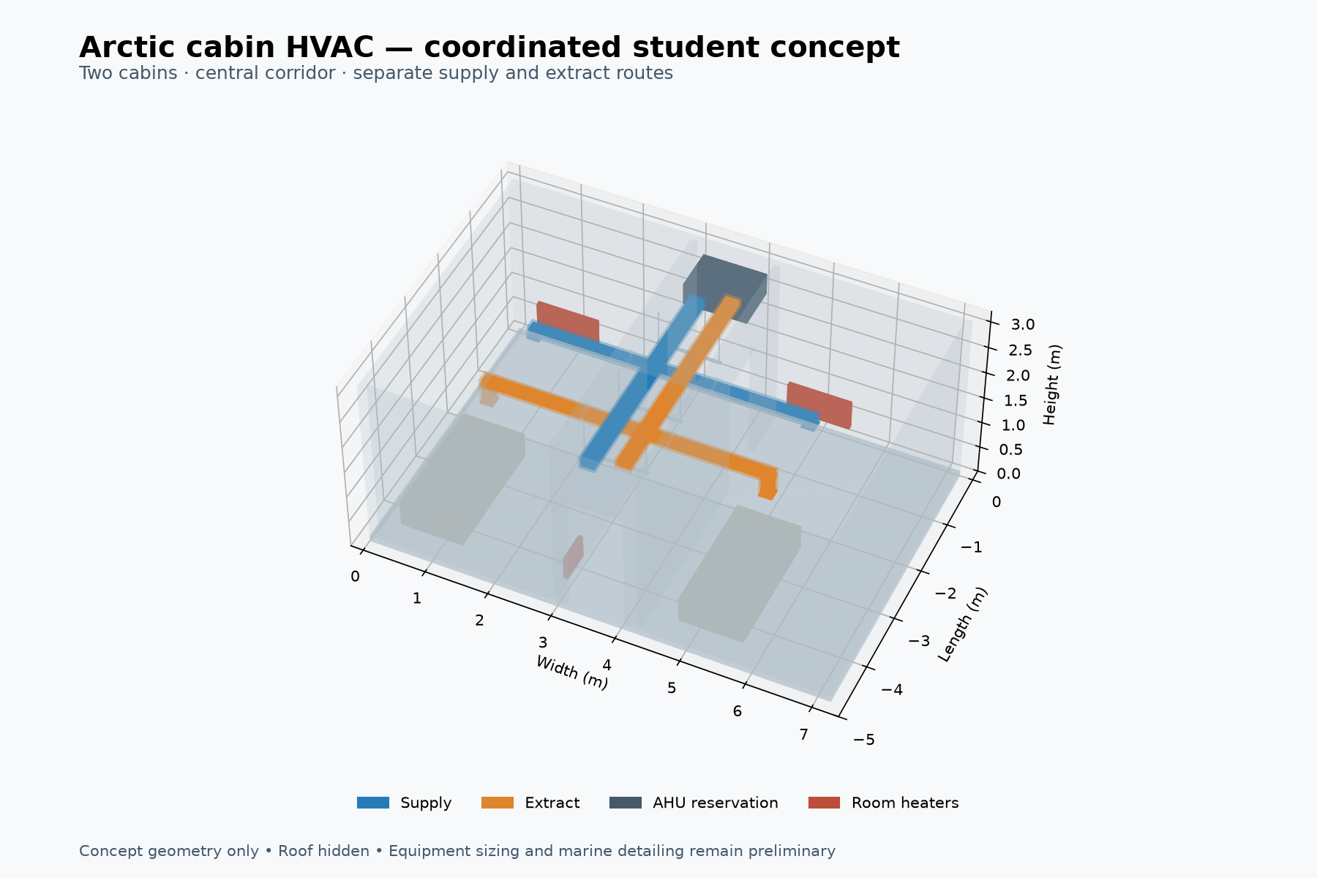
Arctic cabin HVAC
Heating analysis and duct coordination
Two cabins and a corridor
Mechanical engineering portfolio
Y. T. Ahmed / Independent AI-assisted concept study / 1
Notes:
Explain the design as an independent accommodation-module study inspired by Arctic ship integration. The dimensions and thermal values are project assumptions, not a real vessel specification. Source: /Users/yeaalahmed/Documents/Codex/2026-09-12/hi-so-i-want-to-make/outputs/arctic-cabin-concept/Design_Basis.txt

Slide 2
Design basis
Geometry
7.2 × 4.8 m module, 1.2 m clear corridor and 600 mm service zone.
Occupancy and temperatures
Four people, 40 L/s outdoor air, 22°C inside and −30°C design case.
Exposed envelope
Roof and one end wall lose heat outdoors. Adjacent spaces remain heated.
Y. T. Ahmed / Independent AI-assisted concept study / 2
Notes:
Source: /Users/yeaalahmed/Documents/Codex/2026-09-12/hi-so-i-want-to-make/outputs/arctic-cabin-concept/Design_Basis.txt and calculations.json. Roof 34.56 m² at U=0.30 W/m²K, one exposed end wall 21.60 m² at U=0.35. Other boundaries adjoin heated spaces. Infiltration 0.15 ACH. No windows, internal heat gains or heat recovery. Ventilation rate is a study assumption.

Slide 3
Fresh-air heating dominates the winter load
3.64 kW
Calculated total
before allowance
Heat load in kW at −30°C outdoors
Y. T. Ahmed / Independent AI-assisted concept study / 3
Notes:
Source: /Users/yeaalahmed/Documents/Codex/2026-09-12/hi-so-i-want-to-make/outputs/arctic-cabin-concept/calculations.json, -30°C case. Qtransmission=sum(UA)ΔT. Qair=rho cp Vdot ΔT. Infiltration uses occupied volume 75.072 m³ at 0.15 ACH. Total 3636.90 W before allowance. Values in chart rounded to kW. No double counting: local heaters cover envelope and infiltration, while AHU heats outdoor air to room temperature.

Slide 4
Heating allocation
Fresh-air coil: 3.0 kW planning target
2.51 kW calculated duty, or 2.88 kW with the 15% allowance.
Local room heaters: 1.5 kW total target
0.6 kW per cabin and 0.3 kW in the corridor.
Sizing result: 4.18 kW with allowance
The 4.5 kW combined target covers this −30°C study case.
Y. T. Ahmed / Independent AI-assisted concept study / 4
Notes:
Source: /Users/yeaalahmed/Documents/Codex/2026-09-12/hi-so-i-want-to-make/outputs/arctic-cabin-concept/Heating_Calculation_Review.txt and zone_heating.csv. Applying 15% yields 4.182 kW total. Ventilation coil minimum with allowance is 2.885 kW. Cabin local load with allowance 0.532 kW each, corridor 0.233 kW. Planning targets are rounded, not selected products. Total planning target 4.5 kW.

Slide 5
Colder conditions change the equipment target
5.79 kW
At −50°C
Equipment targets need revision.
Total heating demand in kW, including 15%
Y. T. Ahmed / Independent AI-assisted concept study / 5
Notes:
Source: /Users/yeaalahmed/Documents/Codex/2026-09-12/hi-so-i-want-to-make/outputs/arctic-cabin-concept/calculations.json. Constant U values, airflow, density and cp cause linear temperature sensitivity. Chart includes 15% allowance. The 4.5 kW combined planning target falls below demand at -40 and -50°C. Check coil and room heaters separately, not only combined capacity.

Slide 6
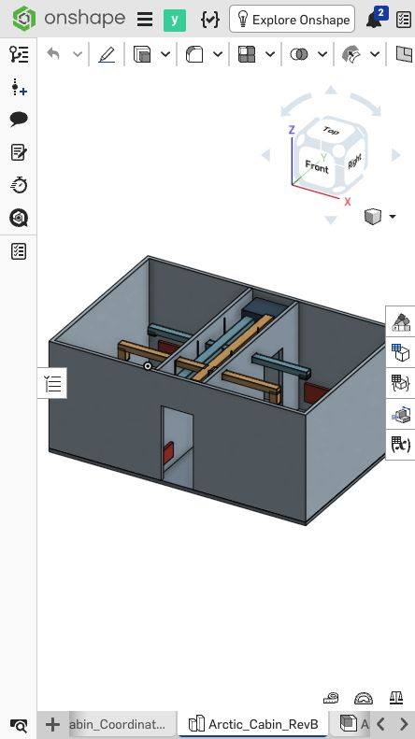
Duct coordination in the service zone
1.33 m/s supply velocity
25 mm insulation modeled
164 mm roof clearance
48 mm crossing gap
Y. T. Ahmed / Independent AI-assisted concept study / 6
Notes:
Sources: /Users/yeaalahmed/Documents/Codex/2026-09-12/hi-so-i-want-to-make/outputs/arctic-cabin-concept/Design_Basis.txt, geometry_checks.json and onshape-revb.jpg. Rev B raises extract elevation 50 mm. Supply main clear 200×150 mm, branches 150×100 mm. 40 L/s main and 20 L/s per branch give 1.33 m/s. STEP includes 43 solids. Supports are space reservations.

Slide 7
Validation and remaining engineering
Completed evidence
43 valid STEP solids and selected duct-clearance checks. Reproducible heating cases.
Pressure-loss scope
About 5.4 Pa for the screened supply route, excluding equipment losses.
Next design stage
Fan selection, frost and condensation control, rated penetrations and service access.
Y. T. Ahmed / Independent AI-assisted concept study / 7
Notes:
Sources: /Users/yeaalahmed/Documents/Codex/2026-09-12/hi-so-i-want-to-make/outputs/arctic-cabin-concept/geometry_checks.json and Design_Basis.txt. No modeled duct/structure, insulation/structure or supply/extract envelope overlaps. The 5.4 Pa route loss excludes filter, coil, terminal and balancing losses. It cannot select a fan. No certification or physical validation.

Slide 8
Engineering contribution and references
Skills demonstrated
Heat balances, sensitivity analysis and mechanical space coordination.
Evidence to discuss
The division between ventilation heating and local room heating, plus duct clearances.
Reference context
Seaspan cabin integration, Genoa polar icebreaker design, ISO 7547 scope and IMO Polar Code.
Y. T. Ahmed / Independent AI-assisted concept study / 8
Notes:
Study uses Onshape context and AI-assisted Python/CadQuery geometry and calculations. Do not claim proprietary vessel design experience. Context: https://www.seaspan.com/stories/designing-the-future-how-vancouver-shipyards-engineers-are-helping-to-change-what-it-means-to-live-and-work-onboard-an-icebreaking-vessel/ ; https://genoadesign.com/projects/polar-icebreaker/ ; https://www.iso.org/standard/76611.html ; https://www.imo.org/en/ourwork/safety/pages/polar-code.aspx . These contextual references do not verify the assumed design inputs or establish compliance.

