Slide 1
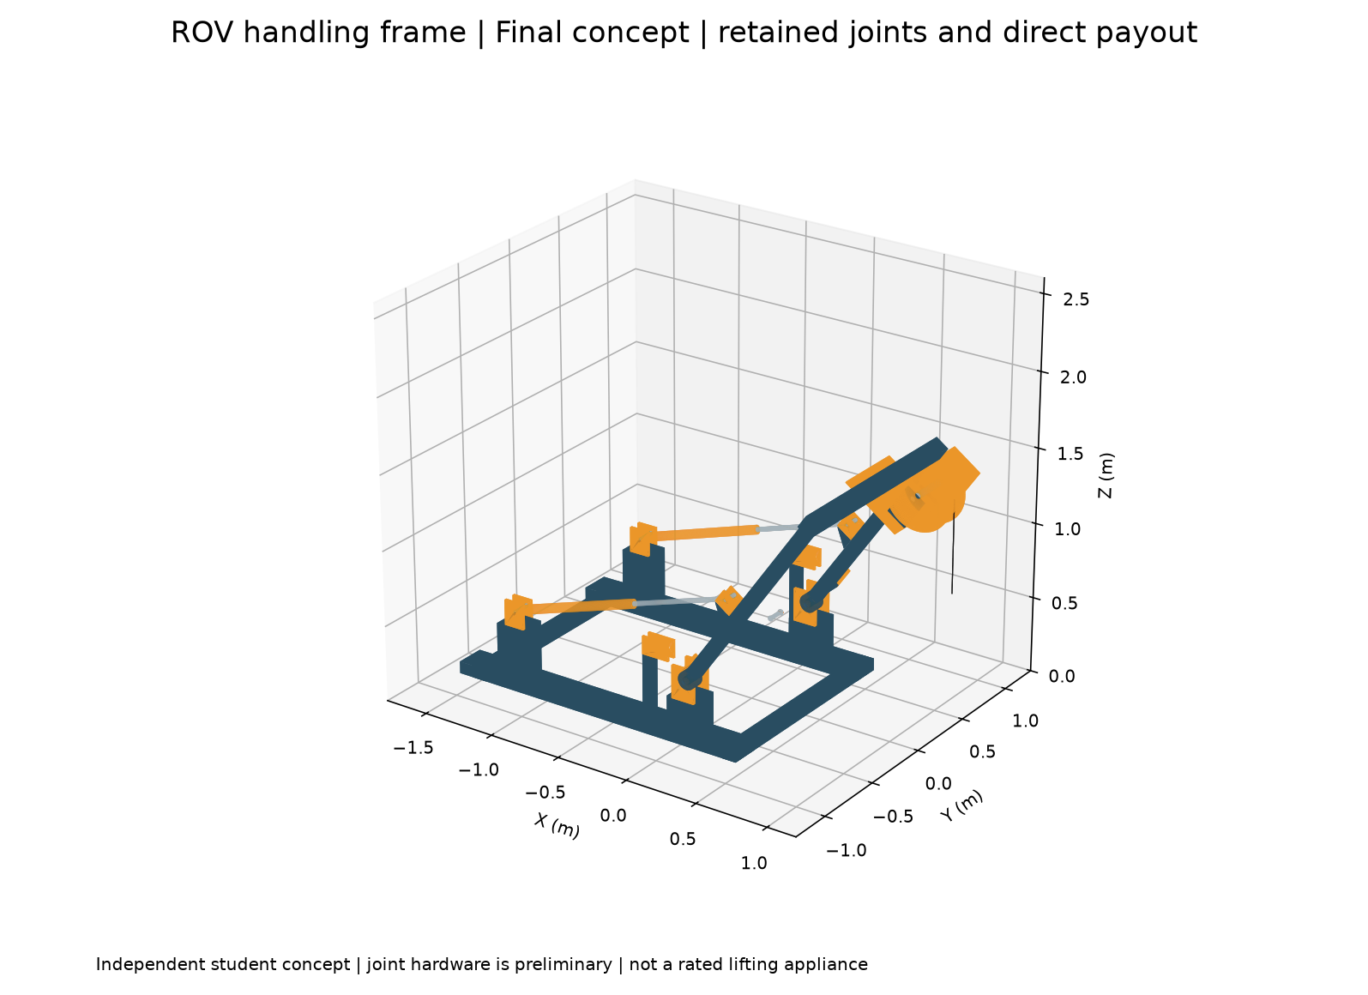
ROV launch frame
Mechanism design and load analysis
Retained joints, parking restraint
and hydraulic packaging
Y. T. Ahmed / Independent AI-assisted concept study / 1
Notes:
Independent AI-assisted concept with an assumed 100 kg payload. It is a pivoting A-frame, not a fully folding transport system. Sources: /Users/yeaalahmed/Documents/Codex/2026-09-12/hi-so-i-want-to-make/outputs/rov-aframe-concept/final/build.py and engineering_results.json. No physical testing, FEA or lifting certification.

Slide 2
Mechanism and operating envelope
100 kg assumed payload
Twin hydraulic cylinders move the frame from −20° to +50° from vertical.
Structural arrangement
1,500 mm pivot-to-head, 1,300 mm leg centres and 80 × 80 × 5 mm SHS legs.
Motion demand
Pin-to-pin cylinder length varies from 1,055 to 1,749 mm.
Y. T. Ahmed / Independent AI-assisted concept study / 2
Notes:
Sources: /Users/yeaalahmed/Documents/Codex/2026-09-12/hi-so-i-want-to-make/outputs/rov-aframe-concept/final/build.py, engineering_results.json. Frame pivot (0,400), actuator fixed pin (-1280,500), upright moving pin (-120,1050), all mm. The rearward pin avoids the leg. Deck foundation remains unverified. CAD unit mm.

Slide 3
Cylinder geometry fits the motion range
ABCo NFR2300800 dimensional reference
50 mm bore, 30 mm rod and 800 mm stroke. Closed/open pin centres: 1,000 / 1,800 mm.
694 mm required travel
About 55 mm retraction margin and 51 mm extension margin.
Temperature boundary
Supplier minimum: −25°C. Arctic or marine service requires further selection.
Y. T. Ahmed / Independent AI-assisted concept study / 3
Notes:
Source: /Users/yeaalahmed/Documents/Codex/2026-09-12/hi-so-i-want-to-make/outputs/rov-aframe-concept/final/engineering_results.json and supplier drawing. https://www.abcohydraulics.com/product/pin-mounted-double-single-acting-hydraulic-cylinder-bore-rod-stroke-50x30x800-nfr2300800/ and https://www.abcohydraulics.com/wp-content/uploads/2022/04/Stock-Cylinder-Dimensions.pdf . Reference is dimensional, not marine qualification. Bore 50, rod 30, eye bore 25.25 and eye width 45 mm. Supplier temperature limit -25°C. Confirm tolerances and actual installed envelope.

Slide 4
Mass and load sharing affect actuator demand
7.14 kN
Highest screened
actuator demand
145.7 kg moving CAD mass
Case labels: payload multiplier / side share
Y. T. Ahmed / Independent AI-assisted concept study / 4
Notes:
Source: /Users/yeaalahmed/Documents/Codex/2026-09-12/hi-so-i-want-to-make/outputs/rov-aframe-concept/final/engineering_results.json. Moving CAD mass 145.70 kg, including assumed motor/brake 12 kg. Cylinders add 13 kg moving equivalent of 26 kg total. Payload multipliers and side share are sensitivity assumptions, not code cases. Peak actuator forces are absolute magnitudes. Static model omits vessel, lateral and snag loads.

Slide 5
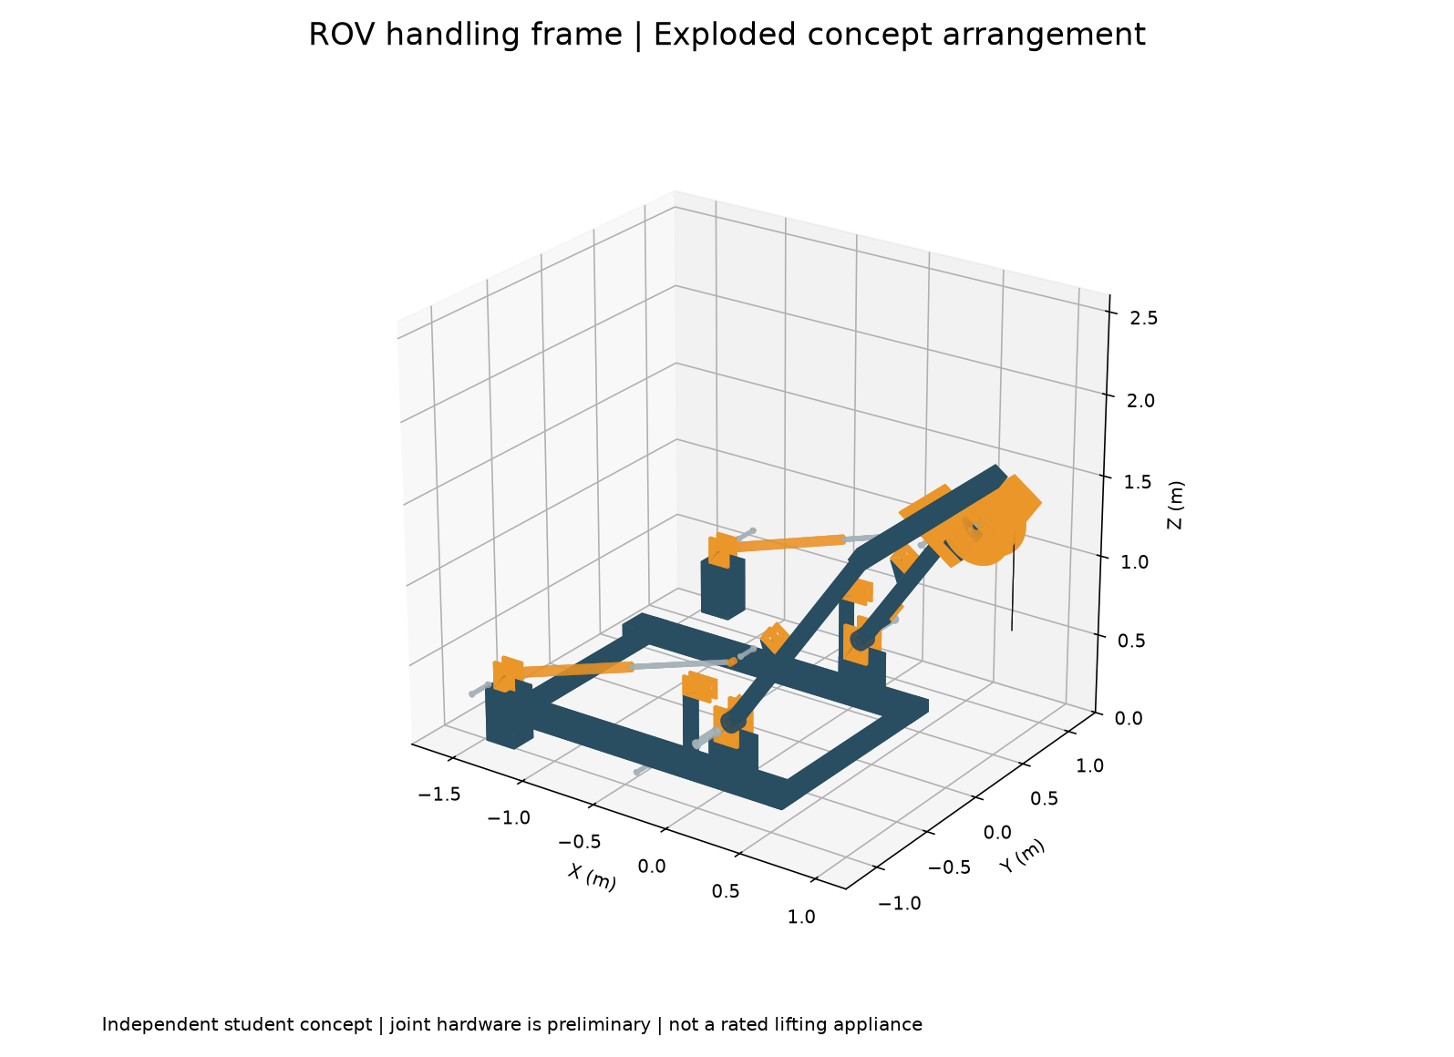
Retained joints and unloaded parking
40 mm main pivot pins
25 mm actuator pins
Two removable parking pins
−20° unloaded parking position
Y. T. Ahmed / Independent AI-assisted concept study / 5
Notes:
Source: /Users/yeaalahmed/Documents/Codex/2026-09-12/hi-so-i-want-to-make/outputs/rov-aframe-concept/final/build.py, parked_locked.step and engineering_results.json. Main pivot pins 40 mm. Actuator and parking pins 25 mm. Washers, flanged heads and cross-drilled keeper envelopes modeled, not detailed commercial retainers. Frame-only parking calculation uses illustrative 2g, gives 2.10 kN per pin. It is not a sea-fastening rating.

Slide 6
Direct payout drum
400 mm rope pitch diameter
The overhung drum provides a vertical lifting-line path past the frame.
18.85 m calculated single-layer capacity
Against 15 m study payout, with an assumed three retained turns.
1.96 kN line pull and 392 Nm ideal torque
Rope, motor and brake product selection remain outside the concept.
Y. T. Ahmed / Independent AI-assisted concept study / 6
Notes:
Source: /Users/yeaalahmed/Documents/Codex/2026-09-12/hi-so-i-want-to-make/outputs/rov-aframe-concept/final/engineering_results.json. Assumed rope diameter 6 mm and lay pitch 7.5 mm across 140 mm face, 18 whole turns with 3 retained turns. Usable (18-3)*pi*.4=18.85 m. Study payout 15 m. Line pull 100*9.81*2=1962 N. Torque F*.2=392.4 Nm before losses. No selected rope MBL, motor or brake. https://liftingsolutions.ingersollrand.com/en/resources/winch-selection-support/fleet-angle-calculations/ provides context for fixed-lead limitations.

Slide 7
Verification evidence and limits
80 valid solids, 15 sampled positions
No overlaps in selected frame, cylinder and three rope-payout lane checks.
Preliminary stress screens
Actuator pin: 94 MPa combined simplified stress. Upper leg: 76.6 MPa bending.
Unverified capacity
Materials, welds, fatigue, foundation and hydraulic load holding need further engineering.
Y. T. Ahmed / Independent AI-assisted concept study / 7
Notes:
Sources: /Users/yeaalahmed/Documents/Codex/2026-09-12/hi-so-i-want-to-make/outputs/rov-aframe-concept/final/geometry_checks.json and engineering_results.json. 80 valid solids. Selected pairs at 15 angles. 25 mm actuator pin combined simple stress 93.99 MPa, 40 mm pivot 44.39 MPa, upper leg bending 76.56 MPa. No material allowable comparison gives a capacity rating. Cylinder force at 100 bar: push19.63/pull12.57 kN, before losses. Parker https://www.parker.com/parkerimages/mobilecylinder/cat/english/0001q.pdf for buckling/mounting context.

Slide 8
Design decisions worth discussing
Geometry and loads developed together
Cylinder fit, actuator leverage and CAD mass informed the mechanism.
Service details improved the concept
Retained pins, removable parking locks and direct payout make the interfaces explicit.
Next engineering gate
Select a rated winch and rope, resolve hydraulic controls, then verify structure and foundation.
Y. T. Ahmed / Independent AI-assisted concept study / 8
Notes:
Sources: /Users/yeaalahmed/Documents/Codex/2026-09-12/hi-so-i-want-to-make/outputs/rov-aframe-concept/final/ROV_Launch_Frame_Final_Concept.pdf and build.py. State contribution as an AI-assisted parametric study that the presenter can explain, not a manufactured or certified system. Supplier and design context citations are in notes on slides 3,6,7. No portfolio publication has occurred.

