Slide 1
Youth Drug Use Analysis Using Decision Trees
Decision Trees, Random Forests, and Boosting with NSDUH Data
Presented by: Yeabsera Worku Genet

Slide 2
Introduction & Objective
Introduction & Objective
This study explores how machine learning models can predict youth substance use.Using data from the 2023 ( National Survey on Drug Use and Health) NSDUH survey focused on individuals under 18.
It aims to identify important predictors of marijuana and cigarette use.
Goals:
Predict marijuana use (Yes/No)
Classify marijuana use frequency
Model cigarette use days

Slide 3
About the Dataset
Source: National Survey on Drug Use and Health NSDUH 2023 by Substance Abuse and Mental Health Services Administration (SAMHSA)
Population: U.S. youth aged 12–17
Size: ~10,500 participants
Key Variables: Gender, Income, Poverty Level, Health, Alcohol Use, Tobacco Use, Cigarette Days

Slide 4
Theoretical Background
Decision Trees:
Recursively split data based on features that maximize separation of classes using measures like Gini impurity.
Easy to interpret and visualize.
Tuned using complexity parameter (cp) for pruning to prevent overfitting.
Random Forests:
Uses bagging and random feature selection to improve stability and accuracy over single decision trees.
Key hyperparameters: number of trees and mtry (number of features per split).
Offers feature importance rankings.
Gradient Boosting Machines (GBM):
Builds trees sequentially where each new tree learns to correct residual errors from the previous tree.
Powerful but can overfit without tuning.
Key hyperparameters: learning rate, number of trees, tree depth.

Slide 5
Evaluation Metrics
Classification
Accuracy: % of correct predictions.
Sensitivity: % of actual positives correctly identified.
Specificity: % of actual negatives correctly identified.
Kappa: agreement beyond chance between predicted
and true labels.
Regression
RMSE: Root Mean Squared Error, penalizes large errors.
MAE: Mean Absolute Error, easier to interpret, less penalizing.
R²: Proportion of variance explained by the model.

Slide 6
Methodology
Data Preparation:
Dropped rows with missing or imputed values in outcome variables.
Converted categorical variables to ordered factors.
Binary target: MRJFLAG (marijuana use: Yes/No)
Multi-class target: MJuseFreq (categorical marijuana frequency)
Regression target: IRCIGFM (cigarette use days)
Train/Test Split:
70% training set, 30% test set
Model Implementation:
Decision Tree: rpart() with cross-validated pruning
Random Forest: randomForest() with 5-fold cross-validation on mtry
GBM: gbm() with tuning on learning rate, tree depth, and number of trees

Slide 7
Result and Discussion
Marijuana Use (Binary Classification)
Model: Decision Tree (rpart)
Key Splits: Alcohol Use → Tobacco Use
Performance Metrics:
Accuracy: 88.8%
Sensitivity: 97.96% (good at identifying non-users)
Specificity: 37.32% (missed many actual users)
Confusion Matrix shows many false negatives.
Insight: Strong association between alcohol/tobacco use and marijuana use.

Slide 8
Decision three to predict marijuana use
Key Takeaways
Behavioral factors (alcohol & tobacco) are strong predictors of marijuana use.
Youth with no alcohol or tobacco use are the least likely to use marijuana.
Youth who use both alcohol and tobacco have the highest likelihood of marijuana use.
Root : All Youth
No: 6280
Yes: 1113
100%
ALCOHOL USE
Alcohol use=Yes
No: 842
Yes: 829 , 23%
Tobacco use
Alcohol use=NO
No: 5438
Yes: 284
77%
Tobacco use=No
No: 738
Yes: 424
16%
Tobacco use=No
No: 104
Yes: 405
7%

Slide 9
Conti…
Confusion Matrix
Additional Statistics:
Accuracy: 0.8883
95% Confidence Interval: (0.8768, 0.899)
No Information Rate: 0.8494
P-Value [Acc > NIR]: 1.284e-10
Kappa: 0.4467
McNemar's Test P-Value: < 2.2e-16
Sensitivity: 0.9796
Specificity: 0.3732
Positive Predictive Value: 0.8981
Negative Predictive Value: 0.7639
Prevalence: 0.8494
Detection Prevalence: 0.9265
Detection Rate: 0.8321
Balanced Accuracy: 0.6764
 | Predicted No | Predicted Yes
Actual No | 2636 | 55
Actual Yes | 299 | 178

Slide 10
Results – Marijuana Use Frequency
Class-level Statistics
Class | Sensitivity | Specificity | Pos Pred Value | Neg Pred Value | Balanced Accuracy
1–2 days | 0.1500 | 0.8831 | 0.3333 | 0.7273 | 0.5166
3–5 days | 0.0000 | 1.0000 | NaN | 0.7757 | 0.5000
6–19 days | 0.0175 | 0.9809 | 0.2500 | 0.7333 | 0.4992
20–30 days | 0.9388 | 0.1697 | 0.2514 | 0.9032 | 0.5542
Confusion Matrix:
Prediction \ Actual | None | 1–2 days | 3–5 days | 6–19 days | 20–30 days
None | 0 | 0 | 0 | 0 | 0
1–2 days | 0 | 9 | 9 | 7 | 2
3–5 days | 0 | 0 | 0 | 0 | 0
6–19 days | 0 | 0 | 2 | 1 | 1
20–30 days | 0 | 51 | 37 | 49 | 46

Slide 11
Confusion Matrix & Model Performance (Marijuana Use Frequency)
Model heavily overpredicts the “20–30 days” class (85% of predictions), missing most lower-use categories.
Accuracy is low (26.2%) and Kappa near zero (0.03), indicating the model performs only slightly better than chance.
Sensitivity is very high for heavy users (94%), but near zero for moderate use classes like 3–5 or 6–19 days.
Key Takeaway: The model successfully identifies heavy marijuana users but fails to detect light and moderate use due to class imbalance and factor level issues. Fixing data handling and using better-balanced, ordinal-aware models can greatly improve classification across all usage levels.

Slide 12
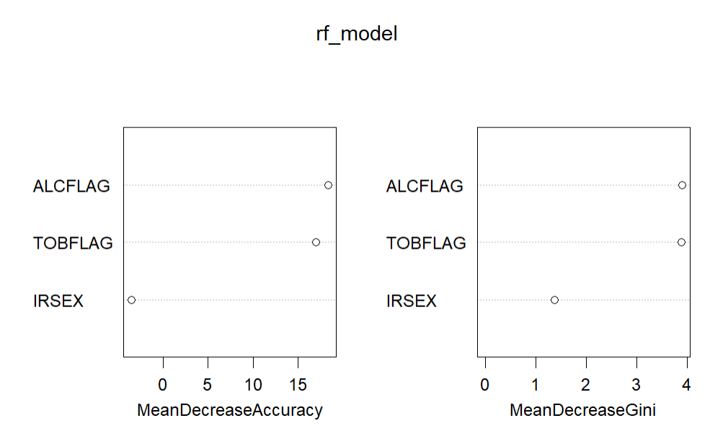

Slide 13
Feature Importance Interpretation (Random Forest)
Alcohol Use (ALCFLAG) is the most important predictor of marijuana use frequency, as shown by the highest scores in both accuracy decrease and Gini impurity.
Tobacco Use (TOBFLAG) is the second strongest indicator, also contributing significantly to model decisions.
Gender (IRSEX) has minimal influence, suggesting it adds little value in predicting marijuana use compared to behavioral factors.
Key takeaway: Behavioral variables (alcohol and tobacco use) are far more predictive than demographic ones like gender.

Slide 14
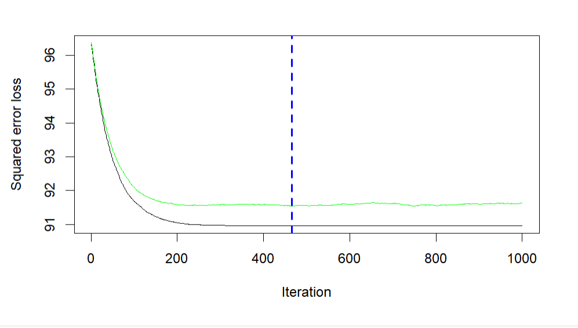
Results : Cigarette Use (Regression)
The plot shows squared error loss vs. iteration.
Loss decreases rapidly and stabilizes around iteration ~450 (blue vertical line), suggesting this is the optimal number of boosting iterations before overfitting begins.
Best performance at ~400 trees (validated by GBM loss plot).

Slide 15
Model Performance Table
Metric | Value
RMSE | 10.2063
R-squared | 0.0578
MAE | 2.2731
RMSE (Root Mean Squared Error) of 10.21 means that, on average, the model’s predictions deviate from the actual values by about 10 units.
MAE (Mean Absolute Error) of 2.27 shows the average magnitude of errors without considering direction.
R-squared of 0.058 means that the model explains only 5.8% of the variability in the response variable — indicating weak predictive power.

Slide 16
Conclusions
We applied three models to explore youth drug use prediction using NSDUH 2023 data:
Decision Tree (Binary Classification – Marijuana Use Yes/No): This model achieved high accuracy (88.8%) and excellent sensitivity (97.9%) for detecting non-users. However, it had low specificity (37%), meaning it missed many actual users.
Random Forest (Multi-class Classification – Marijuana Use Frequency): Accuracy was low at 26.2%, with a Kappa of only 0.033, indicating minimal agreement beyond chance. The model overpredicted heavy users (20–30 days) and performed poorly on moderate/lower-use categories due to class imbalance.
Gradient Boosted Machine (Regression – Cigarette Use Days): The model had an RMSE of 10.21 and R² of 0.058, meaning it could explain only 5.8% of the variability in cigarette use. While the model learned general patterns, it lacked precision in predicting individual outcomes.

Slide 17
References
1.NSDUH 2023 – Substance Abuse and Mental Health Services Administration (SAMHSA)
2.James et al. (2021) – An Introduction to Statistical Learning (ISLR2)
3.R packages: rpart, randomForest, gbm, caret, pROC
4.NHIS 2022 Codebook – IPUMS

Slide 18
THANK YOU!!!

