Slide 1
Introduction
This paper proposes an intelligent mining algorithm for complex attribute medical data based on deep learning.
discrete processing on complex attribute medical data to obtain applicable data types
classifes medical data with diferent attributes according to medical data association rules
finally completes complex attribute medical data mining

Slide 2
How to mine complex medical data intelligently is become an urgent problem in the medical industry
the feld of medical information is facing difculties such as fewer talents and poor academic skills, more difculty in complex attributes of medical data mining, and a wide range of coverage, which greatly limits the application of mining technology in medical data
Conducted in-depth research on medical text entity recognition methods and achieved good research results, verifying the superiority of computer technology
applied mining intelligent technology well, and solved the problem of data loss based on mining technology
pointed out that machine intelligence has powerful algorithmic capabilities, can fnd hidden patterns in data, acquires features of things based on data association patterns, and solves complex medical dataset calculation problems
established a Python-based software platform to facilitate data-driven method analysis, using data mining and statistical learning methods, by using data mining * Xiaofeng Li mberse@126.com 1 Department of Information Engineering, Heilongjiang International University, Harbin 150025, China 2 School of Computer Science and Technology, Harbin Institute of Technology, Harbin 150001, China 3 College of Mathematics and Econometrics, Hunan University, Changsha 410082, China 4 School of Physical Education, Northeast Normal University, Changchun 130024, China X. Li et al. 1 3 and statistical learning methods, the data set is analyzed and a prediction model is established, which gives full play to the superior performance of data mining technology
pointed out that the existing sequential frequent itemsets mining methods have certain limitations. A fast frequent itemset mining method based on GPU is proposed. By making full use of the computing power of the GPU, a very fast performance is achieved, which is suitable for large-scale data.
From the analysis of Fig. 3, we can see that the frequency of data mining is at a high level under diferent mining factors, and the state of data mining is stable. From this, we can conclude that the mining efciency of this algorithm is higher and the time consuming is lower when mining complex attribute medical data, which can save a lot of data mining time. In order to furthe
However, it can be clearly seen that the accuracy of these two algorithms is lower than the other algorithms, and the results are not good. According to the above analysis, it can be seen that the accuracy of the proposed algorithm extraction is high, which can well match the output value of medical data. This is because the proposed algorithm uses the convolutional neural network to extract the association rules of medical data, and uses the association coefficient matrix and the difference coefficient matrix to obtain the association mapping of the data set. The association mapping relationship is used to obtain all the association rules of the complex attribute medical data set, thereby improving the accuracy of association rule extraction, and the medical data mining effect is better.

Slide 3
Steps
1. Discretized medical data with complex attributes, and the processed data is more suitable for subsequent research on convolutional neural networks;
2. The association rules of medical data with complex attributes are extracted, and the associations between data sets are analyzed, which lays the foundation for data mining research;
3. Before data mining, data classifcation was performed frst, which efectively improved mining accuracy;
4. The performance of the proposed algorithm is verifed by multiple groups of comparative experiments. The index content is rich and the results have certain reliability.

Slide 4
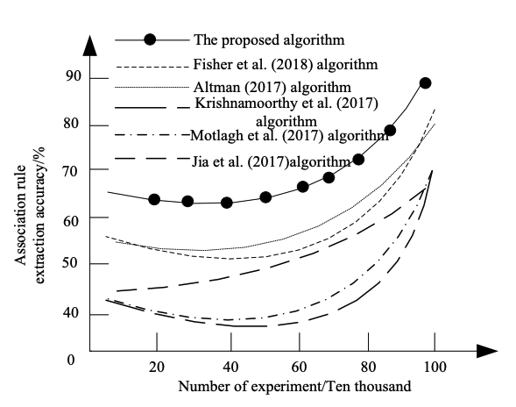
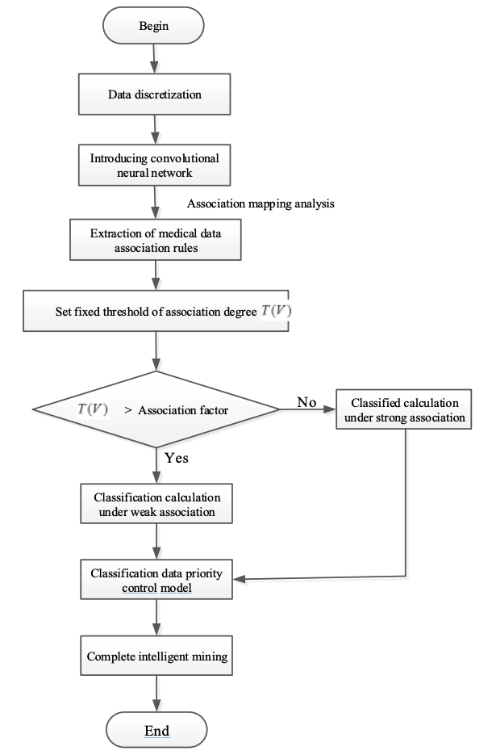
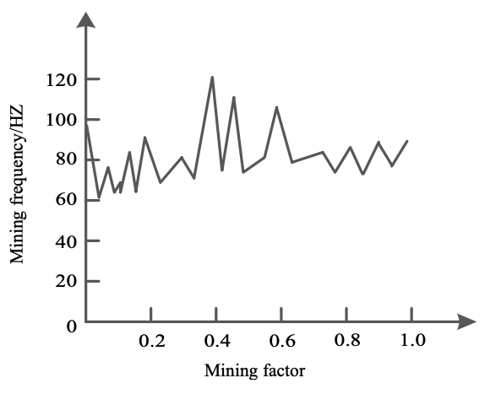
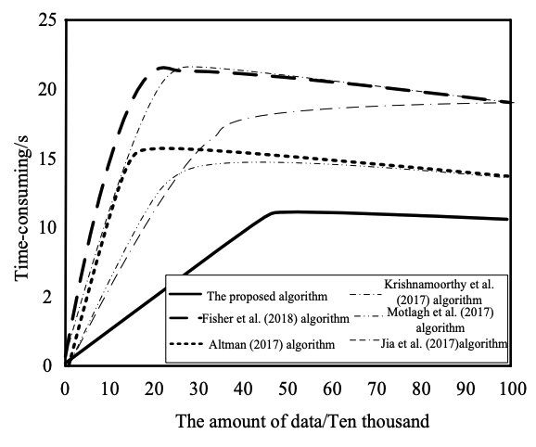
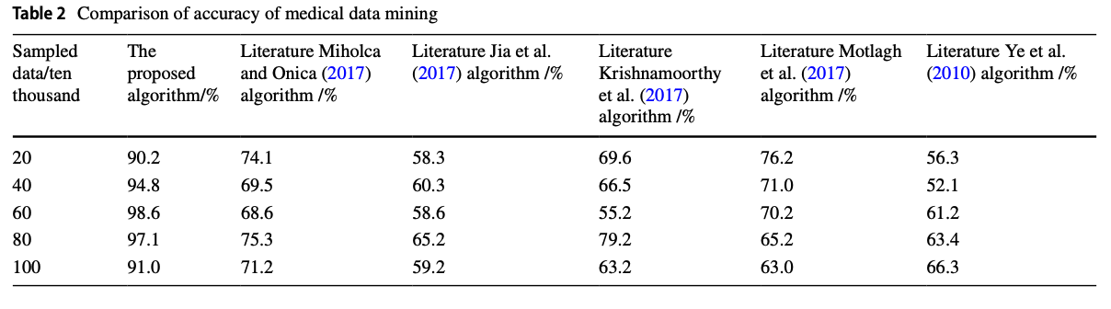

Slide 5
Intelligent Mining of Complex Medical Data
Challenges in Complex Medical Data Analysis
Proposed intelligent mining algorithm
Deep learning approach for complex medical data
Addressing low precision, long processing time, and low recall rate
Discretization and association rule extraction
Experimental validation and results

