Slide 1
CROSS-DEVICE · TASK-ORIENTED AI
Your AI team. Real work.
From anywhere.
Direct complex tasks from your phone.
Let your AI team work on the machines you connect.
Multi-VP teams / Your system prompts / Work Center automation
Notes:
开场：Yeaft 是跨设备、面向任务的 AI 产品。手机是入口，不是算力所在地；你可以从手机发起复杂工作，由所连接机器上的 Agent 执行。多 VP 是团队，System Prompt 是职责与工作规则，Work Center 让目标跨越单轮对话持续推进。不要把“from anywhere”解释为离线可用：需要能访问 Server，执行 Agent 也必须在线。

Slide 2
WHY YEAFT
Delegate the work—not another round of prompting.
Imagine asking from your phone: “Fix this bug, add a regression test, and prepare a reviewed patch.”
ACCESS
COORDINATION
FOLLOW-THROUGH
Away from your desk.
More than one role.
Beyond one reply.
The code and tools are on another machine. You still need to move the task forward.
Investigation, implementation, and review need distinct responsibilities.
Complex work needs execution, checks, recovery, and a clear completion condition.
Yeaft brings access, team control, and task execution into one product.
Notes:
先说人的痛点，而不是堆技术名词。提出一个全场贯穿的使用场景：不在电脑旁时，把带验收标准的 bug 修复交给 AI。它是演示建议，不是已完成的客户案例。三类阻力是设备限制、手动协调和逐轮催促。不声称所有竞品都有这些缺点。

Slide 3
CROSS-DEVICE EXECUTION
Your phone is the control surface. The Agent does the work.
Use a mobile or desktop browser. Connect the machine that has your project and tools.
YOUR CONNECTED AGENT
ANY BROWSER
SERVER
Session + multi-VP team
Phone + tablet + desktop
Authentication + relay
Interactive work, with named contributors
Work Center · Preview
Files, shell, and provider access stay Agent-side.
Requires a reachable Server and an online Agent.
Persistent goals and automated execution
Notes:
讲清手机为什么不只是聊天窗口：浏览器经过 Server 的鉴权和中继，连接用户选择的 Agent。文件、Shell 和模型调用在 Agent 一侧执行，手机不需要运行这些工具。桌面、手机浏览器访问同一 Agent 所属的持久 Session；跨 Agent 不是同一份 Session。Session 和 Work Center 是不同的持久对象，不自动迁移。需要网络可达和在线 Agent。

Slide 4
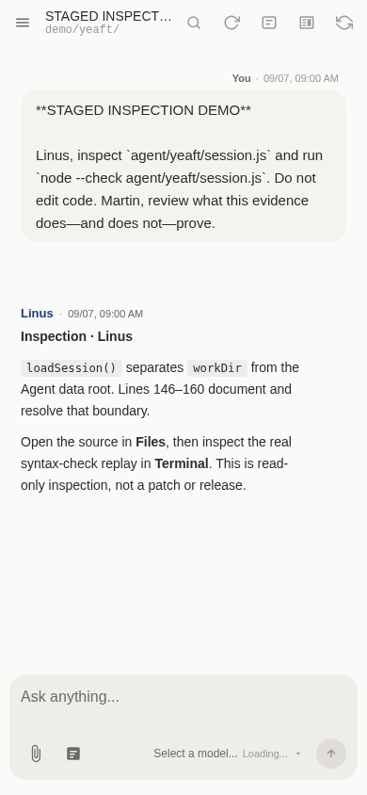
01 / CROSS-DEVICE ACCESS
Step away from the desk—not from the task.
START FROM YOUR PHONE
The project stays on the Agent.
The conversation comes with you.
Send the goal. Read named replies.
Add direction when the work needs a decision.
Continue in a desktop browser with the same Agent + Session.
Real Yeaft UI · Staged inspection demo · Mobile viewport
Notes:
展示真正的移动端响应式界面，不用手机外框代替能力证明。讲用户动作：选择 Agent 和 Session、发起需求、查看回复、在需要时补充决策。图中为隔离环境的只读语法检查示例，只证明 UI 展示，不声称已在手机上完成 bug 修复或实测了跨公网设备接力。演示时可以打开手机浏览器操作同一 Agent 的 Session。

Slide 5
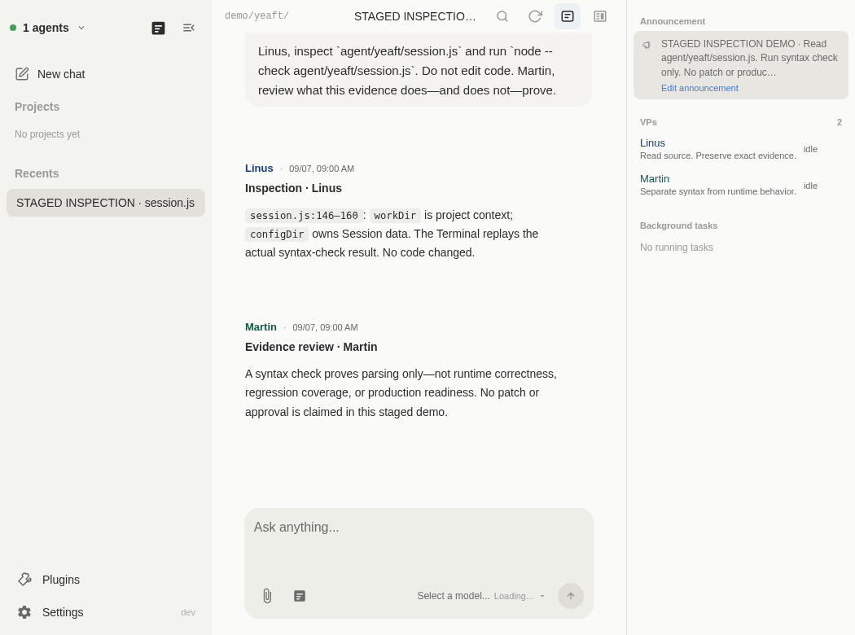
02 / MULTI-VP TEAMS
One workspace. Different minds on the problem.
BUILD
Give an implementer a focused responsibility.
CHALLENGE
Let a reviewer question the result—not just echo it.
Real Yeaft UI · Staged inspection demo · 1..N VPs per Session
Notes:
VP 是 Virtual Person，不是另一台机器。一个 Session 可以有 1..N 个 VP：从一个助手起步，需要时加入实现、审查、研究等不同角色。用户 mention 可以选中成员；VP 间明确交接需要工具路由。截图中的 Linus 和 Martin 是演示配置，不是每个 Session 都内置的强制流程，也不构成对本 PPT 的真实独立审查。

Slide 6
03 / YOUR SYSTEM PROMPTS
Define how your AI team works.
Configure VP personas. Carry shared rules through Project instructions and repository docs.
VP PERSONA / EXAMPLE
PROJECT RULES / EXAMPLE
Give the role a contract.
Keep standards consistent.
“Act as an implementer.
Make the smallest useful change.
Report tests and open risks.”
“Review the exact revision.
Ask before deployment.
Never claim an unrun test passed.”
Reusable instructions—not a one-off reminder in every conversation.
Notes:
这是产品差异点，不再把 VP 只讲成两个头像。用户可以配置 VP persona prompt；Project instruction 和工作目录 CLAUDE.md / AGENTS.md 提供共享规则。这里展示的是可配置指令示例，不是 UI 截图或已经实施的强制策略。System Prompt 定义 AI 如何工作，但并非 OS sandbox 或绝对安全保证；运行时权限与工具边界仍独立生效。

Slide 7
04 / TASK-ORIENTED AUTOMATION · PREVIEW
Give it a goal—not a script of prompts.
Use Session to work with AI. Use Work Center to delegate work to AI.
YOU DEFINE
AI EXECUTES
YOU CHECK
Goal + constraints
Working directory
Acceptance criteria
Plan and assign work
Run tools and checks
Record outcomes
Result + evidence
Or a specific decision
that needs your input
Less turn-by-turn supervision. A persistent goal with visible execution.
Notes:
过渡：Session 适合人和 AI 共同探索，Work Center 适合目标明确后的自动化执行。用户交的是目标、约束和验收，而不是每一步 prompt。概念图说明面向任务的使用方式，不暗示所有任务采用固定 VP 顺序、无限重试或自动成功。Work Center 不等于另一种 chat mode，也不是把 Session transcript 自动转换过去。

Slide 8
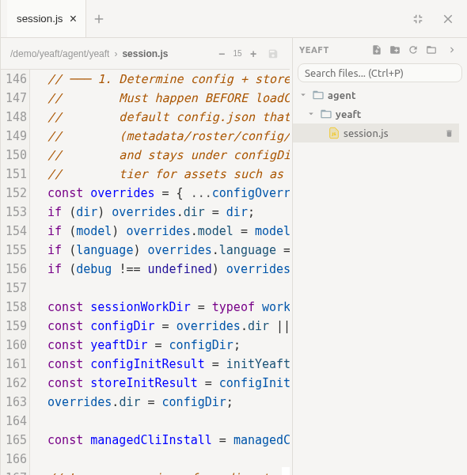
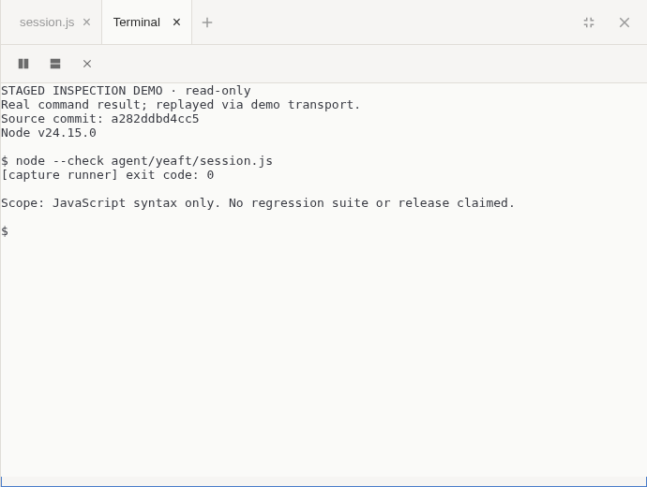
REAL TOOLS. VISIBLE WORK.
More than a chat window: a working environment.
FILES / inspect the actual source
TERMINAL / inspect command output
Stay close to the files the Agent works with.
Example: node --check, not a full test suite.
Real Yeaft UI · Staged inspection demo · Recorded command output
Notes:
工具和文件把“AI 说做了”连接到可查看的实际工作环境。保留用户认可的真实 Files 和 Terminal 组件截图。这里的 terminal 只回放实际 node --check 结果；截图里的语法检查不是 bug 修复证明，也不是完整测试。讲清楚这一句即可，不要把全场重新讲成语法检查教学。

Slide 9
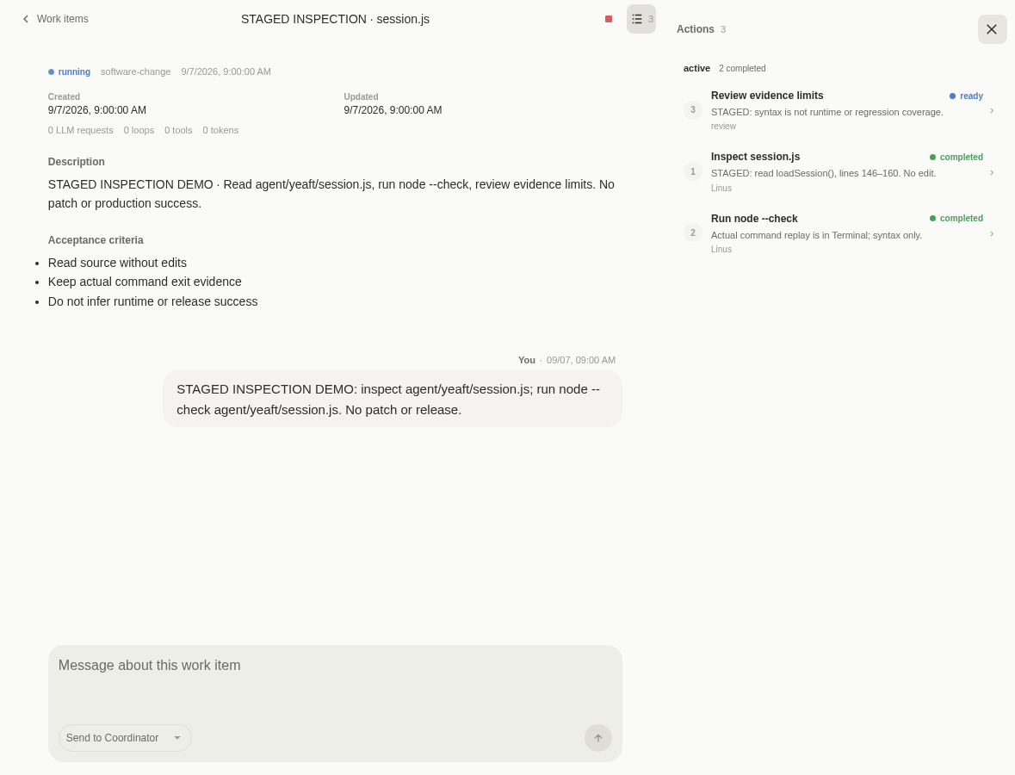
WORK CENTER · PREVIEW
The task persists beyond the conversation.
KEEP THE GOAL
WorkItem: objective and acceptance criteria
FOLLOW THE WORK
Action: assigned work and current status
INSPECT THE RESULT
Run: execution attempts and evidence
Real Yeaft UI · Staged inspection demo · Agent-side execution · Separate from Session
Notes:
展示 Work Center 的实际界面，把它从数据结构介绍变成“任务不是随聊天窗口消失”的价值。WorkItem 持久化目标和验收，Action 是工作单元，Run 是一次执行。在线 Agent 执行不依赖浏览器持续打开；Agent 下线无法继续做事，重启恢复要受状态和副作用安全边界控制。演示 WorkItem 仍是 staged 只读检查，不是已经跑完的复杂自动化案例。

Slide 10
AUTONOMY WITHOUT SURRENDERING CONTROL
Let AI keep working. Keep the decisions that matter.
AUTOMATE
INTERVENE
ACCEPT
Beyond chat turns.
Keep key decisions.
Against the goal.
Ready work runs on the Agent. Outcomes and bounded retries do not need a fresh prompt each time.
Review progress. Supply missing input. Resolve blockers or stop the work.
Completion depends on acceptance checks—not merely an assistant saying “done”.
Within configured tools and permissions. Instructions are not a sandbox.
Notes:
把“纯自动化”说成有边界的目标执行：在目标、权限和验收明确时自动推进，不必逐轮发送继续；缺少用户决策或外部副作用无法确认安全时，应进入 waiting/attention，而不是盲目重试。当前 Work Center 为 Preview。Prompts 和 read 标签都不是沙箱，不能承诺绝对隔离。完成必须经过验收门禁，不能把一次模型回复或一个 Run 结束说成整个任务完成。

Slide 11
WHY THIS COMBINATION MATTERS
An AI workspace built around getting work done.
Access, team design, behavior control, and automation belong together.
CROSS-DEVICE
Direct real Agent-side work from a phone or desktop.
MULTI-VP
Split responsibilities while keeping contributions visible.
SYSTEM PROMPTS
Shape reusable roles and shared working rules.
WORK CENTER
Delegate persistent goals, not just individual replies.
A phone-sized entry point. A task-sized ambition.
Notes:
竞争力来自四种能力的组合，不宣称市场唯一，也不做未实测的竞品功能矩阵。让听众记住：移动访问不是缩小的聊天框，多 VP 不是换头像，Prompt 可控不是一次性提醒，Work Center 不是聊天记录归档。这一页用于回收主线，不再重复产品拓扑或只读检查证据。

Slide 12
TRY YEAFT
Your next task does not have to wait for your desk.
01
02
03
Connect your machine.
Shape your AI team.
Delegate a real goal.
Run an Agent where your project and tools already live.
Choose VPs. Define their roles and your project rules.
Start from your phone. Give Work Center a bounded task and clear acceptance criteria.
Start here → github.com/yeaft/yeaft-web-code-agent
Notes:
收尾：建议现场从手机打开已连接 Agent 的 Session，给一个边界清晰的任务，展示角色和规则，再去 Work Center 创建带验收标准的目标。建议试用任务为修复一个小 bug、加一个回归测试、准备待审查 patch；它是试用建议，不是本稿声称已完成的结果。先按 README 配置，不默认授权自动部署。

