Slide 1
YOUR AI WORKSPACE, WHEREVER YOU ARE
Work from
anywhere.
Your AI team. Your working environment.
Ready when you connect.
ANYWHERE ACCESS / ROLE HANDOFFS / REAL WORK
Notes:
0–10s | Suggested English narration Work from anywhere. With Yeaft, your location can change without leaving the work behind. Connect to your AI team through a browser. 中文讲述提示与事实边界 定位从 phone-first 改为随处工作。用户不必守在原来的设备前；不暗示执行环境会跨 Agent 自动迁移。

Slide 2
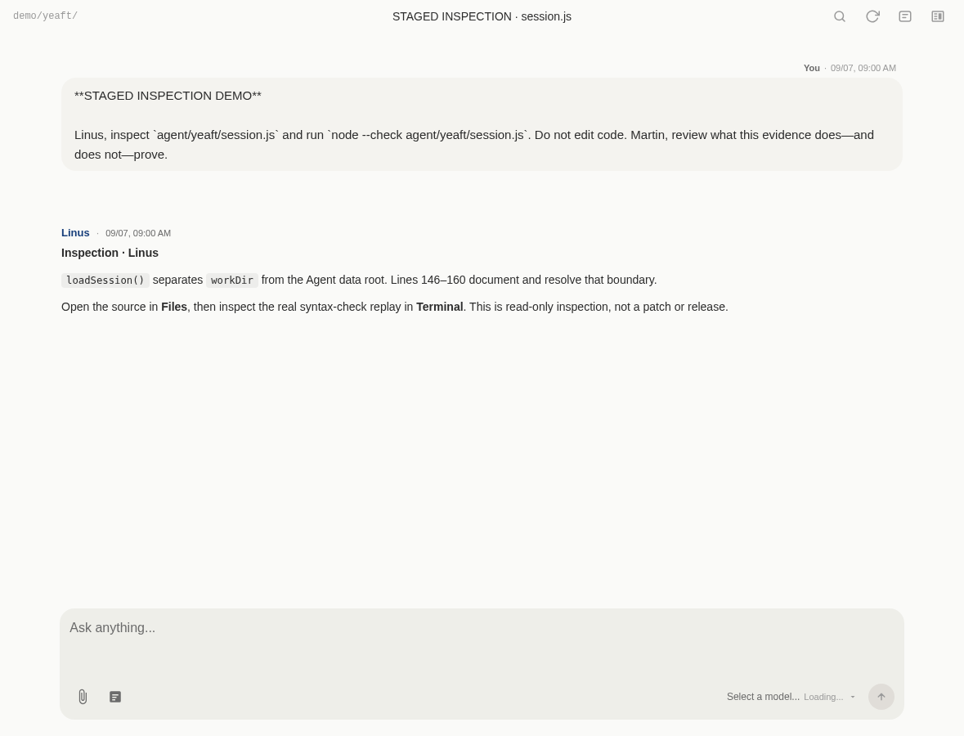
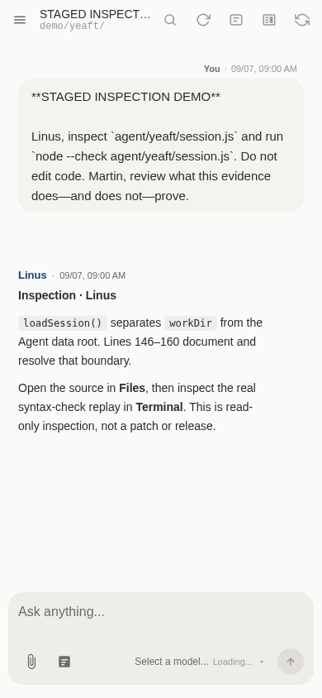
ANYWHERE ACCESS
Different devices. The same working context.
At home. At the office. On the move. Reconnect to the same Agent + Session.
BROWSER = ENTRY POINT
Choose the device
that works for you.
AGENT = WORKING ENVIRONMENT
Project files and execution
stay with your connected Agent.
Real UI · Staged demo · Requires a reachable Server and an online Agent.
Notes:
10–23s | Suggested English narration At home, at the office, or on the move, reconnect to the same Agent and Session. The browser is your entry point; your online Agent provides the working environment. 中文讲述提示与事实边界 桌面与移动布局来自既有隔离 staged UI 截图，不是新完成的跨设备实测。相同 Agent + Session 可从不同浏览器访问；Server 可达、Agent 在线是前提。

Slide 3
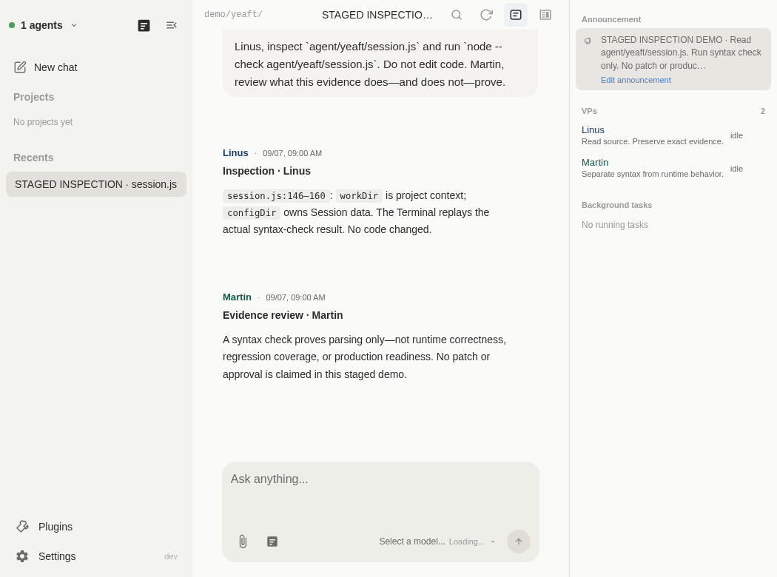
MULTI-ROLE COLLABORATION + HANDOFFS
The right role. The next step.
Start with one VP. Add distinct responsibilities when the task needs them.
01
Investigate
Find the cause. Pass the findings.
↓
02
Implement
Make the change. Hand off the patch.
↓
03
Review
Challenge the result. Return a verdict.
Explicit handoffs—not a fixed pipeline.
Real UI · Staged role configuration · Handoff sequence is illustrative.
Notes:
23–40s | Suggested English narration Bring in the right role for the next step. An investigator finds the cause, an implementer makes the change, and a reviewer challenges it. Explicit handoffs carry the task forward—not a fixed pipeline. 中文讲述提示与事实边界 VP = Virtual Person。一个 Session 有 1..N 个 VP。Investigate → Implement → Review 是交接示意；显式 VP 转发使用路由工具，不是普通文本写 @ 就执行。左侧真实 UI 截图展示配置角色，不是此开发案例的交接证据。

Slide 4
CONFIGURABLE SYSTEM PROMPTS
Define the roles. Set the working rules.
VP personas + shared Project instructions + repository conventions.
ROLE / IMPLEMENTER
SHARED RULES / EXAMPLE
A clear responsibility.
Consistent standards.
“Make the smallest useful change.
Report tests and open risks.”
“Review the exact revision.
Ask before deployment.”
Set expectations once. Carry them into the work.
Illustrative instructions · Prompts guide behavior; they are not a security sandbox.
Notes:
40–52s | Suggested English narration Define each role with configurable system prompts. Add shared project rules, so responsibilities, coding conventions, and review expectations travel with the work. 中文讲述提示与事实边界 示例 System Prompt 不是 UI 截图，也不是强制安全策略。VP persona、Project instruction、仓库规则是不同层，指令不能替代权限和 sandbox。

Slide 5
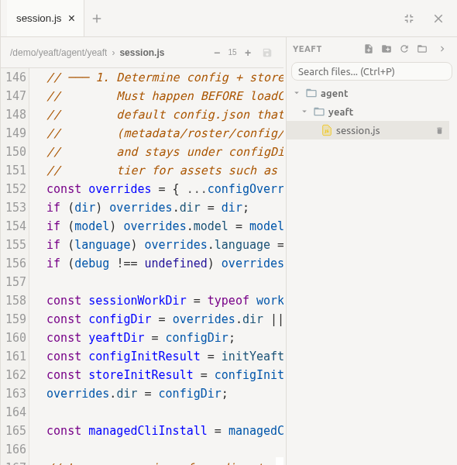
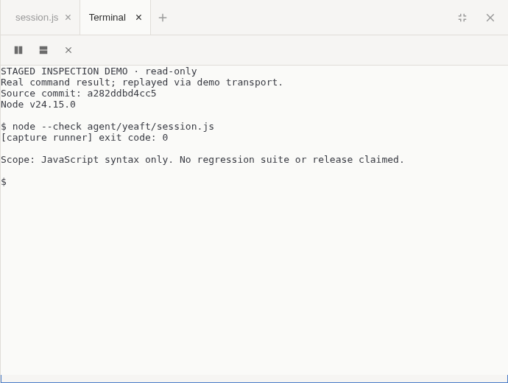
WORKBENCH
Beyond chat. A real workbench.
Inspect, verify, and intervene—not just wait for an answer.
FILES / ACTUAL SOURCE
TERMINAL / COMMAND OUTPUT
Real UI · Staged inspection demo · Terminal shows recorded node --check output, not a full test suite.
Notes:
52–67s | Suggested English narration Go beyond chat with Workbench. Inspect the actual files, check command output, and stay close to what the Agent is doing. Delegate the work without losing visibility. 中文讲述提示与事实边界 Files / Terminal 截图沿用真实 Vue 组件与 staged transport。终端只回放实际 node --check 结果，不是 bug 修复或完整回归测试证明。

Slide 6
DEVELOPMENT AUTOMATION · PREVIEW
From a development goal to execution.
Describe the outcome—not every next prompt.
YOUR BRIEF / ILLUSTRATIVE
AI ADVANCES THE WORK
Fix the bug.
Add a regression test.
Prepare a patch for review.
Investigate and make changes.
Run tools and checks.
Record results and open risks.
Bound the task with constraints and acceptance criteria.
Illustrative scenario—not a completed case study · Execution depends on configured tools and permissions.
Notes:
67–84s | Suggested English narration For development automation, give AI a goal, constraints, and acceptance criteria. For example: fix a bug, add a regression test, and prepare a patch for review—not a script of step-by-step prompts. 中文讲述提示与事实边界 建议的开发场景，不是已完成案例。任务拆解由目标决定，不强制固定流水线。不默认允许部署；Session 与 Work Center 是不同对象，不声称自动转换。

Slide 7
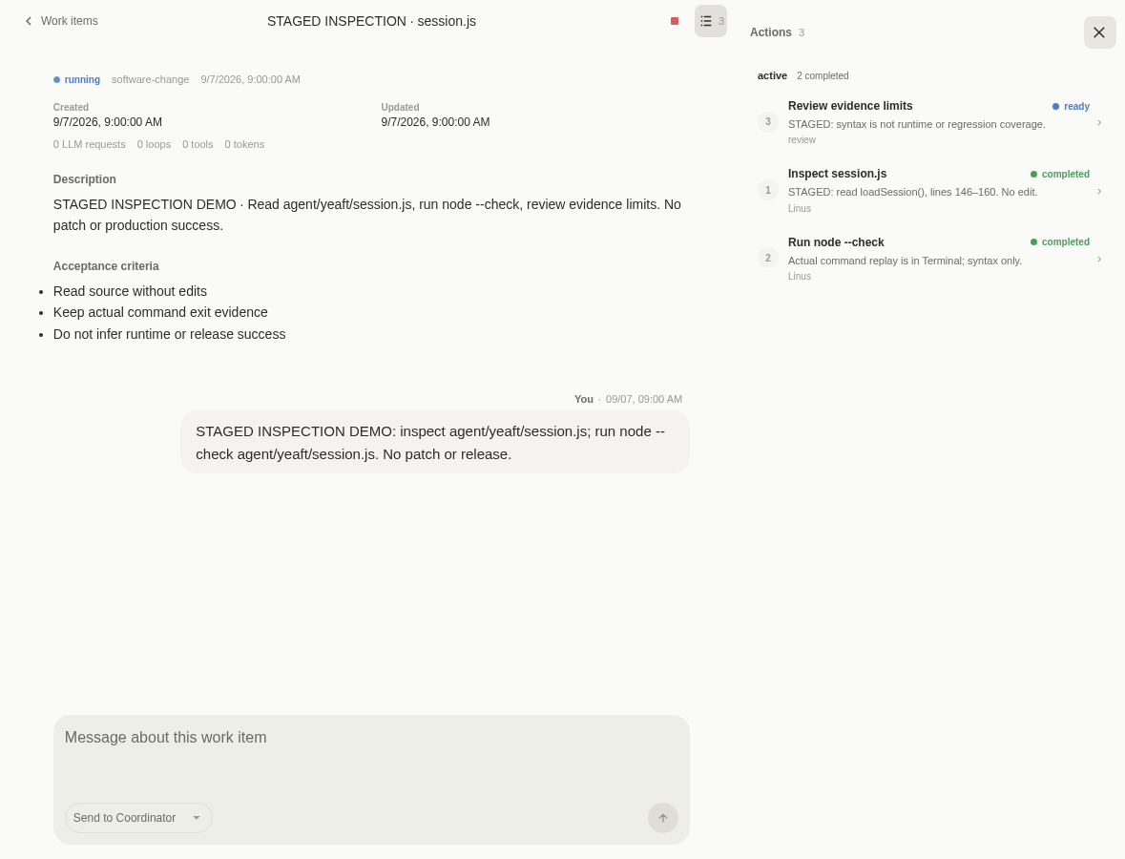
WORK CENTER · PREVIEW
Keep the task moving. Keep control.
A persistent goal, visible execution, and an outcome you can evaluate.
KEEP THE GOAL
Save the objective and acceptance criteria.
FOLLOW PROGRESS
See execution status. Resolve decisions.
CHECK THE OUTCOME
Inspect evidence against the goal.
Real UI · Staged inspection demo · Execution requires an online Agent. Work Center is separate from Session.
Notes:
84–102s | Suggested English narration Work Center keeps the goal, execution progress, and evidence visible. Let ready work advance on the online Agent. Step in for decisions and judge completion against the acceptance criteria. Work Center is currently in Preview. 中文讲述提示与事实边界 Work Center 保留 Preview。持久目标不意味着 Agent 离线可执行；恢复和重试受副作用安全约束。完成需要验收与证据，不等于模型停止输出。Work Center VP 选择独立于 Session 成员。

Slide 8
WORK FROM ANYWHERE.
Your AI team.
Real work.
From anywhere.
Connect. Collaborate. Let the work move forward.
github.com/yeaft/yeaft-web-code-agent
Notes:
102–110s | Suggested English narration Anywhere access. Clear responsibilities. Real tools. Goal-driven execution. Yeaft. Your AI team. Real work. From anywhere. 中文讲述提示与事实边界 收束到随处接入、角色协作和目标执行，不重复整套功能清单。仓库链接指向 README；不暗示已经自动部署或发布。

