Slide 1
M.F.C-2
End Sem Project
Group-9

Slide 2

Group-09
• Ayush Kumar Rai – CB.EN.U4AIE22111
• Anerud– CB.EN.U4AIE22110
• MC Dhanush – CB.EN.U4AIE22130
• Sudheer kumar Chowdary – CB.EN.U4AIE22069

Slide 3
Singular Value Decomposition
The Singular Value Decomposition (SVD) of a matrix is a factorization of that matrix into three matrices. It has some interesting algebraic properties and conveys important geometrical and theoretical insights about linear transformations. It also has some important applications in data science.
Given an input matrix A then the generated form will be A = UΣV^T, where U and V are orthogonal matrices, and Σ is a diagonal matrix with non-negative singular values.

Slide 4
U is mxm and column orthogonal (that means its columns are eigenvectors of AA^{T})
(AA^{T} = UV^{T} VDU^{T} = UD²U^{T} )
V is nxn and orthogonal (that means its columns are eigenvectors of A^{T}A)
(A^{T}A = VDU^{T} UDV^{T} = VD²V ^{T} )
D is nxn diagonal, where non-negative real values are called singular values.

Slide 5
Face-Recognition-with-Singular-Value-Decomposition
The approach of this paper is to apply the concepts of subspace to face recognition. The set of known faces with m × n pixels forms a subspace, called “face space”, of the “image space” containing all images with m × n pixels.
This face space best defines the variation of the known faces. The basis of the face space is defined by the singular vectors of the set of known faces.

Slide 6
These singular-vectors do not necessarily correspond to the distinct features like ears , eyes and noses.
The projection of a new image onto this face space is then compared to the available projections of known faces to identify the person.
Since the dimension of face subspace is much less than the whole image space, it is much easier to compare projections than origin images pixel by pixel.
Based on the above idea, a Singular Value Decomposition (SVD) approach is implemented in this project.

Slide 7
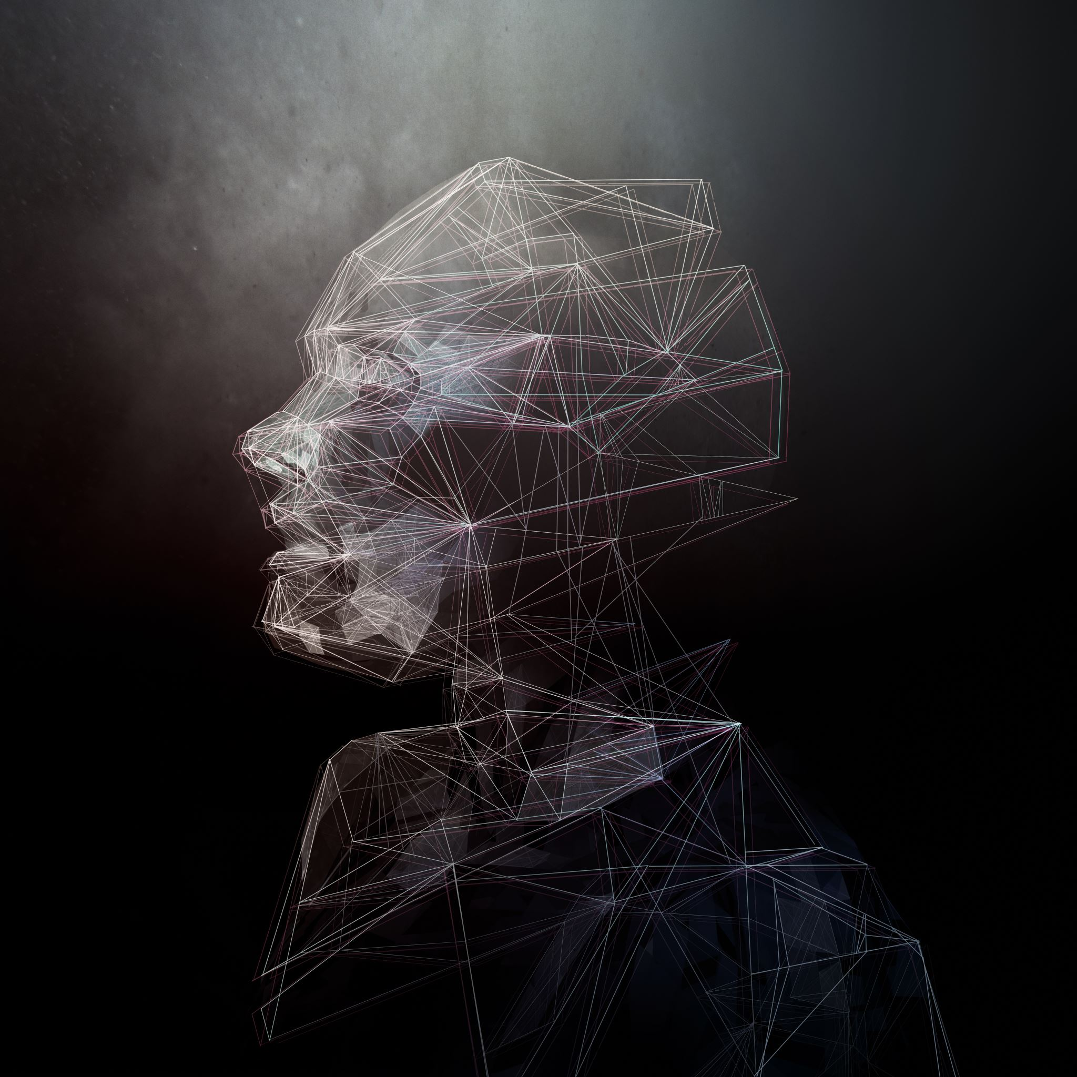
Algorithm
Let's explore the algorithm designed for facial recognition. In this approach, we work with facial pictures represented as M × 1 column vectors, where each picture consists of m × n = M pixels. Our training set, denoted as S, comprises N face photos of well-known individuals, forming an M × N matrix: S = [f1, f2, f3, ..., fN].
To start, we compute the mean image F of the training set S, which is obtained by averaging all the individual face pictures: F = 1/N ∑fi, where i ranges from 1 to N.
Next, we subtract the mean image F from each original face picture, resulting in a set of difference vectors: ai = fi - Fi, for i = 1, 2, 3, ..., N.
These difference vectors are organized into another M × N matrix A: A = [a1, a2, ..., aN].
Before further analysis, the facial images undergo preprocessing techniques such as grayscale conversion, pixel intensity normalization, and resolution scaling.
Once preprocessed, we calculate the covariance matrix for the dataset of facial pictures. This covariance matrix unveils the correlations between different facial traits.
It is symmetric and captures the pairwise covariances among the pixels constituting the variables in the dataset.

Slide 8
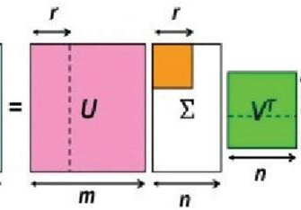
By reducing the dimensionality of the face picture dataset while preserving discriminative information, we create a more compact representation.
The final stage of the algorithm is face recognition. To recognize an unidentified facial picture, we project it onto the subspace defined by the chosen principal components. This projection generates a feature vector representation for the unknown image.
A distance metric, such as Euclidean distance or cosine similarity, is often employed to measure the dissimilarity between the feature vectors of the unknown and known individuals.
The recognized individual is determined based on the closest match according to the distance measure.
In summary, this algorithm for facial recognition encompasses steps from mean image calculation, difference vector formation, and covariance matrix computation, to eigenvalue decomposition, feature extraction, and projection onto the subspace.
By employing distance metrics, it enables the identification of individuals based on facial features, providing a valuable tool in the field of biometric authentication.

Slide 9
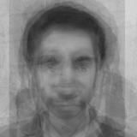
Working of code
First, we gather a training set S consisting of N photographs of known individuals' faces.
Calculate the mean face f from the set S. This average face represents the central tendencies of the known faces.
Form a matrix A by subtracting the mean face f from each individual face in the training set S. This matrix captures the variations in facial features across the known faces.
Perform Singular Value Decomposition (SVD) on matrix A. This decomposition reveals a set of base-faces, which are the key components that contribute to the variations observed in the known faces.
Mean Image

Slide 10
For each known individual, compute the coordinate vector representing their face in the face space defined by the base-faces.
Determine two thresholds: ε1, which sets the maximum allowed separation from the face space, and ε0, which sets the maximum permitted separation from any known face in the training set S. These thresholds play a role in classification decisions.
When presented with a new input image, calculate its coordinate vector x and project it onto the face space to obtain the vector projection fp. Additionally, compute the distance εf between the input image and the face space. If εf exceeds 1, the input image is not recognized as a face.
If εf is less than ε1, proceed to further analysis. Calculate the distances εi from the input image's coordinate vector to each known individual's coordinate vector.
If all εi are greater than ε0, classify the input image as an unknown face. Optionally, the input image can be used to initiate a new individual face in the system.
If εf is less than ε1 and at least one εi is smaller than ε0, classify the input image as the known individual associated with the minimum εi. Optionally, the input image can be added to the original training set, allowing the system to update and incorporate more instances of known faces. Steps 1 to 5 can be repeated to refine the face recognition system.

Slide 11
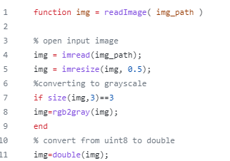
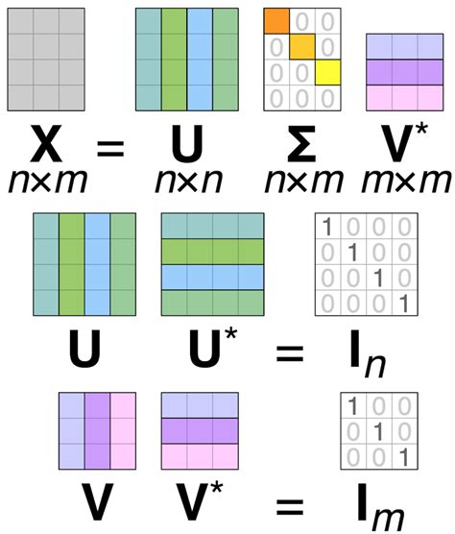
CODE : Reading Image

Slide 12
Explanation
The readImage function reads an image file specified by img_path, resizes it to 50% of its original size using imresize, and converts it to grayscale if it is originally a color image.
The image is loaded using imread and stored in the variable img. If the image has three color channels (indicating a color image), the function applies rgb2gray to convert it to grayscale.
Finally, the image is converted from the default uint8 data type to double using the double function.

Slide 13
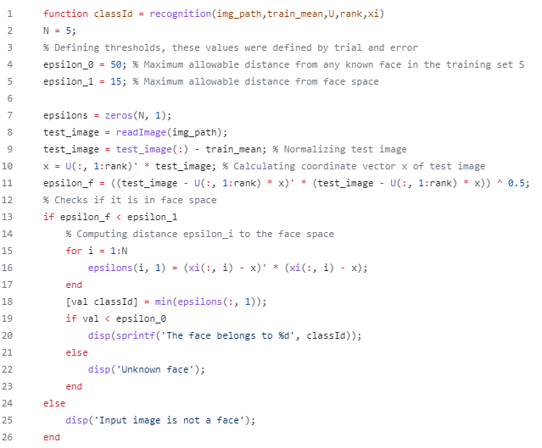
Code :
Recognition.m

Slide 14
Explanation
The function recognition takes several parameters: img_path (the path of the test image), train_mean (the mean face image of the training set), U (the eigenfaces), rank (the number of significant eigenfaces), and xi (the coordinates of training set faces in face space).
The variable N is set to 5, representing the number of classes or individuals in the training set.
Two threshold values, epsilon_0 and epsilon_1, are defined to control the maximum allowable distance for face recognition.
The variable epsilons is initialized as a zero vector of size N.
The test image is loaded using the readImage function, and then its pixel values are normalized by subtracting the mean face image of the training set.

Slide 15
The coordinate vector x of the test image is calculated by projecting the normalized image onto the eigenfaces.
The variable epsilon_f represents the distance of the test image from the face space. If it is less than epsilon_1, it implies that the test image lies within the face space.
If the test image is in the face space, a loop calculates the distances epsilons(i) between the test image and each class (represented by xi(:, i)). The minimum distance is obtained, and the corresponding classId is assigned.
If the minimum distance val is less than epsilon_0, the algorithm recognizes the face and displays the class ID. Otherwise, it labels the face as an unknown face.
If the test image is not in the face space (i.e., epsilon_f is greater than epsilon_1), it indicates that the input image is not a face.
Overall, the code performs face recognition by comparing the distances between the test image and the known face images in the training set using predefined thresholds.

Slide 16
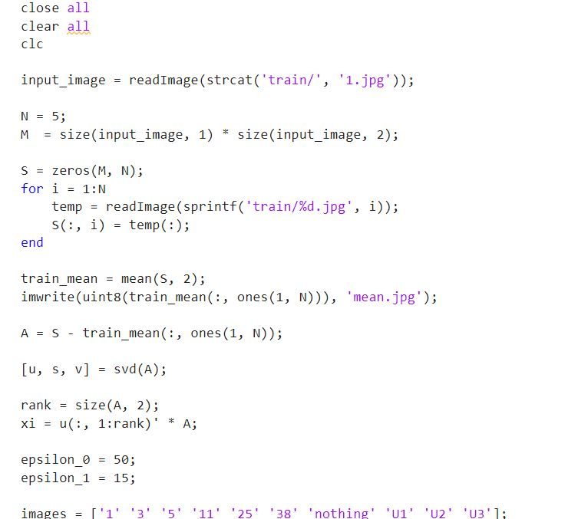
Code : Test.m

Slide 17
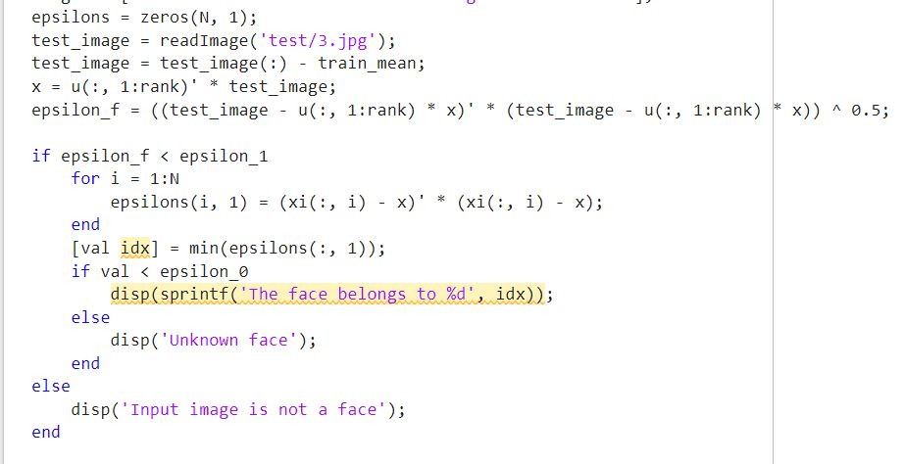

Slide 18
Explanation
Loading and Preparing the Data:
The code starts by loading an input image from the "train" directory and determining its size using the readImage function.
The variables N and M are defined. N represents the number of individuals (known faces) in the training set, and M represents the size of each image (the total number of pixels).
A matrix S of size M x N is initialized with zeros. This matrix will hold the flattened version of each training image.
A for loop is used to iterate over each individual in the training set.
Inside the loop, the corresponding image is read using readImage and stored in the temporary variable temp.
The (:) operation reshapes the image into a column vector, and the resulting vector is stored in the corresponding column of matrix S.

Slide 19
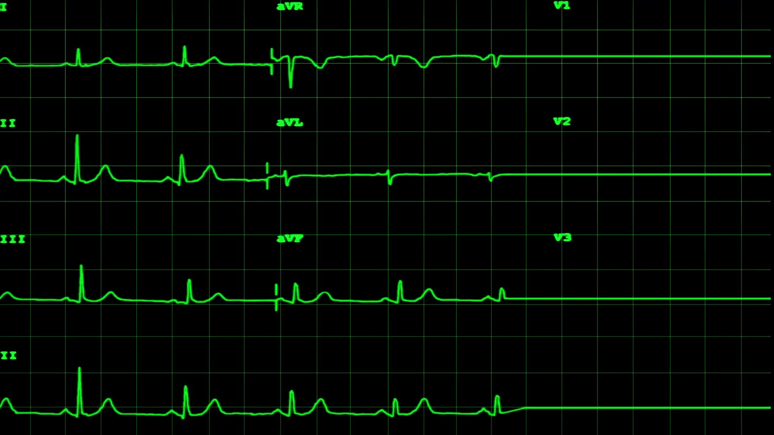
Singular Value Decomposition (SVD):
The code performs the Singular Value Decomposition on the normalized training data matrix A.
The SVD is computed using the svd function, which decomposes A into three matrices: u, s, and v.
Matrix u contains the left singular vectors, s contains the singular values (diagonal matrix), and v contains the right singular vectors.
Computing Coordinate Vectors:
The code calculates the coordinate vector (xi) for each known individual by projecting their normalized images onto the face space.
The variable rank is set to the number of columns in matrix A, representing the rank of the matrix.
The code computes xi by taking the inner product of the first rank columns of matrix u with matrix A. This projection step projects each normalized image onto the face space.

Slide 20
Setting Thresholds:
Two threshold values, epsilon_0 and epsilon_1, are defined.
epsilon_0 represents the maximum allowable distance from any known face in the training set S.
epsilon_1 represents the maximum allowable distance from the face space.
Classification:
The code defines a list of test images and their corresponding labels stored in the images variable.
The code reads a test image using readImage and stores it in the variable test_image.
The test image is normalized by subtracting the mean image calculated earlier.
The coordinate vector (x) of the test image is computed by projecting it onto the face space, similar to the calculation of xi for known individuals.

Slide 21
The distance (epsilon_f) between the test image and the face space is calculated by measuring the Euclidean distance between the test image and its projection onto the face space.
If epsilon_f is below epsilon_1, the test image is considered to be in the face space.
If epsilon_f is greater than or equal to epsilon_1, the test image is considered to be outside the face space.
If the test image is within the face space, the code computes the distances (epsilons) between the test image and each known individual's coordinate vector (xi).
The code finds the minimum distance and its corresponding index (idx), indicating the closest match among the known individuals.
If the minimum distance (val) is below epsilon_0, the code displays a message indicating that the face belongs to the identified individual.
If the minimum distance is greater than or equal to epsilon_0, the code displays a message indicating that the face is unknown.

Slide 22
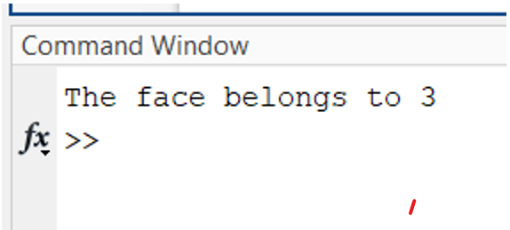
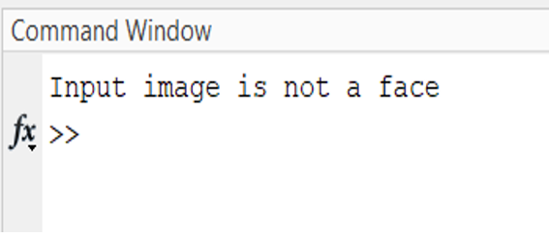
Output:Test.m
If result is an image: If result is not a image:

Slide 23
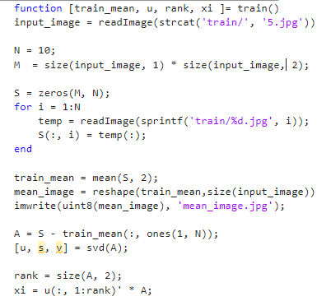
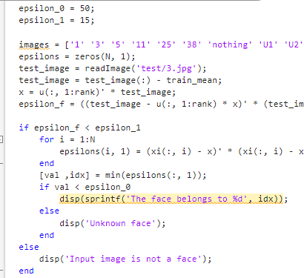
Code : Train.m

Slide 24
Output: Train.m
Mean Image

Slide 25
Thank you

