Slide 1
Agent-Based Modeling of the Ductal Structure in Pancreatic Precancer
Cameron Yeagle
Advisors: Dr. Daniel Bergman and Dr. Elana Fertig
Notes:
Hi everyone and thank you for being here at my thesis presentation, I will be talking today about my phd work on machine learning and computational modeling for genomics data, specifically genomics data from pancreatic ductal adenocarcinoma

Slide 2
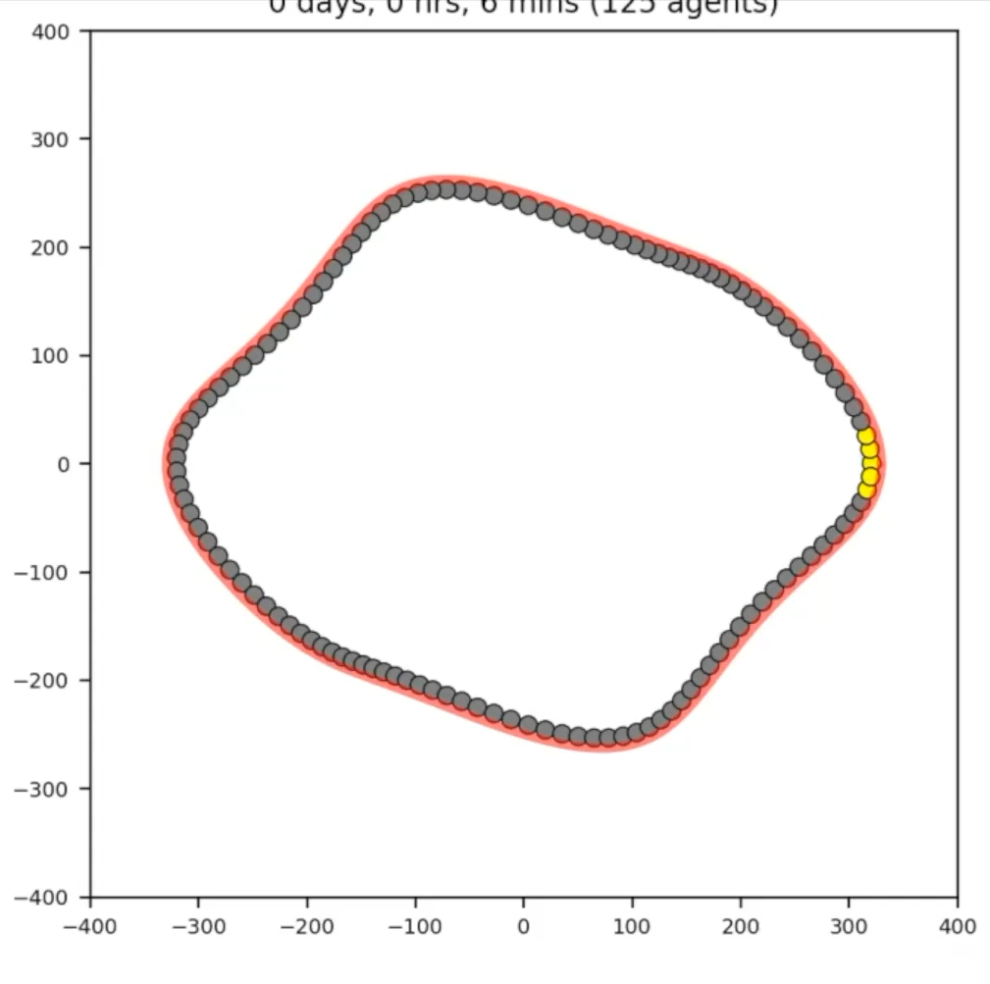
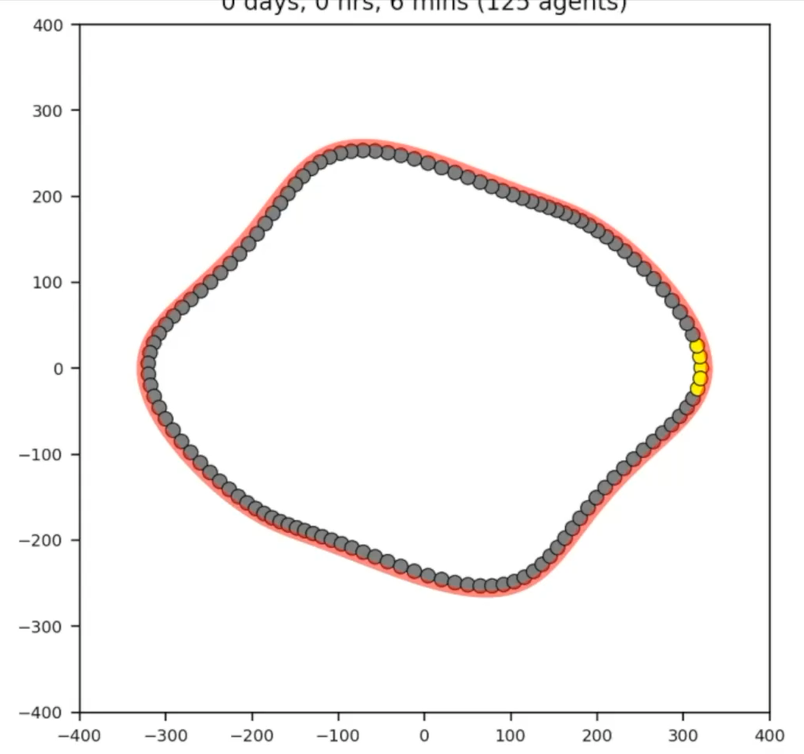

Sigma=25
Strain=.1
Sigma=25
Strain=.1
Notes:
Pancreatic Ductal Adenocarcinoma is the most common subtype of pancreatic cancer, constituting about 90% of all pancreatic cancer. PDAC is the third leading cause of cancer-related deaths in the U.S., with a 5-year survival rate of only 13.3%. It is also known to have extremely poor prognosis, with nearly 90% of tumors already metastasized at diagnosis.
PDAC begins in the epithelial cells lining the pancreatic ducts, which are normally responsible for regulating secretion of digestive enzymes into the small intestine. In PDAC, these cells acquire mutations that cause them to proliferate uncontrollably and eventually rupture the ductal membrane. After spreading into the stroma, cancer-associated fibroblasts develop dense networks of collogen fibers, known as desmoplasia, around the previous pancreatic ducts. This creates almost like a shield around the tumor, protecting it from immune attack and drug penetration.
Pancreatic ductal adenocarcinoma is the most common subtype of pancreatic cancer, with a 5 year survival rate of only 13%. The low survival rate is thought to be due to multiple challenges to treatment such as the difficulty of detecting PDAC before it has metastasized. (add graphic) A hallmark of PDAC is what’s called a “desmoplastic” tumor microenvironment. Compared to healthy tissue on the left, PDAC on the right has masses of cell growth in places that used to be healthy ducts, and is infiltrated by a greater diversity of immune and stromal cells while being crisscrossed and encapsulated in this network of collagen fibers, which are deposited by cancer-associated fibroblasts. The dense fibrotic network of collagen is referred to as desmoplasia and is seen in certain types of tumors.
Those immune cells that are found in this microenvironment are often suppressive such as T regulatory cells and suppressive macrophages. Some of the immune cells are “residents” that were probably there in the healthy tissue, but others are recruited from the periphery (BM+blood)

Slide 3
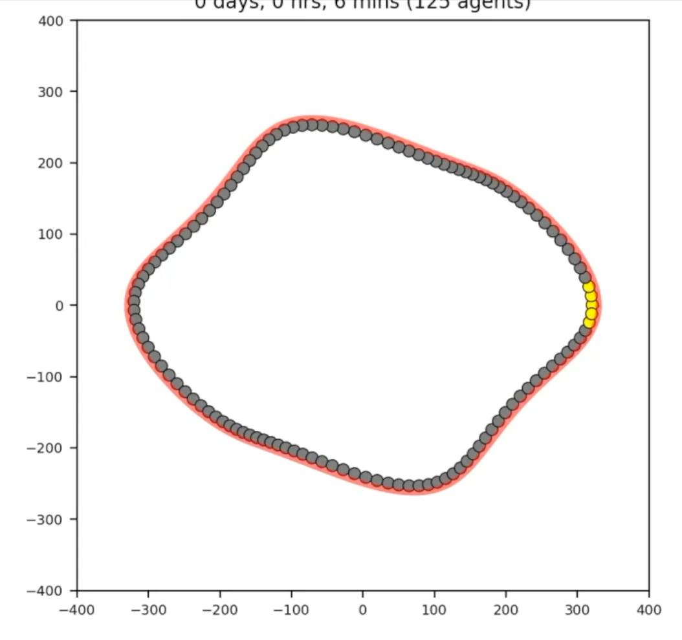


Sigma=8.4 strain=.1
Sigma=0
strain=.1
bend=4
Sigma=8.4
strain=.1
bend=4
Notes:
Pancreatic Ductal Adenocarcinoma is the most common subtype of pancreatic cancer, constituting about 90% of all pancreatic cancer. PDAC is the third leading cause of cancer-related deaths in the U.S., with a 5-year survival rate of only 13.3%. It is also known to have extremely poor prognosis, with nearly 90% of tumors already metastasized at diagnosis.
PDAC begins in the epithelial cells lining the pancreatic ducts, which are normally responsible for regulating secretion of digestive enzymes into the small intestine. In PDAC, these cells acquire mutations that cause them to proliferate uncontrollably and eventually rupture the ductal membrane. After spreading into the stroma, cancer-associated fibroblasts develop dense networks of collogen fibers, known as desmoplasia, around the previous pancreatic ducts. This creates almost like a shield around the tumor, protecting it from immune attack and drug penetration.
Pancreatic ductal adenocarcinoma is the most common subtype of pancreatic cancer, with a 5 year survival rate of only 13%. The low survival rate is thought to be due to multiple challenges to treatment such as the difficulty of detecting PDAC before it has metastasized. (add graphic) A hallmark of PDAC is what’s called a “desmoplastic” tumor microenvironment. Compared to healthy tissue on the left, PDAC on the right has masses of cell growth in places that used to be healthy ducts, and is infiltrated by a greater diversity of immune and stromal cells while being crisscrossed and encapsulated in this network of collagen fibers, which are deposited by cancer-associated fibroblasts. The dense fibrotic network of collagen is referred to as desmoplasia and is seen in certain types of tumors.
Those immune cells that are found in this microenvironment are often suppressive such as T regulatory cells and suppressive macrophages. Some of the immune cells are “residents” that were probably there in the healthy tissue, but others are recruited from the periphery (BM+blood)

Slide 4
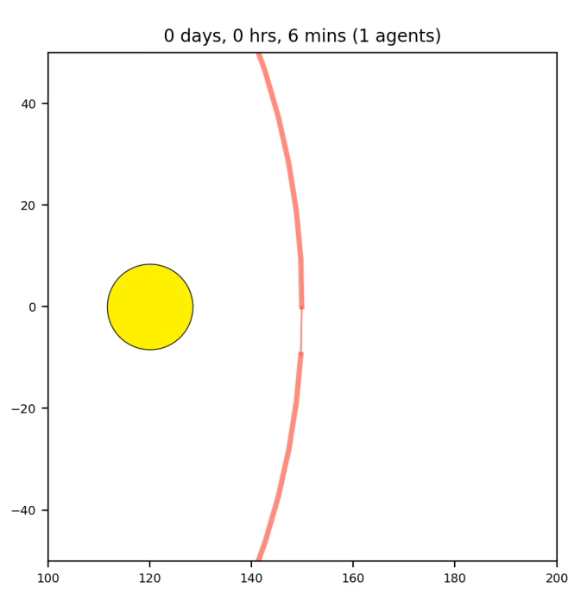


Sigma=0 strain=0
Sigma=0
strain=.1
Sigma=10
strain=0
Notes:
Pancreatic Ductal Adenocarcinoma is the most common subtype of pancreatic cancer, constituting about 90% of all pancreatic cancer. PDAC is the third leading cause of cancer-related deaths in the U.S., with a 5-year survival rate of only 13.3%. It is also known to have extremely poor prognosis, with nearly 90% of tumors already metastasized at diagnosis.
PDAC begins in the epithelial cells lining the pancreatic ducts, which are normally responsible for regulating secretion of digestive enzymes into the small intestine. In PDAC, these cells acquire mutations that cause them to proliferate uncontrollably and eventually rupture the ductal membrane. After spreading into the stroma, cancer-associated fibroblasts develop dense networks of collogen fibers, known as desmoplasia, around the previous pancreatic ducts. This creates almost like a shield around the tumor, protecting it from immune attack and drug penetration.
Pancreatic ductal adenocarcinoma is the most common subtype of pancreatic cancer, with a 5 year survival rate of only 13%. The low survival rate is thought to be due to multiple challenges to treatment such as the difficulty of detecting PDAC before it has metastasized. (add graphic) A hallmark of PDAC is what’s called a “desmoplastic” tumor microenvironment. Compared to healthy tissue on the left, PDAC on the right has masses of cell growth in places that used to be healthy ducts, and is infiltrated by a greater diversity of immune and stromal cells while being crisscrossed and encapsulated in this network of collagen fibers, which are deposited by cancer-associated fibroblasts. The dense fibrotic network of collagen is referred to as desmoplasia and is seen in certain types of tumors.
Those immune cells that are found in this microenvironment are often suppressive such as T regulatory cells and suppressive macrophages. Some of the immune cells are “residents” that were probably there in the healthy tissue, but others are recruited from the periphery (BM+blood)

