Slide 1
Agent-Based Modeling of the Ductal Structure in Pancreatic Precancer
Cameron Yeagle
Advisors: Dr. Daniel Bergman and Dr. Elana Fertig
Notes:
Hi everyone and thank you for being here at my thesis presentation, I will be talking today about my phd work on machine learning and computational modeling for genomics data, specifically genomics data from pancreatic ductal adenocarcinoma

Slide 2
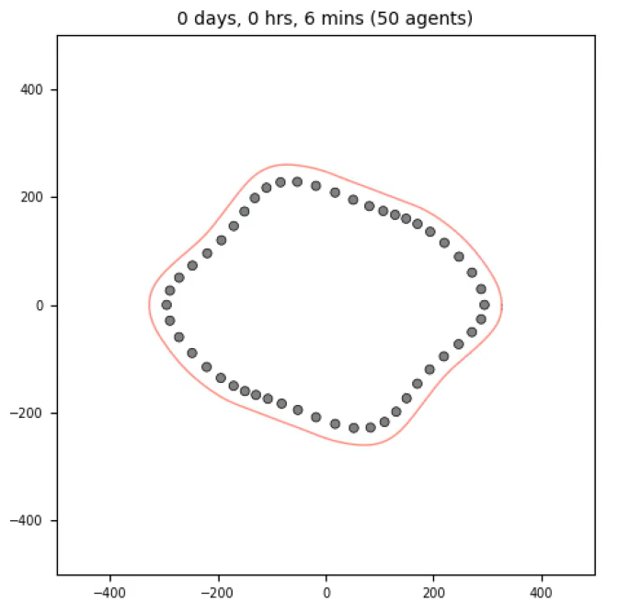

Slide 3


Slide 4
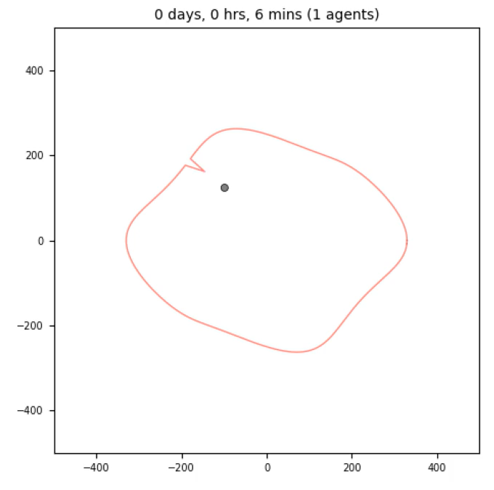

Slide 5


Slide 6


Slide 7


Slide 8
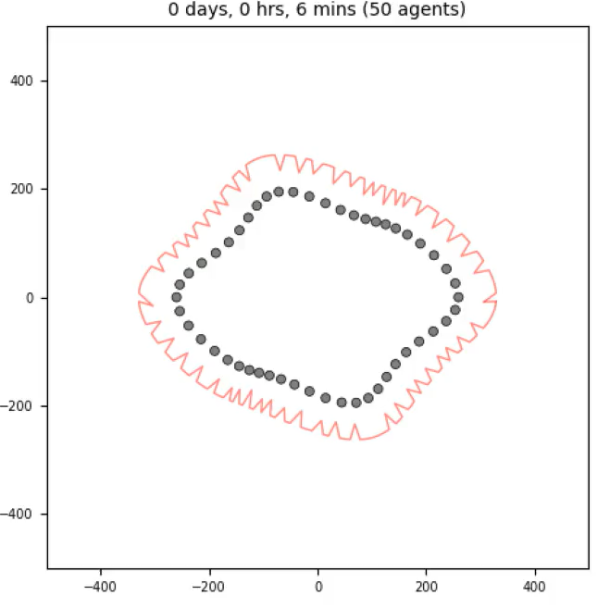

Slide 9
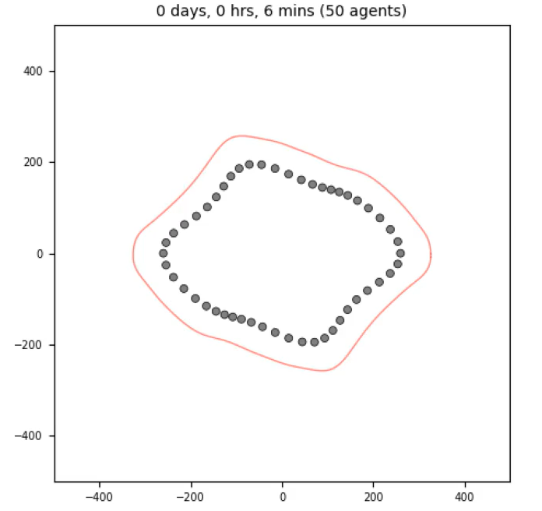

Slide 10
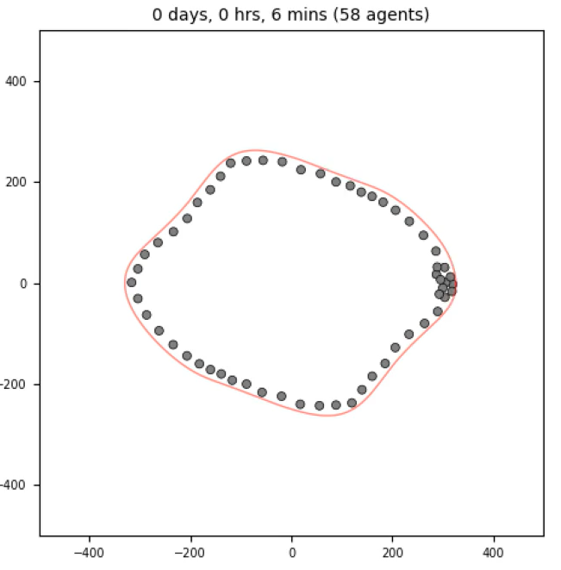

Slide 11
