Slide 1
TELCO CUSTOMER
CHURN ANALYSIS
A complete data science project — from raw data to retention strategy
7,044
21
26.5%
4
Customers
Features
Churn Rate
Notebooks
Data Analysis Project · Machine Learning · Business Strategy

Slide 2
PROJECT PIPELINE
End-to-end analytical workflow across four notebooks
01
02
03
04
05
Data Understanding
Preprocessing
EDA
ML Modeling
Cost Simulation
Column analysis
Dependency mapping
Data quality audit
Type fixes · Encoding
Gated columns
Stratified split
Demographics
Service analysis
Churn correlations
Logistic Regression
Random Forest
XGBoost
Revenue loss
Retention strategies
Break-even analysis
Dataset: IBM Watson Telco Customer Churn · 7,044 rows · 21 columns

Slide 3
DATASET OVERVIEW
Understanding the raw data structure and quality issues
Feature Groups
Data Quality Issues Found
Customer Demographics
TYPE
TotalCharges stored as string with 11 blank rows (tenure=0 customers)
gender · senior citizen · partner · dependents
Account Info
ENCODE
SeniorCitizen uses int 0/1 while all other binary columns use Yes/No
tenure · contract · payment method · billing
Phone Services
REDUND
'No phone/internet service' is redundant in 7 dependent columns
phone service · multiple lines
Internet Services
IMBAL
Class imbalance — 73.5% No Churn vs 26.5% Churn in target variable
internet type · 6 add-on columns
Financials
ID
customerID is a non-informative key — must be dropped before modeling
monthly charges · total charges
All 9 issues documented · 7,044 rows retained after cleaning · 0 records dropped

Slide 4
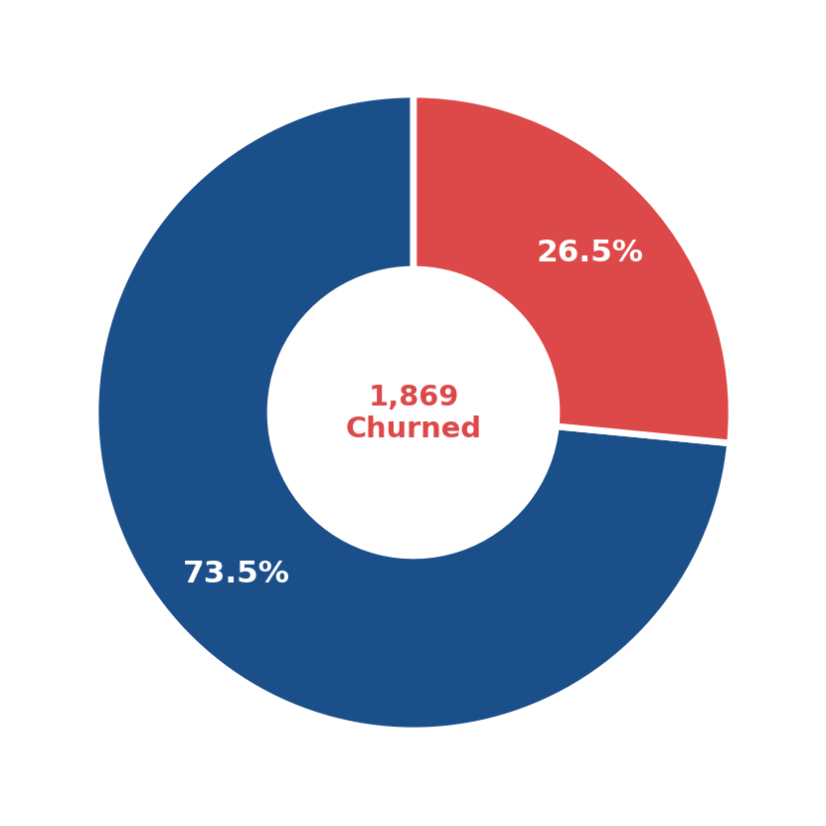
CHURN DISTRIBUTION
1 in 4 customers leaves — the baseline problem
7,044
5,174
Total Customers
Retained (73.5%)
1,869
$74.44
Churned (26.5%)
Avg Monthly — Churned
Class Imbalance Alert: The 73.5/26.5 split means naive models will over-predict 'No Churn'. All models trained with class balancing.

Slide 5
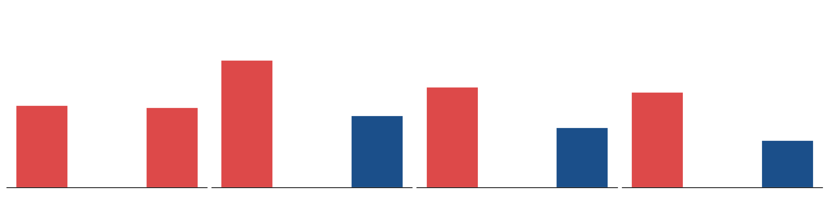
DEMOGRAPHICS & CHURN
Family anchoring reduces churn significantly — gender has no effect
→
Gender: Male vs Female churn is identical (~26%) — not a useful predictor for targeting
↑
Senior Citizens churn at 41% — nearly double the non-senior rate of 24%
↓
Partner & Dependents both reduce churn — family ties create switching friction

Slide 6
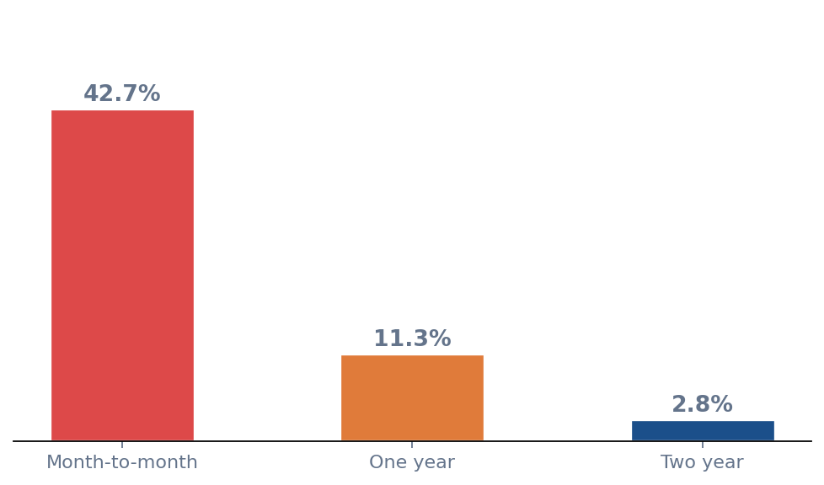
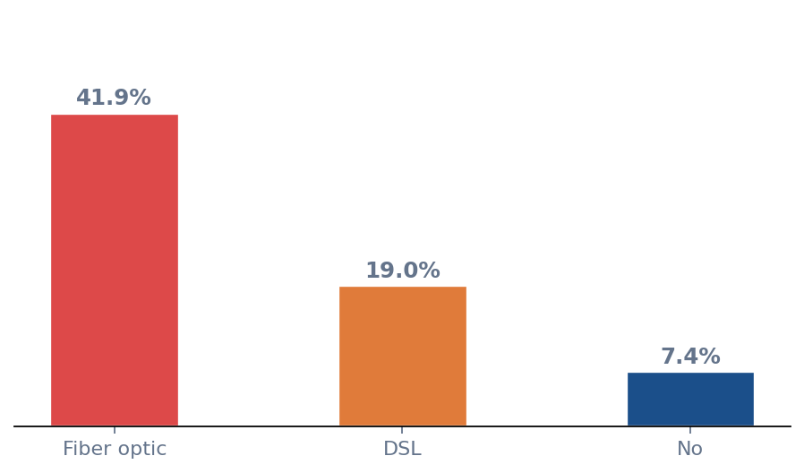
SERVICES & CONTRACT TYPE
Contract type is the single strongest lever — fiber optic users are the highest-risk segment
Churn Rate by Contract
Churn Rate by Internet Service
43%
3%
42%
7%
Month-to-month
churn rate
Two-year contract
churn rate
Fiber optic
churn rate
No internet
churn rate

Slide 7
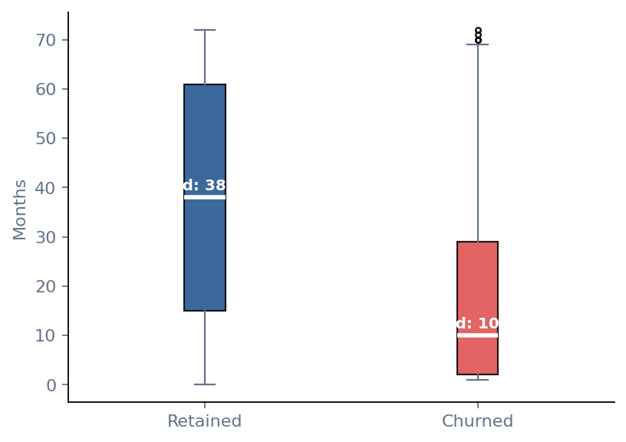
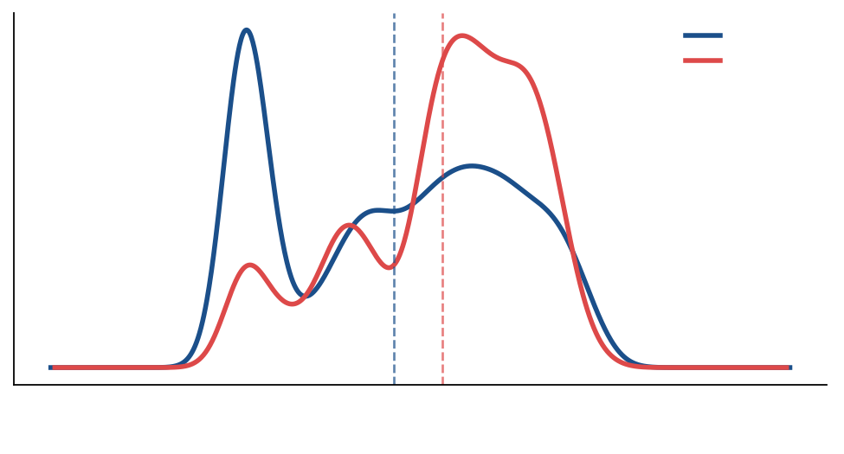
TENURE & MONTHLY CHARGES
Churn is front-loaded — most exits happen in the first year
Tenure Distribution
Monthly Charges Distribution
10 mo
38 mo
$79
$61
47%
Median tenure — Churned
Median tenure — Retained
Median monthly — Churned
Median monthly — Retained
Churn rate: first 12 months

Slide 8
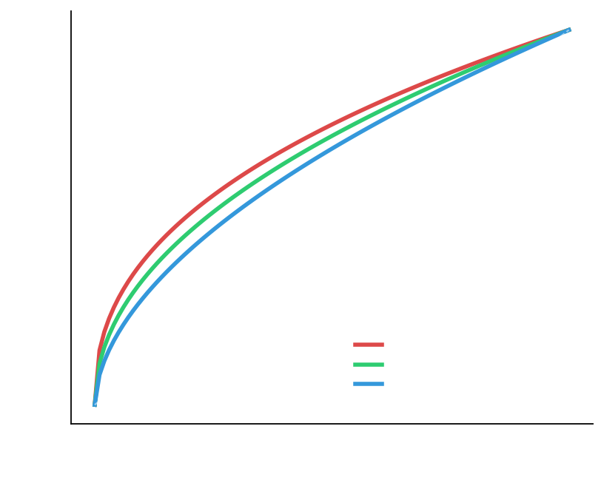
ML MODEL COMPARISON
Three models trained with class balancing on an 80/20 stratified split
ROC Curves
Performance Metrics
Model | Accuracy | Recall | F1 | AUC
Log. Reg. | 74.8% | 77.2% | 58.3% | 0.842
Rand. Forest | 79.4% | 75.6% | 63.2% | 0.840
✦ XGBoost | 80.6% | 79.1% | 65.8% | 0.851
RECOMMENDED: XGBoost
Highest AUC (0.851) and Recall (79.1%) across all folds. Best at catching actual churners — the business-critical metric.

Slide 9
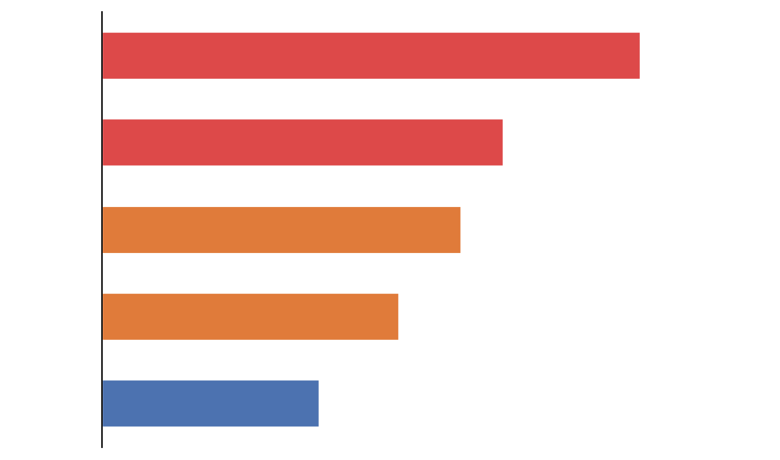
WHAT DRIVES CHURN
Top 5 features by consensus rank across all three models
XGBoost Gain Importance
Tenure
Early-lifecycle customers at highest risk. First 12 months = critical retention window.
Contract Type
Month-to-month = no switching cost. Contract upgrades are the most reliable churn insulator.
Monthly Charges
High bills without perceived value push customers out. Consider targeted plan audits.
Internet: Fiber
Fiber users churn at 2× DSL rate. Service quality or expectation mismatch — not price alone.
Tech Support
Having Tech Support halves churn rate. Proactive bundling creates stickiness.

Slide 10
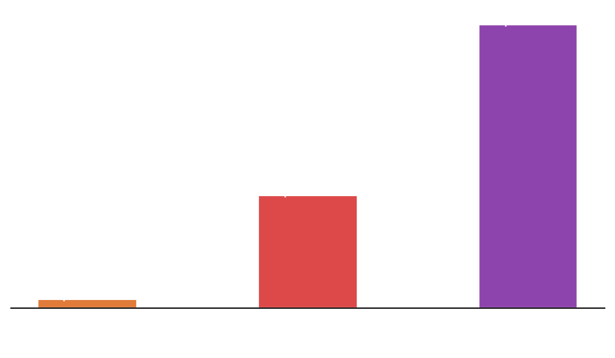
COST & RETENTION STRATEGY
Quantifying the revenue loss and simulating two retention interventions
Revenue Impact of Churn
STRATEGY A
STRATEGY B
Discount Offer
Loyalty Perks
20% bill discount
for 6 months
Free Tech Support +
Security for 12 months
Retention: ~45%
Retention: ~35%
Net: +$1.8M recovered
Net: +$1.2M recovered
✓ Low break-even threshold
✓ Addresses root cause
✗ Trains price-hunting behaviour
✗ Needs ≥12% retention to break even
$1.67M
1,869
$370K
<5%
Annual Revenue Lost
Customers Lost / Year
CAC Wasted on Churners
Break-even — Strategy A
Prime Target: High Risk × High Value segment (~650 customers · $1.1M annual revenue at risk) — deploy both strategies simultaneously

Slide 11
KEY TAKEAWAYS
01
02
Month-to-month is the biggest lever
First 12 months = make or break
43% of M2M customers churn vs 3% on two-year contracts. A targeted upgrade campaign converting 10% of M2M base to annual contracts prevents ~200+ annual churns.
47% churn rate in year 1 drops dramatically after month 24. A structured 90-day onboarding program for new fiber subscribers is the highest-ROI retention investment.
03
04
Fiber + no support = 50% churn
XGBoost model ready for deployment
The Fiber × No Tech Support intersection churns at 50%. Proactively bundling Tech Support into fiber plans addresses root cause without discounting.
AUC 0.851, Recall 79.1% — the model can score all customers monthly. Flag anyone with churn probability > 0.60 for proactive retention outreach.
Telco Customer Churn Analysis · Preprocessing → EDA → ML Modeling → Cost Simulation

