Slide 1
BIDS脑成像数据结构 The Brain Imaging Data Structure
核心规范core specification
特定模态的扩展modality-specific extensions
introduction.
bids-specification starter kit. BIDS规范入门工具包。
BIDS ecosystem, visit the BIDS homepage BIDS生态系统——BIDS主页

Slide 2

Introduction. ——Motivation
Neuroimaging experiments ——complicated data——arranged in different ways
no consensus(or a standard) HOW to organize and share data
rearranging data or rewriteing scripts
a simple and easy-to-adopt way
neuroimaging and behavioral data
intuitive and easy to adopt.
Different researcher VS Same data
Data Analysis Software Packages
Databases(some journals require this)
Validation Tools(spot missing values.)
simple file formats and folder structures

Slide 3
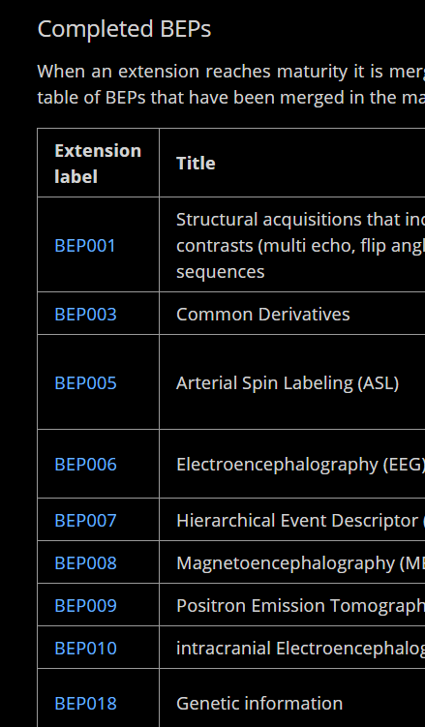
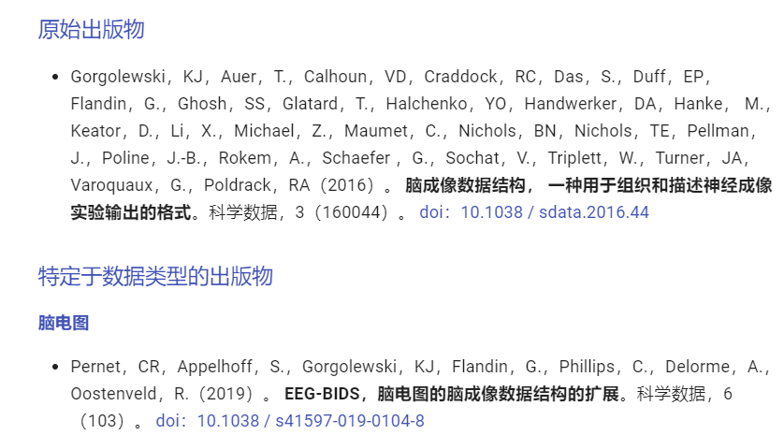
Introduction. ——Extensions&Citing BIDS&RRID
extended in a backwards compatible way 向后兼容的方式扩展
community-driven BIDS Extension Proposals (BEPs)社区驱动的BIDS扩展提案（BEP）
Research Resource Identifier (RRID) 研究资源标识符（RRID）

Slide 4
Common principles——Definitions-RFC 2119
1.MUST 或「REQUIRED」「SHALL」
定义是规范的绝对要求。
2. MUST NOT 或 “ SHALL NOT”
规范的绝对禁止。
3. SHOULD 或“RECOMMENDED”
在特定情况下可能存在有效理由而忽略特定项目，但必须理解全部含义并仔细权衡一下在选择不同进程
4. SHOULD NOT 或“NOT RECOMMENDED”
在特定情况下，可能存在有效理由当特定可接受或者有用的行为， 但应该完整理解其含义，并仔细权衡在执行此标签描述的任何行为之前。
5. MAY或 “ OPTIONAL”
可选的。特定的环境需求；或者可以促进其他人的应用；这个选项的选取可以用来与其他选项进行合作使用。当选取时，一般都会有另外一个选项等着共同操作。
6.使用命令的指南
必须谨慎使用本备忘录中定义的命令类型，它们只能用于互操作或限制行为的实际要求造成损害的可能性（例如，限制重发） 例如，不得将其用于尝试施加特定方法在不需要该方法的实现者上 互操作性。
7.安全注意事项
这些术语通常用于指定具有安全性的行为，不执行MUST或SHOULD或按照规范的规定MUST NOT或SHOULD NOT是非常微妙的。文档作者应该花时间详细阐述不遵循的安全隐患建议或要求，因为大多数实施者将没有受益于产生规范的经验和讨论。

Slide 5
Common principles ——Clarify a list of terms and abbreviations.
Dataset – 数据库neuroimaging and behavioral data_a particular study. (one or more subjects, multiple sessions)
Subject – 受试者a person or animal. Used interchangeably with term Participant.
Session –时段
a logical grouping of neuroimaging and behavioral data consistent across subjects.
can be synonymous to a visit in a longitudinal study.
In general, subjects will stay in the scanner during one session. However, for example, if a subject has to leave the scanner room and then be re-positioned on the scanner bed, the set of MRI acquisitions will still be considered as a session and match sessions acquired in other subjects.
Similarly, in situations where different data types are obtained over several visits (for example fMRI on one day followed by DWI the day after) those can be grouped in one session.
Defining multiple sessions is appropriate when several identical or similar data acquisitions are planned and performed on all -or most- subjects, often in the case of some intervention between sessions (for example, training).
In the PET context, a session may also indicate a group of related scans, taken in one or more visits.

Slide 6
Data acquisition – 数据采集a continuous uninterrupted block of time during which a brain scanning instrument was acquiring data according to particular scanning sequence/protocol.
Data type – 数据类型. Data files are contained in a directory named for the data type. In raw datasets, the data type directory is nested inside subject and (optionally) session directories.
BIDS defines eight data types:
func (task based and resting state functional MRI),
dwi (diffusion weighted imaging),
fmap (field inhomogeneity mapping data such as field maps),
anat (structural imaging such as T1, T2, PD, and so on),
meg (magnetoencephalography),
eeg (electroencephalography),
ieeg (intracranial electroencephalography),
beh (behavioral).
Task - 任务. 包括 stimuli and responses,. "resting state" a task. a task——data acquisition. one (combined) task.
Event - 事件each event has an onset time and duration. Note that not all tasks will have recorded events (for example, "resting state").

Slide 7
Run – 数据采集 ，一个序列的扫描
Modality – 模态（T1w, bold or dwi）. indicated in the suffix.
<index> -一个非负整数，可带有任意数字0的前缀，用于一致的缩进，例如，在run-01中，在run-之后是01.
<label> - alphanumeric value,可带有任意数字0的前缀，for example, ‘task-rest’.
suffix – ‘_’后缀,alphanumeric value, for example, it is eeg in sub-05_task-matchingpennies_eeg.vhdr.
File extension -文件扩展名—位于最左边的句点（.）例如，.gitinore没有文件扩展名，但是test.nii.gz的文件扩展名是.nii.gz。请注意，最左边的句点包含在文件扩展名中。
DEPRECATED -已弃用-在生成新数据集时不应使用“弃用”实体或元数据字段。它保留在标准中，以保持现有数据集的可解释性。
Compulsory, optional, and additional data and metadata
File name structure
subject and session
sub-<label>_ses-<label> sub-01_ses-01
sub-01_task-rest_eeg.edf
sub-<label>/[ses-<label>/] anat/ sub-<label>[_ses-<label>][_acq-<label>][_ce-<label>][_rec-<label>][_run-<index>][_echo-<index>][_flip-<index>][_inv-<index>][_mt-<label>][_part-<label>]_<suffix>.nii[.gz]
Notes:
在实体复制元数据的情况下，不应使用实体的存在来替换相应的元数据字段。例如，在回波平面成像MRI中，dir-<label>实体可用于区分具有不同相位编码方向的文件，但文件的相位编码方向只能指定为元数据。
https://bids-specification.readthedocs.io/en/stable/99-appendices/10-file-collections.html

Slide 8
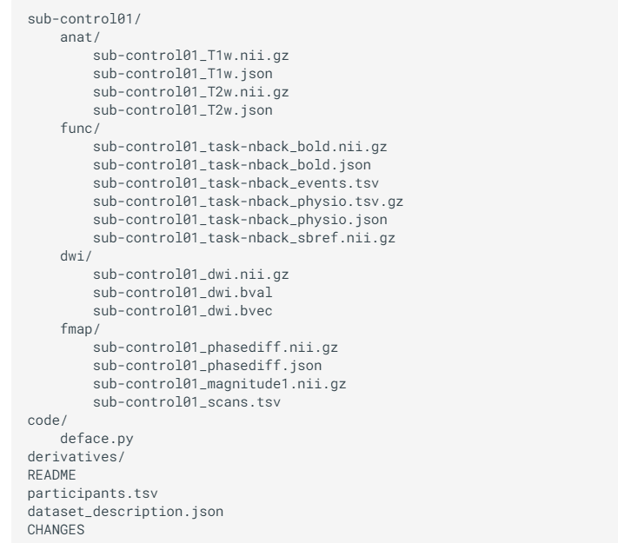

Slide 10
EEG-BIDS
For BIDS, EEG data MUST be stored in one of the following formats:
European data format (Each recording consisting of a .edf file)
BrainVision Core Data Format (Each recording consisting of a .vhdr, .vmrk, .eeg file triplet)
The format used by the MATLAB toolbox EEGLAB (Each recording consisting of a .set file with an optional .fdt file)
Biosemi data format (Each recording consisting of a .bdf file)
It is RECOMMENDED to use the European data format, or the BrainVision data format.
The data in their original format, if different from the supported formats, can be stored in the /sourcedata directory.
Name of the task. No two tasks should have the same name. The task label included in the file name is derived from this TaskName field by removing all non-alphanumeric ([a-zA-Z0-9]) characters. For example TaskName "faces n-back" will correspond to task label facesnback. A RECOMMENDED convention is to name resting state task using labels beginning with rest.

Slide 11
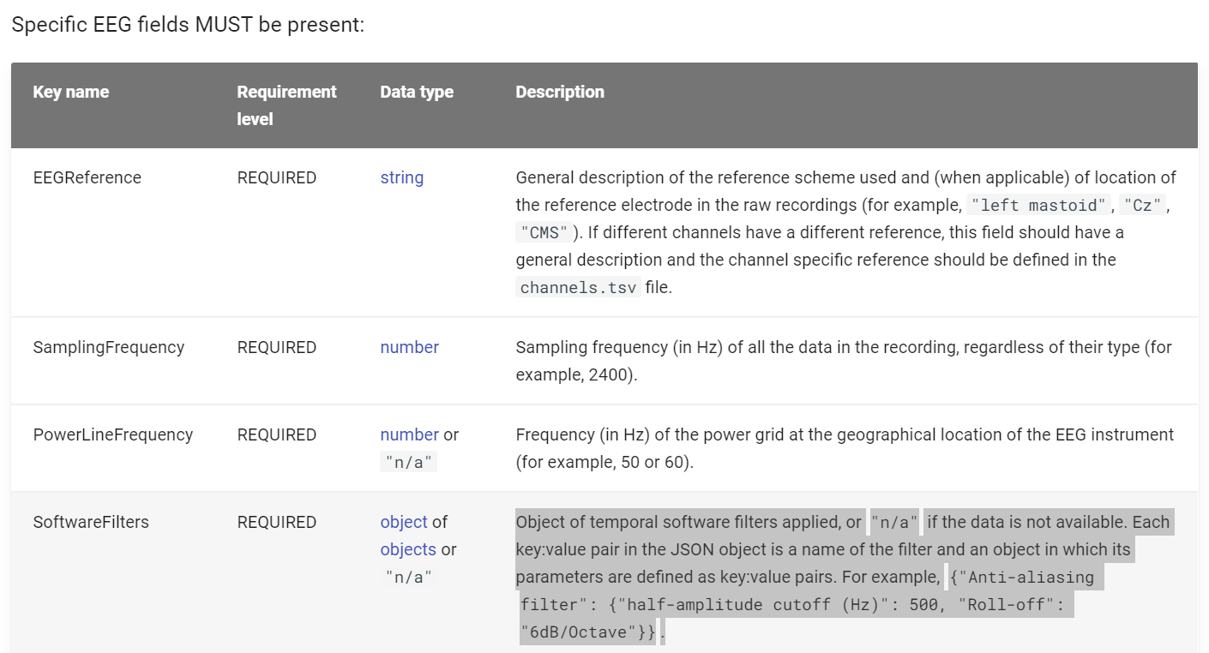

Slide 12
