Slide 1

Bangladesh Army University of Science and Technology
Hall Management System
Group 1
Md Yeamin Islam Sakib(200201015)
Mushrat binte Alam Mithy(200201006)
Harishankar Barman(200201001)
Supervisor
Md mukter Hossain
Lecturer
Bangladesh Army University of Science and Technology

Slide 2
Introduction
Hall management system is a web based application developed for managing various activies in hall.
It helps to know and manage :
Student detailes
Staff details
Hall bill information

Slide 3
overview
Dashboard
Email/id : password:
Home | Submit | Logout
ADMIN
Welcome to Dashboard
client
********
submit
User
System
Login page
User panel

Slide 4
Tools
Front-End
HTML
CSS
Bootstrap
JavaScript
Backend
PHP
My SQL

Slide 5
Objectives
To maintain and manage hostel information easily
To avoid the complexity and to reduce time in data processing

Slide 6
System design
Student details
Database
Bill info
Contact info
user
Room Details

Slide 7
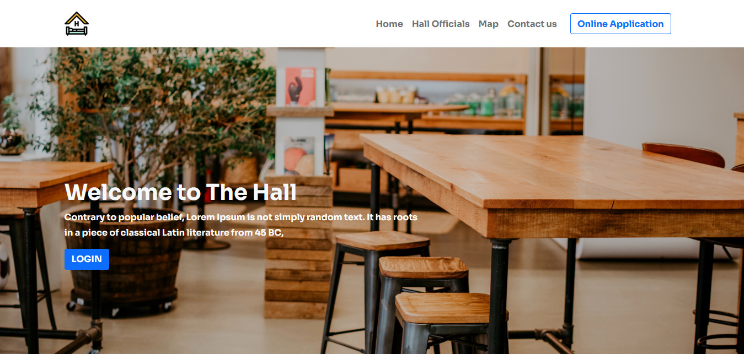
Home page
Contents
Header Menu
logo
Home
Hall officials
Map
Contact page
Application Button

Slide 8
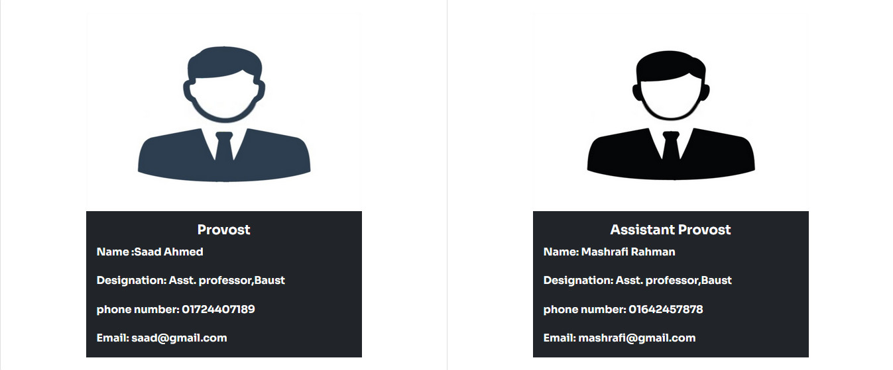
Hall Official Area
Provost
Assistant provost

Slide 9
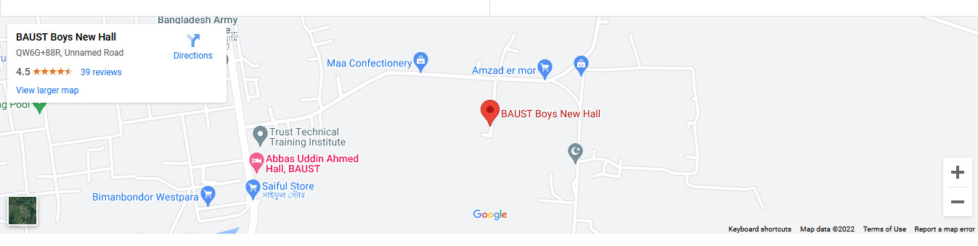
Map Area
Hall location

Slide 10
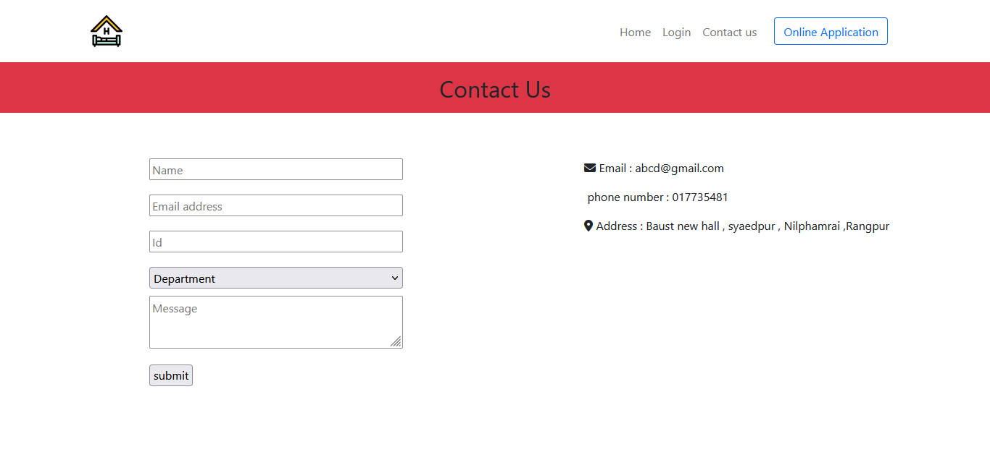
Contact us form
Contact option
Email
Phone number
password

Slide 11
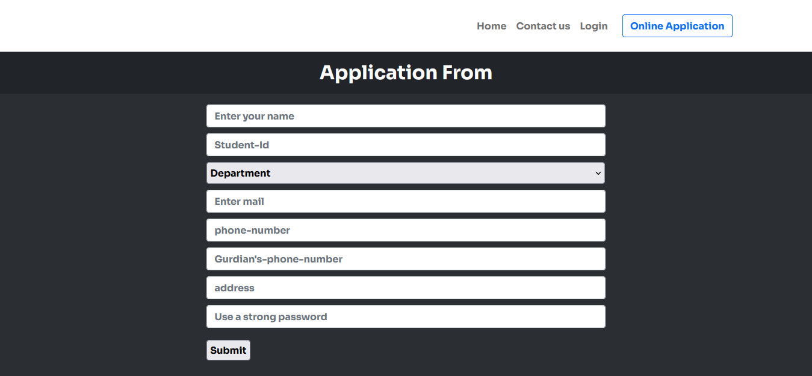
Application Form
Application Form
for New apply

Slide 12
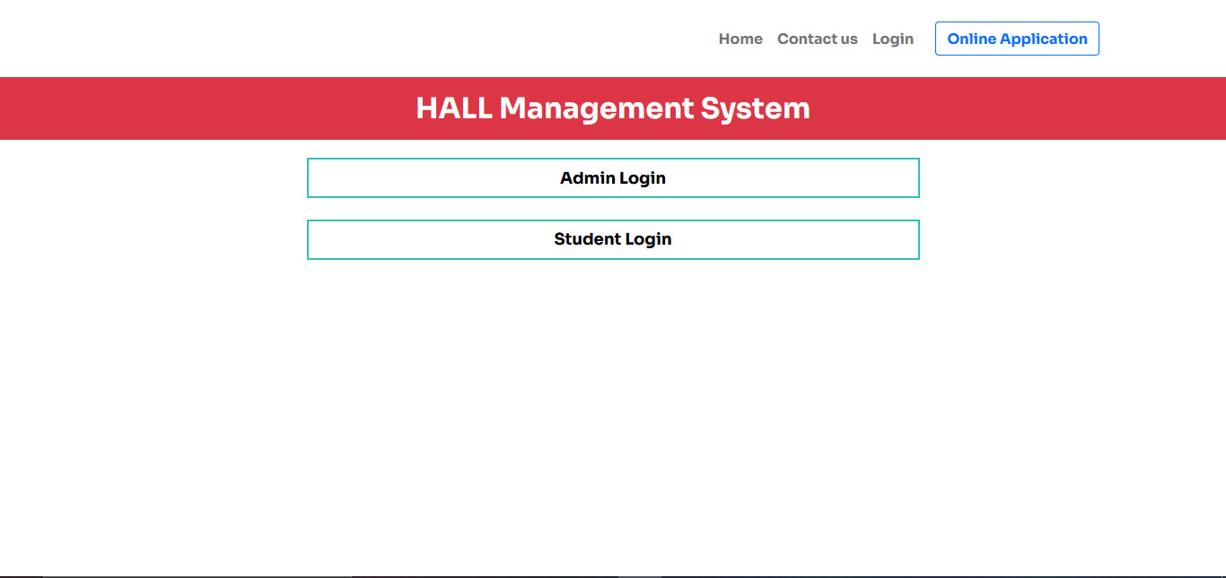
Log-in
Header
Admin login
Student login

Slide 13
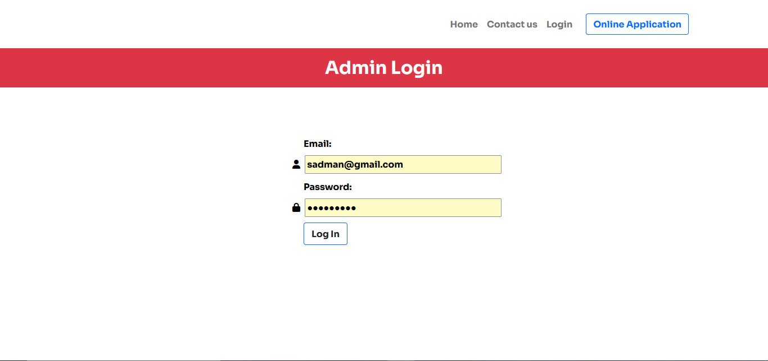
Admin Log-In
Header menu
Header
Email
Password

Slide 14
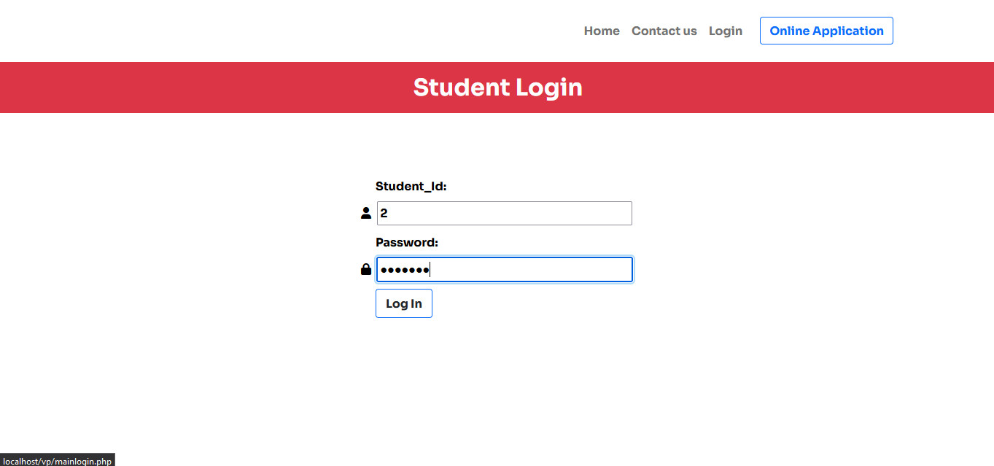
Student log-in
Header menu
Header
Student Id
Password

Slide 15
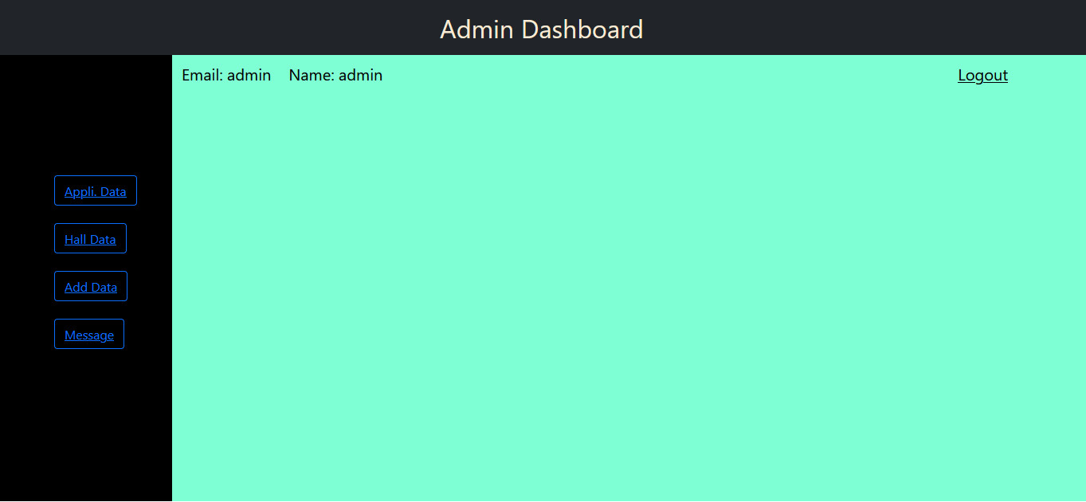
Admin Dashboard
Application data
Hall data
Add hall data
Message
logout

Slide 16
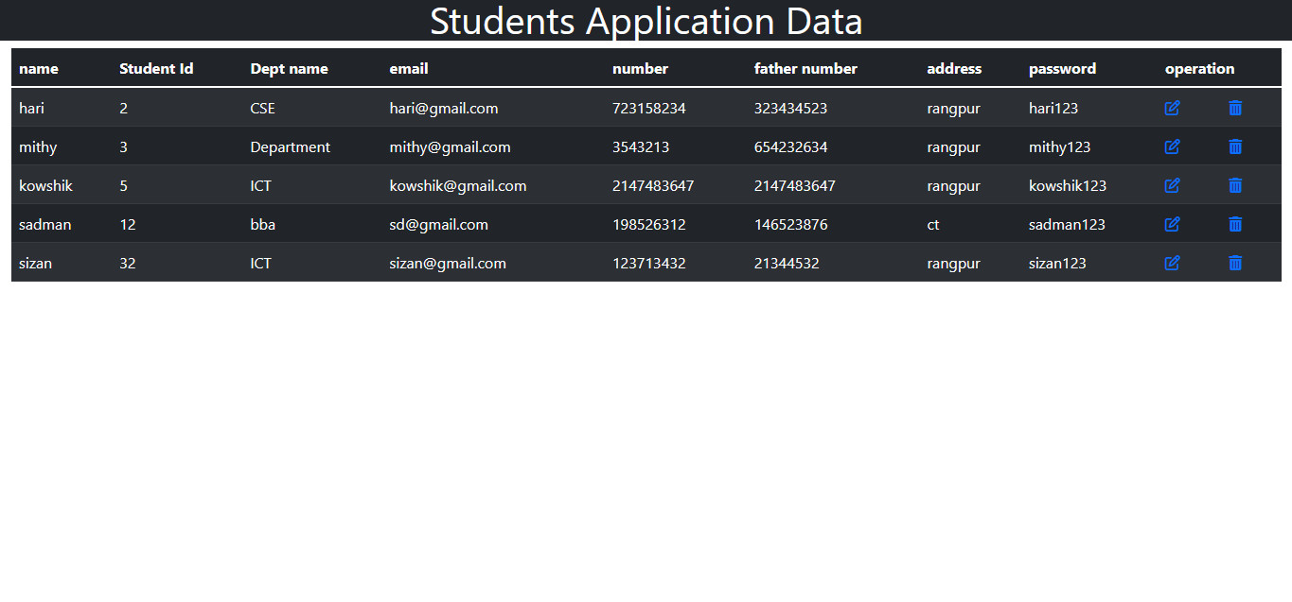
Application Data

Slide 17

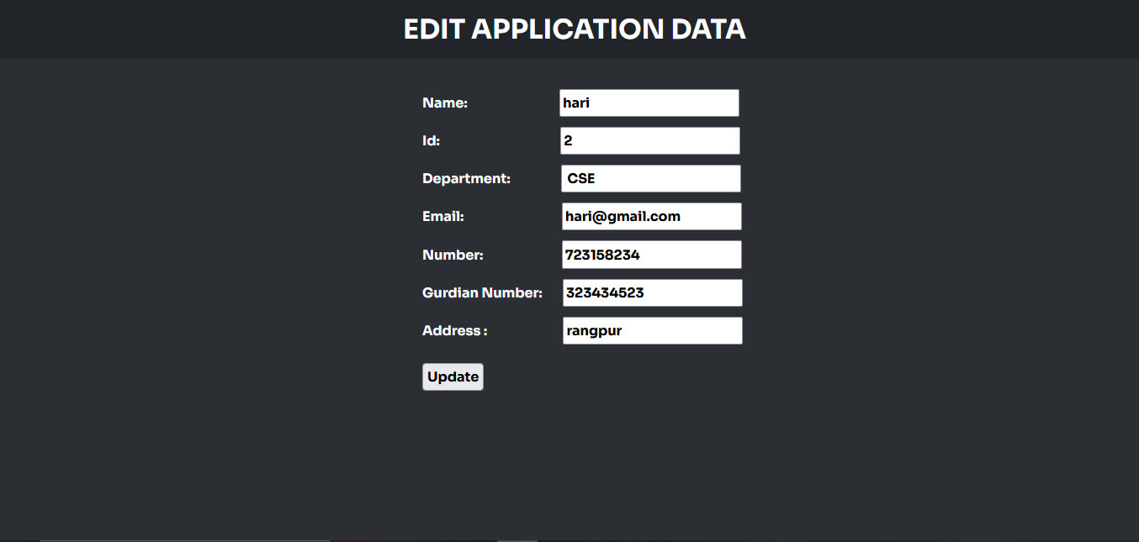
Edit application data

Slide 18
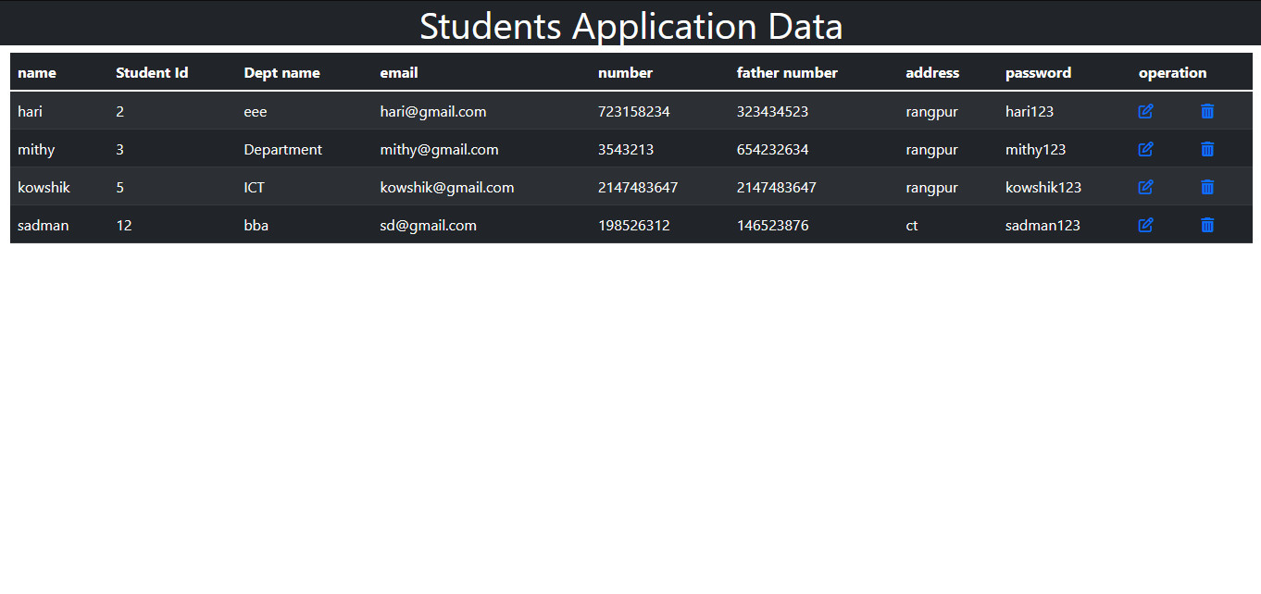
Delete application data

Slide 19
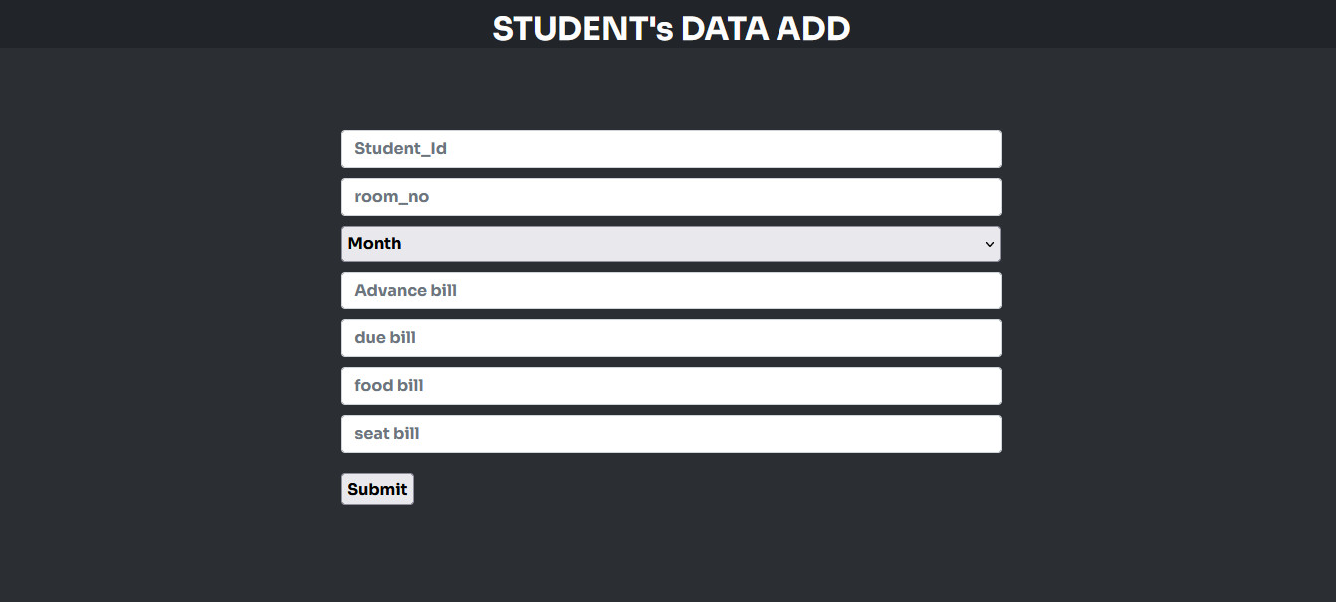
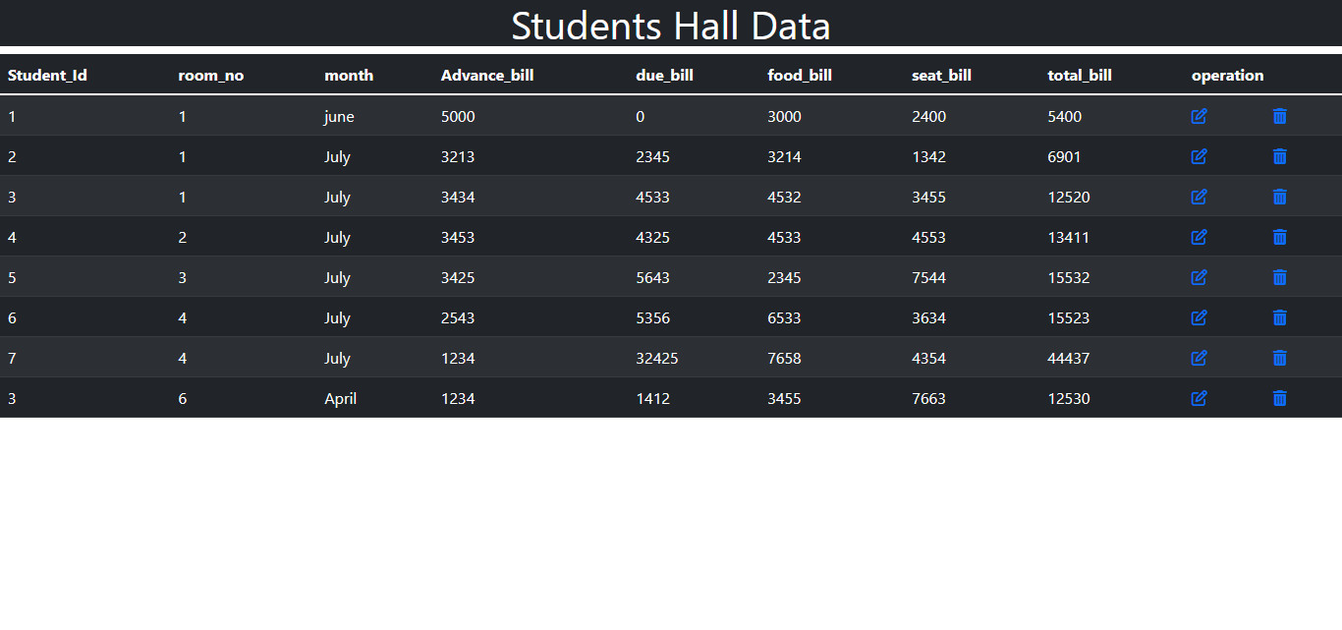
Add Data

Slide 20
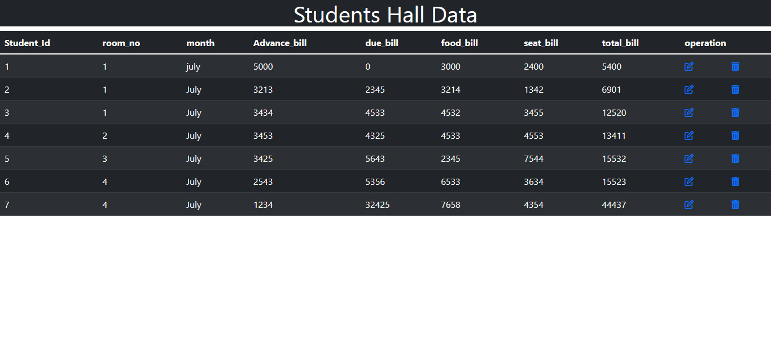
Hall data

Slide 21
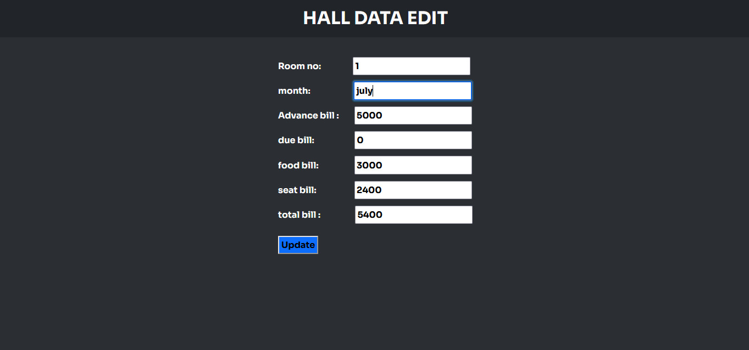
Update hall data

Slide 22

Update hall data

Slide 23
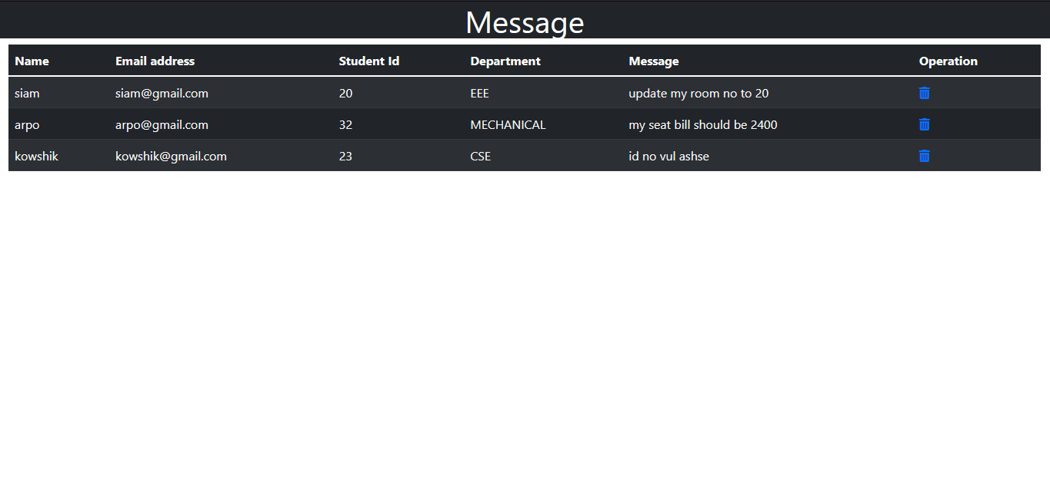
message

Slide 24
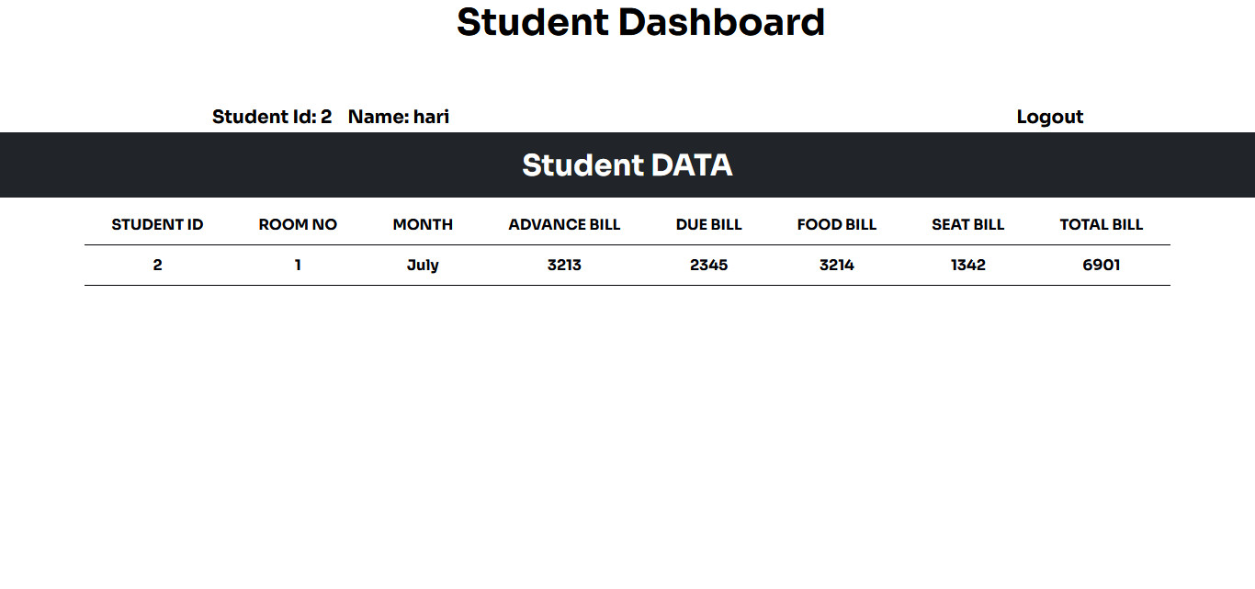
Student Dashboard
Student id
Name
Hall information

Slide 25
Thank you everyone

