Slide 1

Banagladesh Army University Of Science And Technology
Group Members:
Mushrat Binte Alam Mithy(200201006)
MD. Yeamin Islam Sakib(200201015)
Supervisor : Md. Mahadi Hasan
Lecturer
Bangladesh Army University Of Science And Technology(BAUST)

Slide 2
Introduction
Our gaming website is a platform that offers players access to a wide range of online games, from action games to puzzle games .
The Snake Game project is one of the exciting projects we have been working on. Our version of the game will come with improved graphics, sound effects, and a user-friendly interface.

Slide 3
Objectives
The objective of our gaming website is to provide players with a convenient, secure, and enjoyable online gaming experience.
Our aim is to bring the classic games you love to the digital world, and keep them accessible at all times.

Slide 4
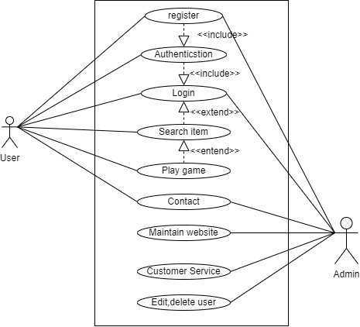
Usecase diagram:
Figure : Usecse diagram for gaming website

Slide 5
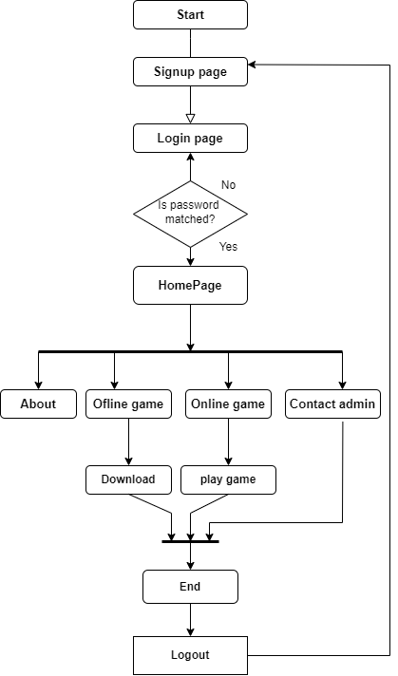
Activity diagram:
Figure : Acticity diagram for Users

Slide 6
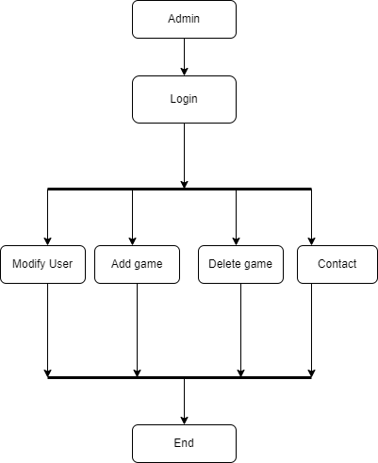
Activity diagram:
Figure : Acticity diagram for Admin

Slide 7
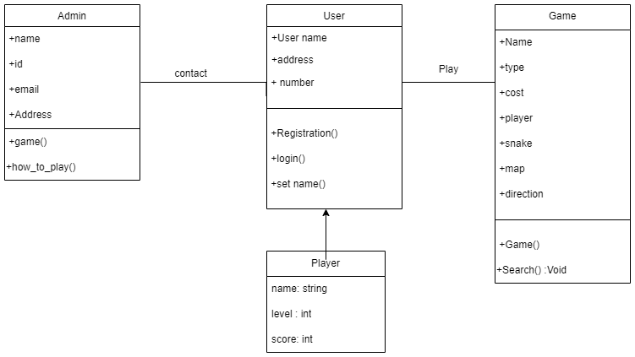
Clsss diagram:
Figure : Class diagram for gaming website

Slide 8
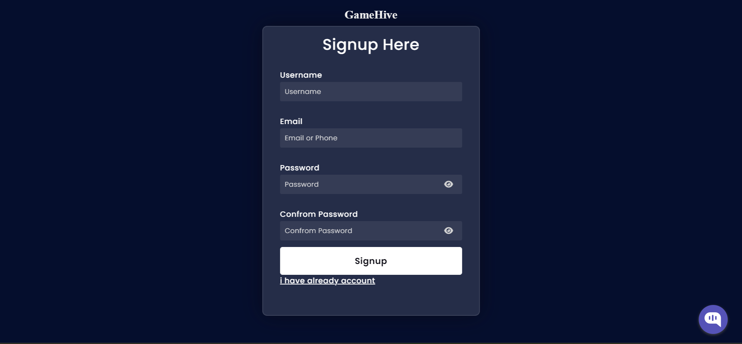
Signup page
Figure: Signup page

Slide 9
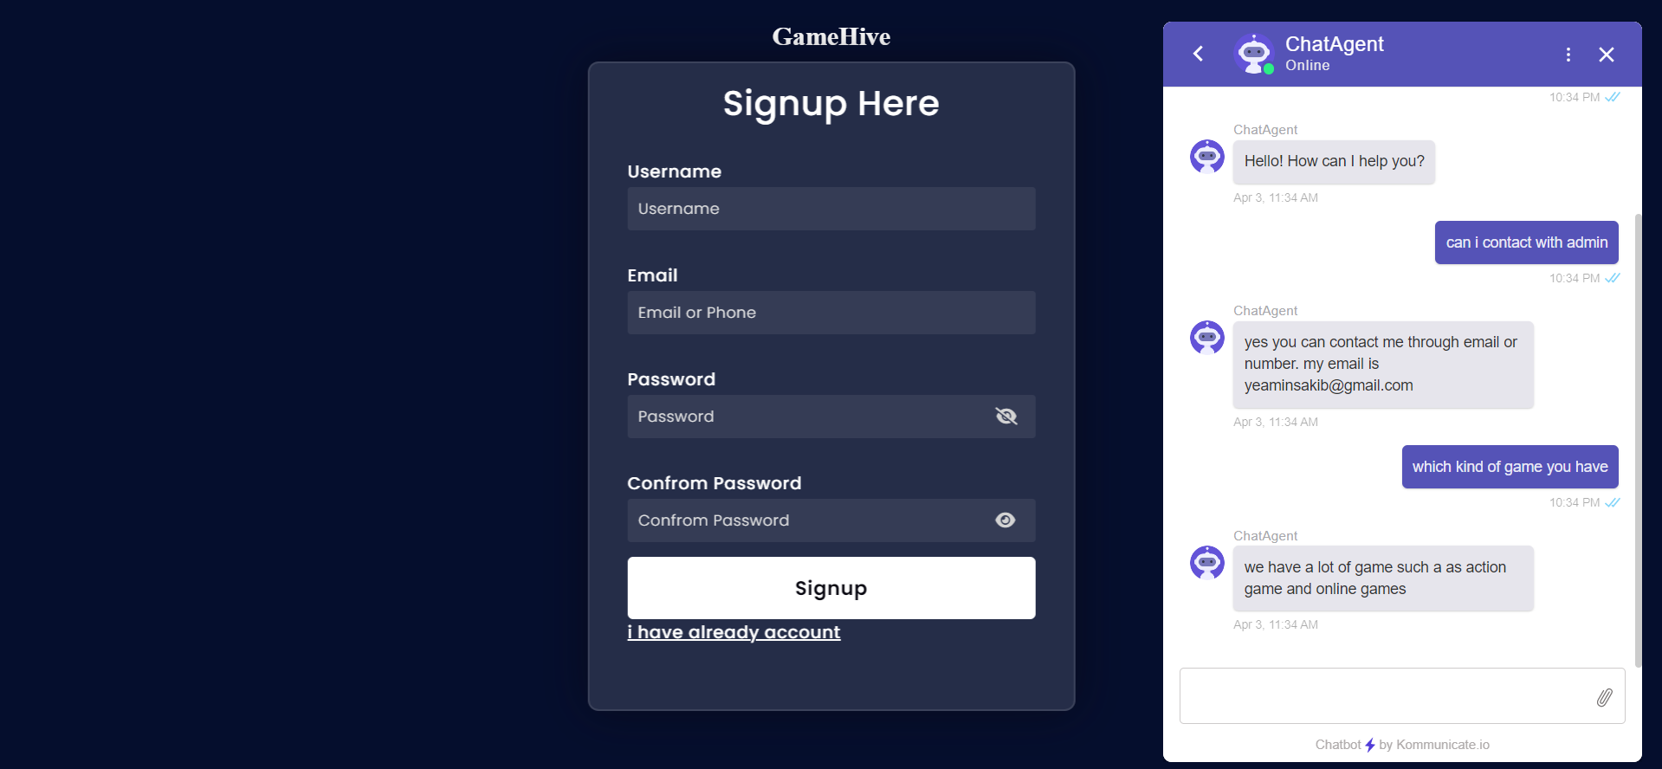
Signup page with chatbot
Figure: Signup page with chatbot

Slide 10
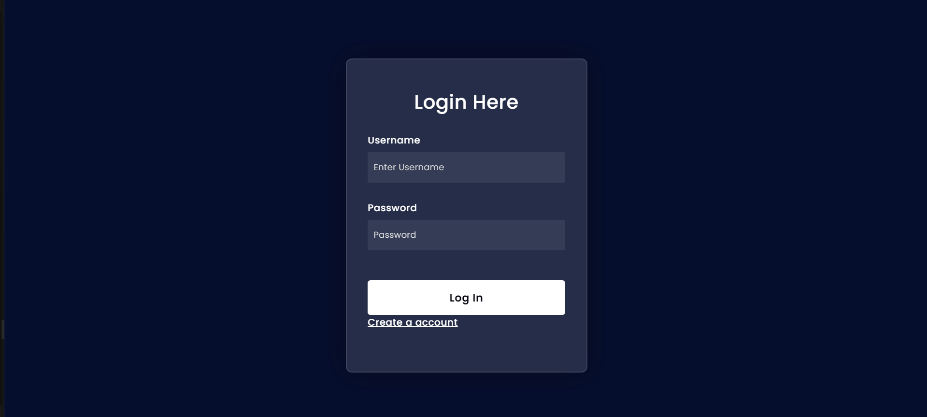
login page
Figure: Login page

Slide 11
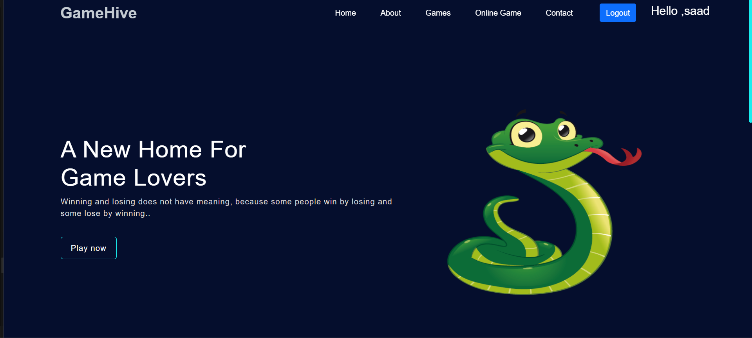
Home page
Figure: Home page

Slide 12
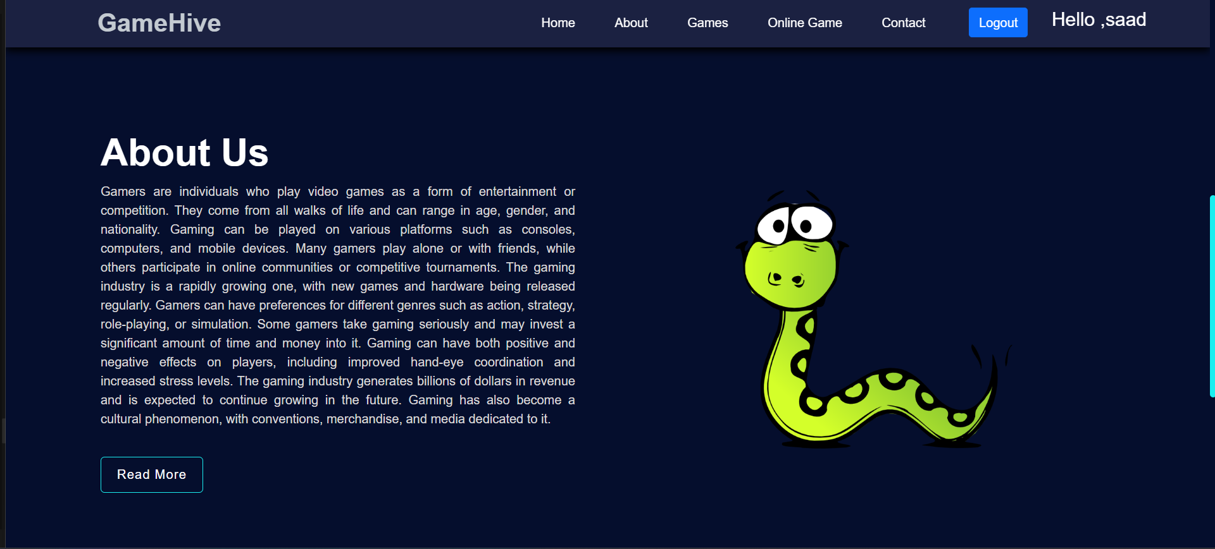
About us page
Figure: About us page

Slide 13
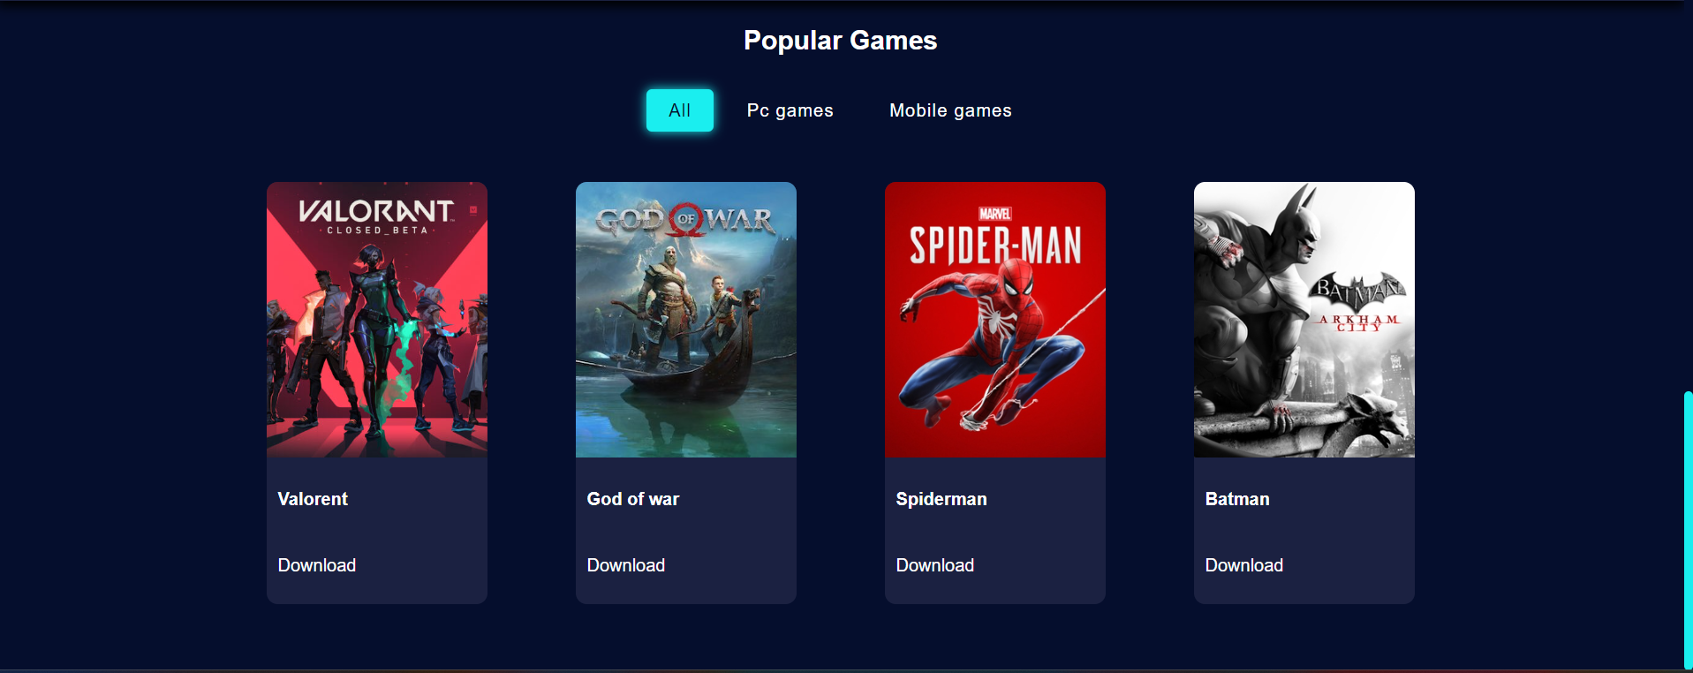
Game section
Figure: Game section

Slide 14
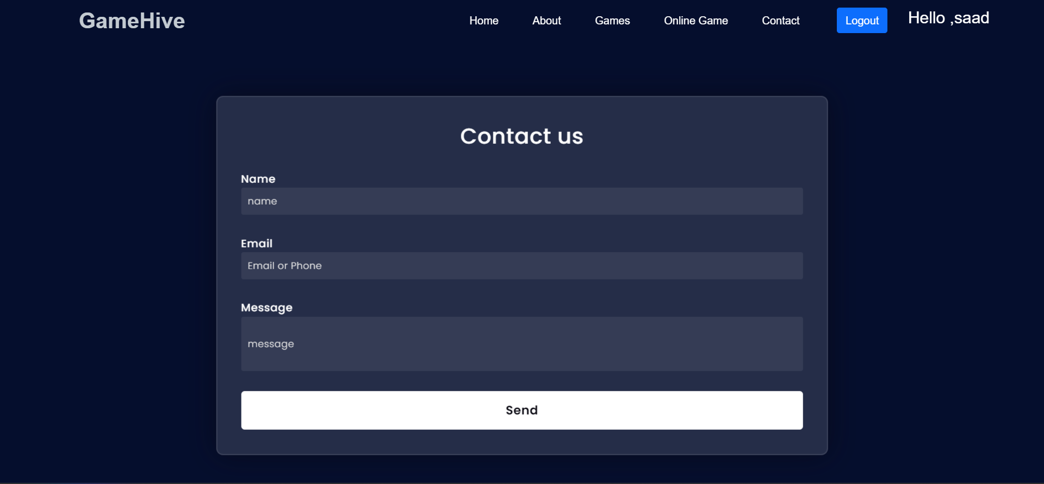
Contact us page
Figure: Contact us page

Slide 15
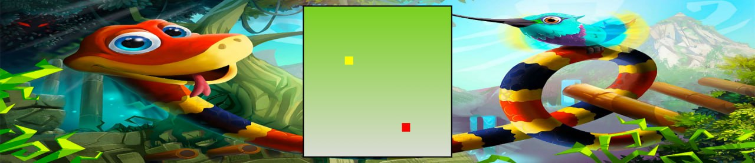
Snake game Page
Figure: Snake game page

Slide 16
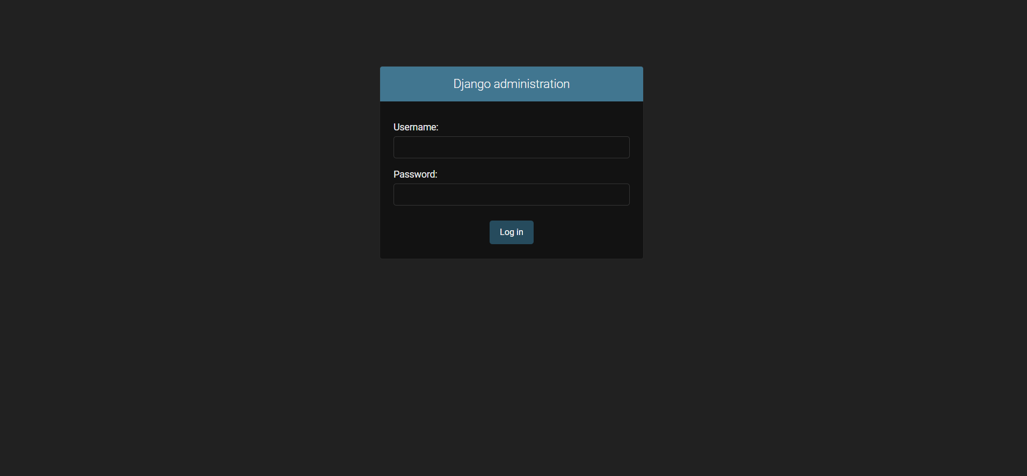
Admin panel login
Figure: Admin Panel login

Slide 17
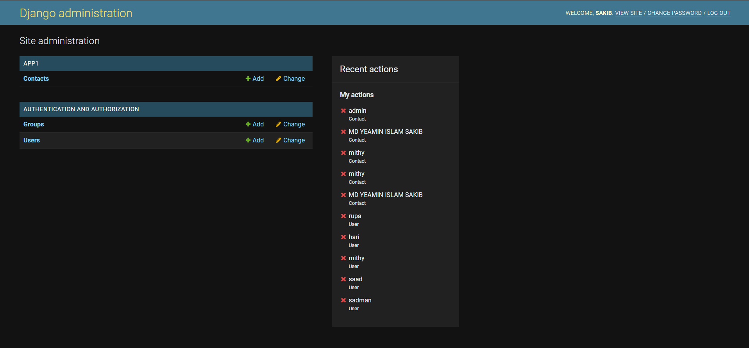
Admin panel
Figure: Admin panel

Slide 18
Snake Game Features
The snake game on our website will come with several new features including:
Improved graphics and sound effects.
A leaderboard to keep track of high scores.
A level system with different difficulty levels.

Slide 19
User Experience
The snake game will have a user-friendly interface and be easy to play.
The game will be accessible on both desktop and mobile devices, providing players with the ability to play on the go.

Slide 20
Conclusion
The website's main objective is to provide players with a convenient, secure, and enjoyable online gaming experience, and we believe the Snake Game will achieve that.

Slide 21
Technical Requirements:
HTML
CSS
Bootstrap
JavaScript
Python Django

Slide 22
Reference
https://snake.io/
https://www.crazygames.com/

Slide 23
END

