Slide 1

Bangladesh Army University of Science and Technology
Department of Computer Science and Engineering
Air-Writting Bangla Digit Recognition through Hand Gestures using Deep Learning Techniques
Course code : CSE 4000
Course Titile: Project/Thesis
Group Members:
Harishankar Barman (200201001)
Mushrat Binte Alam Mithy (200201006)
MD. Yeamin Islam Sakib (200201015)
Supervisor
Hasan Muhammad Kafi
Assistant Professor
Dept. of CSE , BAUST
Co-Supervisor
Md. Mahadi Hasan
Lecturer
Dept. of CSE , BAUST

Slide 2
Contents
Introduction
Literature Review
Research Objective
Dataset Collection
Methodology
Results & Model Hyperparameters
Response to research objective
Conclusion
Future Work
References

Slide 3

Introduction
Classification of Air Writting Bangla digit via hand Gesture using Deep Learning model
Air Writing involves recognizing characters drawn in mid-air using hand gestures, without any physical contact with a surface
Figure1: Air writting Bangla digit using hand gesture

Slide 4
Literature Review
No | Methodology | Limitation | Accuracy
1 | Primarily employs Convolutional Neural Networks (CNNs) as the deep learning model | High Training Accuracy vs. Real-Time Input Recognition | Training accuracy: 99.36% Validation accuracy 97%
2 | Deep learning models applied in the study are Long Short-Term Memory (LSTM) and Convolutional Neural Network (CNN) . | Its reliance on specific hardware, notably the Intel RealSense SR300 camera for fingertip detection and trajectory tracking. | CNN : Without normalization: 98.26% With nearest neighbor: 98.89% Root point : 98.73% Both : 99.06% LSTM: Without normalization: 98.68% With nearest neighbor: 99.08% Root point : 99.02% Both : 99.17%
[1] Saha, Chayti, et al. "Real time Bangla Digit Recognition through Hand Gestures on Air Using Deep Learning and OpenCV." Int. J. Curr. Sci. Res. Rev 5 (2022).
[2] Alam, Md Shahinur, et al. "Trajectory-based air-writing recognition using deep neural network and depth sensor." Sensors 20.2 (2020): 376.

Slide 5
Literature Review
No | Methodology | Limitation | Accuracy
3 | Multi-class Support Vector Machine (SVM) were employed for training and testing | Study was conducted with a relatively small sample size of 15 users in a specific natural environment | For dataset 6, the researchers achieved a high recognition accuracy of 96.85%
4 | AlexNet have been used as primary model. Also used Vgg16,Resnet,InceptionV3, InceptionV4 | Potential difficulty in accurately detecting and tracking fingertips | Accuracy : Alexnet : 96.11% Vgg16 : 96.75 % Resnet : 97.32 % InceptionV3 : 97.56 InceptionV4 : 98.12%
[3]Mahmud, Hasan, Robiul Islam, and Md Kamrul Hasan. "On-air English Capital Alphabet (ECA) recognition using depth information." The Visual Computer 38.3 (2022): 1015-1025.
[4] Mukherjee, Sohom, et al. "Fingertip detection and tracking for recognition of air-writing in videos." Expert Systems with Applications 136 (2019): 217-229.

Slide 6
Research Objective
Create a dataset for our research under variety of conditions
To train a deep learning model model that can detect air written Bangla digit more efficiently.
Ensure the system can handle variability in Bangla digit styles and handwriting from different users.

Slide 7

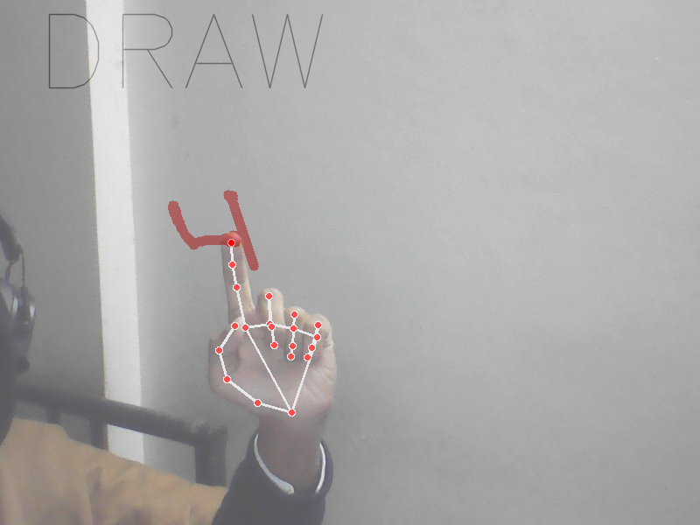
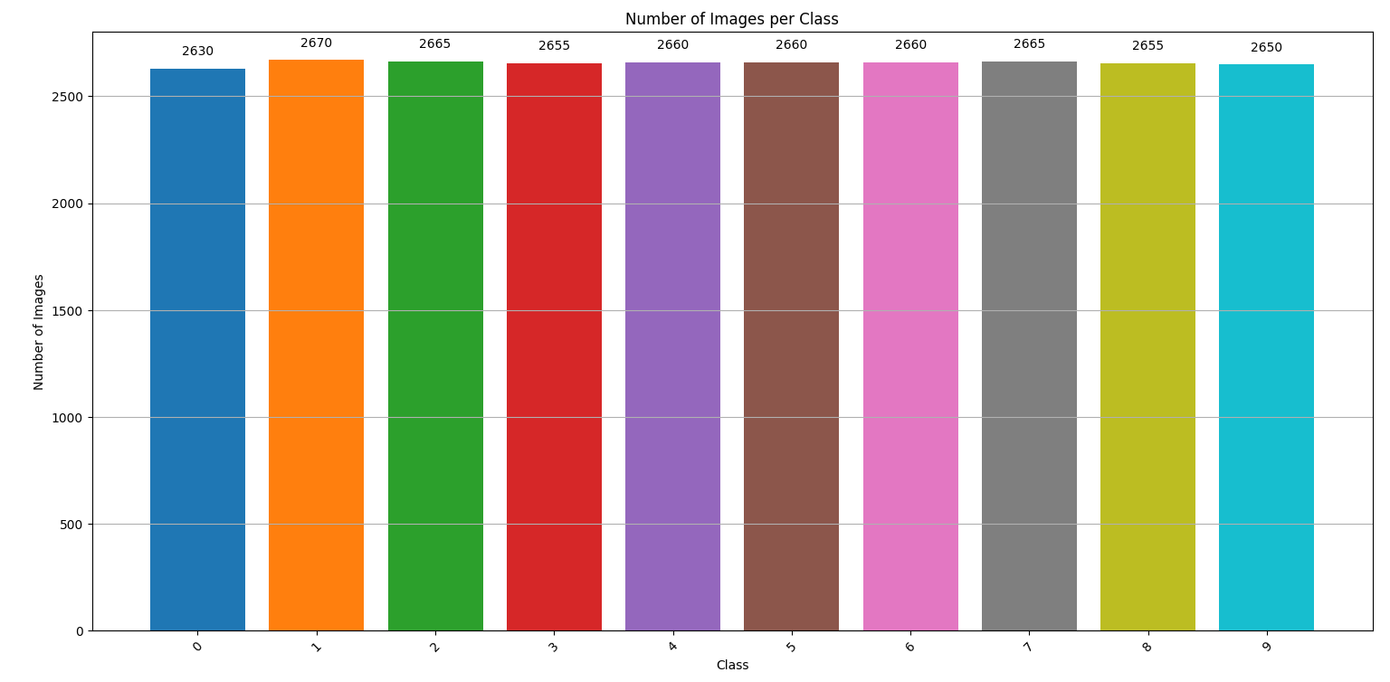
Dataset Collection
Dataset
Dataset Size
Total imgae : 26570
Train with 18599 images
Validation with 3986 images
Test with 3,985 images
Multiple Writers
Digit Variations
Diverse Background
Fig1: Dataset with diverse background
Fig 2: Total images for per classes

Slide 8
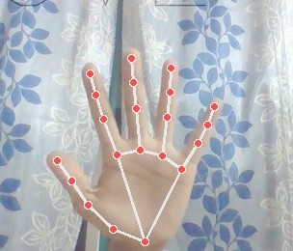
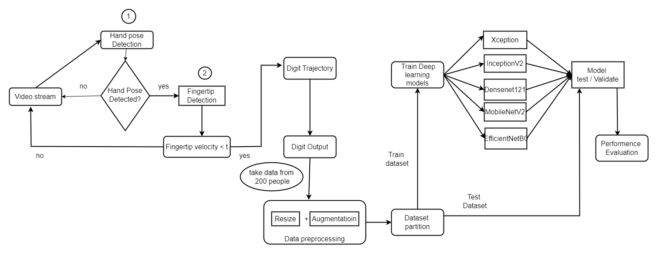
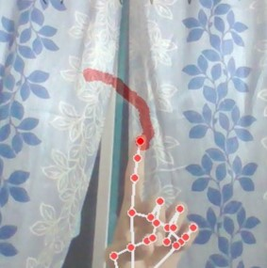
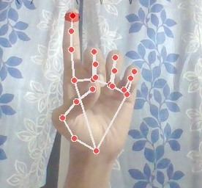
Proposed Methodology
Fig 3: Proposed methodology

Slide 9
Response to research objective
We create air writting Bangla digit dataset under variety of conditions
Applied five different deep learning models to efficiently detect air-written Bangla digits
We have ensured the system can handle variability in Bangla digit styles and handwriting from different users

Slide 10
Results & Model Hyperparameters
We have used 5 different models to train and evaluate the Air Writting Bangla digit .
Model No | Deep Learning model | Highest Accuracy | Batch Size | Dropout Rate | Learning Rate | Epoch
1 | Xception | 98% | 16 | 0.7 | 0.00001 | 3
2 | InceptionV3 | 95% | 16 | 0.7 | 0.0001 | 3
3 | DenseNet121 | 95% | 32 | 0.6 | 0.0001 | 3
4 | MobileNetV2 | 78% | 32 | 0.6 | 0.0001 | 3
5 | EfficientNetB0 | 98% | 16 | 0.7 | 0.00001 | 3

Slide 11
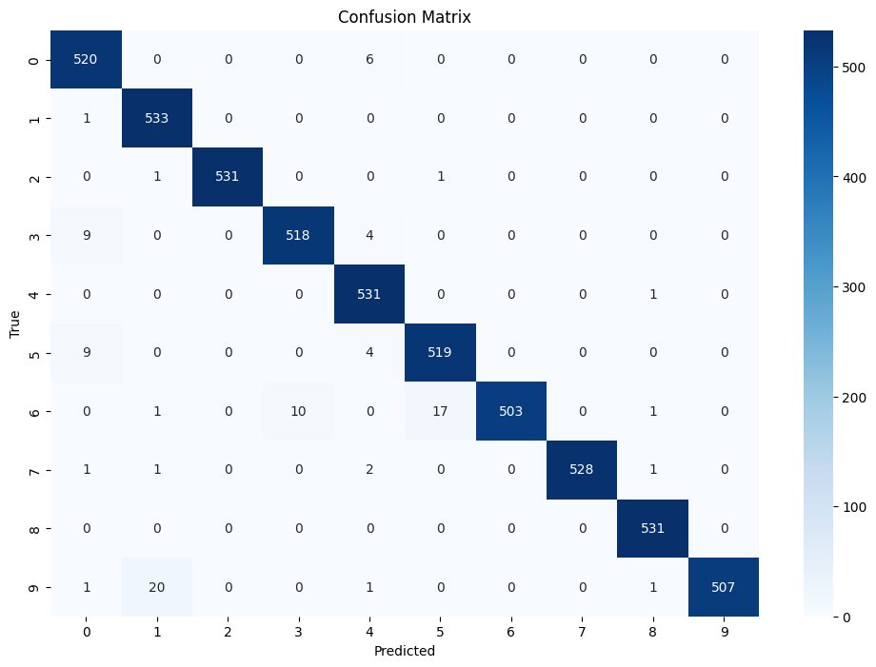
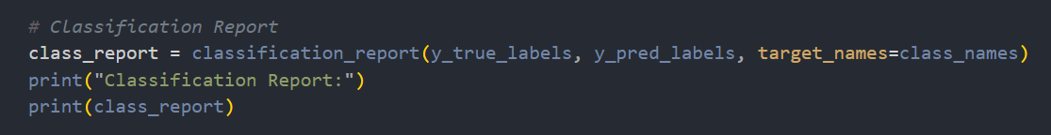
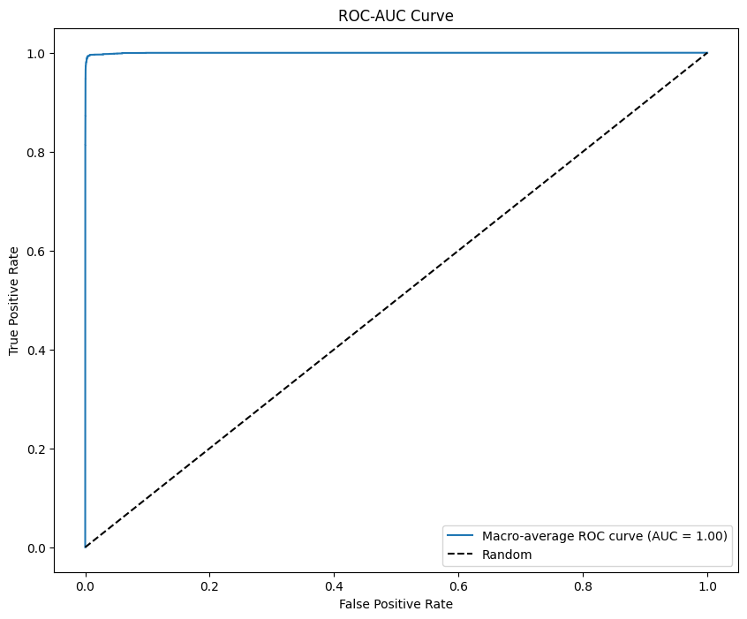
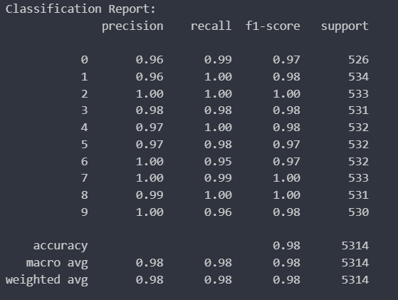
Performance Evaluation (EfficientnetB0)
(a)
(b)
(c)
Fig 5: (a)Confusion matrix (b)Classification report (c)ROC-AUC curve

Slide 12
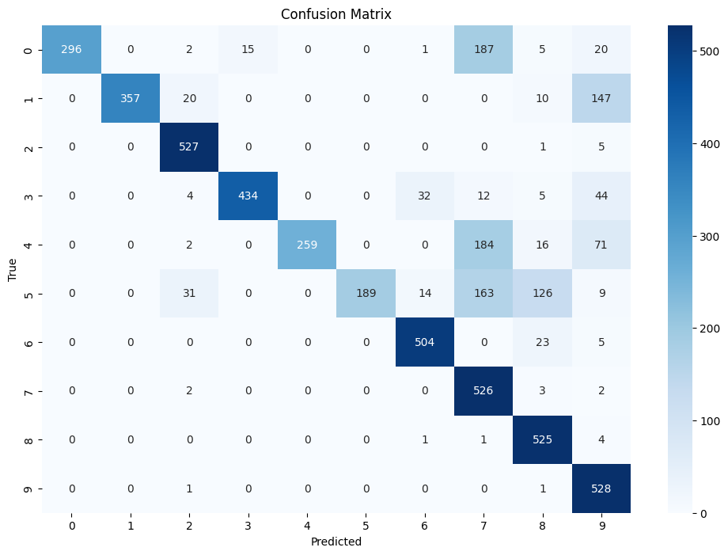
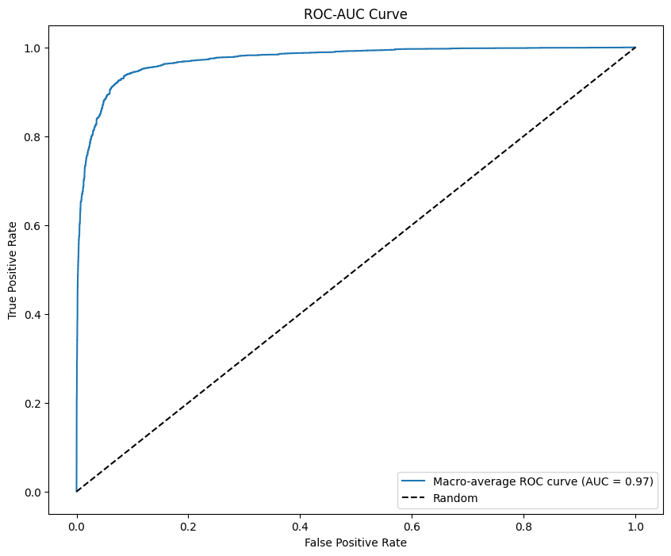
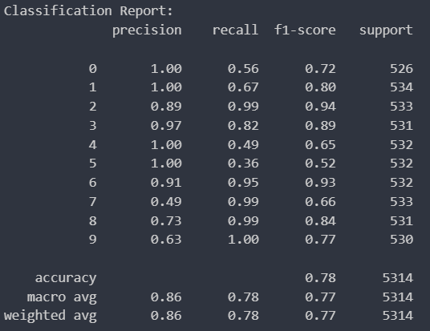
Performance Evaluation (MobileNetV2)
a
c
b
Fig: (a)Confusion matrix (b)Classification report (c)ROC-AUC curve

Slide 13
Conclusion
Our Models can classify air written bangla digit image with high accuracy rate
We evaluate our models air written bangla digit datset
We have found a maximum f1 score 0.9825 for EfficientnetB0, 0.9763 for xception , 0.9421 for inceptionv3, 0.9506 for Densenet121 and 0.9506 for Mobilenetv2.

Slide 14
Future Work
Future Work:
Develop real-time Bangla digit recognition systems using our trained models.
Optimize models for deployment on edge devices or mobile platforms for practical applications.

Slide 15
References
Saha, Chayti, et al. "Real time Bangla Digit Recognition through Hand Gestures on Air Using Deep Learning and OpenCV." Int. J. Curr. Sci. Res. Rev 5 (2022).
Mahmud, Hasan, Robiul Islam, and Md Kamrul Hasan. "On-air English Capital Alphabet (ECA) recognition using depth information." The Visual Computer 38.3 (2022): 1015-1025.
Islam, Robiul. Alphabet recognition in unconstrained Air Writing using Depth Information. Diss. Department of Computer Science and Engineering (CSE), Islamic University of Technology (IUT), Board Bazar, Gazipur-1704, Bangladesh, 2018.
K Jabde, Meenal, et al. "A Comprehensive Literature Review on Air-written Online Handwritten Recognition." International Journal of Computing and Digital Systems 15.1 (2024): 307-322.
Chen, Mingyu, Ghassan AlRegib, and Biing-Hwang Juang. "Air-writing recognition—Part I: Modeling and recognition of characters, words, and connecting motions." IEEE Transactions on Human-Machine Systems 46.3 (2015): 403-413.
Lee, Sun-Kyung, and Jong-Hwan Kim. "Air-text: Air-writing and recognition system." Proceedings of the 29th ACM International Conference on Multimedia. 2021.
Mukherjee, Sohom, et al. "Fingertip detection and tracking for recognition of air-writing in videos." Expert Systems with Applications 136 (2019): 217-229.

Slide 16
References
Chen, Mingyu, Ghassan AlRegib, and Biing-Hwang Juang. "Air-writing recognition—Part II: Detection and recognition of writing activity in continuous stream of motion data." IEEE Transactions on Human-Machine Systems 46.3 (2015): 436-444.

Slide 17
Thank You

Slide 18
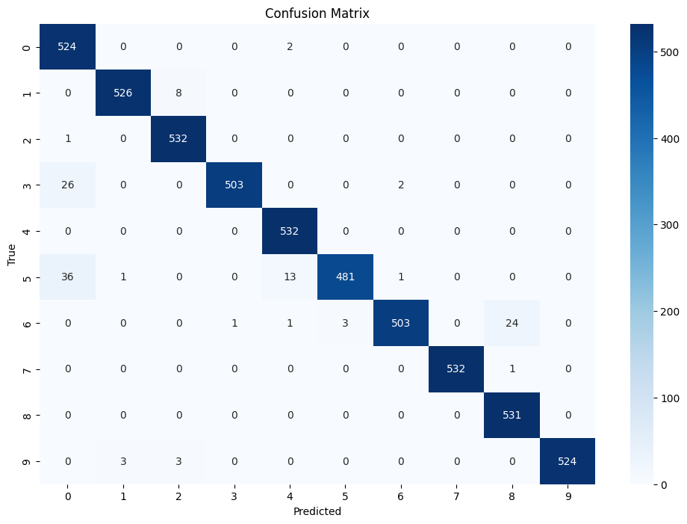

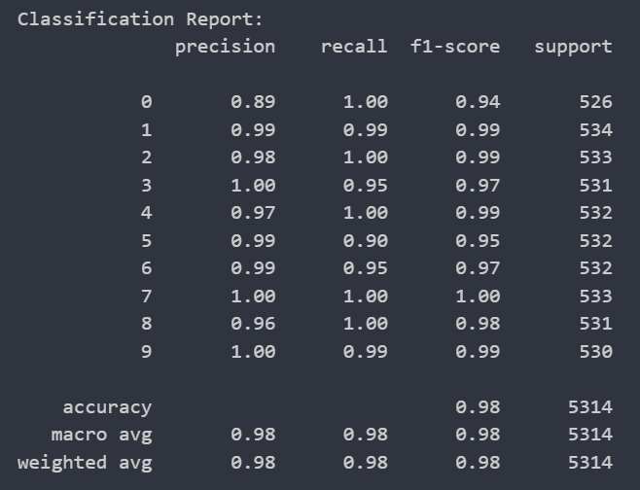
Appendix Performance Evaluation (Xception)
b
a
c
Fig : (a)Confusion matrix (b)Classification report (c)ROC-AUC curve

Slide 19
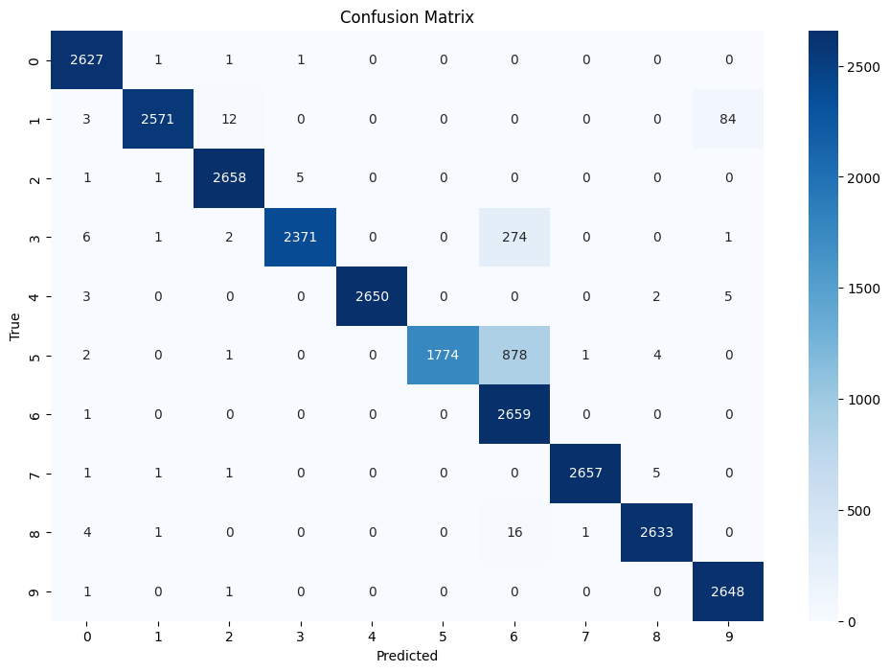
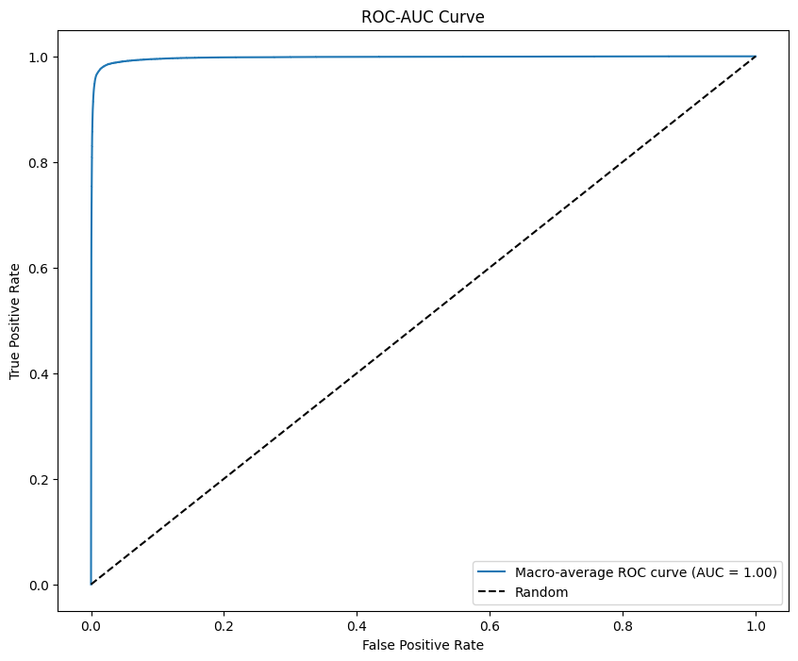
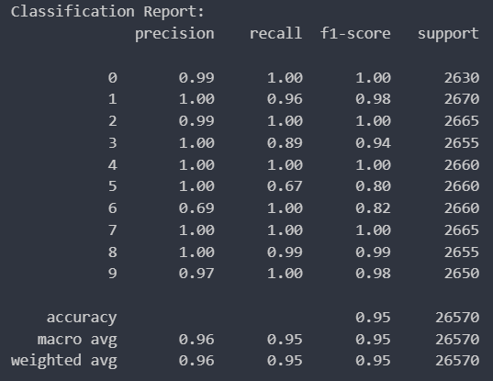
Appendix Performance Evaluation (DenseNet121)
a
c
b
Fig: (a)Confusion matrix (b)Classification report (c)ROC-AUC curve

Slide 20

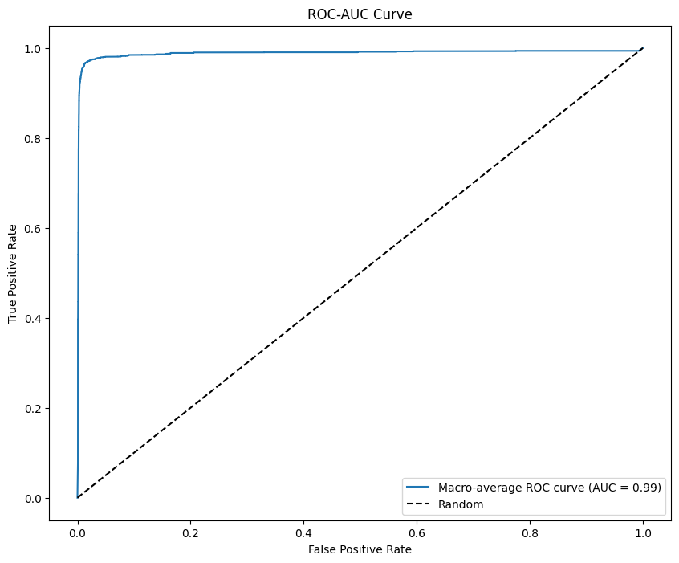
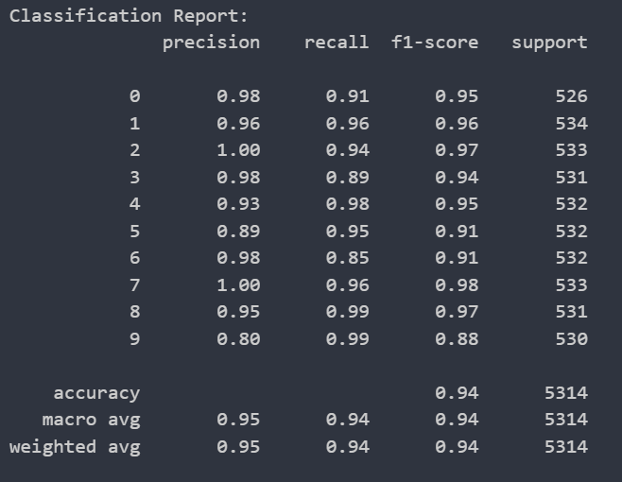
Performance Evaluation (InceptionV3)
a
b
c
Fig 5: (a)Confusion matrix (b)Classification report (c)ROC-AUC curve

