Slide 1

Bangladesh Army University of Science and Technology
Dept. Of Computer Science and Engineering
Bangla Digit Recognition Real-time Hand Gesture Interface with Deep Learning
Course code : CSE 4000
Course Titile: Project/Thesis
Group Members:
Harishankar Barman
Mushrat Binte Alam Mithy
MD. Yeamin Islam Sakib
Supervisor
Hasan Muhammad Kafi
Assistant Professor
Dept. Of CSE , BAUST
(200201001)
(200201006)
(200201015)

Slide 2
Presentation Outline
Introduction
Problem Statement
Literature Review
Objective
Methodology
Dataset Collection
Resource Requirements
Conclusion
Reference

Slide 3

Introduction
Air writing is a method of communication or learning
It involves using hand or finger movements in the air
The movements represent letters, words, or symbols
This is done without actually writing on a physical surface

Slide 4
Problem Statement
Assistive Technology for People with Disabilities
Interactive Educational Tools
Sign Language Recognition
Digital voting systems

Slide 5
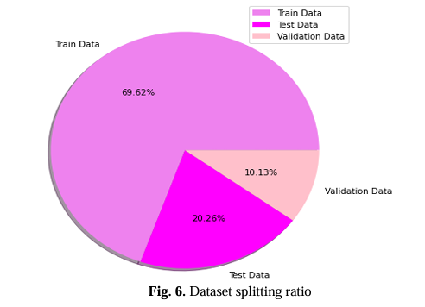
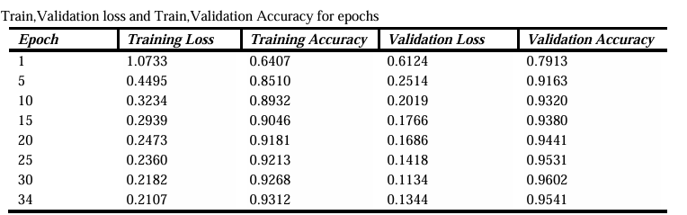
Literature Review
Work On: Real time Bangla Digit Recognition through Hand Gestures on Air Using Deep Learning and OpenCV.
Saha, Chayti, et al (2022)
Dataset Splitting and Ratios:
13,748 photos are used in train
4000 and 2000 images used in test ans validation
Training, validation, and testing sets with a ratio of 70%, 10%, and 20% respectively.
Accuracy:The achieved training accuracy of 93.29%, validation accuracy of 96% and test accuracy of 98.37%

Slide 6
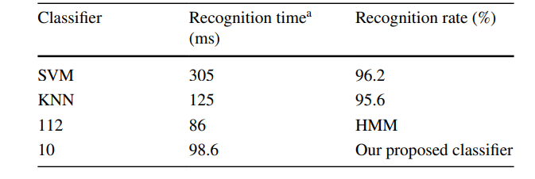
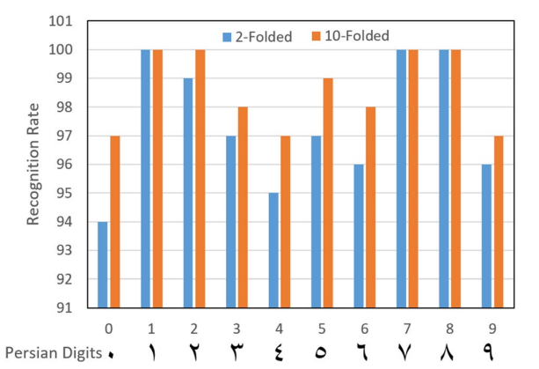
Literature Review(Continue)
Work On: Air-writing recognition system for Persian numbers with a novel classifer
Mohammadi, s et al. (2020)
Accuracy :
SVM had a recognition rate of 96.2% with a recognition time of 305 ms.
KNN achieved a recognition rate of 95.6% with a recognition time of 125 ms.
HMM had a recognition rate of 86% with a recognition time of 112 ms.
The proposed classifier achieved a high recognition rate of 98.6% with a recognition time of 10 ms.

Slide 7
Research Gap
Real-world Variability: The paper does not extensively discuss the performance of the model under real-world conditions,
Benchmark Datasets: The paper should compare the performance of its model on benchmark datasets commonly used in the field

Slide 8
Objective
Create a dataset for our research under variety of conditions
To built a leightweight deep learning model model that can detect air written Bangla digit
more efficiently.
To analyzing and compare the accuracy and performance of the proposed model with state of the art models.

Slide 9
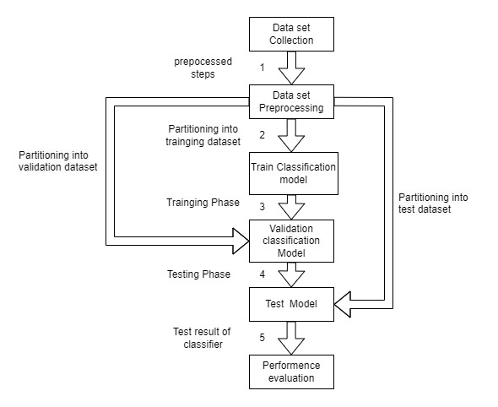
Methodology
Figure : Work Flow

Slide 10
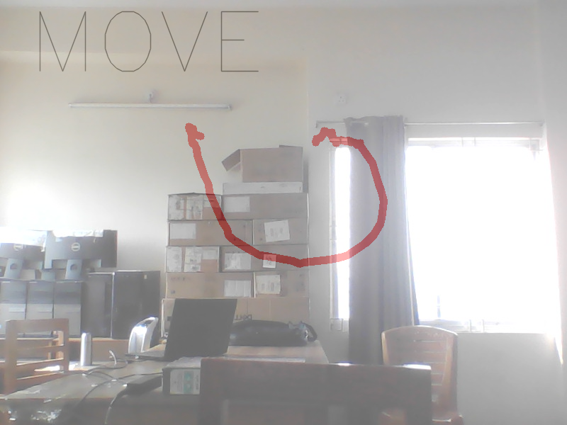
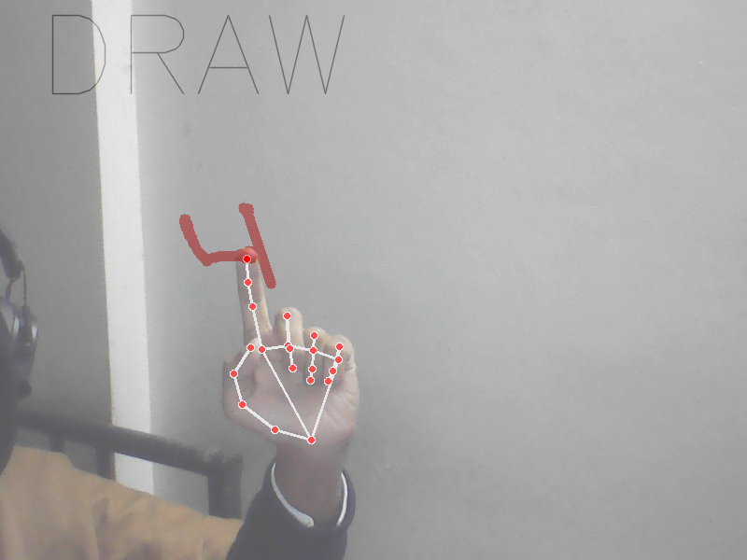
Dataset Collection
Dataset Size
Multiple Writers
Digit Variations
Diverse Background

Slide 11
Tools and Technology
Hardware Requirements
Computer
GPU
Software Requirements
Programming Language
Deep Learning Framework
Image Processing Libraries
Jupyter Notebooks or IDE

Slide 12
Conclusion
In conclusion, our Bangla Digit Recognition Real-time Hand Gesture Interface with Deep Learning not only provides an innovative and culturally relevant way to interact with technology but also ensures precision through deep learning. With real-time processing capabilities, it opens avenues for diverse applications, promising a future where intuitive gestures seamlessly integrate with our digital experiences.

Slide 13
Reference
Saha, Chayti, Fozilatunnesa Masuma, Khalil Ahammad, Chowdhury Shahriar Muzammel, and Md Mohibullah. "Real time Bangla Digit Recognition through Hand Gestures on Air Using Deep Learning and OpenCV."
Mahmud, Hasan, Robiul Islam, and Md Kamrul Hasan. "On-air English Capital Alphabet (ECA) recognition using depth information." The Visual Computer 38, no. 3 (2022): 1015-1025.
Ismail, Sabir. "Air Writing For Bangla Digits and Alphabets Using Android Device."
Mohammadi, Shahram, and Reza Maleki. "Air-writing recognition system for Persian numbers with a novel classifier." The Visual Computer 36.5 (2020): 1001-1015.

Slide 14

Any Question ???

Slide 15
Thank You
THANK YOU

