Slide 1

Banagladesh Army University Of Science And Technology
Course code: Cse 4102
Course Title: Computer security Sessional
Topic : Playfair cipher, Dsa
Group Members:
Mushrat Binte Alam Mithy(200201006)
MD. Yeamin Islam Sakib(200201015)
Jerin Tasnim
Lecturer ,cse

Slide 2
Table of Content
1. Introduction of playfair
2.Algorithm of playfair
3.Playfair metrix generation
4. Playfair Encryption
5. Playfair Decryption
6. Dsa

Slide 3
Introduction
The Playfair cipher is a cryptographic technique developed by Charles Wheatstone in 1854, later promoted by Lord Playfair. It's a substitution cipher that encodes pairs of letters instead of single letters, enhancing security and creating polygraphic substitution, making it more challenging to break. This method employs a 5x5 grid containing a key phrase or word to encrypt messages, popular in the field of cryptography for its effectiveness during its time.

Slide 4
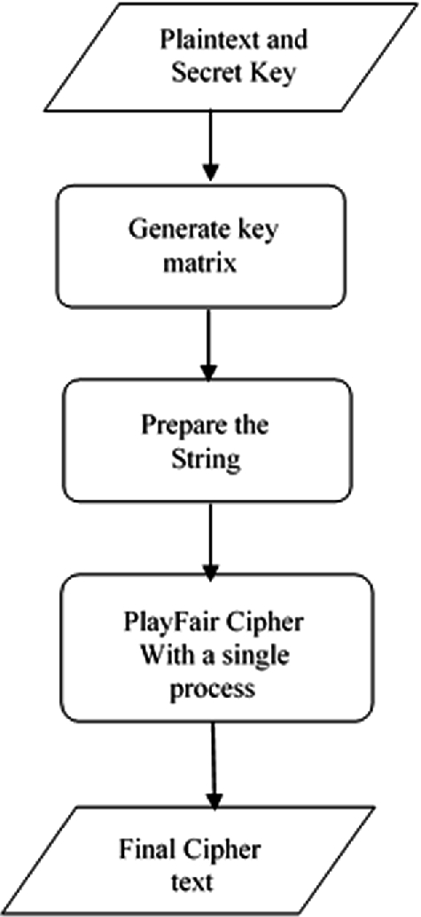
Algorithm

Slide 5
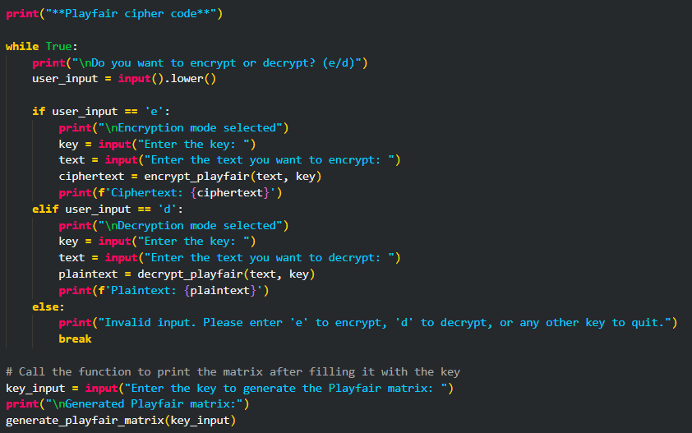
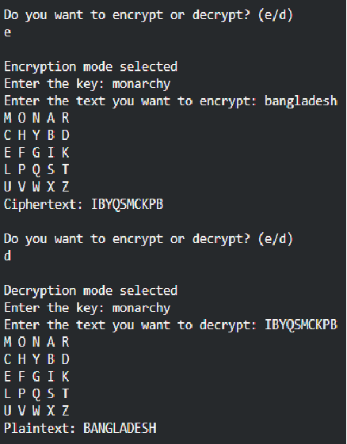
Code (Take Input)

Slide 6
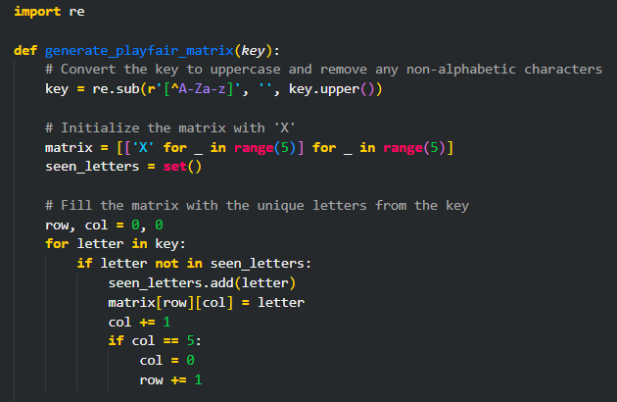
Generate key

Slide 7
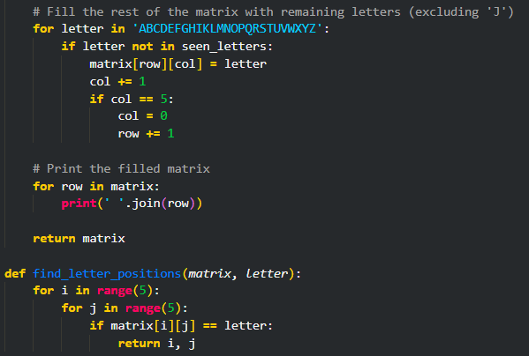
Generate ,print and find position of key

Slide 8
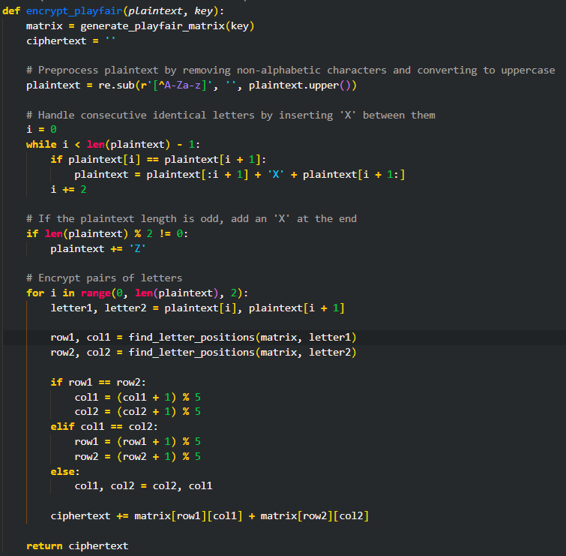
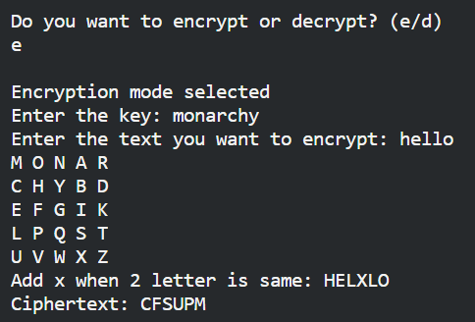
Encryption

Slide 9
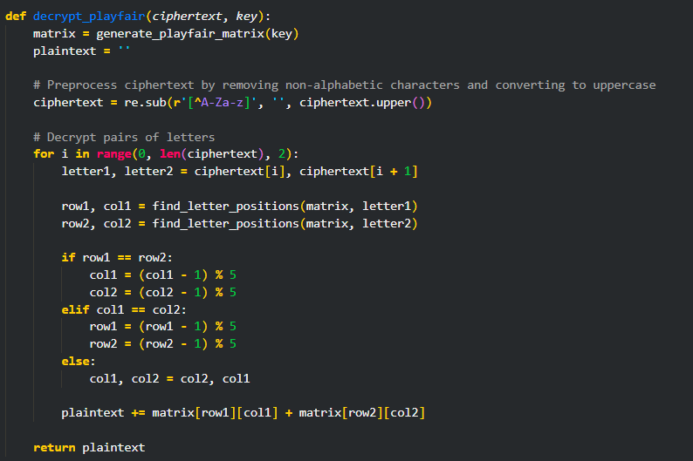
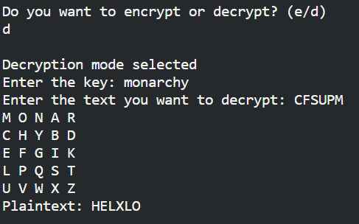
Decryption

Slide 10
DSA Introduction
DSA stands for Digital Signature Algorithm. Digital Signatures Algorithm is a FIPS (Federal Information Processing Standard) for digital signatures. It was proposed in 1991 and globally standardized in 1994 by the National Institute of Standards and Technology (NIST)
It is a cryptographic algorithm used to generate digital signatures, authenticate the sender of a digital message, and prevent message tampering.
DSA works by having two keys: a private key owned by the sender and a public key held by the receiver.

Slide 11
Steps in DSA Algorithm
1. Key Generation
2. Signature Generation
3. Key Distribution
4. Signature Verification

Slide 12
Advantages of DSA
Better Speed: The key generation is much faster compared to the RSA algorithm and such.
Less Storage: DSA requires less storage space to work its entire cycle.

Slide 13
Thank you

