Slide 1
Predicting Student Stress and Smartphone Addiction using Machine Learning
Md. Apple Mahmud
ID : 172-15-10099
Department : CSE
Daffodil International University
Md. Sazzadur Ahamed
Assistant Professor
Department Of CSE
Daffodil International University

Slide 2
Outline
Motivation
Objective
Expected Outcomes
Related Works
Conclusion
Q & A

Slide 3
Motivation
Rising smartphone usage is linked to increased student stress and addiction.
These issues affect students' mental health and academic performance.
Machine Learning can provide effective predictions and interventions to address these challenges

Slide 4
Objective
Predict stress and smartphone addiction using ML.
Evaluate various ML models for accuracy.
Provide intervention recommendations for students.

Slide 5
Expected Outcomes
Best-performing predictive model for stress and addiction.
Data-driven insights for personalized interventions.
Recommendations for reducing student stress.

Slide 6
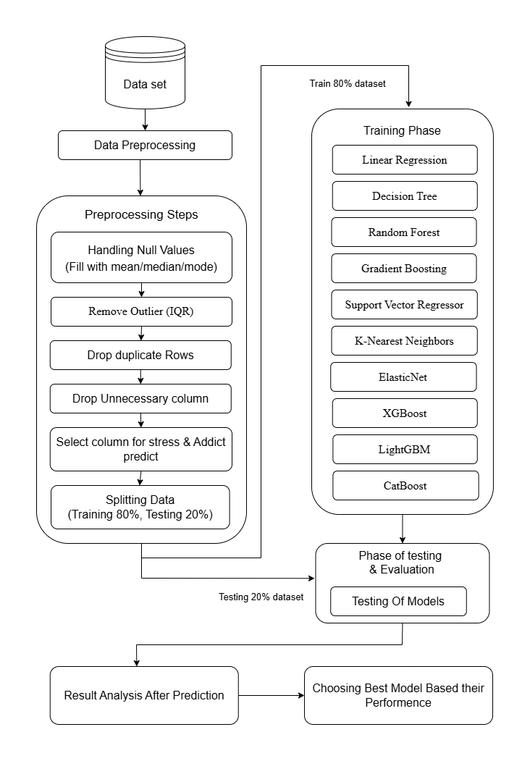
Methodology
Survey data from 1,042 students.
ML models: Linear Regression, Random Forest, etc.
Metrics: MSE, R², F1 Score.

Slide 7
Related Works
Thesis Name | Limitation | Models Used | Highest Accuracy
Predicting Student Stress and Smartphone Addiction Using Machine Learning | Reliance on self-reported data; limited dataset | SVM, Random Forest and Gradient Boosting | SVM: 95% accuracy in stress prediction
Machine Learning for Smartphone Addiction Prediction in Students | Lack of personality and mental health history data; no real-time monitoring | CatBoost, XGBoost and Random Forest | CatBoost : R² of 0.792, MSE of 1.634
Using ElasticNet for Predicting Stress and Smartphone Addiction | Limited feature selection. | ElasticNet , SVR | SVR: 94% accuracy in addiction prediction
Ensemble Models for Stress and Smartphone Addiction Prediction | Limited integration of complex data sources; small sample size | Random Forest, Gradient Boosting | Random Forest: R² of 0.8601 for addiction prediction

Slide 8
Conclusion
The study demonstrates that machine learning models can effectively predict student stress and smartphone addiction, providing valuable insights for intervention. These findings offer a foundation for educational institutions to implement targeted support systems for student well-being.

Slide 9
THANK YOU

