Slide 1

Title: Advanced Mathematics for Data Analysis
Presented by: Rezoan Ahmed Id: 20241238
Course: DAT601 S12025
Institution: Polytechnic Institute Australia
Advanced Mathematics for Data Analysis

Slide 2
Overview of the Cases
Case 1: Conditional Probability
Case 2: Sampling and Confidence Interval Estimation
Case 3: Hypothesis Testing
Case 4: Linear Regression Analysis

Slide 3
Case 1 - Conditional Probability
Key Terms:
V = Valid Complaint
F = False Complaint
FV = Flagged as Valid
FF = Flagged as False
Given Probabilities:
P(V) = 0.15, P(F) = 0.85
P(FV|V) = 0.92, P(FF|F) = 0.85
Calculate probabilities of combined events using multiplication rule.

Slide 4
Case 1 - Conditional Probability (cont.)
Probabilities:
P(V ∩ FV) = 0.138
P(F ∩ FV) = 0.1275
P(V ∩ FF) = 0.012
P(F ∩ FF) = 0.7225
Flagging Probabilities:
P(FV) = 0.2655
P(FF) = 0.7345
Conditional Probabilities:
Probability a complaint flagged as valid is actually valid: P(V|FV) ≈ 51.98%
Probability a complaint flagged as false is actually false: P(F|FF) ≈ 98.37%
Probability a valid complaint is actually false: P(F|FV) = 48.02%
Probability a false complaint is actually valid: P(V|FF) = 1.63%

Slide 5
Case 2 - Sampling and Confidence Interval Estimation
Sampling Method: Simple Random Sampling
Point Estimate: Mean commuting time = 18 hours
Standard Error Calculation: SE ≈ 0.179 hours
Margin of Error: ME ≈ 0.350 hours

Slide 6
Case 2 - Confidence Interval
Confidence Interval Calculation:
Lower Bound: 17.65 hours
Upper Bound: 18.35 hours
Interpretation: 95% confidence that the true average weekly commuting time is between 17.65 and 18.35 hours.

Slide 7
Case 2 - Minimum Sample Size & Hypothesis Test
Minimum Sample Size: 62
Hypothesis Test:
Null Hypothesis: μ = 20 hours
Z-test results: Reject H₀

Slide 8
Case 3 - Hypothesis Testing
Test Setup:
Null Hypothesis (H₀): μₐ = μᵦ
Alternative Hypothesis (H₁): μₐ ≠ μᵦ
Test Statistic: Two-sample t-test for independent samples
T-statistic Calculation: t ≈ -3.715
P-value: p ≈ 0.0003 (Reject H₀, significant difference between Strategy A and Strategy B)

Slide 9
Case 3 - Sample Size Determination
Effect Size (Cohen’s d): d ≈ 0.587 (Medium Effect Size)
Sample Size Calculation: n ≈ 46
Post-hoc Power Analysis: Power ≈ 99% (Very high power for detecting differences)

Slide 10
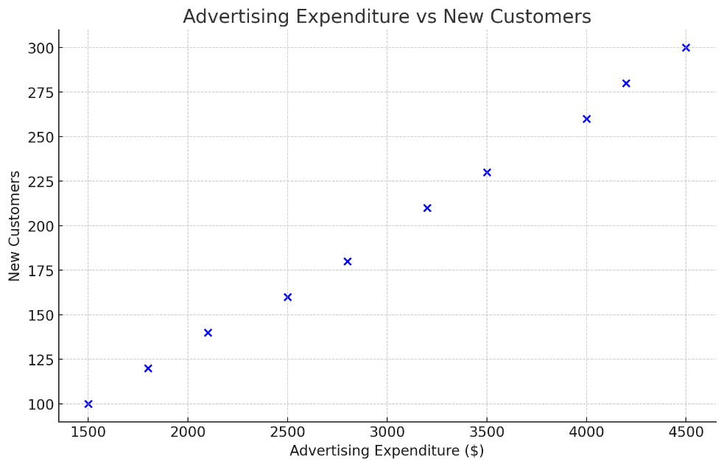
Case 4 - Linear Regression Analysis
Scatter Plot: Shows a positive correlation between advertising expenditure and new customers.
Regression Equation: ŷ = 27.032 + 0.0568x
Goodness of Fit (R²): R² ≈ 0.724

Slide 11
Case 4 - Linear Regression
Hypothesis Test for Linear Relationship:
Null Hypothesis (H₀): β₁ = 0 (no linear relationship)
Alternative Hypothesis (H₁): β₁ ≠ 0 (significant linear relationship)
Test Statistic Calculation:
t ≈ 4.59
Critical t-value for α = 0.05, df = 8: 2.306
Since |t| = 4.59 > 2.306, Reject H₀.
There is strong evidence for a linear relationship between advertising expenditure and new customers.

Slide 12
Case 4 - Linear Regression (cont.)
Standard Error Calculation:
SE(b₁) ≈ 0.01237
Using SE(b₁) and b₁, the t-statistic is calculated.
t ≈ 4.59, which is significant.
Regression Interpretation:
Intercept (b₀) ≈ 27.032: The base number of new customers when no money is spent on advertising.
Slope (b₁) ≈ 0.0568: For each additional dollar spent on advertising, the number of new customers increases by approximately 0.0568.

Slide 13
Conclusion
Key Takeaways:
Case 1: Conditional probability calculations help understand the effectiveness of complaint flagging.
Case 2: Confidence intervals and sample size estimation are crucial for population mean estimation.
Case 3: Hypothesis testing provides insights into comparing different strategies and determining statistical significance.
Case 4: Linear regression analysis helps quantify the relationship between advertising expenditure and customer acquisition, with a strong positive correlation.

Slide 14
References
Bertsekas, D. P., & Tsitsiklis, J. N. (2008). Introduction to Probability.
Feller, W. (1968). An Introduction to Probability Theory and Its Applications.
Ross, S. M. (2014). Introduction to Probability and Statistics for Engineers and Scientists.
DeGroot, M. H., & Schervish, M. J. (2012). Probability and Statistics.
Casella, G., & Berger, R. L. (2002). Statistical Inference.

Slide 15
Questions?

