Slide 1
Predicting Student Stress and Smartphone Addiction using Machine Learning
Md. Apple Mahmud
ID : 172-15-10099
Department : CSE
Daffodil International University
Md. Sazzadur Ahamed
Assistant Professor
Department Of CSE
Daffodil International University

Slide 2
Outline
Motivation
Objective
Expected Outcomes
Related Works
Methodology
Result and Analysis
Conclusion
References
Q & A

Slide 3
Motivation
Rising smartphone usage is linked to increased student stress and addiction.
These issues affect students' mental health and academic performance.
Machine Learning can provide effective predictions and interventions to address these challenges

Slide 4
Objective
Predict stress and smartphone addiction using ML.
Evaluate various ML models for accuracy.
Provide intervention recommendations for students.

Slide 5
Expected Outcomes
Best-performing predictive model for stress and addiction.
Data-driven insights for personalized interventions.
Recommendations for reducing student stress.

Slide 6
Related Works
Thesis Name | Limitation | Models Used | Highest Accuracy
Predicting Student Stress and Smartphone Addiction Using Machine Learning | Reliance on self-reported data; limited dataset | SVM, Random Forest and Gradient Boosting | SVM: 95% accuracy in stress prediction
Machine Learning for Smartphone Addiction Prediction in Students | Lack of personality and mental health history data; no real-time monitoring | CatBoost, XGBoost and Random Forest | CatBoost : R² of 0.792, MSE of 1.634
Using ElasticNet for Predicting Stress and Smartphone Addiction | Limited feature selection. | ElasticNet , SVR | SVR: 94% accuracy in addiction prediction
Ensemble Models for Stress and Smartphone Addiction Prediction | Limited integration of complex data sources; small sample size | Random Forest, Gradient Boosting | Random Forest: R² of 0.8601 for addiction prediction

Slide 7
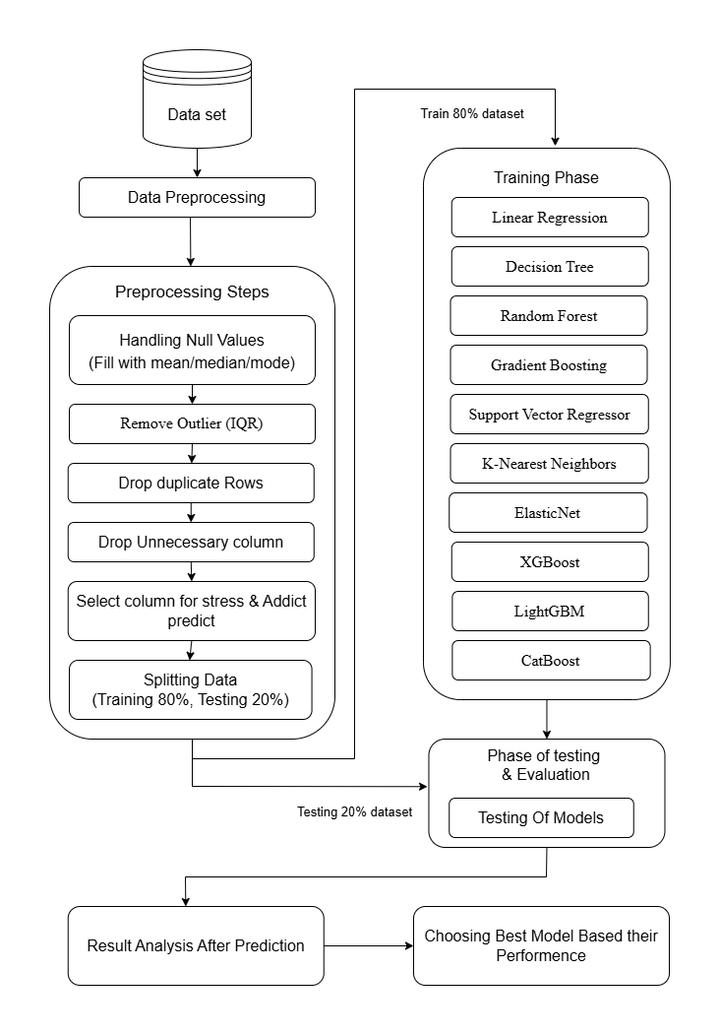
Methodology
Survey data from 1,042 students.
ML models: Linear Regression, Random Forest, etc.
Metrics: MSE, R², F1 Score.

Slide 8
Result and Analysis
Model | Stress MSE | Stress R² | Addiction MSE | Addiction R²
Linear Regression | 1.733768 | 0.779947 | 0.377224 | 0.953765
Decision Tree | 1.706552 | 0.783401 | 1.561420 | 0.808621
Random Forest | 1.645959 | 0.791092 | 1.141199 | 0.860126
Gradient Boosting | 1.739346 | 0.779239 | 0.731382 | 0.910356
SVR | 1.716774 | 0.782104 | 0.475553 | 0.941713
KNN | 1.976469 | 0.749143 | 0.788959 | 0.903299
ElasticNet | 1.732152 | 0.780152 | 0.486095 | 0.940421
XGBoost | 1.680703 | 0.786682 | 0.881356 | 0.891974
LightGBM | 1.667953 | 0.788300 | 0.906749 | 0.888862
CatBoost | 1.634175 | 0.792587 | 1.078971 | 0.867753
Best Model for stress : CatBoost
Stress MSE = 1.634175
Stress R² = 0.792587
Best Model for Addiction: Linear Regression
Addiction MSE = 0.377224
Addiction R² = 0.953765

Slide 9
Conclusion
The study demonstrates that machine learning models can effectively predict student stress and smartphone addiction, providing valuable insights for intervention. These findings offer a foundation for educational institutions to implement targeted support systems for student well-being.

Slide 10
References
Akter, S., & Akter, S. (2025). Predicting Student Stress and Smartphone Addiction using Machine Learning. Final Year Design Project Report, Department of Computer Science and Engineering, Daffodil International University
Singh, et al. (2024). Machine Learning Algorithms for Detecting Mental Stress in College Students. Journal of Computer Science, 843 students surveyed. AIIMS Raipur, India.
Arya, S., Anju, A., & Ramli, N. A. (2024). Predicting the Stress Level of Students Using Supervised Machine Learning and Artificial Neural Networks. Tribhuvan University, Nepal.
Lee, S., & Kim, J. (2021). Prediction of Problematic Smartphone Use: A Machine Learning Approach. KISA Survey, South Korea
Raj, A., et al. (2024). Machine Learning Model for Prediction of Smartphone Addiction. Public Database of 5,000 records.

Slide 11
THANK YOU

