Slide 1
Discount Analysis
Group 2
2023-06-23

Slide 2
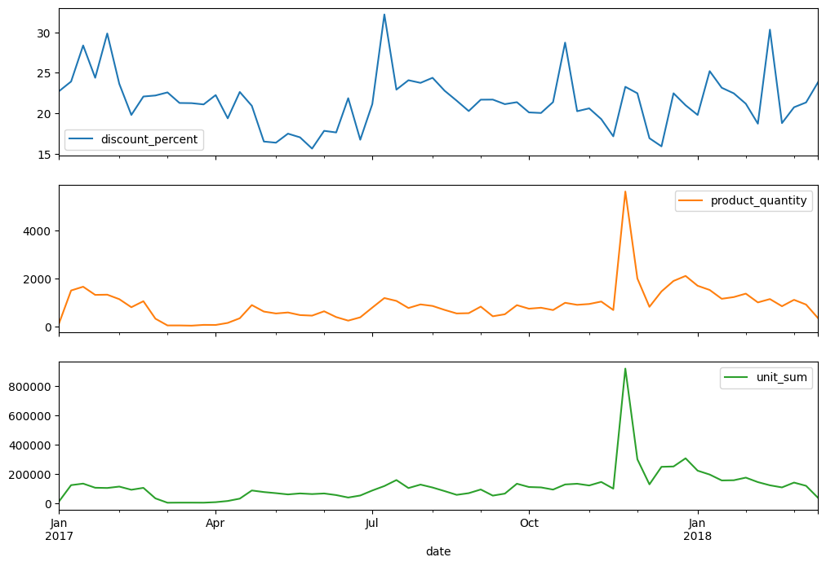
Sales over time
seasonal patterns
end of November (Christmas)
March (before Easter)
July peak
revenue doesn’t show growth

Slide 3
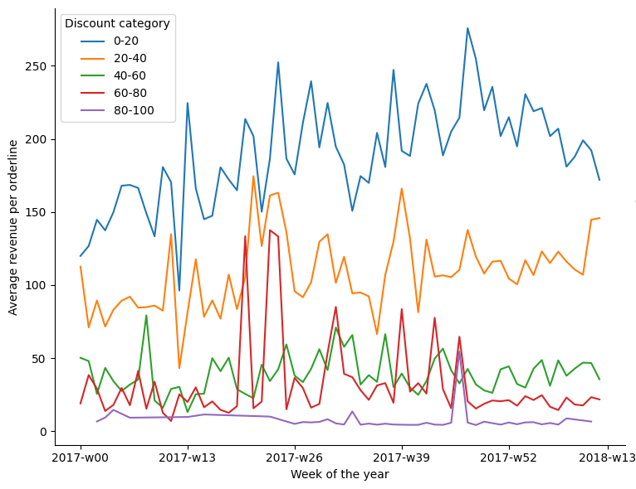
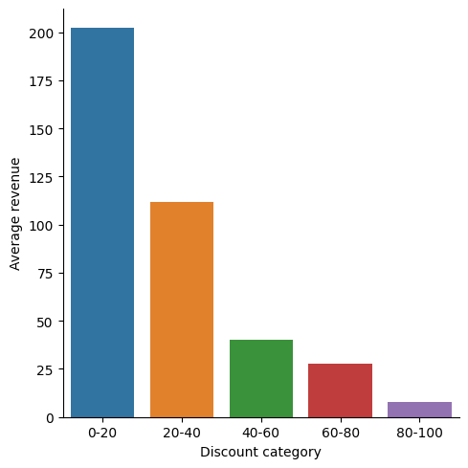
Average revenue in different discount categories
lower discount category - higher average revenue

Slide 4
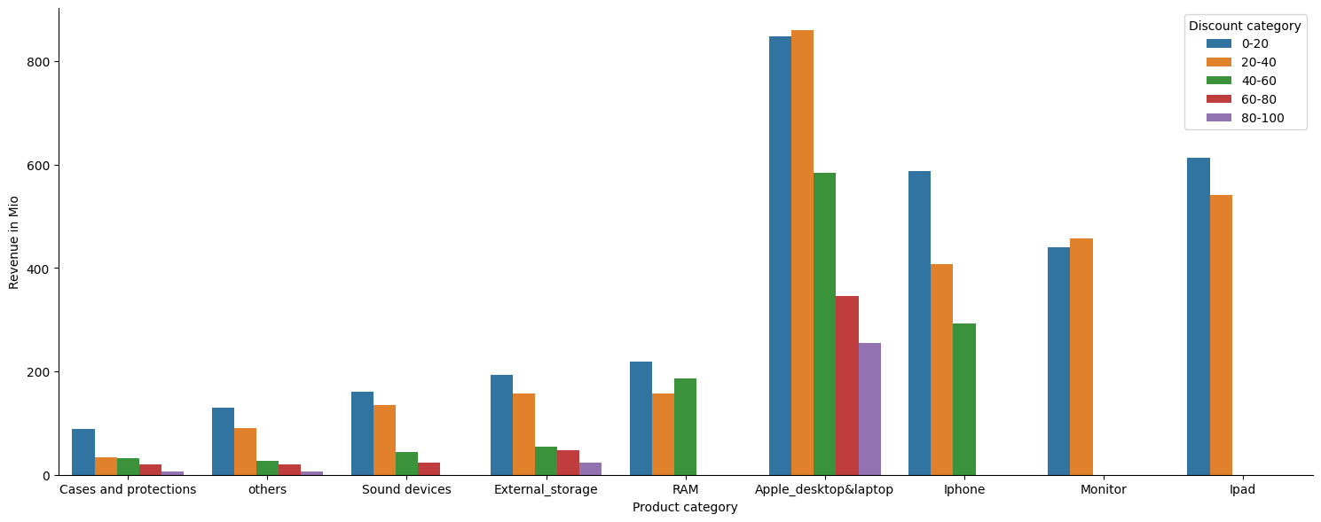
Average revenue in different product categories

Slide 5
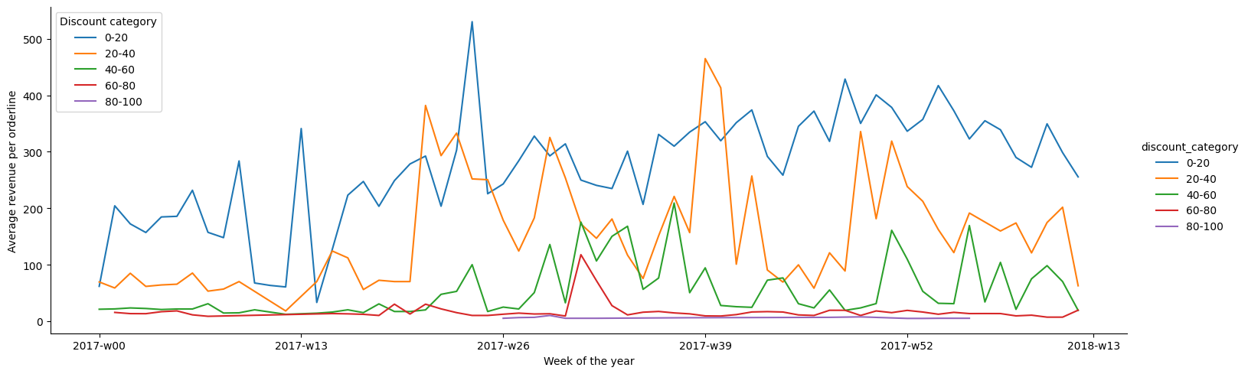
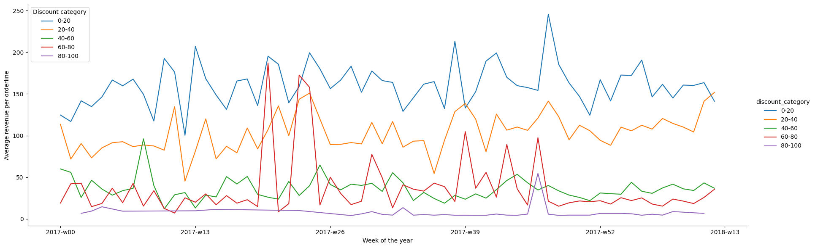
Average revenue for Apple and non-Apple products
some abnormalities from the assumption found

Slide 6
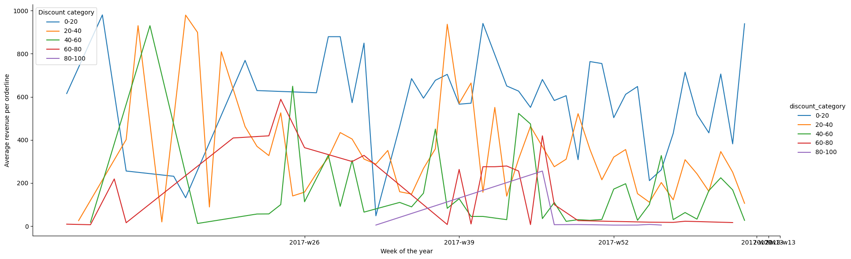
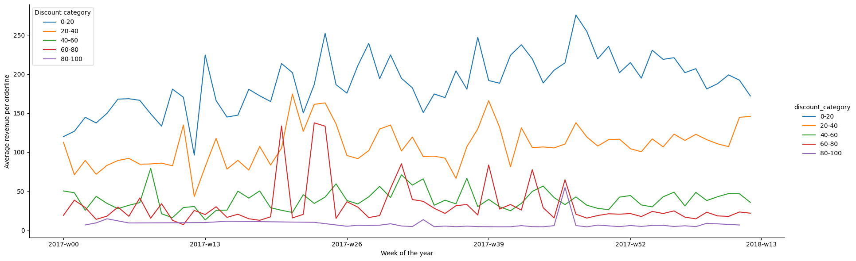
Average revenue for refurbished/new
defined pattern doesn’t stay for refurbished products

Slide 7
Conclusions and recommendations
sales with low discounts provide the biggest part of total revenue and the highest average revenue in general
improve Data Quality (see appendix)
conduct further analysis
product margin
A/B tests
product categories
some exclusions should be considered separately for more precise discount policy

Slide 8
Appendix

Slide 9
Data Quality issues and actions
Dataframe structure
update the dataframe “products” as some SKUs from other databases were not found
include “product category” into the “products”
Data collection process
revise a process of data input into “orders” and “orderlines” as there are many duplicates —> poka-yoke
Business process
explore shipping costs and added to “orders” as a column
investigate our theory: “noise” and “loyalty/special discount”
explore negative difference between paid and calculated sum of orderlines

Slide 10
Possible discount policy actions
for customers base / revenue increase we may:
special loyalty based discount (vouchers)
special sale days / weeks in the low sales periods
discounts in low seasons

Slide 11
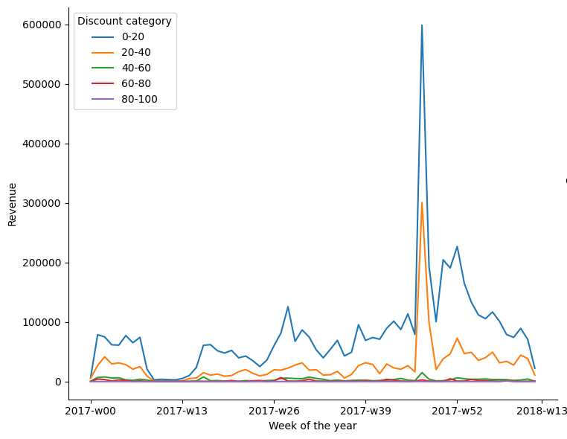
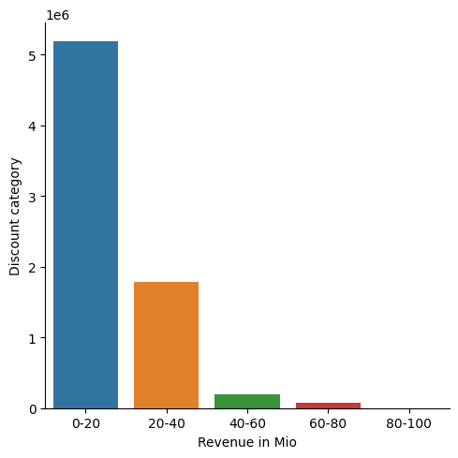
Revenue in different discount categories

Slide 12
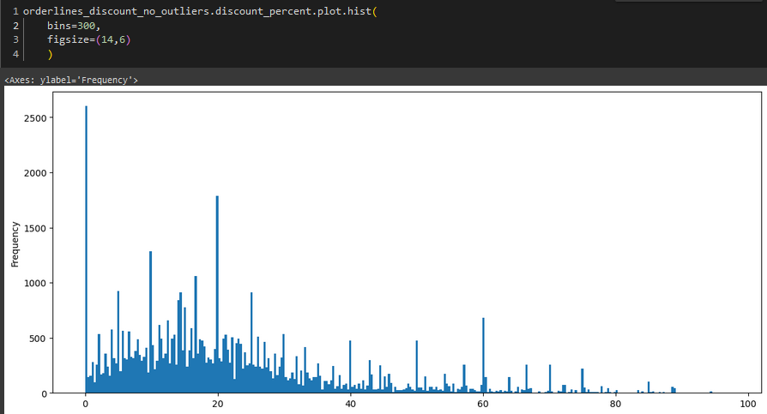
Distribution of discounts (in %)

Slide 13
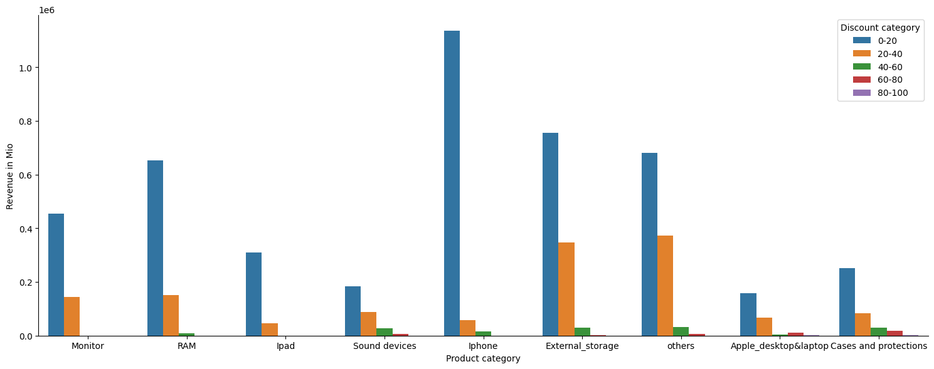
Revenue in different product categories

Slide 14
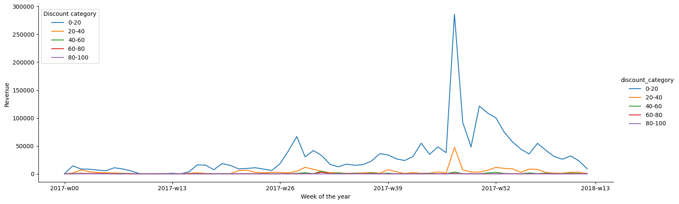
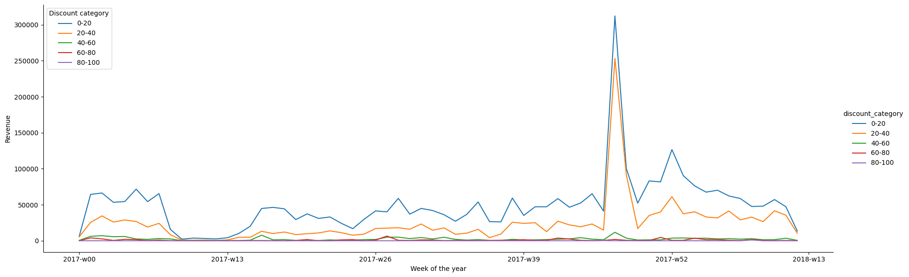
Revenue for Apple and non-Apple products
revenues in different discount categories show similar dynamic

Slide 15
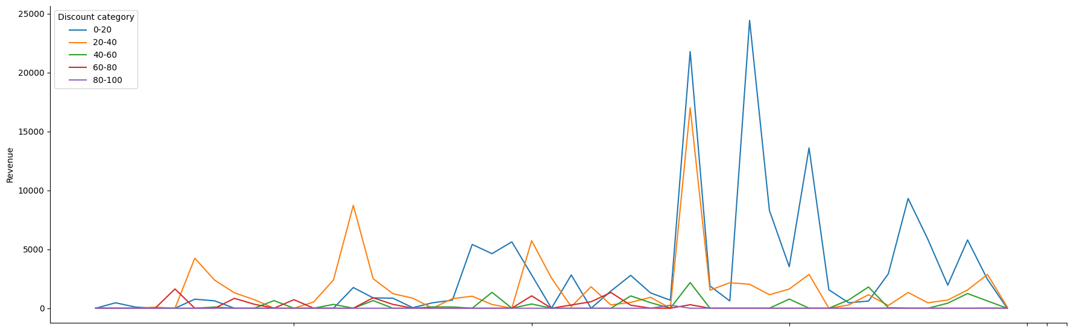
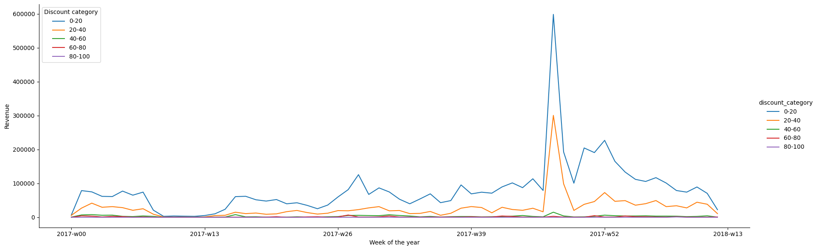
Revenue vs discount categories for refurbished/new

Slide 16
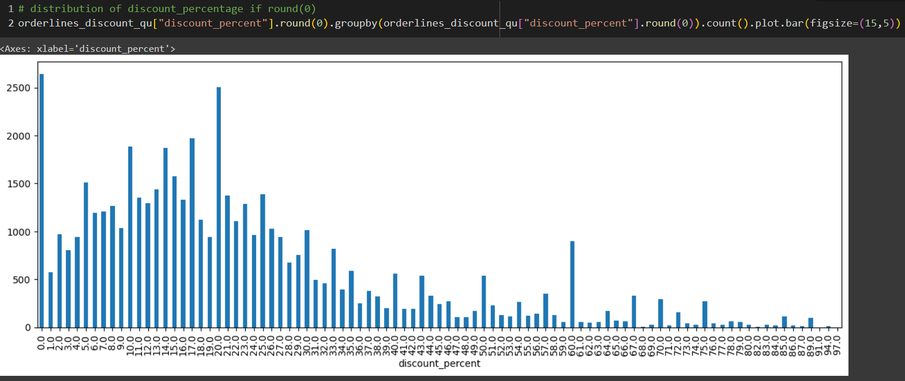
Distribution of discounts (in %) rounded to whole numbers

Slide 17
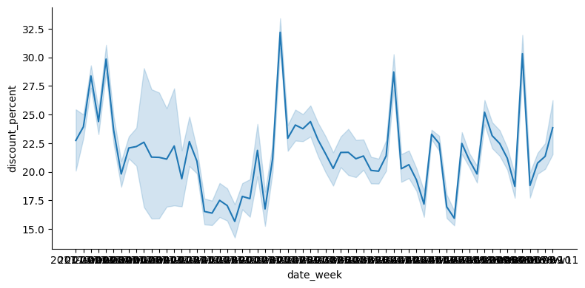
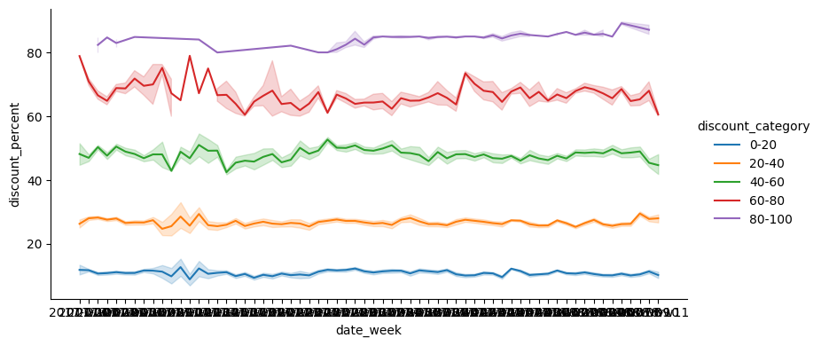

Slide 18
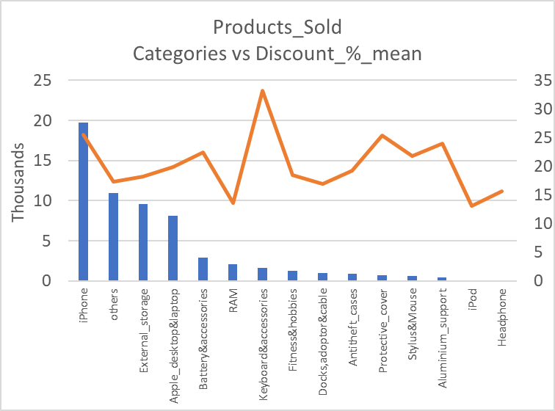
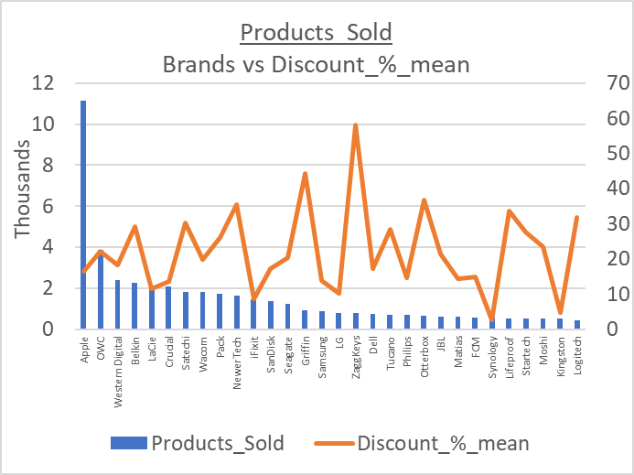
Sales revenue for Brands / Pro. Categories vs Discount

Slide 19
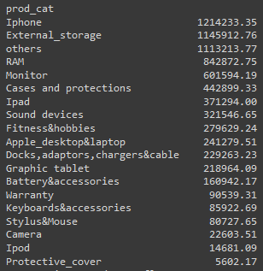
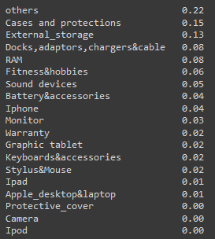
Product categories

