Slide 1
CITY UNIVERSITY, BANGLADESH
Department of Computer Science & Engineering • Course: CSE-4252
OFFLINE MESSENGER
Zero-Infrastructure Peer-to-Peer Communication System for Android
SUBMITTED BY
Name: Yeasaleh
Student ID: 0272310005101123
Batch: 62nd Batch
Program: B.Sc. in CSE
Department: Dept. of CSE, City University
SUBMITTED TO
Supervisor: Naima Sultana Ayesha
Designation: Lecturer
Department: Computer Science & Engineering
Institution: City University, Bangladesh
Submission: November 2026

Slide 2
CSE-4252 : ADVANCED ENTERPRISE JAVA LAB
The Problem vs. Offline Messenger
❌ Centralized Infrastructure Failure
• Single Point of Failure
Apps like WhatsApp, Signal, & Telegram depend 100% on cell towers, DNS, & central cloud servers.
• Blackout in Emergencies
Cyclones, floods, earthquakes, or power grid failures instantly disconnect populations when communication is vital.
• Restricted Environments
Underground mines, deep tunnels, and remote expeditions have zero cellular connectivity.
⚡ The Offline Messenger Solution
✔ 100% Air-Gapped Operation
Direct smartphone-to-smartphone ad-hoc links. No SIM card, internet, or Wi-Fi router needed.
✔ Native Wi-Fi Direct Mesh
High-speed 250 Mbps radio links with 50–100m direct range over standard Android devices.
✔ Complete Media Suite
Instant text, AAC voice notes, binary files, VoIP voice calls & live video on raw sockets.

Slide 3
CSE-4252 : ADVANCED ENTERPRISE JAVA LAB
Core Architecture & Socket Protocol Stack
RADIO LAYER
Wi-Fi Direct P2P
• Auto GO Negotiation
Group Owner at 192.168.49.1
• Dynamic IP Lease
DHCP range 192.168.49.x
• High Bandwidth
Up to 250 Mbps (802.11ac)
• Coverage
50m – 100m direct range
TEXT & CHAT
TCP Port 8888
• Sub-10ms Latency
Direct bi-directional stream
• Strict Packet Framing
[0x01][4B Len][UTF-8 Text]
• Reliable Delivery
0x06 ACK byte confirmation
• State Tracker
SENDING & DELIVERED status
VOIP CALLS
UDP Port 8889
• Raw PCM Audio
16 kHz AudioRecord stream
• Ultra-Low Latency
Sub-20ms datagram packets
• Signaling State Machine
INVITE -> Ringing -> ACCEPT
• Zero Server Relay
Direct phone-to-phone audio
VIDEO CALLS
TCP Port 8890
• SurfaceView Preview
Hardware frame buffer
• JPEG Streaming
Compressed progressive feed
• Full In-Call Control
Front/rear cam & mute toggle
• Air-Gapped Visuals
Mission-critical face-to-face

Slide 4
CSE-4252 : ADVANCED ENTERPRISE JAVA LAB
Key Capabilities & Engineering Features
💬 Multi-Peer Group Relay
✔ Autonomous Group Owner (GO) fan-out architecture
✔ Broadcast relay: 1 peer transmits, all connected peers receive
✔ Distinct sender origin attribution (recreates WhatsApp feel)
🎙️ Inline Voice Messaging
✔ VoiceRecorderHelper encodes clean AAC (.m4a) audio
✔ Interactive waveform visualizer inside chat bubble
✔ Lightweight chunked stream with immediate playback
📁 8 KB Chunk File Transfer
✔ Memory-safe binary streaming in discrete 8 KB buffers
✔ Strictly caps Heap RAM < 10 MB (Zero OutOfMemory risk)
✔ Android FileProvider: Tap-to-open directly in system viewers
🛡️ Local SQLite & 1-Tap Wipe
✔ Zero-cloud persistence: Contacts, messages & groups stored locally
✔ Retained across device reboots and app restarts
✔ Emergency Purge: Instant table truncate + SQLite VACUUM

Slide 5
CSE-4252 : ADVANCED ENTERPRISE JAVA LAB
Benchmark: Wi-Fi Direct vs. Bluetooth
Operational Parameter | Wi-Fi Direct (Offline Messenger) | Traditional Bluetooth (v4/5) | Architectural Advantage
Peak Throughput | Up to 250 Mbps (802.11ac) | 1 to 2 Mbps (BLE / EDR) | 125x – 250x Bandwidth Gain
Operating Range | 50 to 100 Meters Line-of-Sight | 10 to 20 Meters Maximum | 5x – 10x Physical Coverage
Network Topology | Autonomous Star & Relay Groups | Rigid Master-Slave Pairs | Multi-Peer Fan-Out Relaying
Live Media Streaming | Sub-10ms delivery (VoIP & Video) | Severe jitter & packet dropping | Full Voice & Video Calling
File Transfer (50 MB) | ~1.8 Seconds Transfer Time | ~4.5 Minutes (High failure rate) | Instant Field Media Exchange

Slide 6
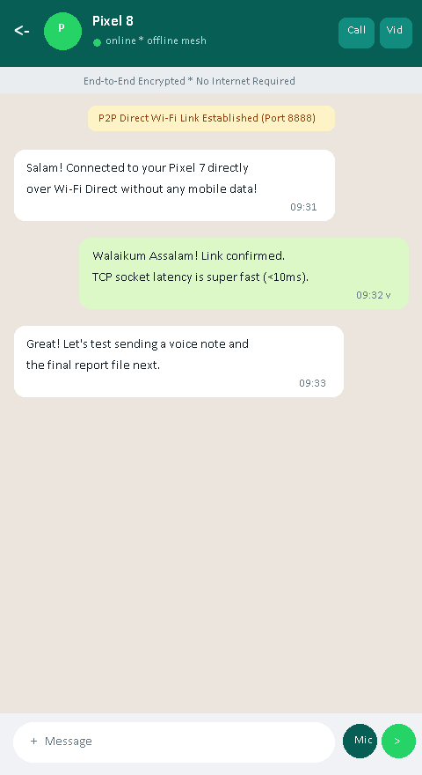
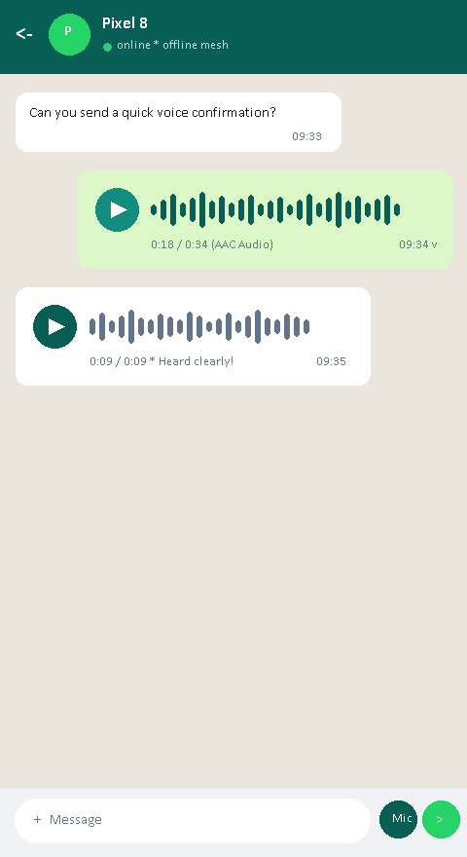
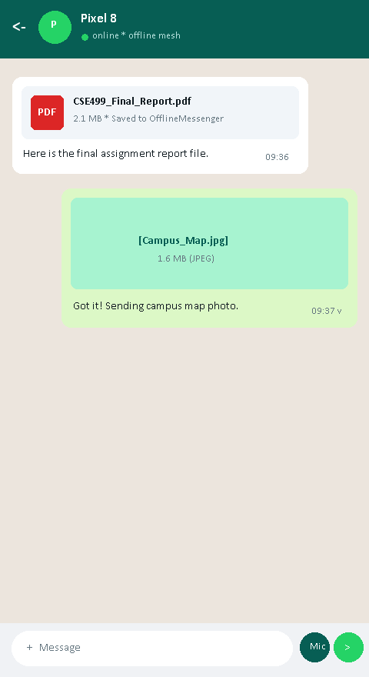
CSE-4252 : ADVANCED ENTERPRISE JAVA LAB
Field Test: 1-on-1 Chat, Voice Notes & File Sharing
1-on-1 Offline Chat
• Pixel 7 ↔ Pixel 8 direct link
• Sub-10ms TCP 8888 delivery
Inline Voice Notes
• Lightweight AAC (.m4a) audio
• Waveform visualizer player
Memory-Safe File Share
• 8 KB buffer chunk streaming
• Heap RAM capped < 10 MB

Slide 7
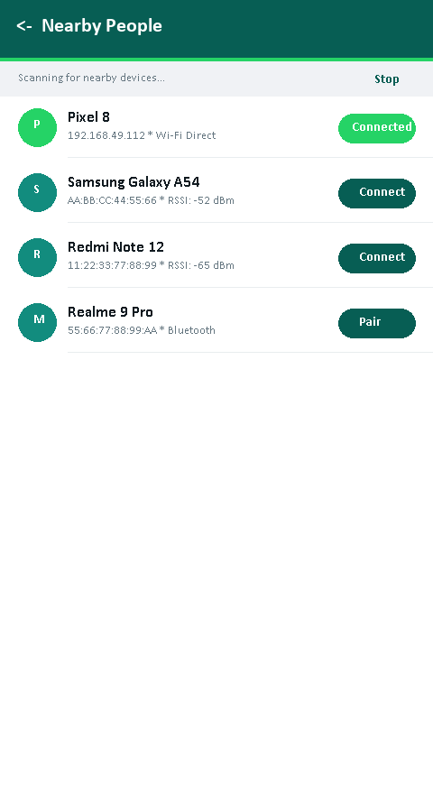
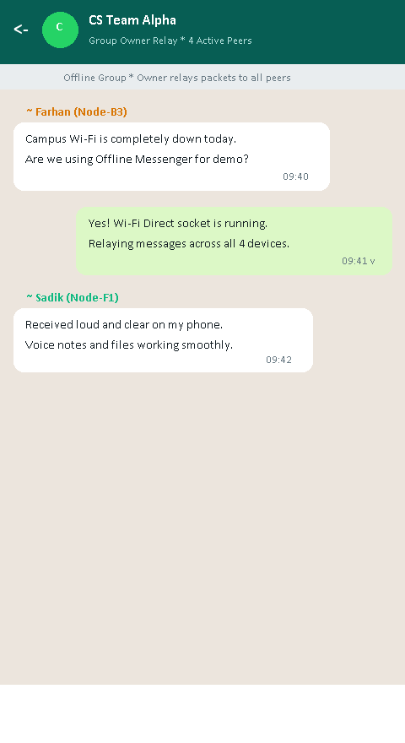
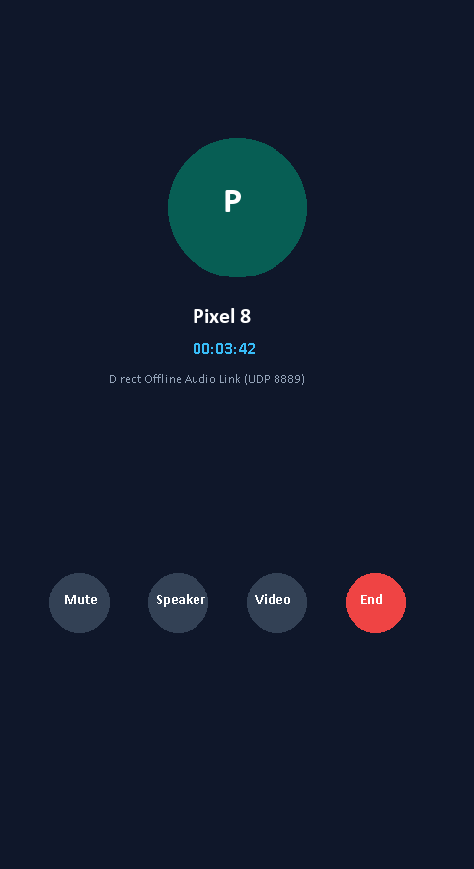
CSE-4252 : ADVANCED ENTERPRISE JAVA LAB
Field Test: Device Discovery, Mesh Groups & VoIP Calls
Peer Discovery & Pairing
• Wi-Fi Direct & Bluetooth scan
• Dynamic IP: 192.168.49.112
Offline Group Discussion
• Multi-peer autonomous mesh
• Group Owner (GO) fan-out relay
Real-Time VoIP Audio Call
• UDP Port 8889 PCM streaming
• Hardware mute & speaker controls

Slide 8
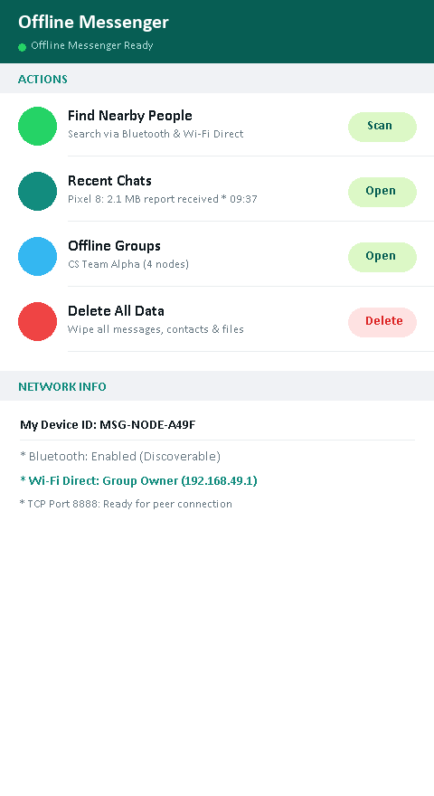
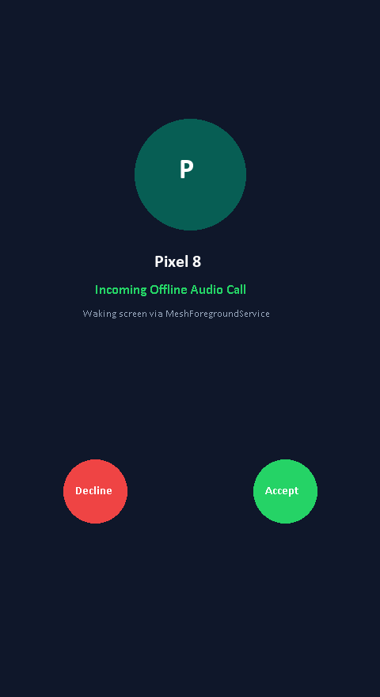
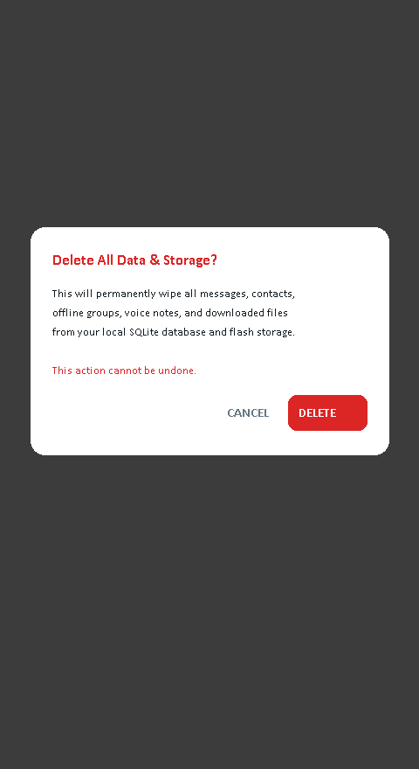
CSE-4252 : ADVANCED ENTERPRISE JAVA LAB
Field Test: Dashboard, Background Alert & Privacy Wipe
Main Dashboard
• Live mesh link overview
• Fast navigation & hardware status
Incoming Call Alert
• Foreground service wake-lock
• showWhenLocked wakes locked phone
Privacy Data Purge
• 1-Tap emergency data wipe
• Truncates SQLite & runs VACUUM

Slide 9
CSE-4252 : ADVANCED ENTERPRISE JAVA LAB
Operational Use Cases (Where It Matters Most)
🌊 Disaster & Flood Relief
FIRST-RESPONDERS & RESCUE
• Cellular towers collapse during floods & storms
• Zero-infrastructure coordination for rescue teams
• Immediate audio calls and medical document sharing
🧗 Remote Expeditions & Forests
FIELD RESEARCHERS & HIKERS
• No cell signal in deep forests, mountains & parks
• 100m peer coverage keeps team members linked
• Instant group alerts without internet or satellite fees
⛏️ Underground & Mining Zones
INDUSTRIAL & MINING TEAMS
• Sub-surface tunnels and basements shield cell signals
• Direct P2P Wi-Fi signals penetrate localized zones
• Reliable voice notes & emergency status fan-out
🔒 Air-Gapped Tactical Security
HIGH-SECURITY OPERATIONS
• Zero data routed through ISP or third-party servers
• Immune to man-in-the-middle or external interception
• 1-Tap emergency data wipe leaves zero forensic footprint

Slide 10
CSE-4252 : ADVANCED ENTERPRISE JAVA LAB
Summary, Academic Outcomes & Q&A
Key Project Takeaways
✔ Zero Infrastructure Viability
Proved standard commercial Android smartphones can form full-featured, zero-internet communication networks.
✔ Low-Level Socket Mastery
Implemented high-performance TCP/UDP protocol stacks with sub-10ms delivery and memory-safe 8 KB streaming.
✔ Autonomous Mesh Fan-Out
Group Owner fan-out relaying delivers true multi-device group communications off-the-grid.
✔ Local Privacy & Forensics
SQLite relational persistence keeps user data 100% private, with one-tap instant emergency scrubbing.
OFFLINE MESSENGER
Advanced Enterprise Java Laboratory (CSE-4252)
THANK YOU!
Any Questions or Discussion?

