Slide 1
Welcome
To
My Presentation

Slide 2
Dual Axis Solar Tracker
Md.Yeasin Sheikh
181-15-2049

Slide 3
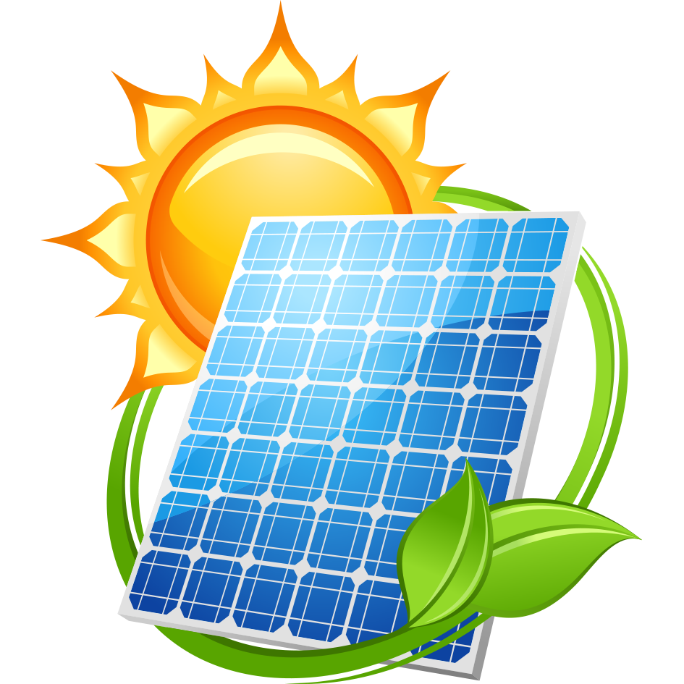
Why Solar Energy?
Easily accessible.
Energy harnessed is free of cost.
Pollution Free.
Available in infinite quantity.

Slide 4
Solar power technology
Solar power is the conversion of sunlight into electricity,
either directly using Photovoltaics(PV), or
indirectly using concentrated solar power(CSP).
In order to do this, it is necessary to have solar cells. These cells are topically in the form of panels that perpendicularly placed, facing the sun to capture the maximum light possible.

Slide 5
Solar Tracker
One way to make the Solar panel more effective by adding the ability to track the sun as it moves across the sky.
A Solar tracker is a device used for orientating a Solar PV panel or lens towards the sun by using the light sensors interfaced to motors , used for rotation through a microcontroller, to have maximum solar radiation incident on the solar panel.

Slide 6
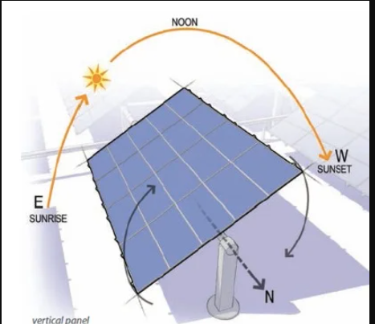
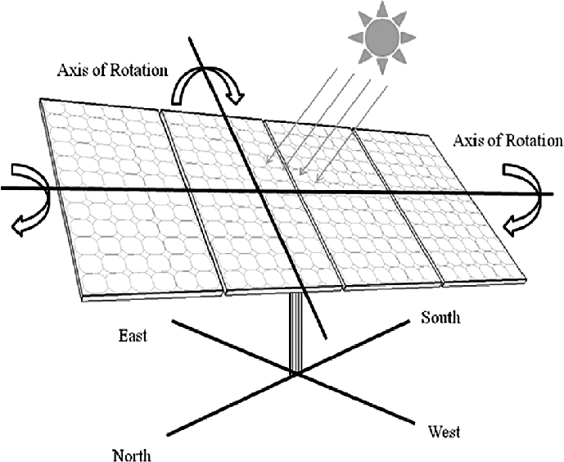
Solar Tracker
Single axis Solar Tracker
Dual axis Solar Tracker

Slide 7
Block Diagram of Solar Tracker
Charge Controller
Battery
Servo Motor
Solar Panel
Servo Motor
LDRs
Arduino
Power Supply

Slide 8
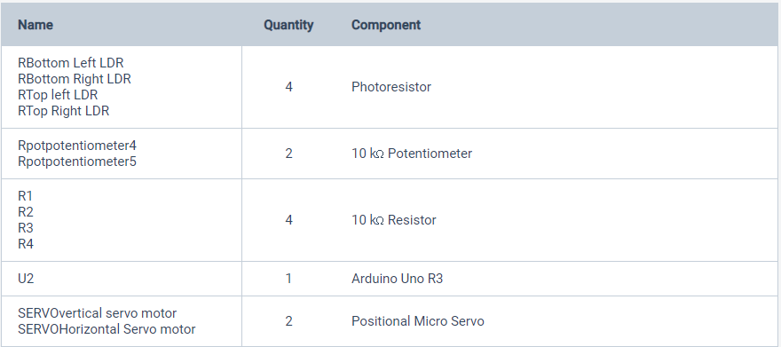
Requirements

Slide 9
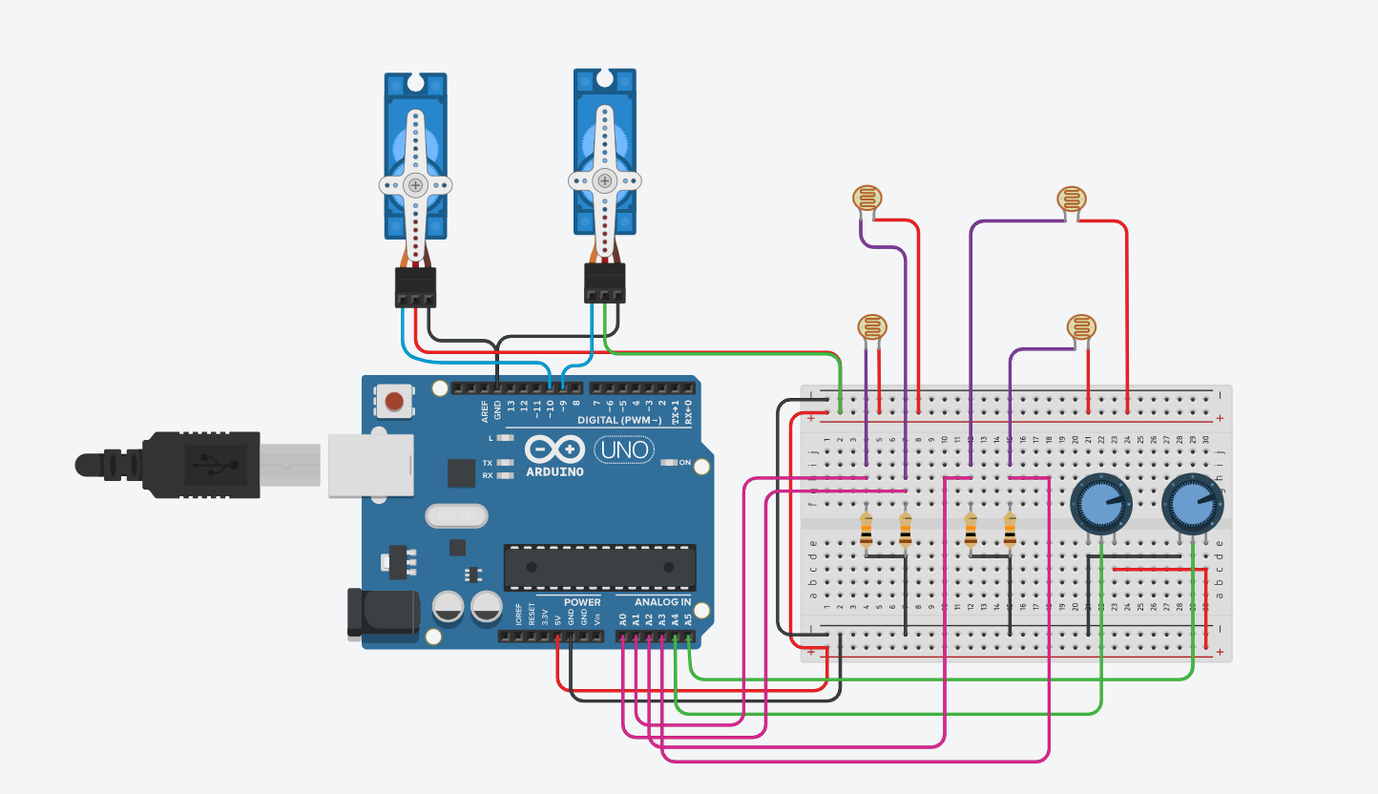
Circuit

Slide 10
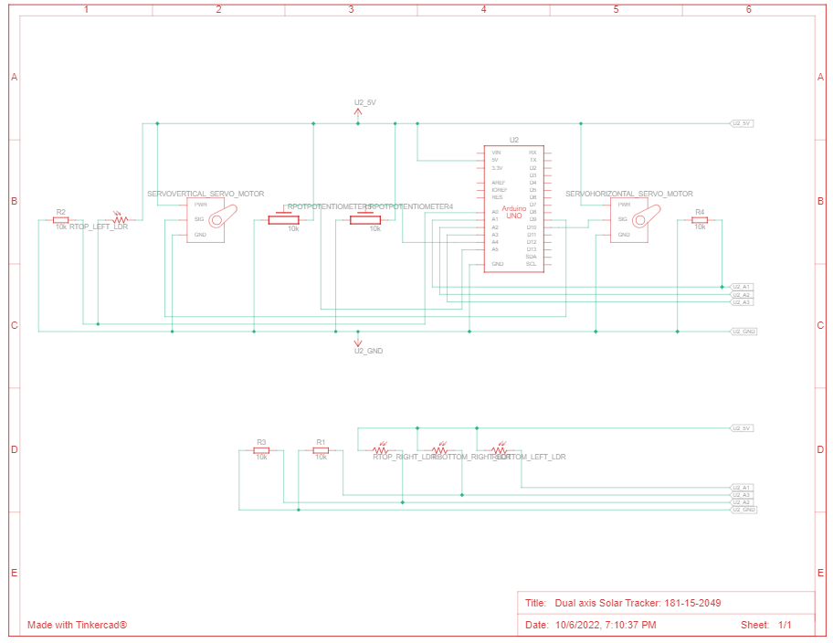
Semantic View

Slide 11
Advantages
Solar Tracking systems continuously orient PV panels towards the sun and can help maximize the investment on PV system.
One Time investment, which provides higher efficiency and flexibility on dependency
Energy production is at an optimum and energy output is increased year round.
It enhances the clean and emission free power production.
40% more power from each panel on dual axis tracking and higher revenues.

Slide 12
Disadvantages
Initial investment is high.
Moving parts such as gears needed periodic maintenances.
Maintenance and repairing of mechanical and electronic parts of the tracking system requires extra man-power and of extra investment.
Has to be built extreme environmental conditions such as storms, heavy rainfall etc.

Slide 13
Future Scope of the project
Fabrication of microcontroller using ASIC concepts.
Design impartments
Mounting of the Panels

Slide 14
Conclusion
With Global Warming constantly affecting the world in numerous ways, It is essential we to take care of the nature whatever way possible.
Present day technologies stress on being clean and green.
Being environmentally friendly, solar power generators and panels are reasonably easy, safe and convenient to install.
Hence enhancing the solar powered systems with intelligent trackers proves to be the optimal solution for utilizing the available solar energy.

Slide 15


