Slide 1
Maksuda Akter 183-15-11955
Muslima Akter 181-15-10885
Md. Yeasin Sheikh 181-15-2049
Reform intelligente

Slide 2
COVID-19
current situation

Slide 3
What can we do
……
People awareness

Slide 4
We are trying to Solve

Slide 5
Project work flow

Slide 6
Limitation &
Future Scope
Md. Yeasin Sheikh 181-15-2049
Face Mask Detection

Slide 7
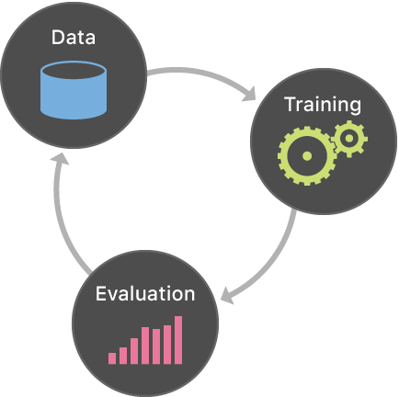

Slide 8
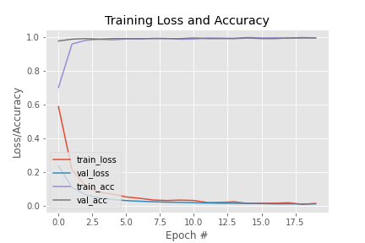

Slide 9
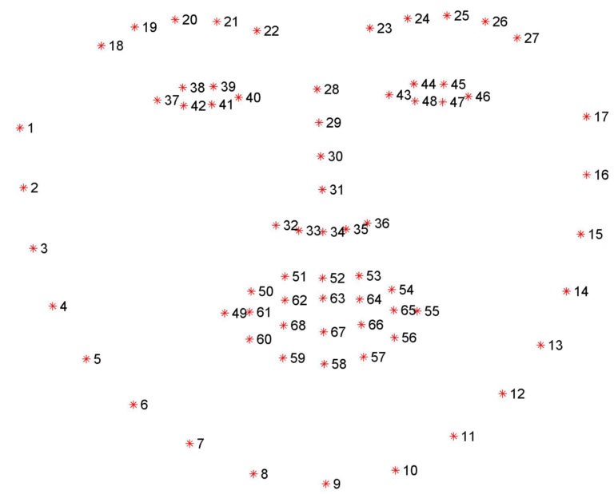
Limitation
Analyze face is covered with mask shape doesn't guaranty it will be covered with Mask.

Slide 10
Limitation
Current model can detect up to 24-30fps.
Current model is using 20k people and generated Mask
Accuracy can be improved

Slide 11
Future Scope
Using real-time data
Include more CNN filters
Deploying with API
Include body temperature detections
Include emojis/ filter to encourage to wear mask

