Slide 1
Analysis of Recursive Algorithms
What is a recurrence relation?
Forming Recurrence Relations
Solving Recurrence Relations
Analysis Of Recursive Factorial
Analysis Of Recursive Selection Sort
Analysis Of Recursive Binary Search
Analysis Of Recursive Towers of Hanoi
Analysis Of Recursive Fibonacci
Simplified Master Theorem

Slide 2
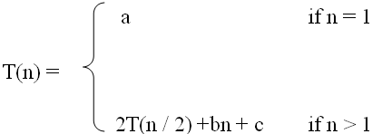
What is a recurrence relation?
A recurrence relation, T(n), is a recursive function of an integer variable n.
Like all recursive functions, it has one or more recursive cases and one or more base cases.
Example:
The portion of the definition that does not contain T is called the base case of the recurrence relation; the portion that contains T is called the recurrent or recursive case.
Recurrence relations are useful for expressing the running times (i.e., the number of basic operations executed) of recursive algorithms
The specific values of the constants such as a, b, and c (in the above recurrence) are important in determining the exact solution to the recurrence. Often however we are only concerned with finding an asymptotic upper bound on the solution. We call such a bound an asymptotic solution to the recurrence.

Slide 3
Forming Recurrence Relations
For a given recursive method, the base case and the recursive case of its recurrence relation correspond directly to the base case and the recursive case of the method.
Example 1: Write the recurrence relation for the following method:
The base case is reached when n = = 0. The method performs one comparison. Thus, the number of operations when n = = 0, T(0), is some constant a.
When n > 0, the method performs two basic operations and then calls itself, using ONE recursive call, with a parameter n – 1.
Therefore the recurrence relation is:
T(0) = a for some constant a
T(n) = b + T(n – 1) for some constant b
public void f (int n) {
if (n > 0) {
System.out.println(n);
f(n-1);
}
}
In General, T(n) is usually a sum of various choices of T(m ), the cost of the recursive
subproblems, plus the cost of the work done outside the recursive calls:
T(n ) = aT(f(n)) + bT(g(n)) + . . . + c(n)
where a and b are the number of subproblems, f(n) and g(n) are subproblem sizes, and
c(n) is the cost of the work done outside the recursive calls [Note: c(n) may be a constant]

Slide 4
Forming Recurrence Relations (Cont’d)
Example 2: Write the recurrence relation for the following method:
The base case is reached when n == 1. The method performs one comparison and one return statement. Therefore, T(1), is some constant c.
When n > 1, the method performs TWO recursive calls, each with the parameter n / 2, and some constant # of basic operations.
Hence, the recurrence relation is:
T(1) = c for some constant c
T(n) = b + 2T(n / 2) for some constant b
public int g(int n) {
if (n == 1)
return 2;
else
return 3 * g(n / 2) + g( n / 2) + 5;
}

Slide 5
Forming Recurrence Relations (Cont’d)
Example 3: Write the recurrence relation for the following method:
The base case is reached when n == 1 or n == 2. The method performs one comparison and one return statement. Therefore each of T(1) and T(2) is some constant c.
When n > 2, the method performs TWO recursive calls, one with the parameter n - 1 , another with parameter n – 2, and some constant # of basic operations.
Hence, the recurrence relation is:
T(n) = c if n = 1 or n = 2
T(n) = T(n – 1) + T(n – 2) + b if n > 2
long fibonacci (int n) { // Recursively calculates Fibonacci number
if( n == 1 || n == 2)
return 1;
else
return fibonacci(n – 1) + fibonacci(n – 2);
}

Slide 6
Forming Recurrence Relations (Cont’d)
Example 4: Write the recurrence relation for the following method:
The base case is reached when n == 0 or n == 1. The method performs one comparison and one return statement. ThereforeT(0) and T(1) is some constant c.
At every step the problem size reduces to half the size. When the power is an odd number, an additional multiplication is involved. To work out time complexity, let us consider the worst case, that is we assume that at every step an additional multiplication is needed. Thus total number of operations T(n) will reduce to number of operations for n/2, that is T(n/2) with seven additional basic operations (the odd power case)
Hence, the recurrence relation is:
T(n) = c if n = 0 or n = 1
T(n) = 2T(n /2) + b if n > 2
long power (long x, long n) {
if(n == 0)
return 1;
else if(n == 1)
return x;
else if ((n % 2) == 0)
return power (x, n/2) * power (x, n/2);
else
return x * power (x, n/2) * power (x, n/2);
}

Slide 7
Solving Recurrence Relations
To solve a recurrence relation T(n) we need to derive a form of T(n) that is not a recurrence relation. Such a form is called a closed form of the recurrence relation.
There are five methods to solve recurrence relations that represent the running time of recursive methods:
  Iteration method (unrolling and summing)
  Substitution method (Guess the solution and verify by induction)
  Recursion tree method
  Master theorem (Master method)
  Using Generating functions or Characteristic equations
In this course, we will use the Iteration method and a simplified Master theorem.

Slide 8

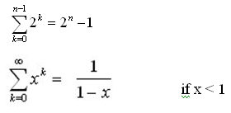


Solving Recurrence Relations - Iteration method
Steps:
  Expand the recurrence
  Express the expansion as a summation by plugging the recurrence back into itself until you see a pattern.
  Evaluate the summation
In evaluating the summation one or more of the following summation formulae may be used:
Arithmetic series:
Geometric Series:
Special Cases of Geometric Series:

Slide 9

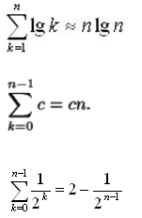
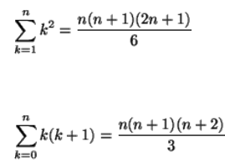
Solving Recurrence Relations - Iteration method (Cont’d)
Harmonic Series:
Others:

Slide 10
Analysis Of Recursive Factorial method
Example1: Form and solve the recurrence relation for the running time of factorial method and hence determine its big-O complexity:
  T(0) = c (1)
  T(n) = b + T(n - 1) (2)
  = b + b + T(n - 2) by subtituting T(n – 1) in (2)
  = b +b +b + T(n - 3) by substituting T(n – 2) in (2)
  …
  = kb + T(n - k)
  The base case is reached when n – k = 0 → k = n, we then have:
  T(n) = nb + T(n - n)
  = bn + T(0)
  = bn + c
  Therefore the method factorial is O(n)
long factorial (int n) {
if (n == 0)
return 1;
else
return n * factorial (n – 1);
}

Slide 11
Analysis Of Recursive Selection Sort
public static void selectionSort(int[] x) {
selectionSort(x, x.length - 1);
}
private static void selectionSort(int[] x, int n) {
int minPos;
if (n > 0) {
minPos = findMinPos(x, n);
swap(x, minPos, n);
selectionSort(x, n - 1);
}
}
private static int findMinPos (int[] x, int n) {
int k = n;
for(int i = 0; i < n; i++)
if(x[i] < x[k]) k = i;
return k;
}
private static void swap(int[] x, int minPos, int n) {
int temp=x[n]; x[n]=x[minPos]; x[minPos]=temp;
}

Slide 12
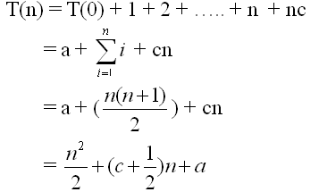
Analysis Of Recursive Selection Sort (Cont’d)
findMinPos is O(n), and swap is O(1), therefore the recurrence relation for the
running time of the selectionSort method is:
T(0) = a (1)
T(n) = T(n – 1) + n + c if n > 0 (2)
= [T(n-2) +(n-1) + c] + n + c = T(n-2) + (n-1) + n + 2c by substituting T(n-1) in (2)
= [T(n-3) + (n-2) + c] +(n-1) + n + 2c= T(n-3) + (n-2) + (n-1) + n + 3c by substituting T(n-2) in (2)
= T(n-4) + (n-3) + (n-2) + (n-1) + n + 4c
= ……
= T(n-k) + (n-k + 1) + (n-k + 2) + …….+ n + kc
The base case is reached when n – k = 0 → k = n, we then have :
Therefore, Recursive Selection Sort is O(n²)

Slide 13
Analysis Of Recursive Binary Search
public int binarySearch (int target, int[] array,
int low, int high) {
if (low > high)
return -1;
else {
int middle = (low + high)/2;
if (array[middle] == target)
return middle;
else if(array[middle] < target)
return binarySearch(target, array, middle + 1, high);
else
return binarySearch(target, array, low, middle - 1);
}
}
The recurrence relation for the running time of the method is:
  T(1) = a if n = 1 (one element array)
  T(n) = T(n / 2) + b if n > 1

Slide 14
Analysis Of Recursive Binary Search (Cont’d)
Without loss of generality, assume n, the problem size, is a multiple of 2, i.e., n = 2^{k}
  Expanding:
  T(1) = a (1)
  T(n) = T(n / 2) + b (2)
  = [T(n / 2²) + b] + b = T (n / 2²) + 2b by substituting T(n/2) in (2)
  = [T(n / 2³) + b] + 2b = T(n / 2³) + 3b by substituting T(n/2²) in (2)
  = ……..
  = T( n / 2^{k}) + kb
  The base case is reached when n / 2^{k} = 1 ➔ n = 2^{k} ➔ k = log₂ n, we then
  have:
  T(n) = T(1) + b log₂ n
  = a + b log₂ n
  Therefore, Recursive Binary Search is O(log n)

Slide 15
Analysis Of Recursive Towers of Hanoi Algorithm
The recurrence relation for the running time of the method hanoi is:
  T(n) = a if n = 1
  T(n) = 2T(n - 1) + b if n > 1
public static void hanoi(int n, char from, char to, char temp){
if (n == 1)
System.out.println(from + " --------> " + to);
else{
hanoi(n - 1, from, temp, to);
System.out.println(from + " --------> " + to);
hanoi(n - 1, temp, to, from);
}
}

Slide 16
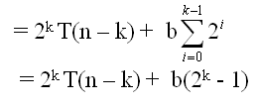
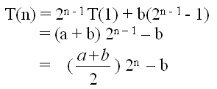
Analysis Of Recursive Towers of Hanoi Algorithm (Cont’d)
Expanding:
T(1) = a (1)
T(n) = 2T(n – 1) + b if n > 1 (2)
= 2[2T(n – 2) + b] + b = 2² T(n – 2) + 2b + b by substituting T(n – 1) in (2)
= 2² [2T(n – 3) + b] + 2b + b = 2³ T(n – 3) + 2²b + 2b + b by substituting T(n-2) in (2)
= 2³ [2T(n – 4) + b] + 2²b + 2b + b = 2⁴ T(n – 4) + 2³ b + 2²b + 2¹b + 2⁰b by substituting
T(n – 3) in (2)
= ……
= 2^{k} T(n – k) + b[2^{k- 1} + 2^{k– 2} + . . . 2¹ + 2⁰]
The base case is reached when n – k = 1 → k = n – 1, we then have:
Therefore, The method hanoi is O(2^{n})

Slide 17
Analysis Of Recursive Fibonacci
long fibonacci (int n) { // Recursively calculates Fibonacci number
if( n == 1 || n == 2)
return 1;
else
return fibonacci(n – 1) + fibonacci(n – 2);
}
T(n) = c if n = 1 or n = 2 (1)
T(n) = T(n – 1) + T(n – 2) + b if n > 2 (2)
We determine a lower bound on T(n):
Expanding: T(n) = T(n - 1) + T(n - 2) + b
≥ T(n - 2) + T(n-2) + b
= 2T(n - 2) + b
= 2[T(n - 3) + T(n - 4) + b] + b by substituting T(n - 2) in (2)
≥ 2[T(n - 4) + T(n - 4) + b] + b
= 2²T(n - 4) + 2b + b
= 2²[T(n - 5) + T(n - 6) + b] + 2b + b by substituting T(n - 4) in (2)
≥ 2³T(n – 6) + (2² + 2¹ + 2⁰)b
. . .
≥ 2^{k}T(n – 2k) + (2^{k-1} + 2^{k-2} + . . . + 2¹ + 2⁰)b
= 2^{k}T(n – 2k) + (2^{k} – 1)b
The base case is reached when n – 2k = 2 → k = (n - 2) / 2
Hence T(n) ≥ 2 ^{(n – 2) / 2} T(2) + [2 ^{(n - 2) / 2} – 1]b
= (b + c)2 ^{(n – 2) / 2} – b
= [(b + c) / 2]*(2)^{n/2} – b → Recursive Fibonacci is exponential

Slide 18

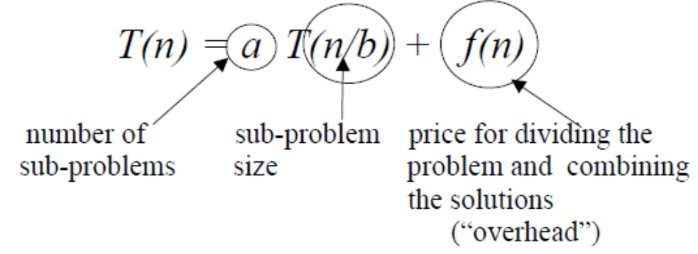
Master Theorem (Master Method)
The master method provides an estimate of the growth rate of the solution for recurrences of the form:
where a ≥ 1, b > 1 and the overhead function f(n) > 0
If T(n) is interpreted as the number of steps needed to execute an algorithm for an input of size n, this recurrence corresponds to a “divide and conquer” algorithm, in which a problem of size n is divided into a sub-problems of size n / b, where a, b are positive constants:
Divide-and-conquer algorithm:
  • divide the problem into a number of subproblems
  • conquer the subproblems (solve them)
  • combine the subproblem solutions to get the solution to the original problem
Example: Merge Sort
  • divide the n-element sequence to be sorted into two n/2- element sequences.
  • conquer the subproblems recursively using merge sort.
  • combine the resulting two sorted n/2-element sequences by merging

Slide 19
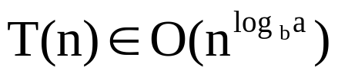
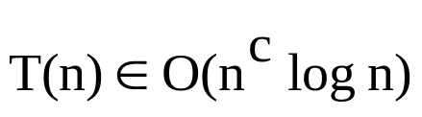

Simplified Master Theorem
The Simplified Master Method for Solving Recurrences:
  Consider recurrences of the form:
  T(1) = 1
  T(n) = aT(n/b) + kn^{c} + h
  for constants a ≥ 1, b > 1, c ≥ 0, k ≥ 1, and h ≥ 0 then:
if a > b^{c}
if a = b^{c}
if a < b^{c}
Note: Since k and h do not affect the result, they are sometimes not included
in the above recurrence

Slide 20
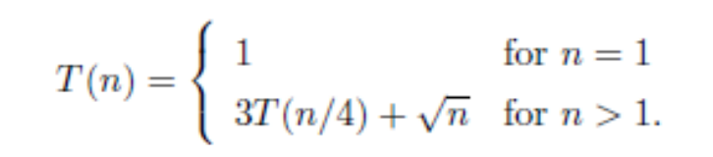
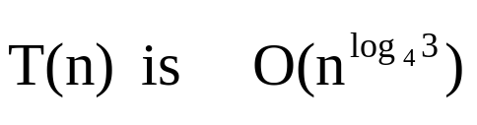
Simplified Master Theorem (Cont’d)
Example1: Find the big-Oh running time of the following recurrence. Use the Master
Theorem:
Solution: a = 3, b = 4, c = ½ → a > b^{c} → Case 1
Hence
Example2: Find the big-Oh running time of the following recurrence. Use the Master
Theorem:
T(1) = 1
T(n) = 2T(n / 2) + n
Solution: a = 2, b = 2, c = 1 → a = b^{c} → Case 2
Hence T(n) is O(n log n)
Example3: Find the big-Oh running time of the following recurrence. Use the Master Theorem:
T(1) = 1
T(n) = 4T(n / 2) + kn³ + h where k ≥ 1 and h ≥ 1
Solution: a = 4, b = 2, c = 3 → a < b^{c} → Case 3
Hence T(n) is O(n³)

