Slide 1
Jurong West Jewel 991A

Slide 2
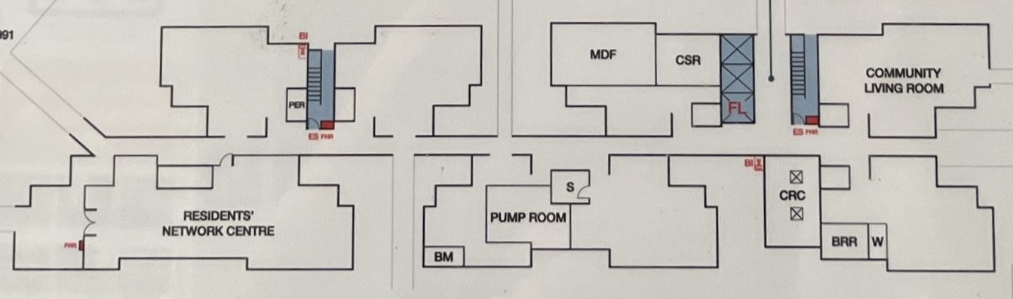
Block 991A 1st STOREY FLOOR PLAN

Slide 3
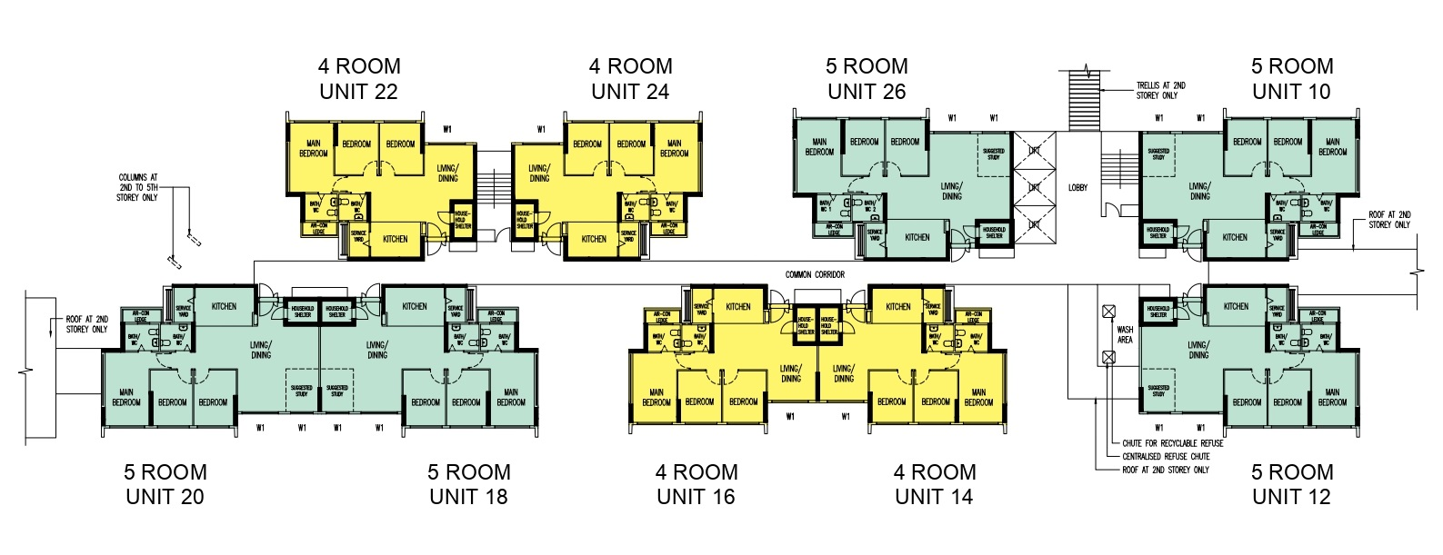
STAIR A
STAIR B
MDF
CSR
COMMUNITY LIVING ROOM
LOBBY
PER
COMMON CORRIDOR
S
CRC
PUMP
ROOM
RESIDENTS’ NETWORK CENTER
BRR
W
BM

Slide 4
Block 991A 2nd TO 5th , 7th TO 18th STOREY FLOOR PLAN

Slide 5
STAIR A
STAIR B
22
24
26
10
LOBBY
COMMON CORRIDOR
20
18
16
WASH
AREA
14
12

Slide 6
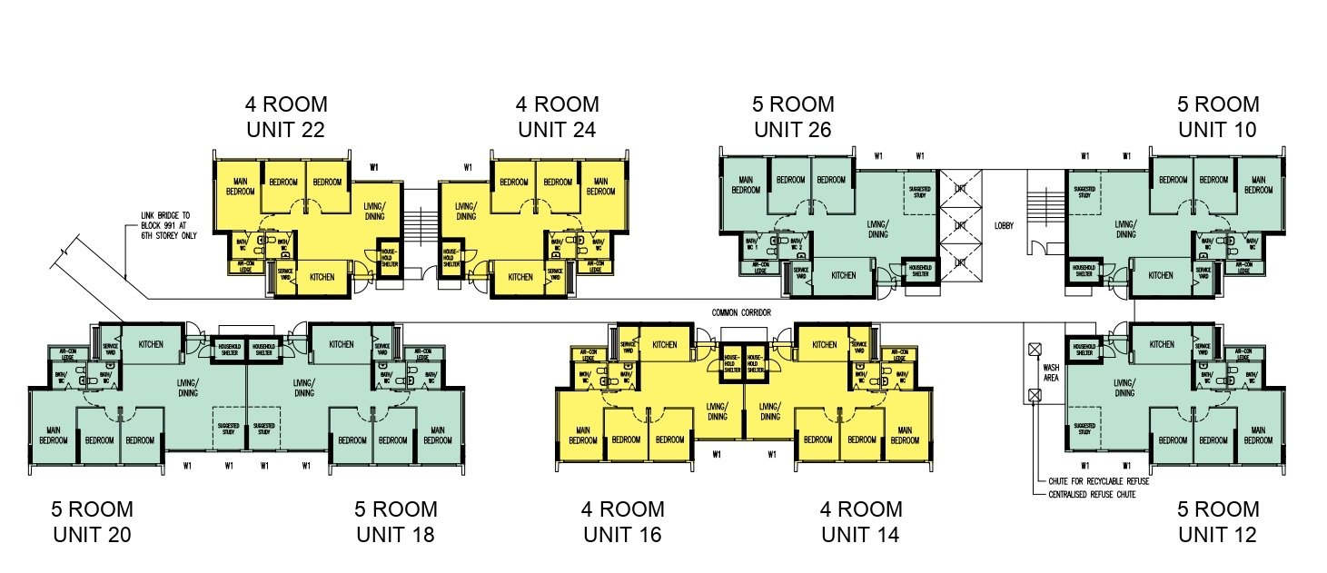
Block 991A 6th STOREY FLOOR PLAN

Slide 7
STAIR A
STAIR B
22
24
26
10
LOBBY
COMMON CORRIDOR
20
18
16
WASH
AREA
14
12

