Slide 1
Jurong West Jewel 991B

Slide 2
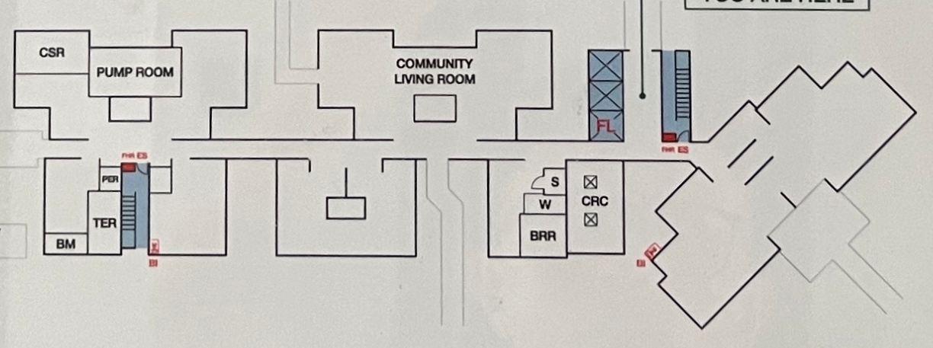
Block 991B 1st STOREY FLOOR PLAN

Slide 3
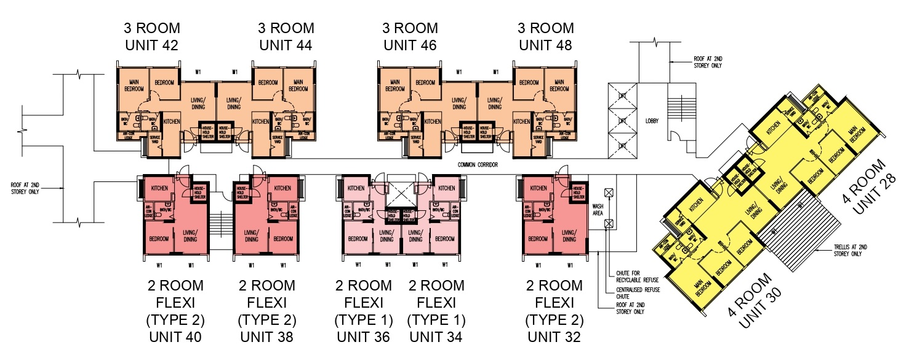
STAIR A
CSR
PUMP ROOM
COMMUNITY LIVING ROOM
LOBBY
COMMON CORRIDOR
PER
S
W
CRC
TER
BM
BRR
STAIR B

Slide 4
Block 991B 2nd TO 12th STOREY FLOOR PLAN

Slide 5
STAIR A
42
44
46
48
LOBBY
28
COMMON CORRIDOR
40
38
36
34
32
WASH
AREA
30
STAIR B

Slide 6
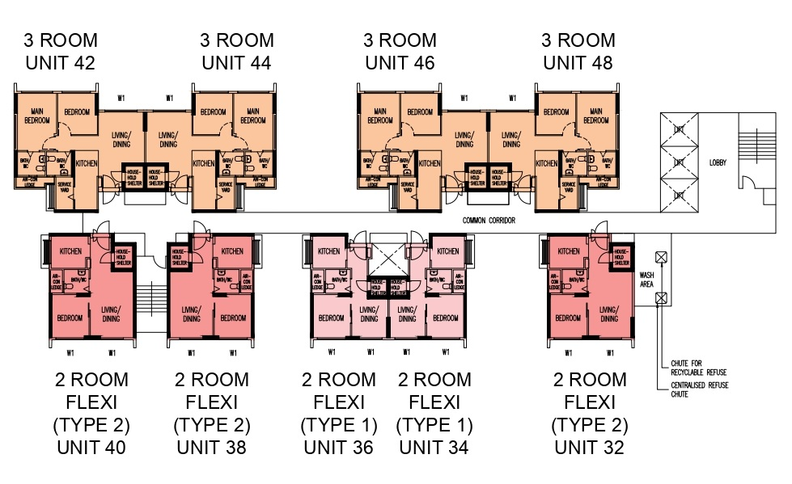
Block 991B 13th TO 18th STOREY FLOOR PLAN

Slide 7
STAIR A
42
44
46
48
LOBBY
COMMON CORRIDOR
WASH
AREA
40
38
36
34
32
STAIR B

