Slide 1
Jurong West Jewel 992A

Slide 2
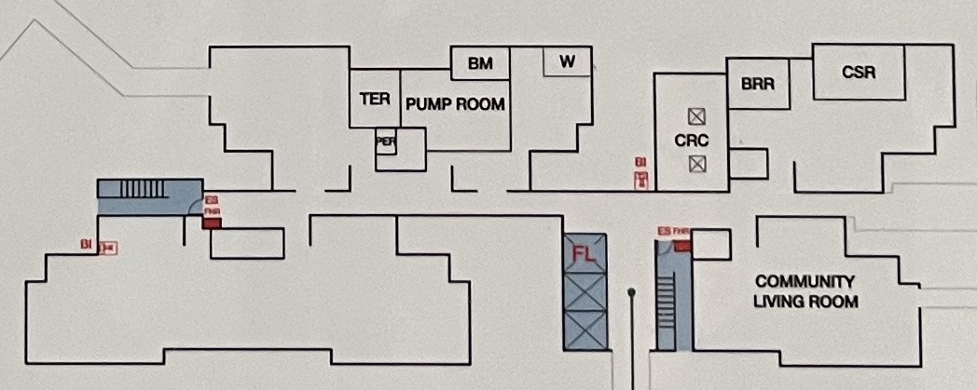
Block 992A 1st STOREY FLOOR PLAN

Slide 3
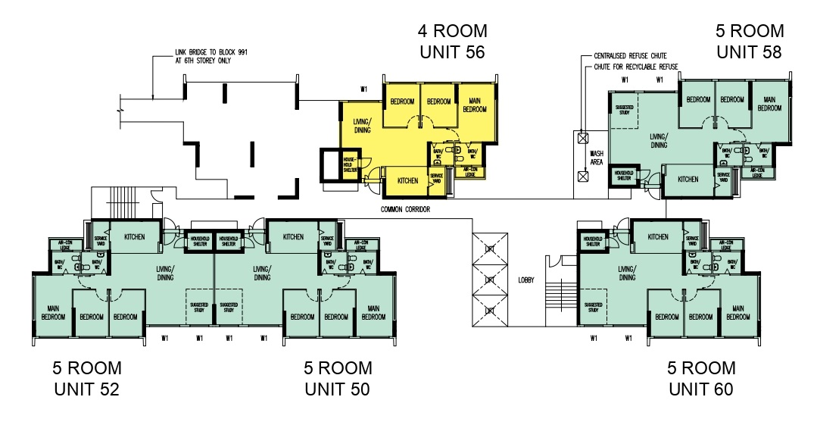
BM
W
CSR
BRR
TER
PUMP ROOM
PER
CRC
STAIR B
COMMON CORRIDOR
LOBBY
COMMUNITY LIVING ROOM
STAIR A

Slide 4
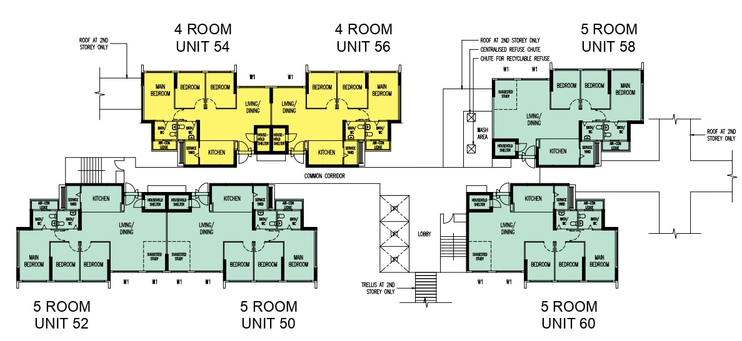

Slide 5
54
56
58
WASH
AREA
STAIR B
COMMON CORRIDOR
52
50
60
LOBBY
STAIR A
Block 992A 2nd TO 5th , 7th TO 18th STOREY FLOOR PLAN

Slide 6
Block 992A 6th STOREY FLOOR PLAN

Slide 7
56
58
WASH
AREA
STAIR B
COMMON CORRIDOR
52
50
60
LOBBY
STAIR A

