Slide 1
Jurong West Jewel 992B

Slide 2
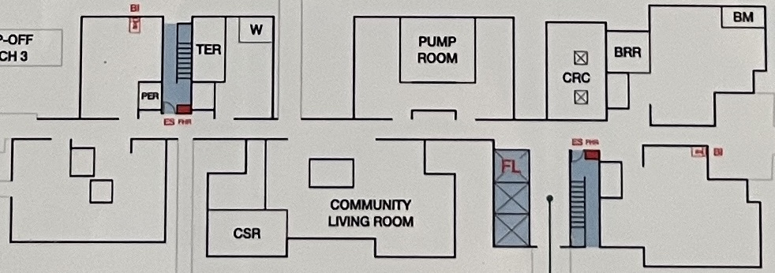
Block 992B 1st STOREY FLOOR PLAN

Slide 3
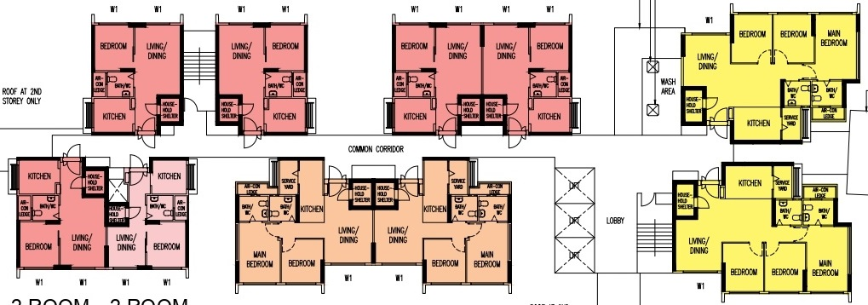
STAIR B
BM
W
TER
PUMP
ROOM
BRR
CRC
PER
COMMON CORRIDOR
LOBBY
COMMUNITY LIVING ROOM
CSR
STAIR A

Slide 4
Block 992B 2nd TO 18th STOREY FLOOR PLAN

Slide 5
STAIR B
70
72
74
76
78
WASH AREA
COMMON CORRIDOR
68
66
64
62
LOBBY
80
STAIR A

