Slide 1

Command-line JSON processor In WSL2
Supervised By - Touhid Alam
(IT Manager at S3 Innovate Pte. Ltd.)
By - Shashangka Shekhar
(Sr. Software Engineer at S3 Innovate Pte. Ltd.)

Slide 2
Context:
Introduction
Setup
Jq Starting
Basic Filter
Identity Operator
Object Identifier-Index
Generic Object Index
Array Index
Array/String Slice
Comma
Pipe
Parenthesis
Functions
Keys
Length
Mapping Values
Min and Max
Selecting Values
Regular Expressions
Finding Unique Values
Deleting Keys From JSON
Transforming JSON
Q/A
References
Thanks

Slide 3
Introduction:
jq is a lightweight and flexible command-line JSON processor.
It plays nice with UNIX pipes and offers extensive functionality for interrogating, manipulating and working with JSON file.
jq can pretty print file using the . filter. This takes the entire input and sends it to standard output.
Playground for jq 1.6

Slide 4
./jq Setup – WSL2

Slide 5
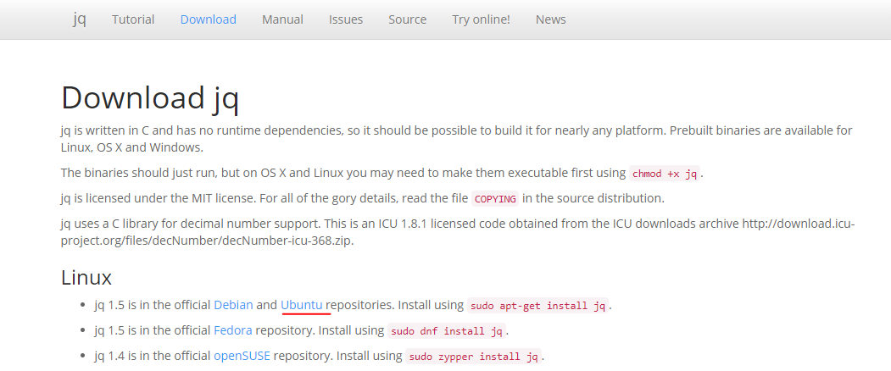
Setup:
Download jq
https://stedolan.github.io/jq/download
Downloading & Installing jq Package

Slide 6
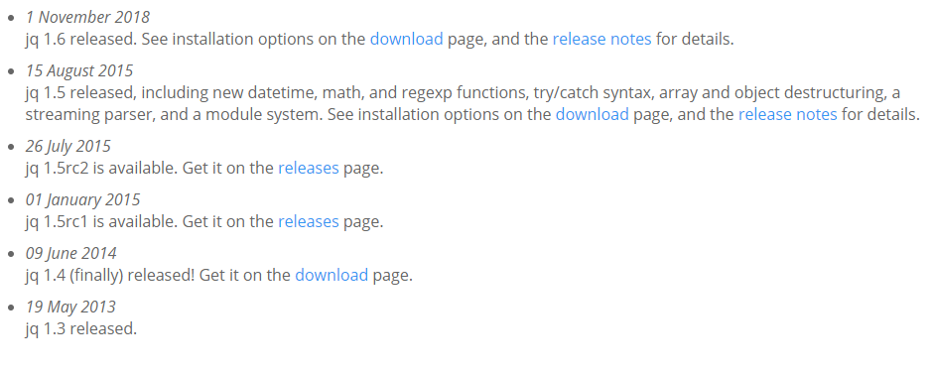
Setup:
Release News
https://stedolan.github.io/jq

Slide 7
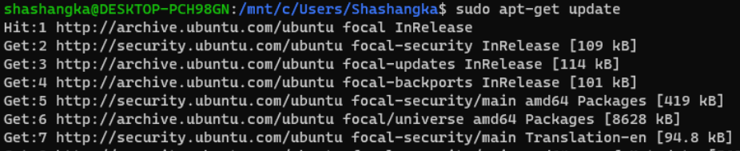
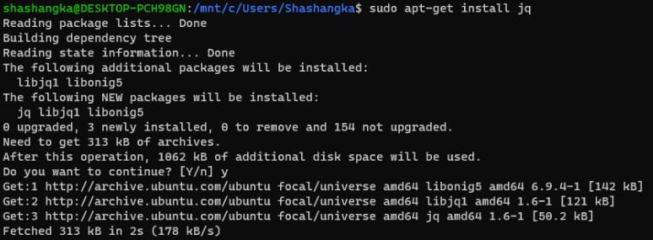
Setup:
WSL2 Command
sudo apt-get update
sudo apt-get install jq
Run Update(if Packages are not Updated) Package Lists Command
Then Run jq Install Command

Slide 8
Starting

Slide 9
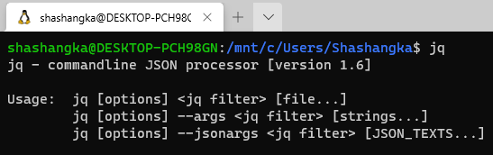
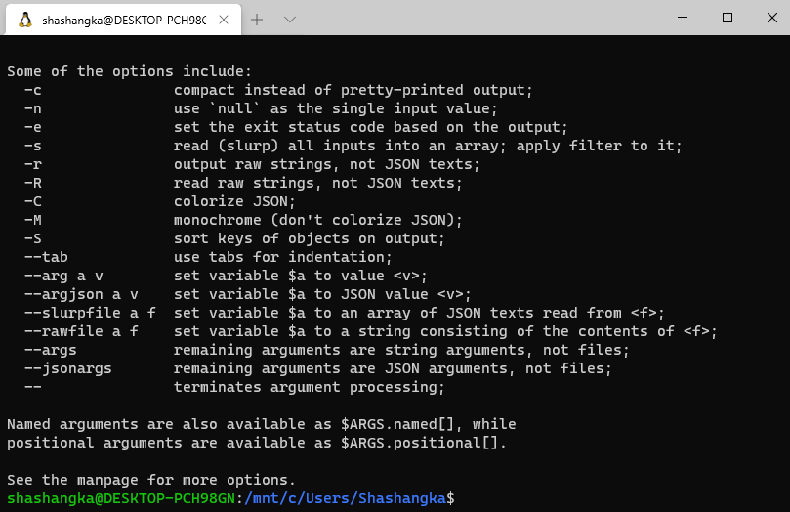
Starting:
Cmd: jq
Getting Help Info
Cmd: jq --help
Verify the installation

Slide 10
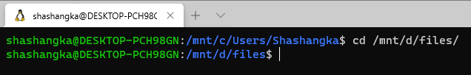

Starting:
Cmd: cd /mnt/d/files/
Before start, let’s change dump local source path in different directory.

Slide 11
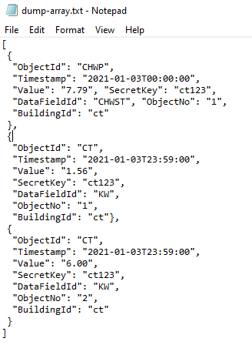
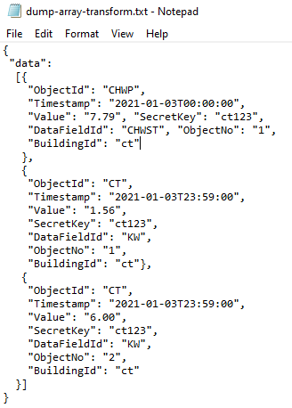
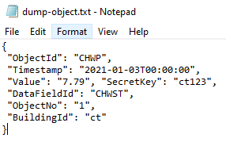
Starting: Sample Data
Sample Data to getting started with jq
Dump Array
Dump Array Transformed
Dump Object

Slide 12
Basic Filters

Slide 13
Basic Filter:
Identity Operator
Takes input and produces it unchanged as output.
Object Identifier-Index
Produces output value at the key, or null if there's none present.
Generic Object Index
Look up fields of an object using syntax
Array Index
Access object in the array directly by passing the index.
Array/String Slice
Return a subarray of an array.
Comma
Two filters separated by a comma that produce separate outputs.
Pipe
The | operator combines two filters by feeding the output(s) of the one on the left into the input of the one on the right.

Slide 14
Identity Operator

Slide 15
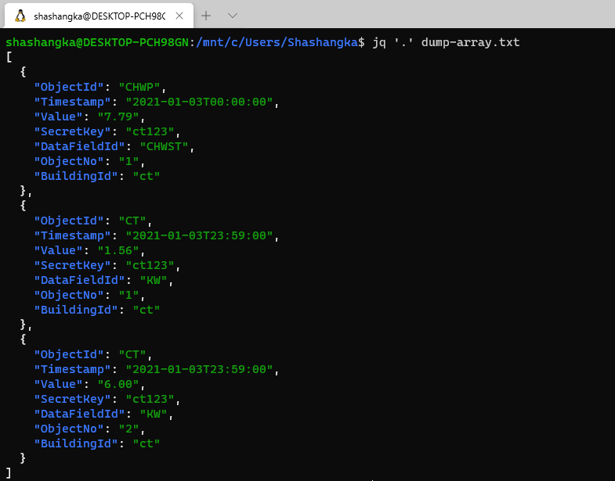
Basic Filter: Identity Operator
Cmd: jq '.' dump-array.txt
By default pretty-prints all output of an array

Slide 16
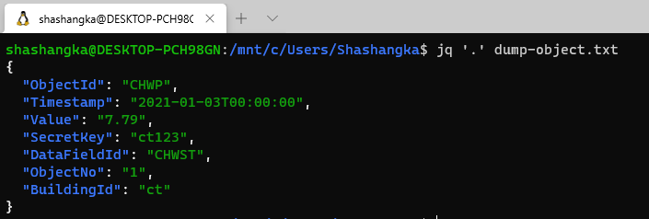
Basic Filter: Identity Operator
Cmd: jq '.' dump-object.txt
By default pretty-prints all output of an object

Slide 17
Object Identifier-Index

Slide 18

Basic Filter: Object Identifier-Index
Cmd: jq '.[1].Timestamp' dump-array.txt
Access one of the items in the array directly by passing the index

Slide 19

Basic Filter: Object Identifier-Index
Cmd: jq '.Timestamp' dump-object.txt
Access item directly by passing property name

Slide 20
Generic Object Index

Slide 21
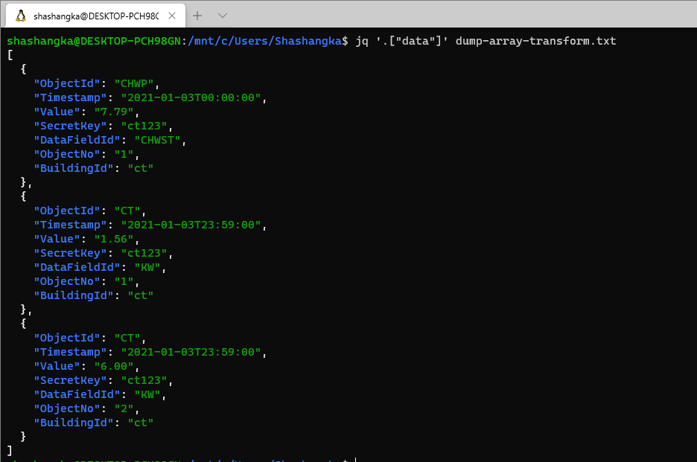
Basic Filter: Generic Object Index
Cmd: jq '.["data"]' dump-array-transform.txt
look up data of an array using syntax

Slide 22

Basic Filter: Generic Object Index
Cmd: jq '.["Timestamp"]' dump-object.txt
look up fields of an object using syntax

Slide 23
Array Index

Slide 24
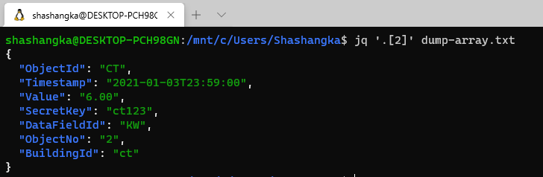
Basic Filter: Array Index
Cmd: jq '.[2]' dump-array.txt
Access object in the array directly by passing the index

Slide 25
Array/String Slice

Slide 26
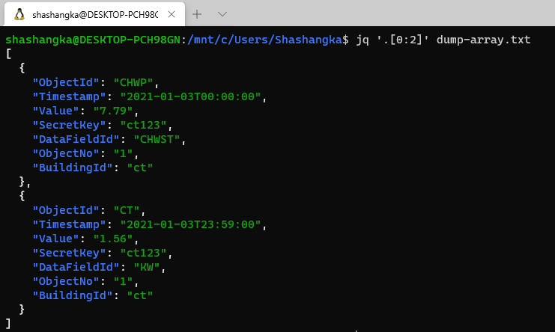
Basic Filter: Array/String Slice
Cmd: jq '.[0:2]' dump-array.txt
Return a subarray of an array

Slide 27
Comma

Slide 28
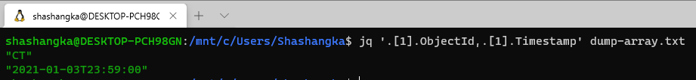
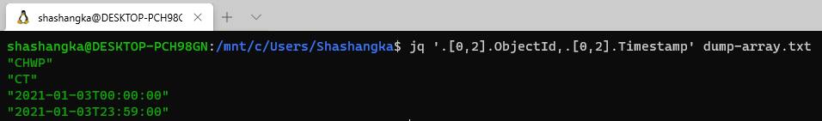
Basic Filter: Comma
Cmd: jq '.[1].ObjectId,.[1].Timestamp' dump-array.txt
Two filters are separated by a comma that produce separate outputs from an array
Cmd: jq '.[0,2].ObjectId,.[0,2].Timestamp' dump-array.txt

Slide 29
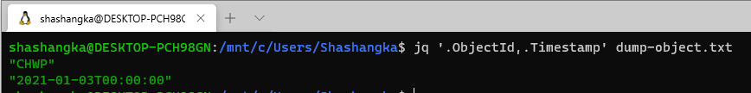
Basic Filter: Comma
Cmd: jq '.ObjectId,.Timestamp' dump-object.txt
Two filters are separated by a comma that produce separate outputs from an object

Slide 30
Pipe

Slide 31
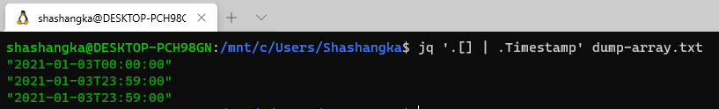
Basic Filter: Pipe
Cmd: jq '.[] | .Timestamp' dump-array.txt
Retrieves the "Timestamp" field of each element of the input array
The | operator combines two filters by feeding the output(s) of the one on the left into the input of the one on the right.

Slide 32
Functions

Slide 33
Functions:
Getting Keys
This gives us the keys sorted alphabetically.
Getting Length
This function to return the array’s length or the number of properties on an object.
Mapping Values
The map function is a powerful function we can use to apply a filter or function to an array.
Min and Max
Find the minimum or maximum element of an input array.
Selecting Values
The select function is another impressive utility that we can use for querying JSON.
Regular Expressions
Shows if an input matches against a given regular expression.
Finding Unique Values
Shows unique occurrences of a particular value within an array or remove duplicates.
Deleting Keys From JSON
Remove a key and corresponding value from JSON objects.

Slide 34
Functions:
Transforming JSON
When we are only interested in several properties or values.

Slide 35
Keys

Slide 36
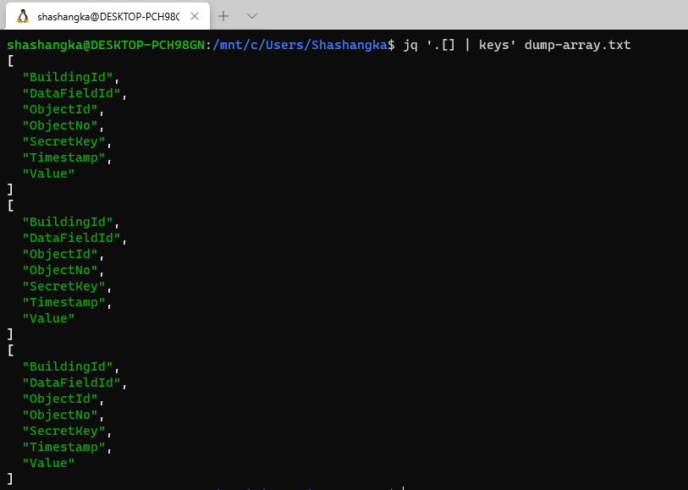
Basic Functions: Keys
Cmd: jq '.[] | [keys]' dump-array.txt
Gives us the keys sorted alphabetically

Slide 37
Length

Slide 38
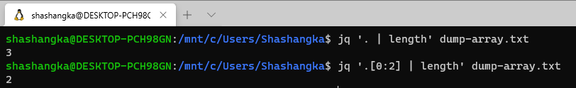
Basic Functions :Length
Cmd: jq '. | length' dump-array.txt
Total Length
Cmd: jq '.[0:2] | length' dump-array.txt
Sliced Length
This function to return the array’s length or the number of properties on an object

Slide 39
Mapping Values

Slide 40
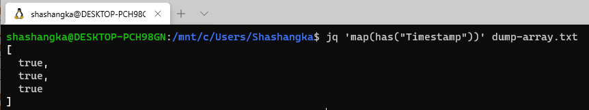
Basic Functions :Mapping Values
Cmd: jq 'map(has("Timestamp"))' dump-array.txt
Applying the has function to each item in the array and looking to see if there is a Timestamp property

Slide 41
Min and Max

Slide 42
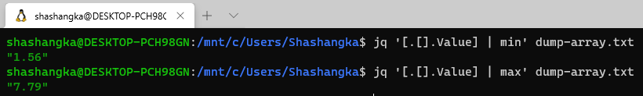
Basic Functions :Min and Max
Cmd: jq '[.[].Value] | min' dump-array.txt
Cmd: jq '[.[].Value] | max' dump-array.txt
Find the minimum or maximum element of an input array

Slide 43
Selecting Values

Slide 44
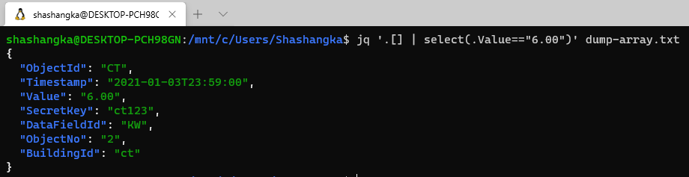
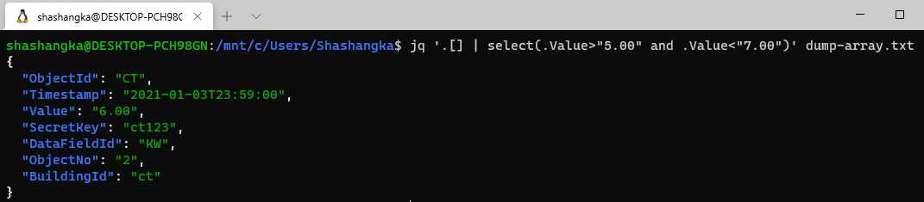
Basic Functions :Selecting Values
Cmd: jq '.[] | select(.Value=="6.00")' dump-array.txt
Cmd: jq '.[] | select(.Value>"5.00" and .Value<"7.00")' dump-array.txt

Slide 45
Regular Expressions

Slide 46
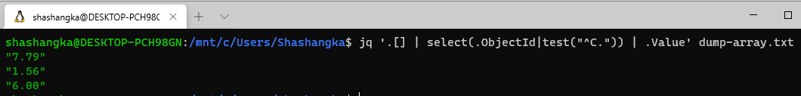
Basic Functions :Regular Expressions
Cmd: jq '.[] | select(.ObjectId|test("^C.")) | .Value' dump-array.txt
Retrieves the field of each element of the input array matches against a given regular expression by test function.
In this example, retrieving the Value whose ObjectId starts with the letter “C”

Slide 47
Finding Unique Values

Slide 48
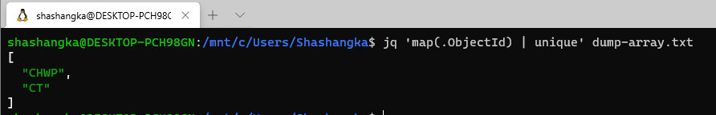
Basic Functions :Unique Values
Cmd: jq 'map(.ObjectId) | unique' dump-array.txt
Retrieves unique occurrences of a particular value within an array or remove duplicates.

Slide 49
Deleting Keys From JSON

Slide 50
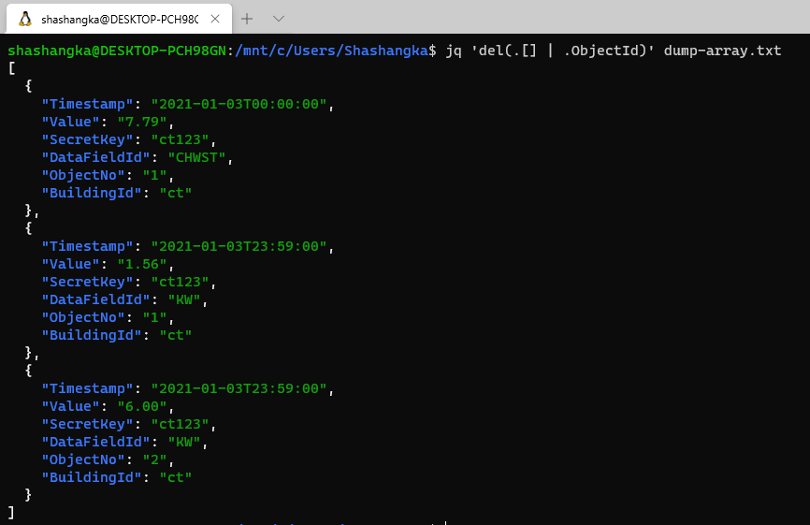
Basic Functions :Deleting Keys From JSON
Cmd: jq 'del(.[] | .ObjectId)' dump1.txt
Removed “Objectid” and corresponding value from JSON objects.

Slide 51
Transforming JSON

Slide 52
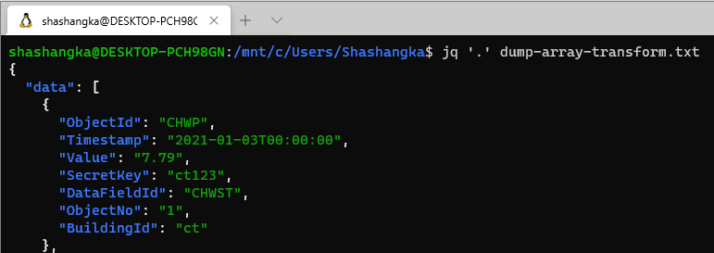
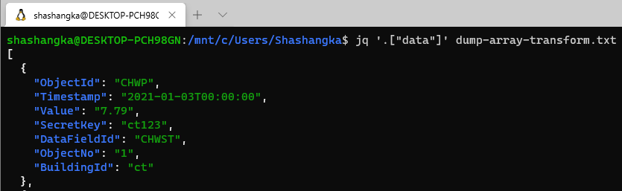
Basic Functions :Transforming JSON
Cmd: jq '.' dump-array-transform.txt
Transforming one data structure into another
Cmd: jq '.["data"]' dump-array-transform.txt

Slide 53
Q/A:

Slide 54
References:
https://stedolan.github.io/jq
https://stedolan.github.io/jq/manual
https://www.baeldung.com/linux/jq-command-json
https://shapeshed.com/jq-json
https://thoughtbot.com/blog/jq-is-sed-for-json
https://jqplay.org/jq

Slide 55
Thanks
Email: shashangka@s3innovate.com
Contact: +8801929515253
Blog: http://shashangka.com

